Slide 1
Spare Part Inventory Management System
Project Members :-
Vikrant kambli
Prasad Patil
Tejas Jadhav
Sagar Mali

Slide 2
Introduction
Web-based application for managing spare part inventory.
Eliminates manual errors through automation.
Provides real-time inventory visibility and control.
Enhances efficiency and reduces operational delays.

Slide 3
Problem Definition
In many organizations, spare parts are tracked manually using spreadsheets or registers.
This leads to stock mismatches, untracked consumption, and procurement delays.
Lack of centralized control results in part shortages or overstocking.
Inefficient communication between departments and vendors adds to operational downtime.

Slide 4
Goals & Objectives
Goals:
Develop a centralized spare part inventory system.
Eliminate manual errors and mismatches.
Streamline procurement and part tracking processes.
Objectives:
Provide real-time visibility of stock levels.
Allow role-based login for admin, customer, seller.

Slide 5
Future Scope
1. Payment Integration
Integrate secure online payment gateways (like Razorpay, Paytm, UPI, Debit/Credit Cards).
Allow users to pay during order placement, enabling smooth end-to-end automation.
Store payment history linked to each order for transparency and recordkeeping.
2. Order Tracking System
Implement real-time tracking of orders using unique order IDs.
Users can check current order status (Processing → Packed → Shipped → Out for Delivery → Delivered).
Auto-update order status based on admin or shipper input.

Slide 6
.
3. Shipper Entity
Introduce a separate shipper panel to manage bulk logistics.
Assign orders to different shipping vendors.
Shippers can update delivery milestones and manage multiple orders.
4 .Delivery Boy Entity
Assign individual delivery boys to specific local deliveries.
Track their current delivery load and routes.
Enable delivery status update and feedback collection from users after delivery.
5. Inventory Alerts & Forecasting
Add auto-alerts for low stock levels.
Predict future demand for specific spare parts using purchase history.

Slide 7
Software Requirement Specification
Functional Requirements:
User login and role-based access (admin, customer, seller).
Add, update, and delete spare part records.
Stock tracking and real-time availability status.
Purchase order management and vendor linking.

Slide 8
.
Non-Functional Requirements:
Secure login with session management.
Fast database queries and quick response time.
Cross-browser and device compatibility.

Slide 9
Technologies Used:
Frontend: React.js,CSS,Bootstrap.
Backend: Java (Spring Boot,JPA)
Database: MySQL
Server/Tools: Visual Studio, Eclipse, MySQL Workbench

Slide 10
System Modules
1.User Management Module
Handles login/logout, registration, and role-based access.
2. Admin Module
View Register seller
View Register Customer
View Feedback
View All Customer Orders

Slide 11
.
3. Seller Module
Add Category
Add Products
Edit Products
Delete Product
View All Added Product

Slide 12
.
4. Customer Module
View Product
Add to cart
Place Order
View Order
Remove Product From Cart
Place Order
Feedback

Slide 13
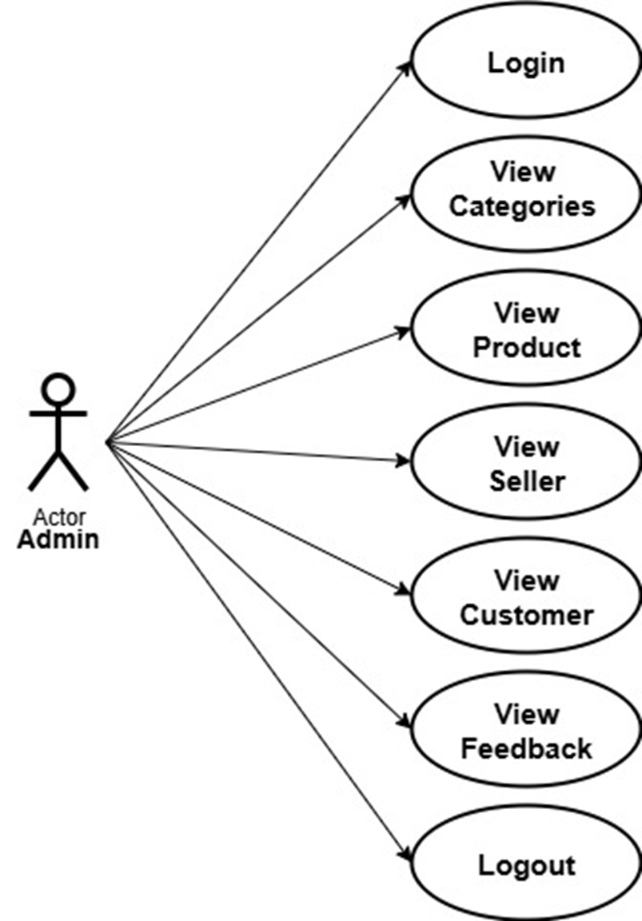
UML Diagrams

Slide 14
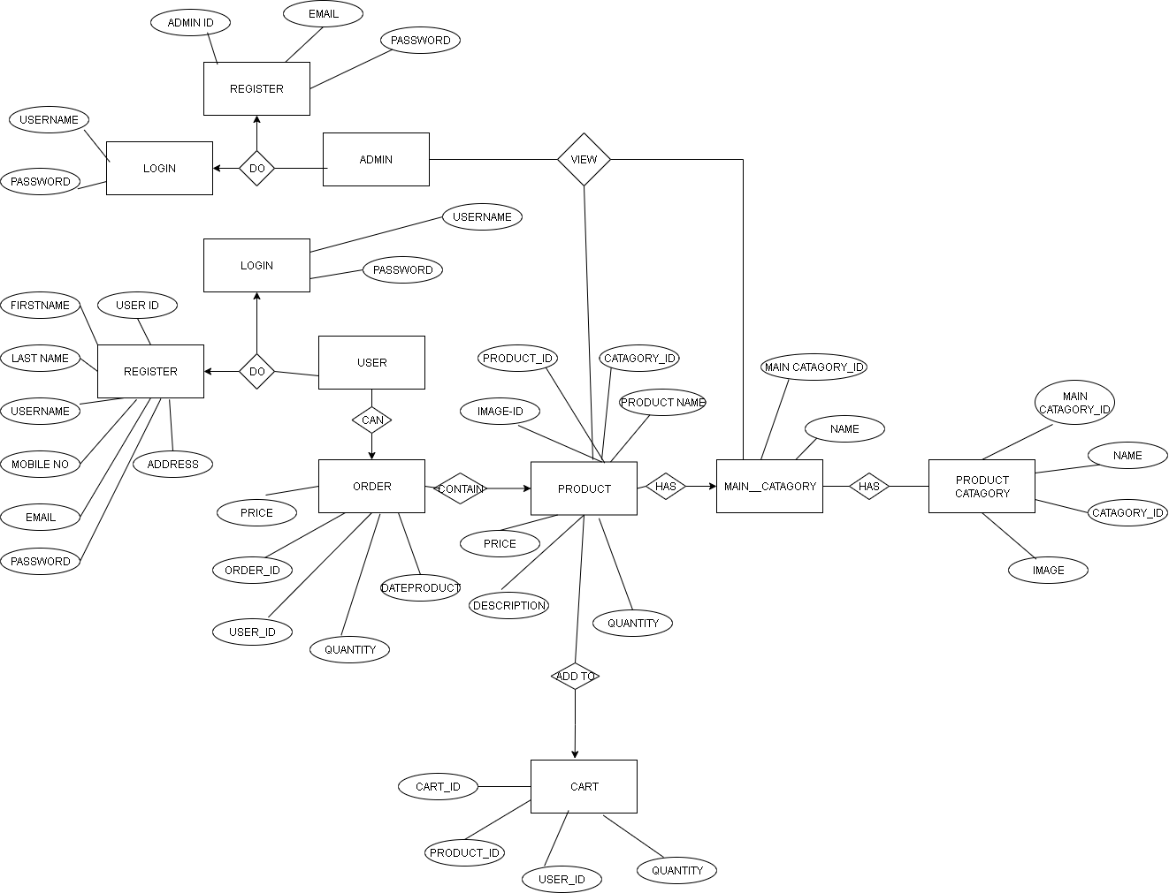
ERD Diagram

Slide 15
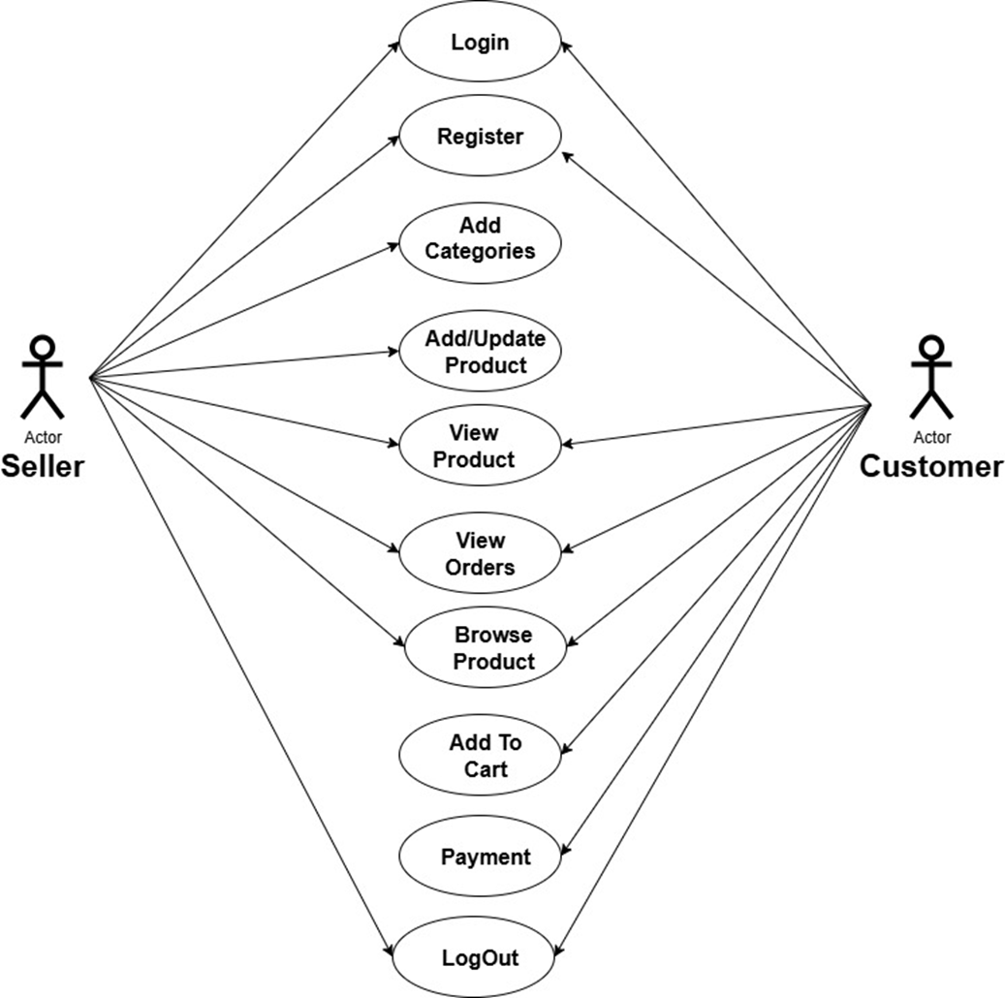
Use Case Diagrams

Slide 16
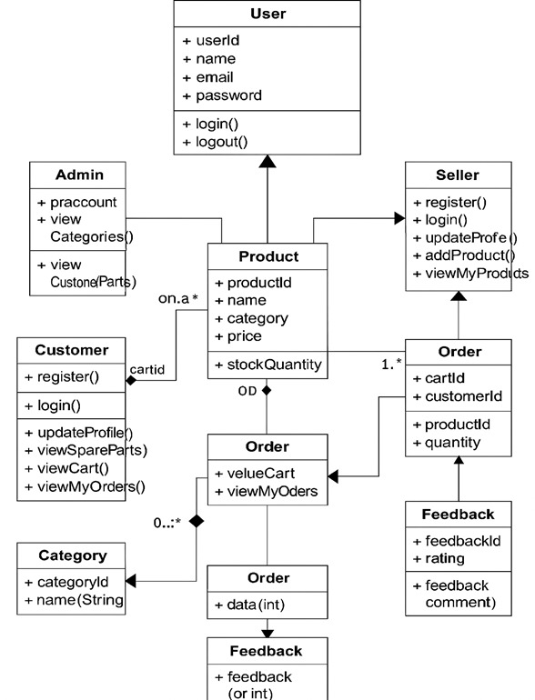
Class Diagrams
.

Slide 17
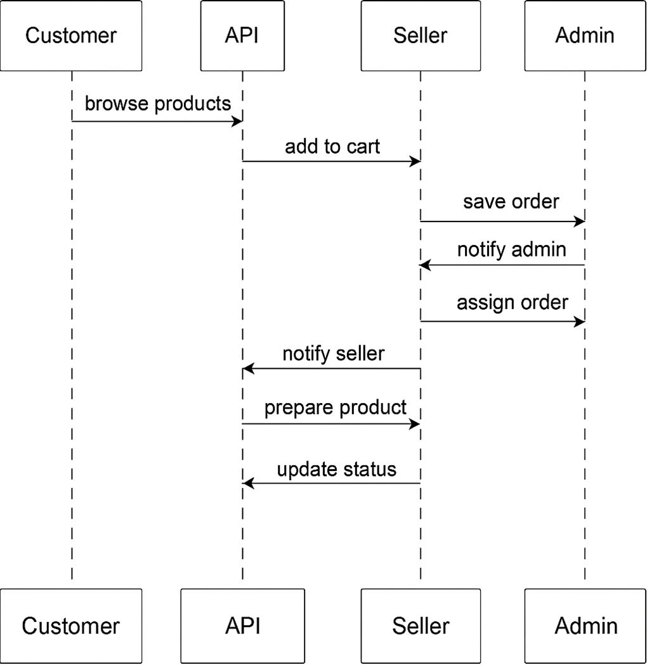
Sequence Diagrams

Slide 18
Methods Used to Implement the System
1. Requirement Gathering
Collected functional and non-functional requirements from real-world inventory use cases.
Identified key users: Admin, Customer, Seller.
2. System Design (UML & Architecture)
Designed Use Case, ER, Class, Sequence, activity diagrams.
Defined module-wise architecture with proper component segregation.

Slide 19
3. Frontend Development (React.js)
Created responsive UI with reusable components.
Used Axios for API calls and React Router for navigation.
4. Backend Development (.NET & Java)
Java(Spring boot) used for part management and vendor logic.
REST APIs implemented for smooth client-server communication.

Slide 20
5. Database Design (MySQL)
Normalized tables for SparePart, Vendor, User, PurchaseOrder, etc.
Used foreign key constraints for relational integrity.
6. Testing & Debugging
Unit testing of modules using Postman and browser dev tools.
Manual test cases executed for CRUD, login, and report features.

Slide 21


