Slide 1

Multi-Class News Article Classification System Using Natural Language Processing and Deep Learning Techniques
Automating intelligent news categorization through NLP pipelines and deep learning architectures.
Mr.KAMOJULA PRASAD
324129510025

Slide 2

Introduction and Problem Context
Information Overload
Digital news platforms generate thousands of articles daily, creating massive challenges for content organization and discovery.
Manual Categorization Fails
Human-led tagging is time-consuming, inconsistent, and entirely impractical at the scale modern platforms demand.
Intelligent Automation
NLP and deep learning techniques understand semantic meaning and context, enabling accurate and scalable automated classification.

Slide 3

Problem Statement
Labor-Intensive & Error-Prone
Manual categorization introduces human bias and inconsistency across large news corpora.
Shallow Keyword Systems
Rule-based and keyword-driven methods fail to capture contextual meaning, synonyms, and domain-specific terminology.
Need for Scale-Aware Intelligence
A context-aware, automated, and scalable multi-class classification system is essential for modern news ecosystems.

Slide 4
Objectives
Multi-Class Classification
NLP Preprocessing
Automatically assign articles to categories: Politics, Sports, Business, Technology, Entertainment, and Health.
Apply robust text preprocessing and feature extraction techniques to prepare raw news content for modeling.
Word Embeddings
Deep Learning Models
Leverage embeddings to capture rich semantic relationships between words across diverse news domains.
Develop LSTM and Transformer architectures for accurate multi-class prediction with confidence scores and analytics.

Slide 5
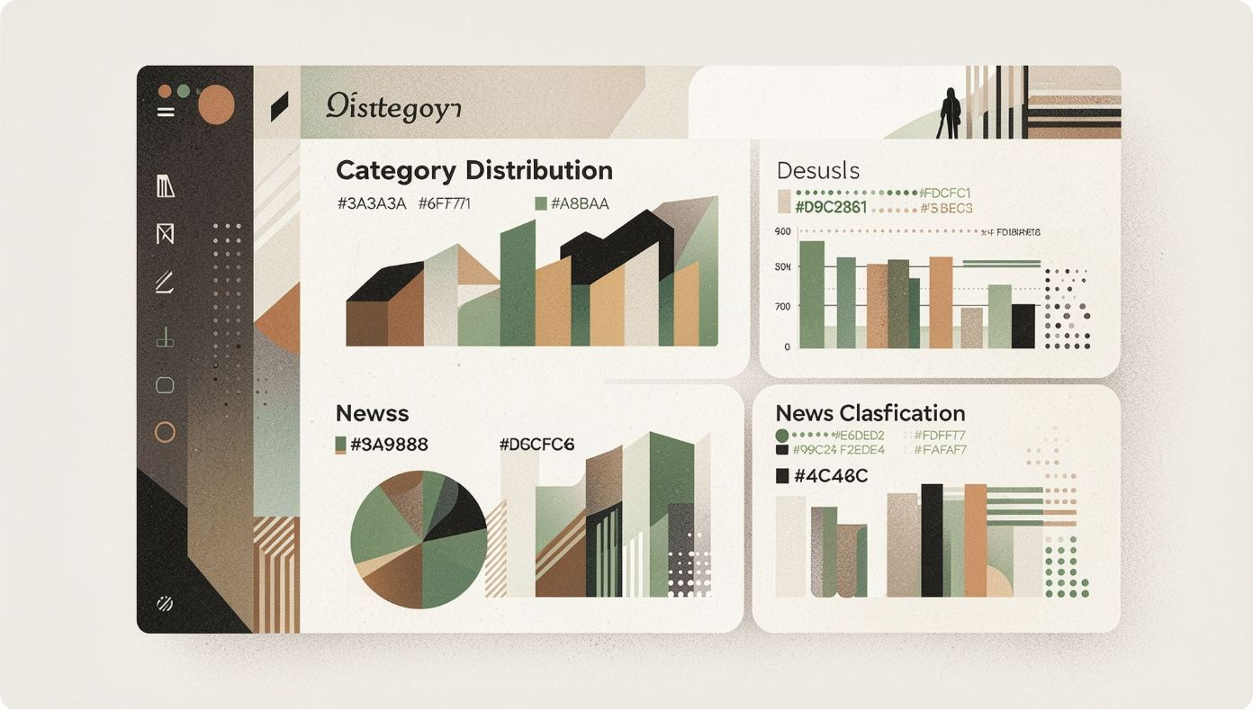
Proposed System Overview
End-to-End Classification Pipeline
The system accepts raw news article headlines and body content, processes them through a multi-stage NLP pipeline, and returns a predicted category with a confidence score.
Input: News headline and article content
Processing: NLP pipeline for text normalization and feature extraction
Classification: Deep learning model assigns one of six predefined categories
Output: Predicted label with probability confidence score
Dashboard: Analytics, classification history, and category distribution visualization

Slide 6
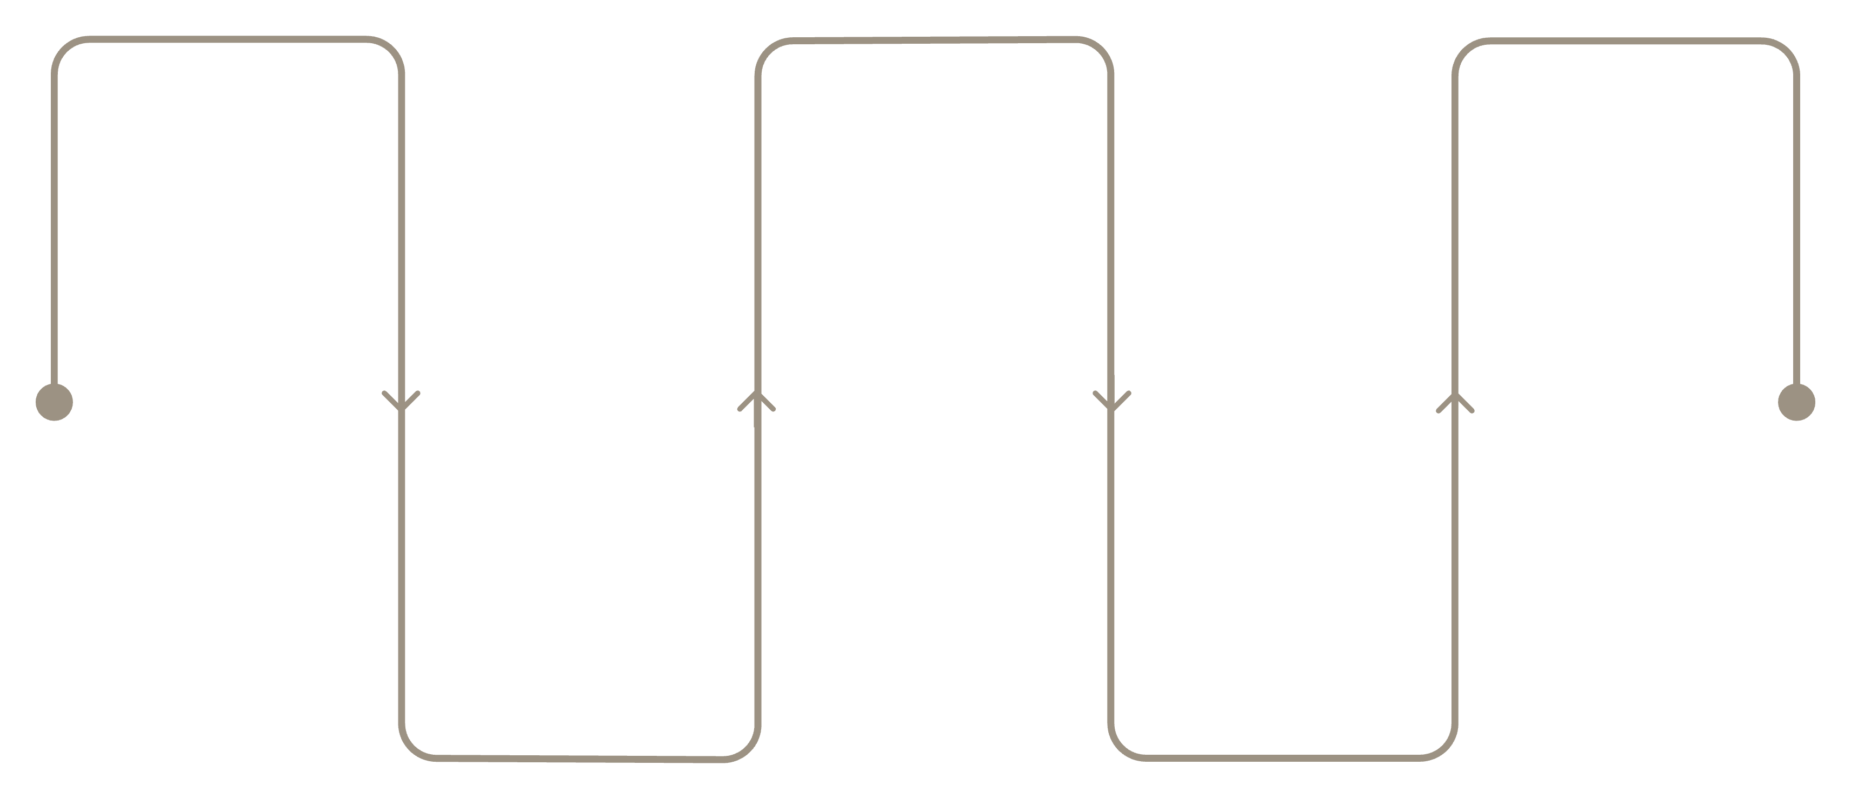
System Architecture and Processing Pipeline
Input
Preprocessing
Model
News headline and content
Tokenize, remove stop-words, lemmatize
LSTM or Transformer for classification
Text Cleaning
Feature Extraction
Normalize, lowercase, remove punctuation
TF-IDF, Word2Vec, GloVe, transformers
Each stage transforms raw text into structured, semantically rich representations that enable accurate multi-class classification.

Slide 7
Data Collection and Preprocessing
Dataset Construction
Preprocessing Steps
Collect news articles from reliable sources with headline, body, category label, and metadata
Label articles across six predefined categories with balanced class distribution
Partition into training, validation, and testing splits
Remove missing, duplicate, and noisy records through rigorous cleaning and validation
Ensure diverse and representative training data for robust generalization
01
Normalization
Lowercase conversion, punctuation and special character removal
02
Tokenization
Split text into meaningful word and subword tokens
03
Stop-word Removal
Eliminate common non-informative words
04
Lemmatization / Stemming
Reduce words to canonical root forms for consistency

Slide 8
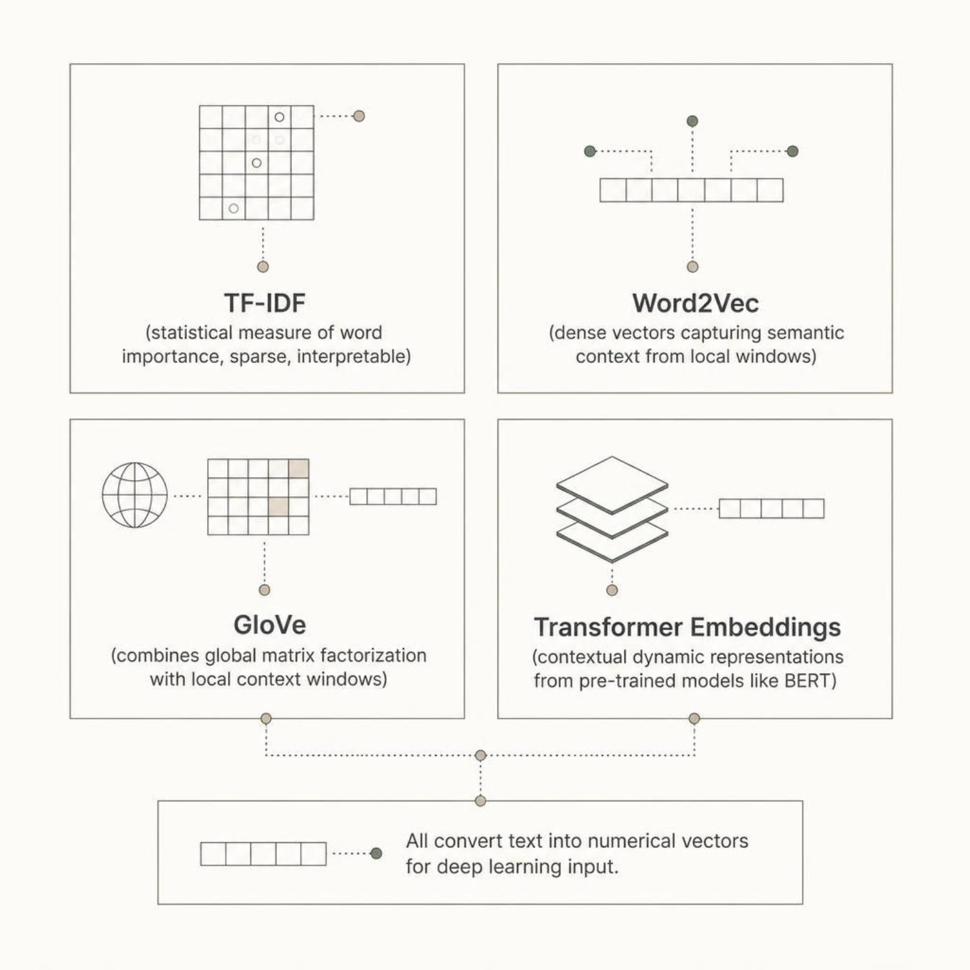
Feature Extraction and Word Embeddings
From Words to Vectors
Embeddings are the bridge between raw text and deep learning models. Each technique offers a different trade-off between computational efficiency and semantic richness.
TF-IDF: Lightweight, statistical, interpretable — ideal for baselines
Word2Vec: Dense, context-driven semantic similarity
GloVe: Combines corpus-wide co-occurrence statistics with local context
Transformer Embeddings: Dynamic, context-dependent representations from pre-trained models

Slide 9
Deep Learning Models: LSTM and Transformer Approaches
LSTM Architecture
Transformer Architecture
Input → Embedding Layer → LSTM Layers → Dropout Regularization → Dense Layer → Softmax Output
Captures sequential dependencies and long-range patterns in text through gated memory cells, making it effective for variable-length news articles.
Token Embeddings → Positional Encoding → Multi-Head Self-Attention → Transformer Encoder Layers → Classification Head
Processes entire sequences in parallel using self-attention to model global contextual dependencies across all token positions simultaneously.
Both architectures produce a probability distribution across all six news categories via the output layer, with the highest probability class selected as the final prediction.

Slide 10
Model Training, Evaluation, and Applications
Training Strategy & Evaluation
Applications & Advantages
Loss Function: Categorical cross-entropy for multi-class optimization
Optimizer: Adam with adaptive learning rate scheduling
Overfitting Control: Dropout, early stopping, and validation monitoring
News & Media Platforms
News agencies, digital media platforms, and aggregation services automate content tagging at scale.
Information Systems
Evaluation Metrics
Digital libraries, content management systems, and information retrieval engines benefit from structured categorization.
Accuracy — overall correct predictions
Precision & Recall — per-class correctness and coverage
F1-Score — harmonic mean balancing precision and recall
Confusion Matrix — cross-category error analysis
Key Advantages
Reduced manual effort, faster organization, improved retrieval accuracy, and a fully scalable architecture.

Slide 11
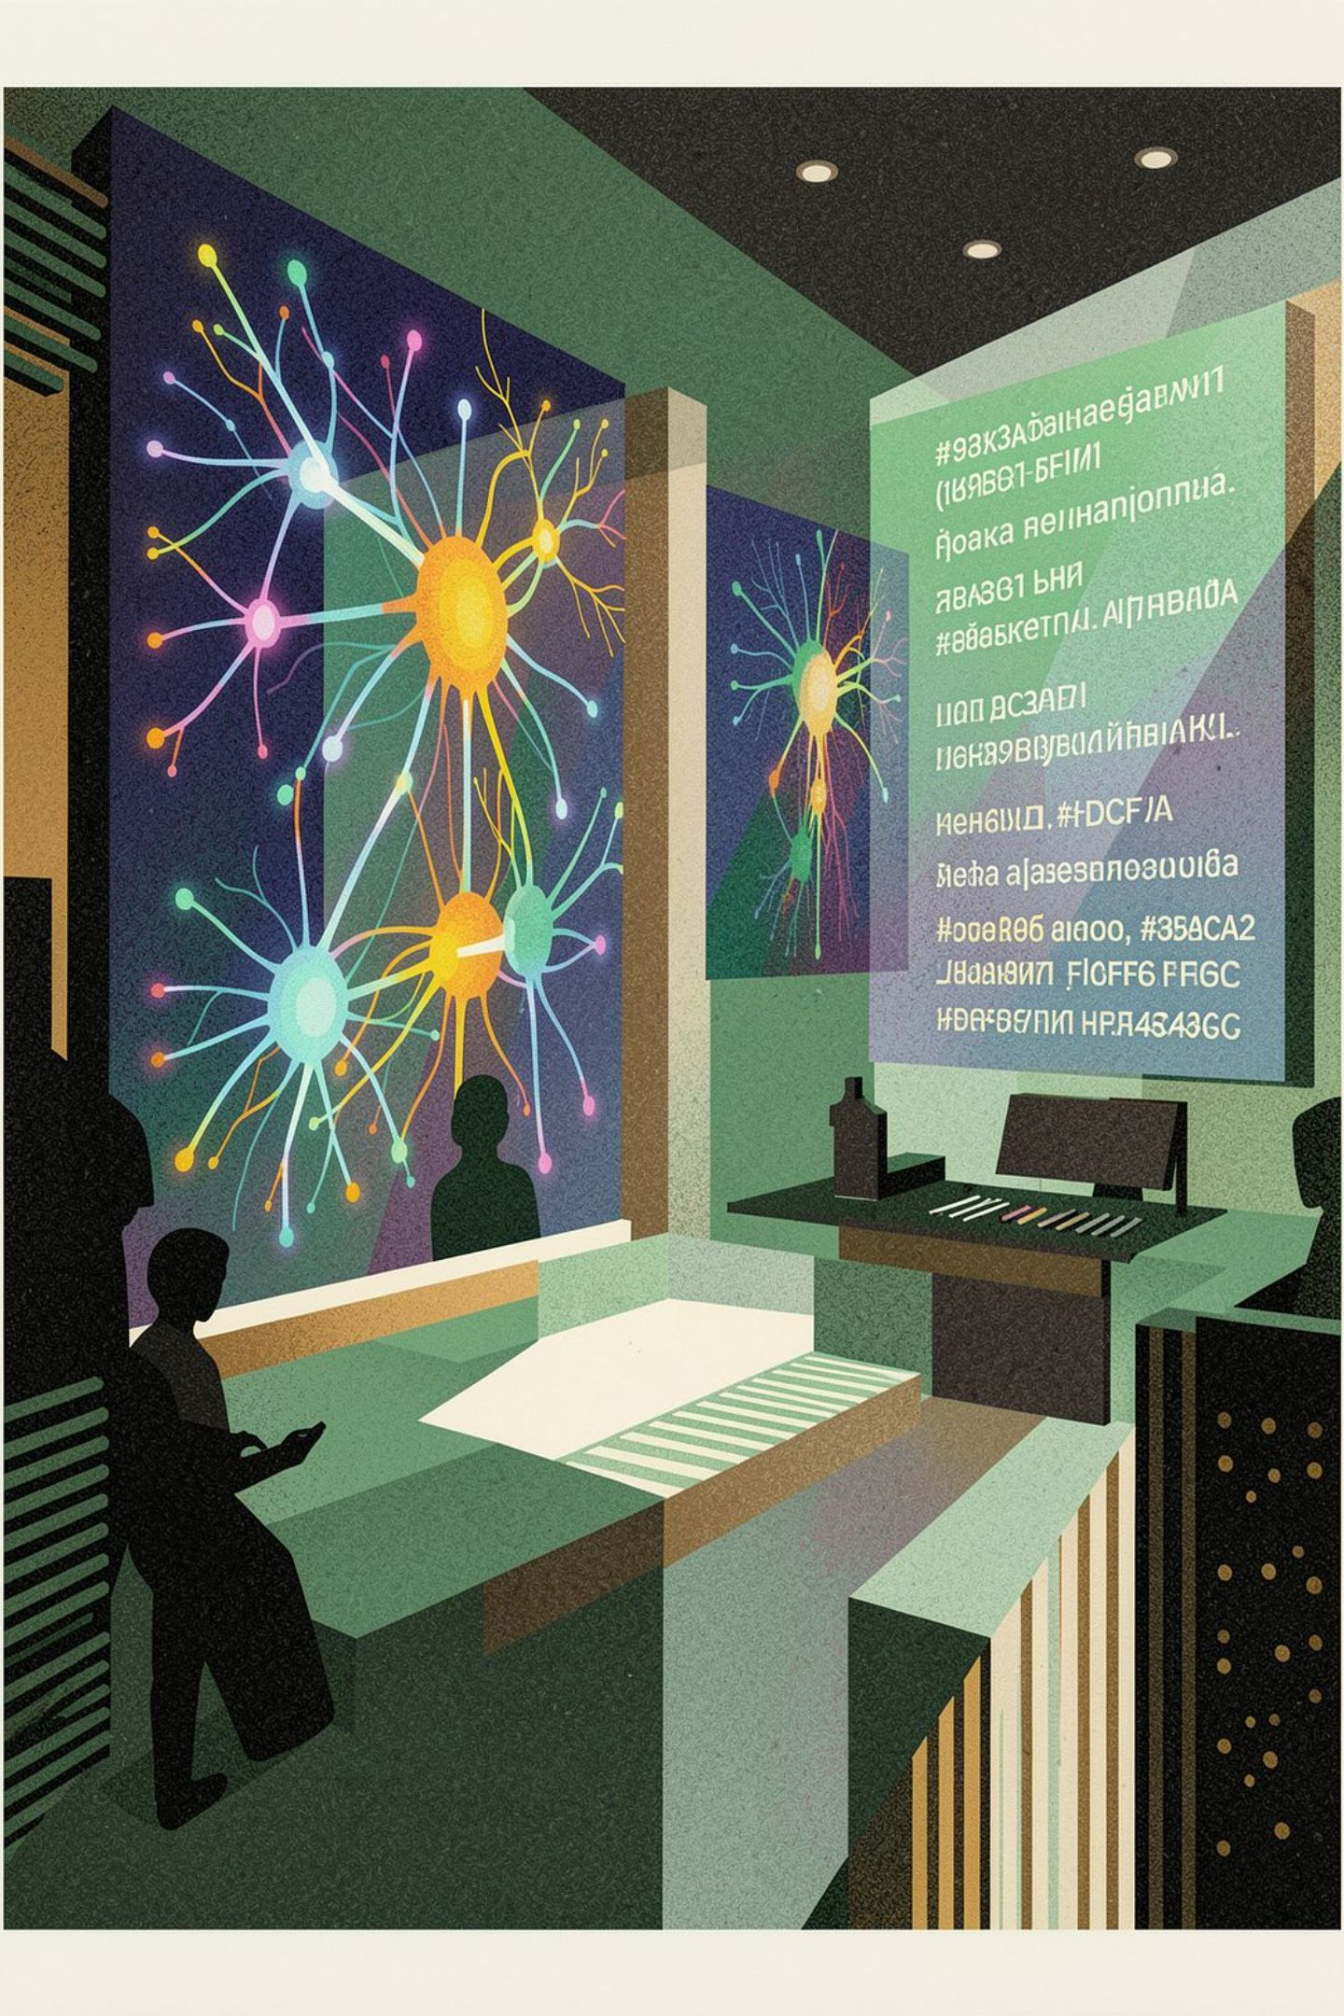
Conclusion and Future Scope
Conclusion
Future Enhancements
NLP preprocessing, word embeddings, and deep learning architectures — LSTM and Transformer — together enable efficient, automated classification of large-scale news collections into semantically meaningful categories, reducing manual effort and improving content organization at scale.
Advanced Transformers
Fine-tune BERT, RoBERTa, and domain-specific pre-trained models for higher accuracy
Multilingual & Real-Time
Extend to multilingual classification and real-time streaming article processing
Expanded Intelligence
Integrate fake news detection, sentiment analysis, and personalized content recommendations
Cloud Deployment
Deploy as a scalable, cloud-native microservice for enterprise-grade production systems

