Slide 1
Locating Nearby Hospital

Slide 2
Introduction:
Now a days, at the time of medical emergency, it’s too hard for locating the nearby Hospital,
especially when you are in unknown city, town, place etc.
The main idea is to pick the location of the user and compare it with the location of the
Hospitals from our datasets.
User will get this information on the single click

Slide 3
Data:
Here’s link for the data set I used for this :
https://github.com/Prasad18-coder/Capstone/blob/master/hospital-locations.csv
I have converted this csv file into Data Frame using Python Library “Pandas”. It contains data
such as: Name, Address, Zip code, Neighbor, X Co-ordinate, Y Co-ordinate of the Hospitals.
Previously, X Co-ordinate and Y Co-ordinate from the Dataset where in the following format:

Slide 4
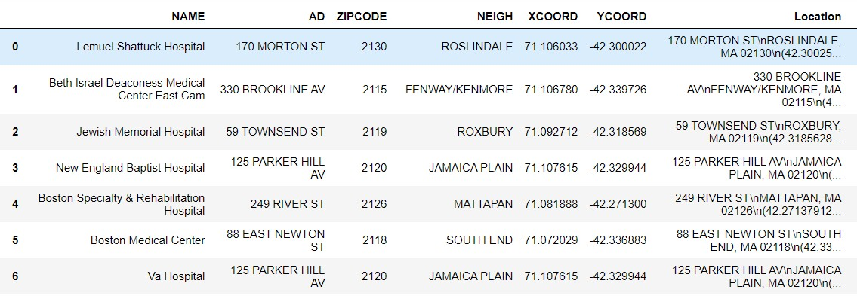
Final DataSet

Slide 5
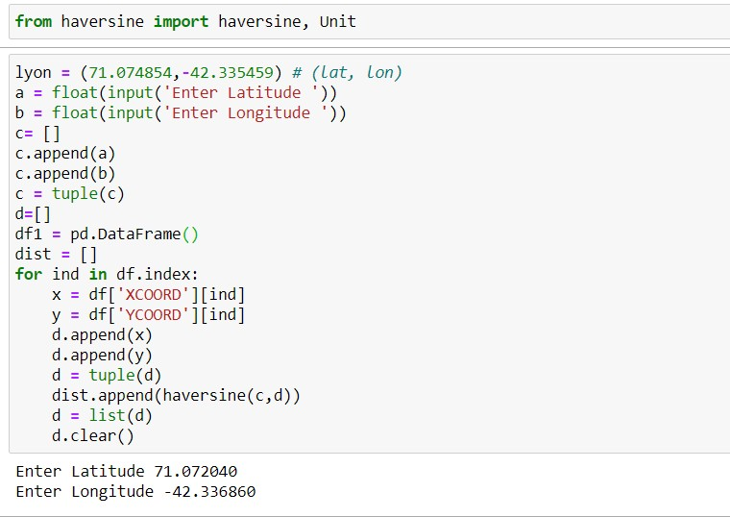
Methodology:
After cleaning data, we take input from the user. Here, I have inputted the co-ordinates.

Slide 6
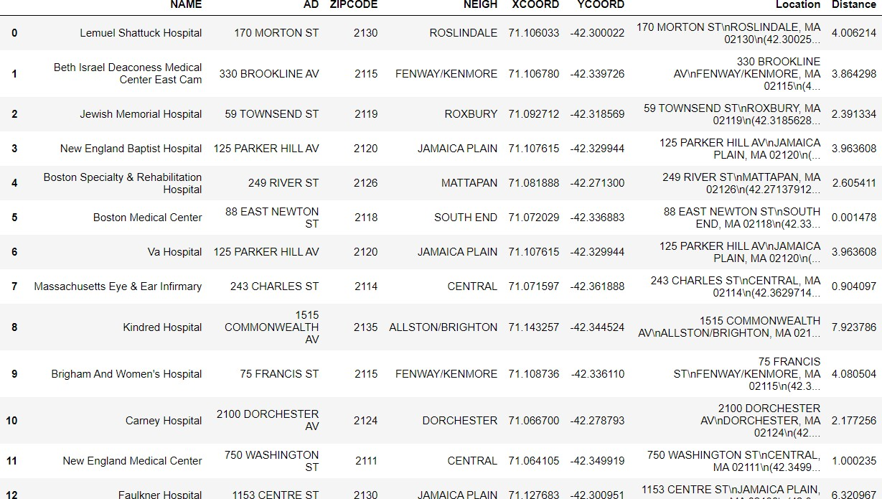
Basically, this compares the distance between the inputted co-ordinates and the co-ordinates from
the dataset. List named ‘dist’ is created and further added as a column to the dataset.

Slide 7
Result:

