Slide 1


RAG Pipelines for Intelligent Recommendations on Reddit
Exploring the use of Retrieval-Augmented Generation (RAG) pipelines to provide intelligent recommendations on Reddit.

Slide 2
Revolutionizing Content Understanding with RAG
Retrieval-Augmented Generation (RAG) combines information retrieval and text generation. RAG pipelines first retrieve relevant information from a Vector Database.
This retrieved information is then used as input for a large language model, enabling the generation of accurate and contextually relevant responses.

Slide 3
Project Goals: From Data to Insights
1
Data Acquisition
2
Data Preprocessing
Extract relevant Reddit data.
Prepare the data for efficient processing.
3
Embeddings Generation
4
Vector Database Implementation
Store and index embeddings for efficient retrieval.
Transform text data into vectors for similarity search.
5
Advanced RAG Pipeline Development
6
Anomaly Detection and Content Synthesis
Tracking User Activities
Develop the RAG pipeline to generate contextual insights.
Uncover valuable insights from Reddit discussions.
7
Response Generation
Meaningful insights from LLM model gives better understanding

Slide 4
Gathering Reddit's Wisdom: Data Acquisition
Target specific Reddit subreddits like r/machinelearning or r/artificialintelligence for relevant data.
Utilize tools and APIs like Reddit API and PRAW to extract posts, comments, and user interactions.
Store the raw data efficiently using Structured JSON format for future processing.

Slide 5
Preparing the Data: Data Preprocessing
Clean the data by removing duplicates, handling missing data, and correcting inconsistencies.
Used: Regular Expressions( RE ) and Unicodedata
hashing the data into hexadecimal to manage input token limitations for language models. Hashing preserves contextual coherence.

Slide 6
Transforming Text to Vectors: Embeddings
Making documents based on the post , content, comments and
User details by keeping the relevant attribute as metadata for each document.
Generate embeddings for text using Transformer-based models like Sentence Transformers. Embeddings capture semantic meaning in vector form.
Used Model: all-MiniLM-L6-V2

Slide 7
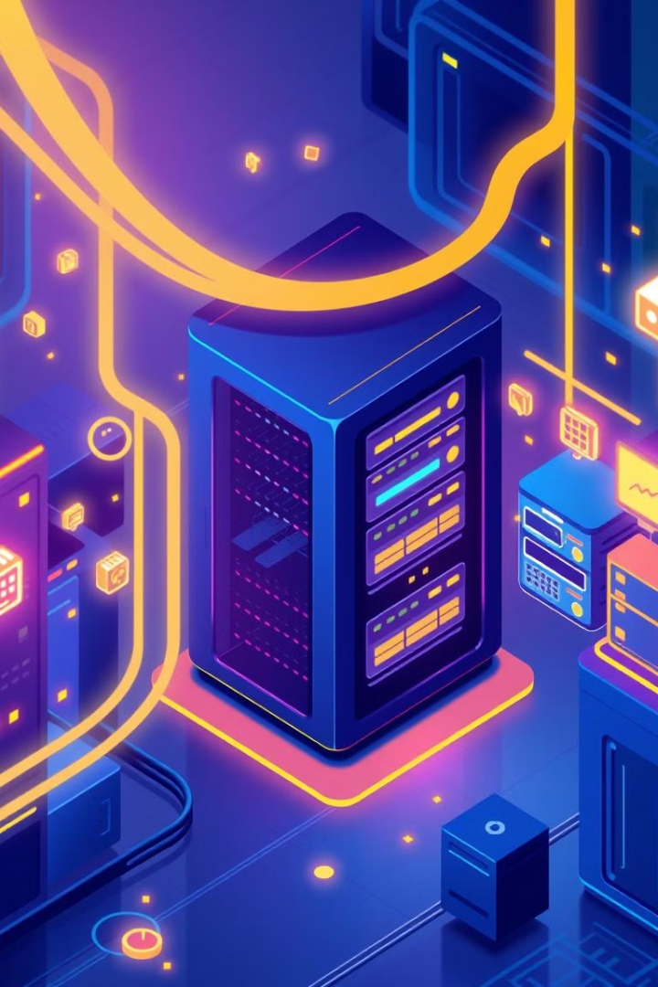
Storing and Indexing: Vector Database
Utilize Chroma as a vector database to store and index embeddings. Chroma efficiently retrieves similar vectors based on cosine similarity.
Design the Chroma schema to optimize for retrieval patterns and ensure accurate retrieval of relevant documents based on user queries.

Slide 8
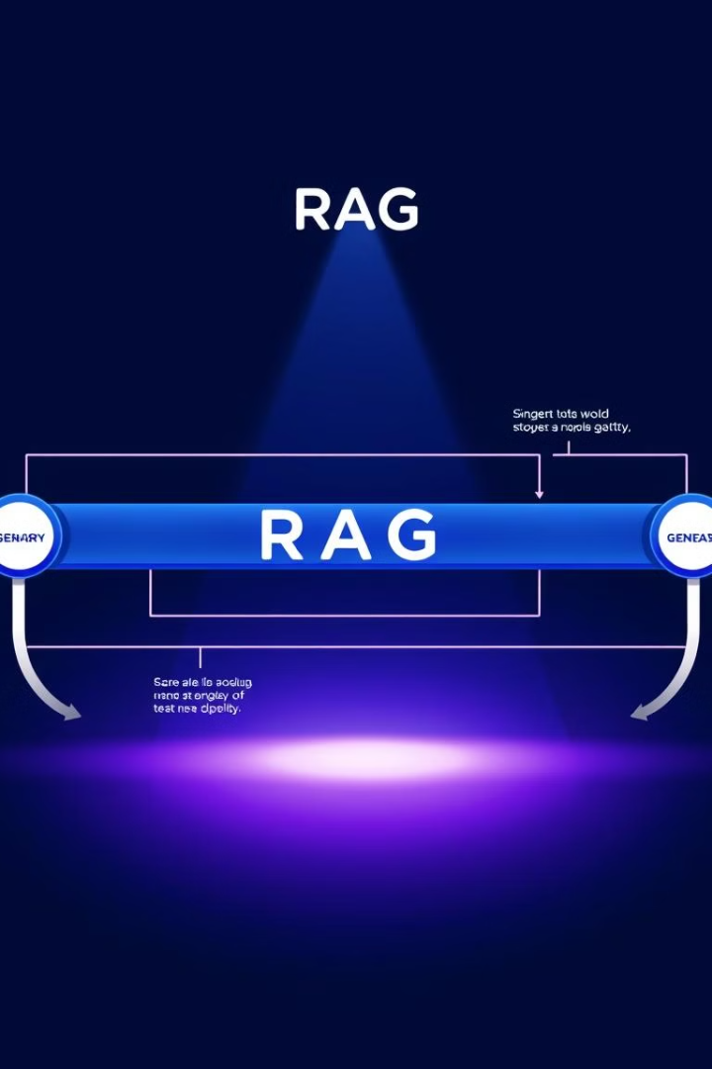
Building the RAG Pipeline
Query
User query is processed and transformed into a vector.
Retrieval
Relevant documents are retrieved from the vector database based on cosine similarity.
Processing
Retrieved documents are integrated with LLMs for further processing. e.g. llama 3.2
Generation
A large language model (llama 3.2)generates a response incorporating the processed document and contextual understanding.

Slide 9
Insights from the reddit data:
Tracking user activity :
Understanding the activity of the user based on the statistics generated such as number of posts , comments along with user interactions
Content Exploration:
Based on the topic of the content exploring the posts and comments along with the user details
Content synthesis:
Based on the query given generating and summarizing the retrieved relevant document

Slide 10
Uncovering Insights: Anomaly Detection and Synthesis
Use algorithms like Isolation Forest, DBSCAN, or LLM models to detect anomalies in Reddit discussions. This helps identify unusual patterns or outliers.
Employ LLMs or sequence-to-sequence models for content summarization, condensing lengthy discussions into concise summaries. This provides users with valuable insights.

Slide 11
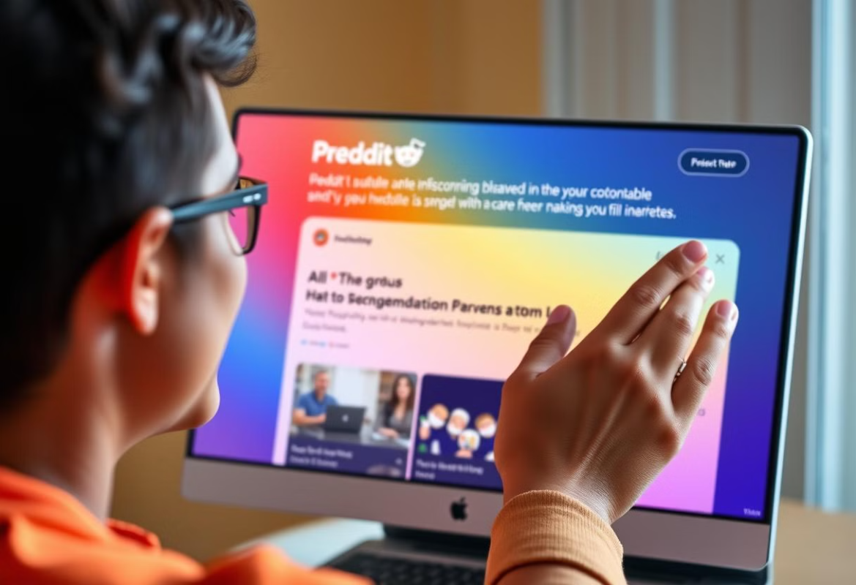
RAG for Intelligent Recommendations
Thank
You
Leveraging RAG pipelines, We get recommendation to provide insightful and relevant content for Reddit users. These systems learn from user preferences, creating more personalized and engaging experiences.

