Slide 1
UpTimeEngine
Status: Sandbox Project
Autonomous, memory-safe incident triage and remediation for enterprise infrastructure.

Slide 2
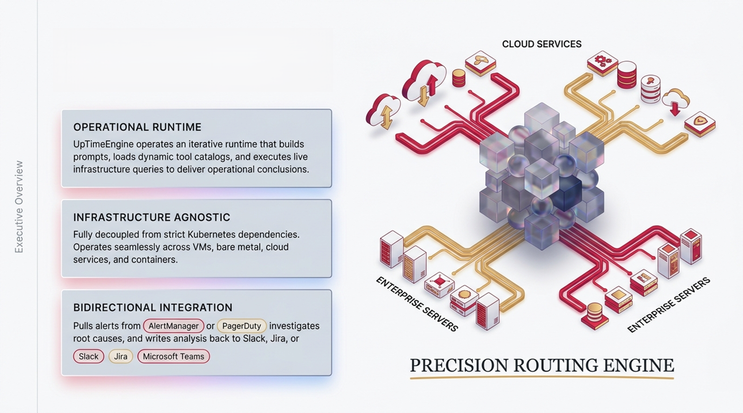
A Layered, Agentic Investigation Platform

Slide 3


The Operator Mode Paradigm
Dimension
Standard Al Assistants
Proactive 24/7 background execution
Trigger
Waits for human invocation
Spots deployment regressions instantly
Detection
Delayed until user notices
Context Gathering
Limited by initial prompt
Deep, iterative live-system querying
Applies fixes and opens GitHub PRs directly
Execution
Suggests passive fixes
Kubernetes-native persistent health checks
Architecture
Stateless wrapper

Slide 4

The Agentic Investigation Loop
Step 1: Construct Prompt & Load Catalog
Dynamic evaluation of available built-in and custom toolsets based on current context.
Step 2: LLM Orchestration
LiteLLM provider abstraction normalizes access across OpenAI, Anthropic, Azure, or Bedrock.
Step 4: Result Parsing
& Loop Iteration
Tool outputs are evaluated. The engine iterates until an operational conclusion is reached, minimizing hallucination through empirical data.
Step 3:Tool Execution
Live query execution against internal K8s clusters, external APls, or Saas endpoints.

Slide 5
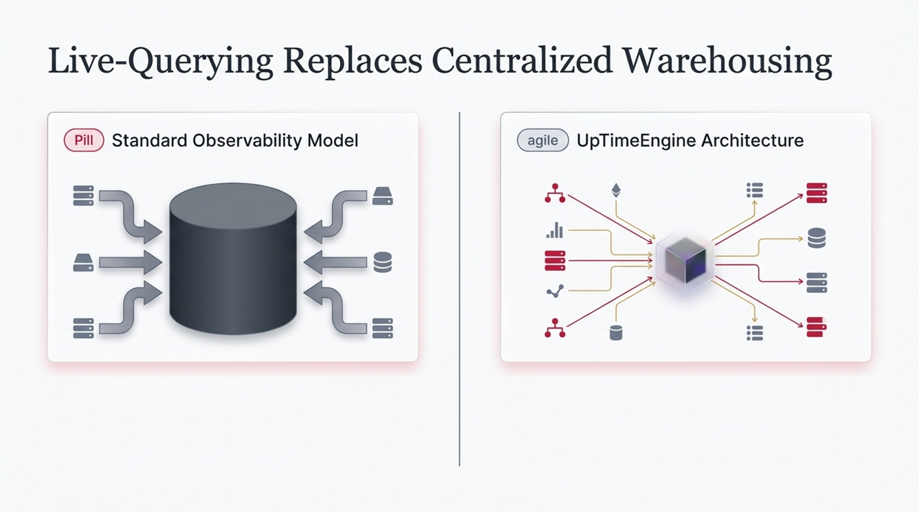
Data-flow-heavy, live-query-based runtime.
Retrieves operational evidence dynamically from external systems.
Zero local warehouse maintenance. Real-time accuracy.
Data shipped to centralized petabyte warehouse.
High latency, high storage costs.
Models query stale, aggregated data.

Slide 6
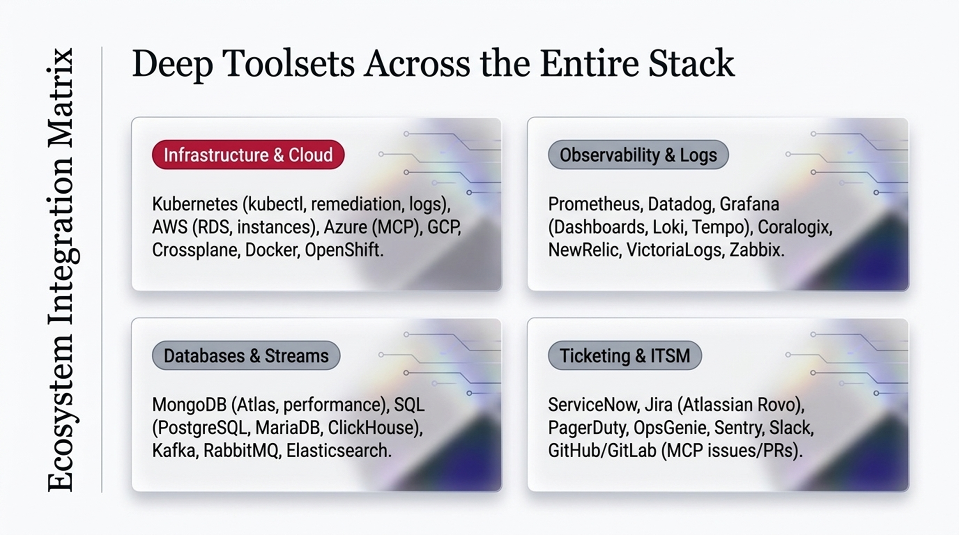

Slide 7


Slide 8
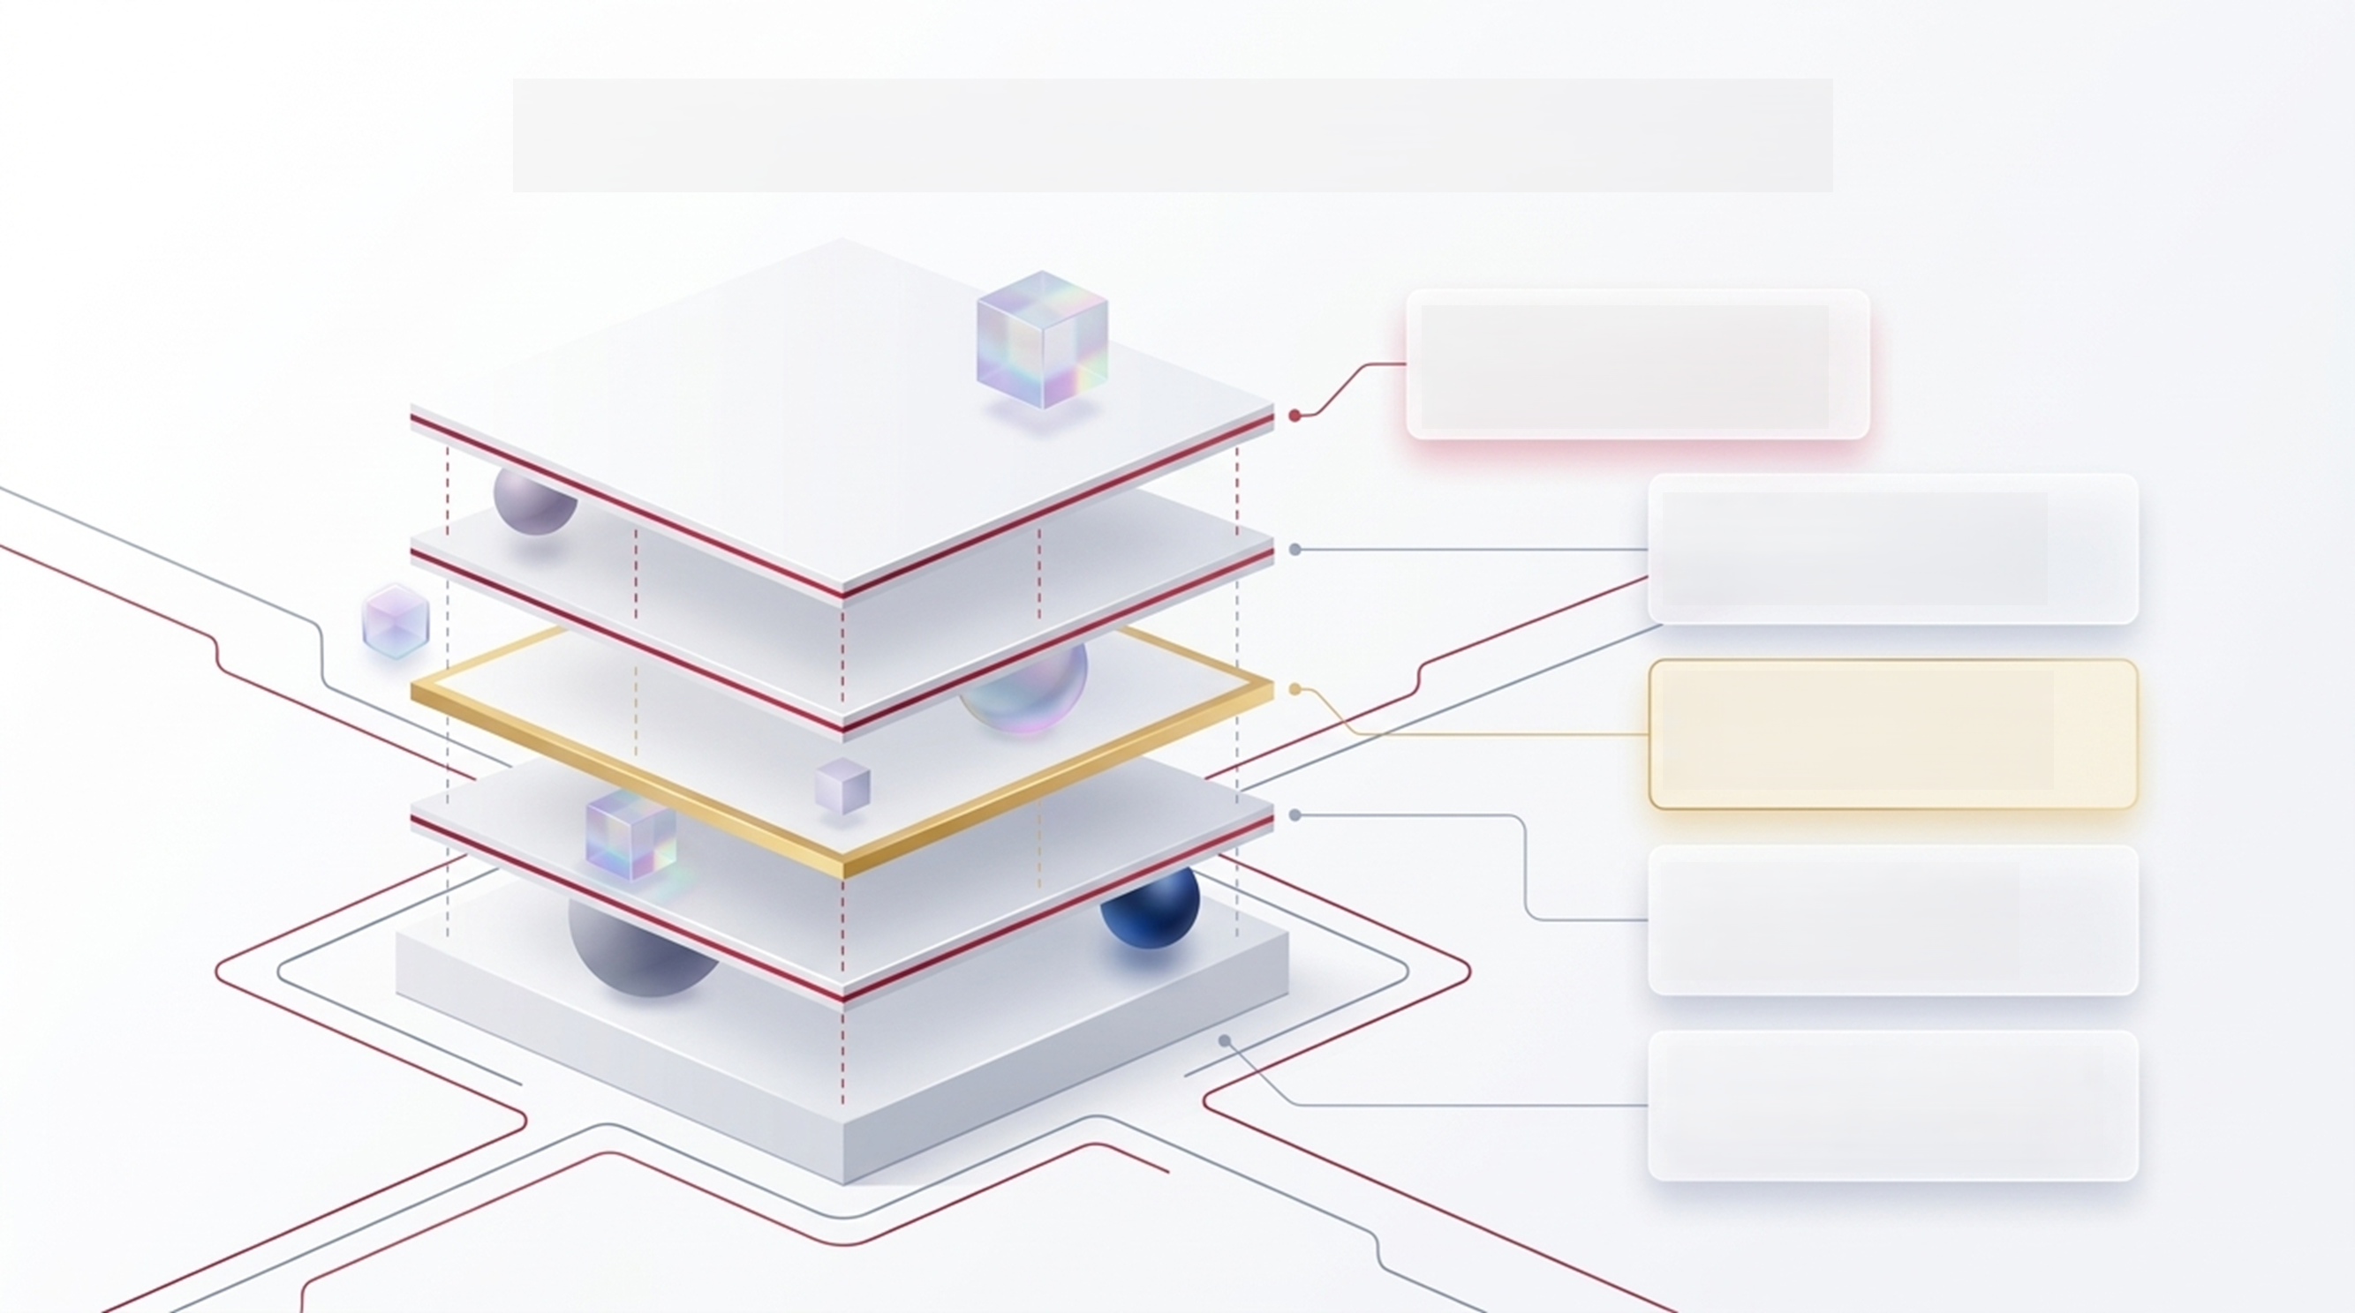
The Enterprise Architecture Stack
Layer 1:Presentation & API Typer CLI & FastAPI / Uvicorn (Admin and health-check execution)
Layer 2: Configuration
Pydantic models & YAML merging credentials and toolset selection
Layer 3: Agent Orchestration
ToolCallingLLM & LiteLLM (Normalizes provider metadata)
Layer 4: Tool Integration
MCP servers, Python toolsets, HTTP integrations
Layer 5: Data Services
Supabase DAL, file caches, config JSON (OAuth state and operational metadata)

Slide 9
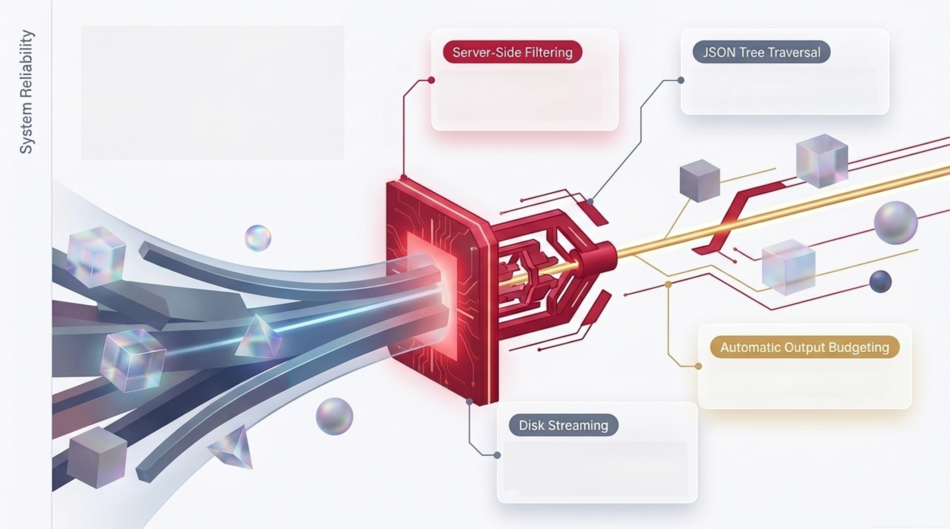
Memory-Safe Execution at Petabyte Scale
Prevents massive payloads from ever reaching the LLM context window.
Extracts only the required nodes from deep API responses.
Enforces strict per-tool memory limits.
Temporarily spools exceptionally large diagnostic results to disk, entirely eliminating OOM kill risks.

Slide 10
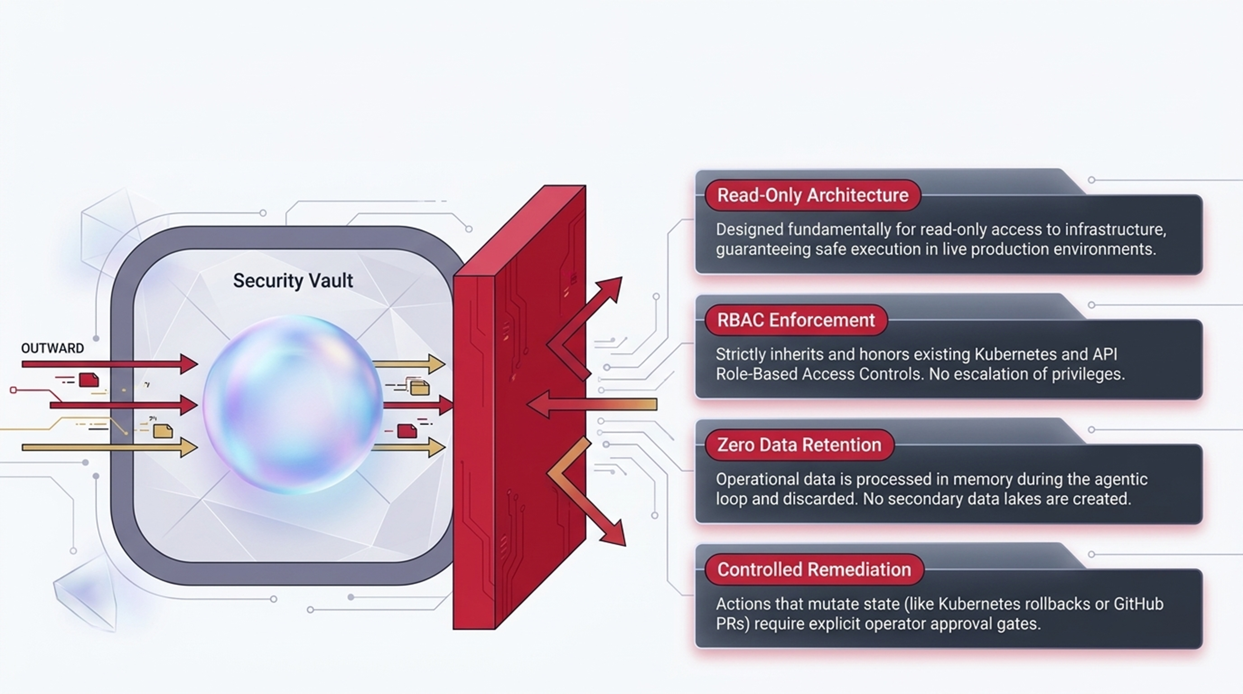
Zero-Trust Deployment &
Enterprise Safeguards

Slide 11
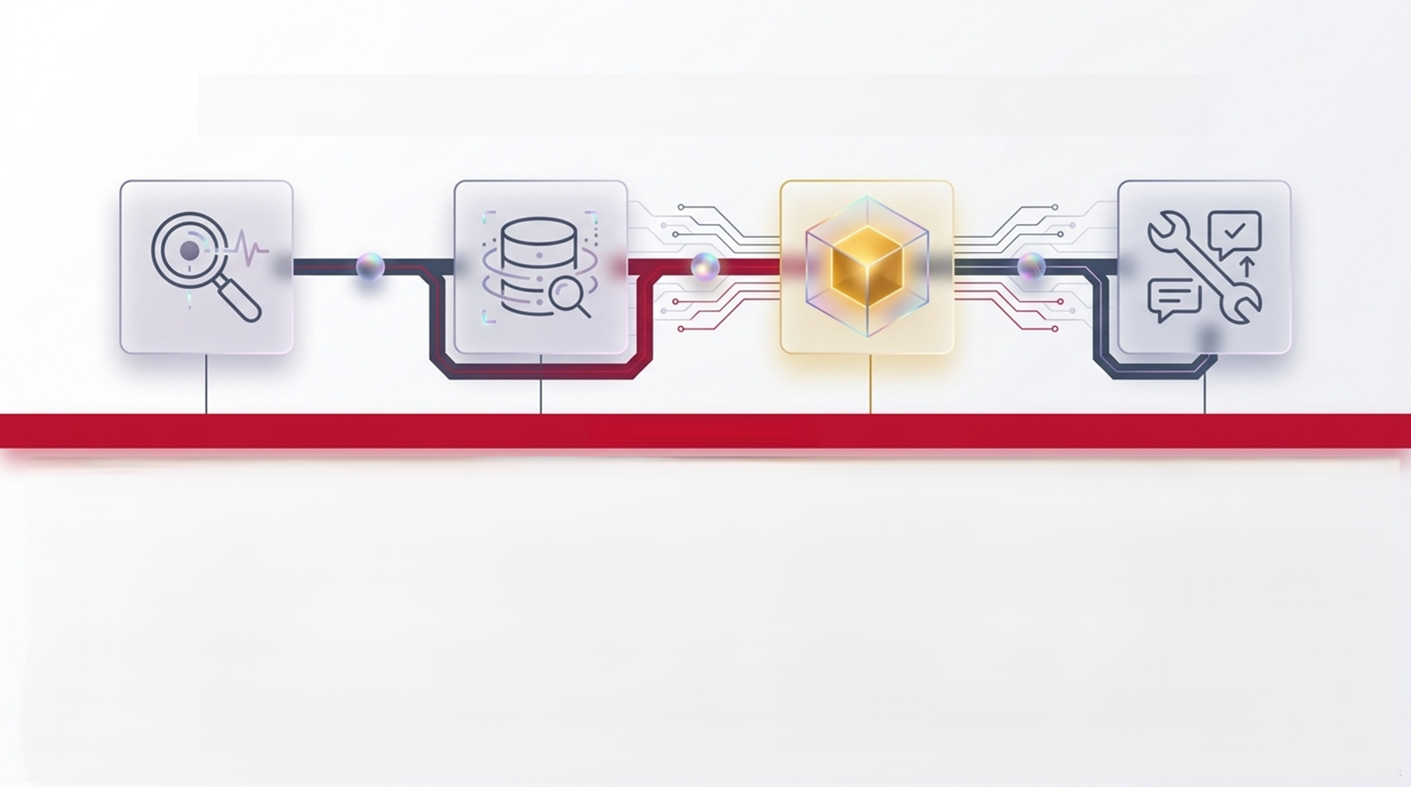
Synthesis: Zero-Touch Triage Architecture
24/7 Operator Mode
Step 1: Background Detection
UTE Operator spots database deployment drift via ArgoCD health check.
Step 2: Contextual Querying
Agentic loop autonomously queries Loki and VictoriaMetrics to confirm latency spike.
Step 3:
Root Cause Diagnosis
Identifies missing index in PostgreSQL via specific error logs.
Step 4: Automated Remediation
Generates database migration script, opens PR via GitHub MCP, and alerts engineer in Slack for final merge approval.
A unified orchestration layer sitting directly between your infrastructure and your engineering teams.

