Slide 1





SCCM 2012 – infrastructure considerations, new features, look & feel
Mariusz Zarzycki
PhD, MCT, MCTS, MCSE, MCITP, MCSA
mariusz.zarzycki@interia.pl
BLOG: http://www.e-zarzycki.com

Slide 2

Agenda
Introduction
Configuration Manager 2012 console
Client Settings
Focus on the user
Infrastructure Simplification
Role-based Acces Control
User-Centric Management
Apps and OS Delivery
Reporting
Inventory
Site Recovery
Planning a Migration from SCCM 2007 to SCCM 2012

Slide 3

Introduction
The idea of this presentation is to give a brief overview of all the features of Configuration Manager 2012(based on BETA 2).
The main focus is to:
present differences between Configuration Manager 2007 and Configuration Manager 2012
LIVE DEMO, based on public BETA2 version of a new release of Microsoft ConfigMgr

Slide 4

Prerequisites
The database can only be SQL 2008 SP1 with CU10 or higher (no support for SP2 or R2 yet!)
x64 OS (finally ConfigMgr is on the same platform as the rest of the System Center Family)
RAM, it needs a lot! The minimum is 2GB, but bear in mind ‘the minimum’. Running this one in a lab environment with SQL on the same machine, go for 4-6GB.
.NET 3.5.1
.NET 4.0
RDC (Remote Differential Compression)
BITS (Background Intelligence Transfer Service)
IIS Role Service –> IIS 6 WMI Compatibility
WSUS 3.0 SP1 if you want to manage Software Updates with SCCM
One thing that directly caught my attention, no more need for WebDAV

Slide 5
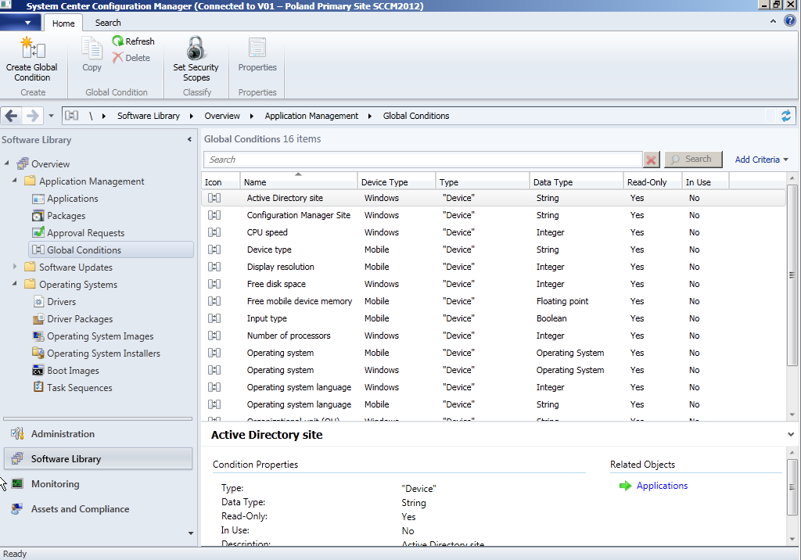
Configuration Manager Console 2012
1
Ribbon concept, the ribbon shows only the functions you need or can use when selecting or browsing a page or object
The tabs are contextual and appear only if an object or a subject is selected.
The commands are grouped by functionality and are also contextual and displayed on the ribbon.
Command or function within the group and available to use in combination with the selected object.
Breadcrumbs or navigator is used to quickly browse back to a page in the tree.
Objects of a selected feature. When selecting a feature, you are able to create related objects.
Selecting an object will give you straightaway information about the object or the possibility to change related objects
The information is grouped per tab(not in this view).
The new Configuration Manager Console is divided into 4 work spaces . These work spaces group the features of Configuration Manager in a logical way.
Features of the selected workspace. Since the features are grouped in nodes, selecting a node will change the list of features. Each feature has one of more subjects.
The search capability throughout the management console helps you to find Configuration Manager objects easily.
2
3
4
9
5
8
6
7

Slide 6
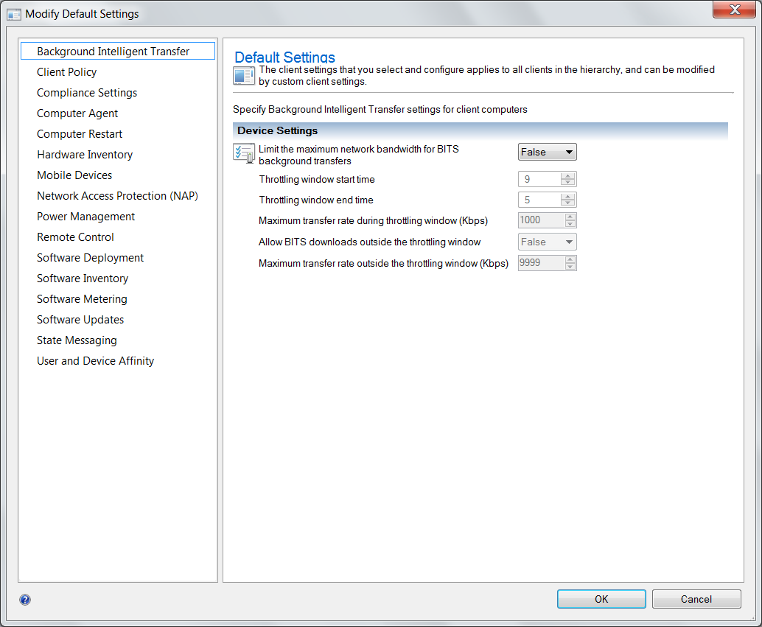
Client settings 1/2
Client settings are used to configure the agents that are used in the Configuration Manager 2012 Clients.
In Configuration Manager 2012 you are able to assign client settings to collections of devices or users.
Being able to do this, you don’t need to implement an extra Primary Site for different client settings like you where used to in Configuration Manager 2007.

Slide 7
Client settings 2/2
Background intelligent transfer - Configure BITS bandwidth properties.
Client Policy - Configure how often a Configuration Manager 2012 Client polls the Primary Site to retrieve the latest policies.
Compliance Settings - Configure if clients are evaluated for compliancy and how often they are evaluated.
Computer Agent - Configure the general settings for communications between client and server.
Computer Restart - Configure the restart behavior (countdown in minutes) of the clients.
Hardware Inventory - Specify how and when client computers retrieve hardware and system inventory.
Mobile Devices - Define a mobile device profile and the polling interval of the mobile devices. You are also able to create a client user setting.
Network Access Protection - Configure Network Access Protection settings on client computers.
Power Management - Enable or disable power management for client computers.
Remote Control - Configure settings how remote control is behaving and what is possible with remote control.
Software Deployment - Configure how client computers deploy software.
Software Inventory - Specify how and when client computers retrieve software inventory
Software Metering - Configure if and when client computers retrieve software metering.
Software Updates - Configure when and if client computers scan for and deploy software updates. You are also able to configure what to do when a deadline occurs.
State Messaging - Configure how often client computers reports state messages.
User and device affinity - Configure user and device affinity settings for client computers. You are also able to create a client user setting.

Slide 8
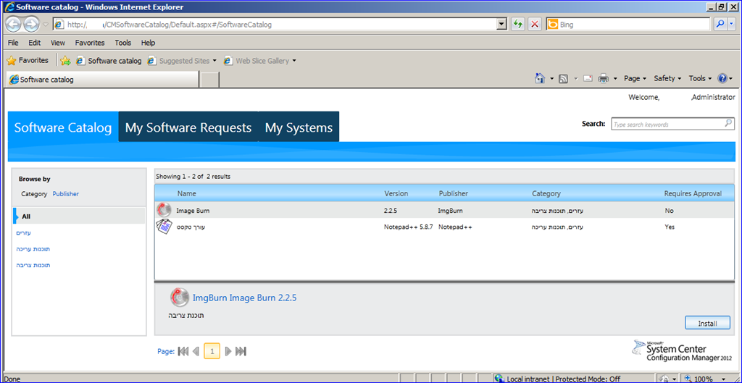
Focus on the user !!!
Consumerization of IT” is a fact of life.
SCCM has always been about systems management.
Each of your users can have one or more Primary
Further involving users in managing their own systems is a new interface called the Software Center(previous Run Advertised Programs). This employs a familiar browser and shopping cart interface to let users search for and request applications. Depending on the application, you can have it installed straight away or first require administrator approval(Software Catalog).
Notes:
Consumerization of IT” is a fact of life. Resistance to this trend is probably futile in the long run. Along with this trend comes a multitude of devices and platforms you’re expected to support.
SCCM has always been about systems management. Handling the changing landscape, it’s rightly putting users in a central role. This new philosophy is affording them more control over what software they have installed and when it’s installed. For example, a user can define their own work hours so installations and upgrades take place when they’re not working
Each of your users can have one or more Primary Devices (meaning a desktop PC, laptop or smartphone). There can be more than one Primary User of a particular device (for example, during shift work in a factory). You help define these relationships by user device affinity (UDA). There are several methods to create the link: file import, manually by administrator, by the end user or through usage statistics.
Further involving users in managing their own systems is a new interface called the Software Center(previous Run Advertised Programs). This employs a familiar browser and shopping cart interface to let users search for and request applications. Depending on the application, you can have it installed straight away or first require administrator approval(Software Catalog).

Slide 9
Infrastructure simplification 1/2
A flatter structure with less site system servers.
SCCM 2012 is 64-bit only. Only run on Windows Server 2008 or Windows Server 2008 R2 with SQL Server 2008 SP1 (x64) or later in the back end. However, DPs can still run on 32-bit Windows.
Content distribution is now the responsibility of SQL Server replication, though software packages, patches and OS images still use the file-based model. Replicated data is divided into Global data (administrator generated, such as collections) and Site data (system generated). Because of this, each secondary site will need SQL Server (SQL Server Express is included).
A new Central Administration Site (CAS) that can’t have assigned clients. It’s used only for administration and reporting (through SQL Server reporting).There’s no need for a CAS unless you have more than one primary site. Each primary site supports about 100,000 clients. You may want more than one for redundancy, even in smaller environments. You can’t tier primary sites as you could in SCCM 2007. You can with secondary sites, but you could probably turn many of those into DPs as they now offer bandwidth control.
Notes:
A flatter structure with less site system servers.
SCCM 2012 is 64-bit only. Only run on Windows Server 2008 or Windows Server 2008 R2 with SQL Server 2008 SP1 (x64) or later in the back end. However, DPs can still run on 32-bit Windows.
Content distribution is now the responsibility of SQL Server replication, though software packages, patches and OS images still use the file-based model. Replicated data is divided into Global data (administrator generated, such as collections) and Site data (system generated). Because of this, each secondary site will need SQL Server (SQL Server Express is included).
A new Central Administration Site (CAS) that can’t have assigned clients. It’s used only for administration and reporting (through SQL Server reporting).There’s no need for a CAS unless you have more than one primary site. Each primary site supports about 100,000 clients. You may want more than one for redundancy, even in smaller environments. You can’t tier primary sites as you could in SCCM 2007. You can with secondary sites, but you could probably turn many of those into DPs as they now offer bandwidth control.
Microsoft has added a new site type, the Central Administration Site (CAS). This is a site needed for large scale deployments and is used for all administration and reporting for the hierarchy. If this type of site is deployed, it would be at the top of the hierarchy. This site type is similar to the SCCM 2007 central site. However, this site can't have clients assigned to it and can't process client data.
When a CAS site is deployed, a primary site must also be deployed to manage systems and users (normally in the same location as the CAS). Having a CAS also allows you to deploy additional primary sites. If a CAS site isn't installed because you are working on a small deployment, then the first site deployed in the hierarchy is a primary site. You can't install additional primary sites if you don't have a CAS server. However, you can install secondary sites as child sites of the single primary site server.
A primary site in SCCM 2012 is similar to primary sites in SCCM 2007. A primary site is no longer needed as a boundary for client agent settings or security or for network bandwidth control. In SCCM 2012, instead of creating different sites to manage clients, you create different collections. You can configure custom client agent settings using collection-based targeting.
A primary site can't be a child site of another primary site. Primary sites can only be child sites of the CAS site. SCCM 2012 has moved to a flat primary site relationship (this is due to the new database replication model). However, secondary sites can still be child sites of primary sites.
Secondary sites in SCCM 2012 provide the same functionality as in SCCM 2007. A proxy management point and distribution point are deployed automatically when the site is installed. Microsoft has introduced a new technology in SCCM 2012 that provides the ability to remove secondary sites. This is the capability of distribution points to implement bandwidth throttling and scheduling.
Secondary sites can no longer be installed from the SCCM setup. They must be installed from the console. These are the available options presented by setup.

Slide 10
Infrastructure simplification 2/2
Client agent settings are now defined at the collection level, instead of at the site level. You can have each client receive settings from multiple collections. Active Directory schema extensions are the same as in SCCM 2007, so publishing site information will work without any further schema changes. If you have Windows Server 2008 R2 with Windows 7 (Ultimate or Enterprise) in a branch, SCCM 2012 can take advantage of BranchCache.
Branch Distribution Points let you store packages on a workstation computer. This works well in offices with fewer than 100 devices, where Background Intelligent Transfer System, or BITS, bandwidth control is enough. Although there are DP groups in SCCM 2007, they’re mostly a cosmetic administrative aid. When you add content to a DP group in SCCM 2012, all members receive that data. When you add another DP, it, too, receives all group content. SCCM 2012 also lets you manually copy content to both branch DPs and standard DPs. SCCM 2007 only allows this for branch DPs.

Slide 11
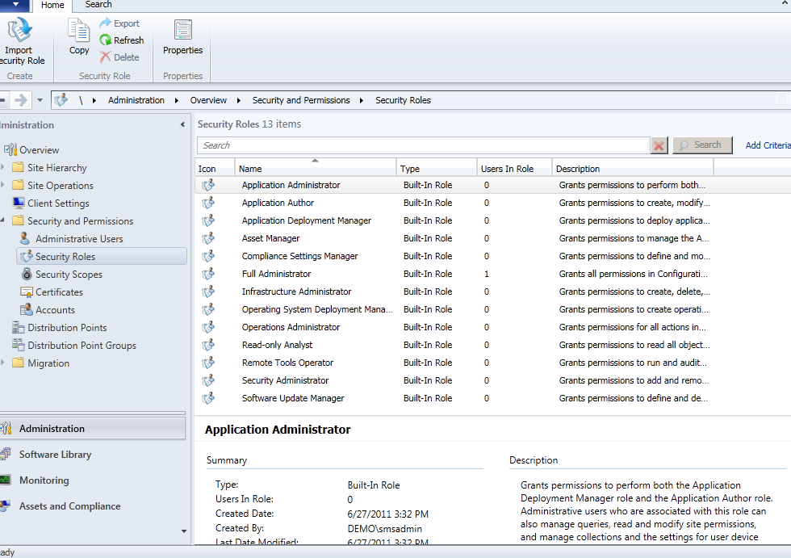
Role-based Access Control
There’s a trend in Microsoft enterprise products, as well as the industry in general, to adopting a role-based approach to administrative security. In SCCM 2012, this means Primary Sites are no longer security boundaries. The new console is controlled by Role-Based Access Control (RBAC), hiding interface elements if the user doesn’t have legitimate access. The administrative tasks are grouped in Security roles. They’re combined with Security scopes to control exactly who can do what, where and when.

Slide 12
User-Centric Management
SCCM2012 changes its focus from systems management to putting the user in the central role and involves end users to give them wider control over what software is installed on their devices and when it gets installed. Users can for instance define their own work-hour pattern so that software installations take place outside thes times.
SCCM 2012 accomplishes this by linking users to particular devices. A device that’s used most often by a person is called a primary device; a user can have more than one of these. Primary user is the main user of the device, and each device can have more than one primary user.

Slide 13
Apps and OS Delivery 1/2
Hand in hand with the new user focus is a new way of delivering applications to users. The idea is to capture the administrators’s intent through requirement rules, deployment purpose and deployment types. The latter can be Windows Installer, Script Installer, Script Installer, Microsoft Application Virtualization, Remote Desktop App or Windows Mobile Cabinet.
An administrator can define that an application should be installed natively on a user's primary device. Should the user log in to a device that’s not his primary device, SCCM 2012 can distribute the apps ad an App-V program or Remote desktop app instead. Dependencies allow you to link one app deployment to another as a prerequisite.
For testing or backup, an application can be exported in its entirety from one 2012 environment to another, and all dependent files are included in the export. Metadata about each application can be harvested from MSI files or manually entered, making it easier for users to find the right application in the Software Catalog.
In SCCM 2007, a separate Status Message Viewer was used to track software installations, in SCCM 2012 the deployment of all software(updates, compliance settings, applications, task sequences, packages and programs) is tracked under Monitoring node.
Pre-flight – testing application without actually deploying it to a client device.

Slide 14
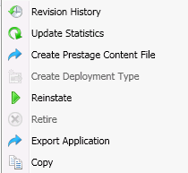
Apps and OS Delivery 2/2
The main improvement in SCCM 2012 for Operating System Deployment(OSD) is that User State Migration Toolkit(USMT) version 4 is now fully integrated into the UI
In SCCM 2007 you had to use the command line to control USMT version 4.
Another improvement is hierarchy-wide bootable media, mitigating the necessity for OSD bootable media to be duplicated in every location.
Offline servicing of images is now automated – updates and patches that are approved can be targeted to the image library to make sure that your OS installs are up-to-date immediately after installation
OLD WAY still supported = packages/programs/advertisements etc
NEW WAY = applications
No need two create two packages/programs, first for install and second for uninstall. NOW ONLY one with two options inside. To uninstall applications SCCM 2012 now uses ‘retirement’, the application can also be ‘reinstated’
Single application can now be deployed with multiple deployment methods! So let’s say you have an application XYZ. You want to deploy this application to your Baseline desktop PC’s as a native application, stream it as an App-v program to your Laptops and make it available as an Remote Desktop Application when an user logs on to a server. All from 1 application.

Slide 15
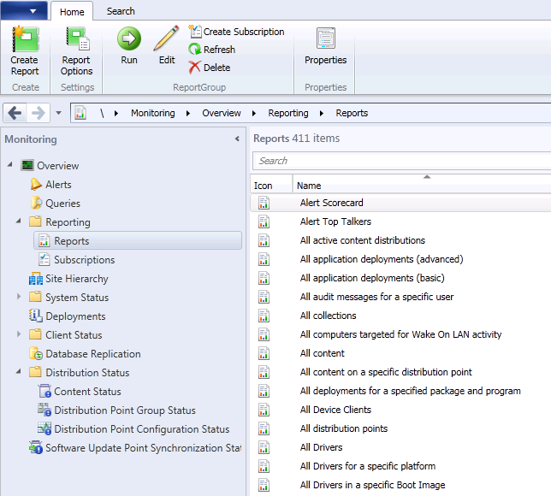
Reporting
Reporting is taken out of SCCM 2012 and is done by SQL 2008 by means of Reporting Services. This is how it should be.
Of course in SCCM 2007 it was also possible, but in SCCM 2012 the Reporting Point does no longer exists.

Slide 16
Inventory
There is no need to modify MOF files. Microsoft is going to rid off MOF files. :-) True or not?
Hardware inventory and software inventory can be easily set up via Client Settings.

Slide 17
Site recovery
Configuration Manager 2007 used the Site Repair Wizard to recover sites.
In Configuration Manager 2012, recovery is integrated in the Configuration Manager 2012 Setup Wizard

Slide 18
Planning a migration from SCCM 2007 to SCCM 2012
Upgrading SCCM 2007 to SCCM 2012 is not supported
Source Hierarchy
Branch Distribution Points
Secondary Sites
Collections
Packages
Server Locator Point
Software Update Point
Reporting Point
Shared Distribution Points
Upgrading Clients

Slide 19
Planning a migration from SCCM 2007 to SCCM 2012
Upgrading SCCM 2007 to SCCM 2012 is not supported
Source Hierarchy
Branch Distribution Points
Secondary Sites
Collections
Packages
Server Locator Point
Software Update Point
Reporting Point
Shared Distribution Points
Upgrading Clients
Due to changes introduced in SCCM 2012, if you want to keep your SCCM data and objects, you have to do a side-by-side migration. This was common when going from SMS 2003 to SCCM 2007 but now Microsoft provides built-in tools to assist with the migration. Before you use these tools, you have to have the new SCCM 2012 hierarchy deployed and functioning. SCCM 2012 introduces no new changes to the Active Directory (AD) Schema from SCCM 2007, so if your AD schema has already been extended for SCCM 2007, you don't have to extend it for SCCM 2012. Just make sure that you don't have overlapping boundaries in AD from the SCCM 2007 and the SCCM 2012 hierarchies. On the SCCM 2012 console, there's a Migration page where you'll specify the Source Hierarchy, which is the SCCM 2007 hierarchy that you want to migrate data and objects from.

Slide 20
Planning a migration from SCCM 2007 to SCCM 2012
Upgrading SCCM 2007 to SCCM 2012 is not supported
Source Hierarchy
Branch Distribution Points
Secondary Sites
Collections
Packages
Server Locator Point
Software Update Point
Reporting Point
Shared Distribution Points
Upgrading Clients
For the source hierarchy you specify the top-level site of the ConfigMgr 2007 hierarchy (must be at SCCM SP2 level). If you have child sites on your SCCM 2007 hierarchy, you can then configure them as additional source sites so you are able to select objects to migrate from them. You can migrate objects from multiple sites into one SCCM 2012 site, allowing you to consolidate sites. You can even migrate data from more than one SCCM 2007 hierarchy and from untrusted AD forests, with the limitation of migrating one hierarchy at a time. Site codes on source and target sites and hierarchies must be unique. You can't re-use site codes from a source hierarchy to the new one.

Slide 21
Planning a migration from SCCM 2007 to SCCM 2012
Upgrading SCCM 2007 to SCCM 2012 is not supported
Source Hierarchy
Branch Distribution Points
Secondary Sites
Collections
Packages
Server Locator Point
Software Update Point
Reporting Point
Shared Distribution Points
Upgrading Clients
The SCCM Branch Distribution Point is no longer available in SCCM 2012. If you are currently using it in your hierarchy, you may want to start thinking about using Windows BranchCache instead.

Slide 22
Planning a migration from SCCM 2007 to SCCM 2012
Upgrading SCCM 2007 to SCCM 2012 is not supported
Source Hierarchy
Branch Distribution Points
Secondary Sites
Collections
Packages
Server Locator Point
Software Update Point
Reporting Point
Shared Distribution Points
Upgrading Clients
If you need to control SCCM traffic from a site server to another location, you can now use the SCCM 2012 distribution point, which includes throttling and scheduling features. You would only need a secondary site if you also need to control traffic sent from client systems to the site server, as the secondary site has a Proxy Management Point. The PXE server role is now part of the Distribution Point. Secondary sites and other system roles have to be manually uninstalled from the SCCM 2007 hierarchy and redeployed on the SCCM 2012 hierarchy.

Slide 23
Planning a migration from SCCM 2007 to SCCM 2012
Upgrading SCCM 2007 to SCCM 2012 is not supported
Source Hierarchy
Branch Distribution Points
Secondary Sites
Collections
Packages
Server Locator Point
Software Update Point
Reporting Point
Shared Distribution Points
Upgrading Clients
Collections containing both users and systems or devices can't be migrated. If you have these collections in SCCM 2007 and you need to migrate them, start separating users from systems. This also applies to linked or sub-collections that may have resources of a type different than the parent. Empty collections are migrated as an organizational folder of the same name. If you select to migrate a collection that is linked to another one or has sub-collections, the dependent collections are automatically selected for migration. Because collections in SCCM 2012 are global data, they are evaluated at each site in the hierarchy. Plan to limit the scope of a collection after it is migrated (by limiting the members to another collection) to avoid having unanticipated members that could be unexpected targets of advertisements targeting the collection. Collection-based migration jobs disable advertisements targeting the collection by default, but this option can be disabled during the migration job configuration.

Slide 24
Planning a migration from SCCM 2007 to SCCM 2012
Upgrading SCCM 2007 to SCCM 2012 is not supported
Source Hierarchy
Branch Distribution Points
Secondary Sites
Collections
Packages
Server Locator Point
Software Update Point
Reporting Point
Shared Distribution Points
Upgrading Clients
Packages and Programs, part of Software Distribution, can be automatically migrated (the metadata of the package objects). For content migration (binary files) see the "Shared Distribution Points" section below. Most of the time, a package setting includes the package source. Ensure that all your packages in the SCCM 2007 hierarchy are using a UNC path as the source file location. App-V packages are converted to applications during the migration but a deployment needs to be created afterwards. Distribution Point Sharing does not apply to App-V packages.

Slide 25
Planning a migration from SCCM 2007 to SCCM 2012
Upgrading SCCM 2007 to SCCM 2012 is not supported
Source Hierarchy
Branch Distribution Points
Secondary Sites
Collections
Packages
Server Locator Point
Software Update Point
Reporting Point
Shared Distribution Points
Upgrading Clients
The Server Locator Point role is scheduled to go away in the RTM version of SCCM 2012, as this functionality is planned to be included in the Management Point (MP) role.

Slide 26
Planning a migration from SCCM 2007 to SCCM 2012
Upgrading SCCM 2007 to SCCM 2012 is not supported
Source Hierarchy
Branch Distribution Points
Secondary Sites
Collections
Packages
Server Locator Point
Software Update Point
Reporting Point
Shared Distribution Points
Upgrading Clients
If you are going to migrate Software Update objects, you must have first deployed a Software Update Point (SUP) on your new SCCM 2012 hierarchy. The new SCCM 2012 SUP must contain the same updates as the SCCM 2007 SUP before the migration. You can use wsusutil.exe to assist you with this. The migration supports converting Update Lists to Update Groups, migrating Deployments to Deployments and Update Groups, and migrating Software Update Packages and Templates.

Slide 27
Planning a migration from SCCM 2007 to SCCM 2012
Upgrading SCCM 2007 to SCCM 2012 is not supported
Source Hierarchy
Branch Distribution Points
Secondary Sites
Collections
Packages
Server Locator Point
Software Update Point
Reporting Point
Shared Distribution Points
Upgrading Clients
The standard Reporting Point role (Web reporting) is no longer supported in SCCM 2012. Only the Reporting Services Point, based on SQL Server Reporting Services (SSRS), is supported. Migrating SCCM 2007 Web reports or SQL Server Reporting Services reports from SCCM 2007 to SCCM 2012 is not supported. Due to this, you may want to start using SQL Server Reporting Services on SCCM 2007 now because you can export these reports to an RDL file and then import it into your SCCM 2012 hierarchy. You can copy your standard Web reports in your SCCM 2007 hierarchy to SQL Reporting Services on the same hierarchy to help you prepare.

Slide 28
Planning a migration from SCCM 2007 to SCCM 2012
Upgrading SCCM 2007 to SCCM 2012 is not supported
Source Hierarchy
Branch Distribution Points
Secondary Sites
Collections
Packages
Server Locator Point
Software Update Point
Reporting Point
Shared Distribution Points
Upgrading Clients
One of the migration tools offered by Microsoft is to be able to share Distribution Points (DP) from the SCCM 2007 hierarchy with the SCCM 2012 hierarchy. This way, you can deploy software to clients that have been migrated to SCCM 2012 without having to push the content of packages to an SCCM 2012 DP, as they can obtain content from the shared SCCM 2007 DP. Once the migration completes, it is not supported to keep sharing the DPs as a DP can be shared only when the SCCM 2007 hierarchy where the shared DP belongs to remains as the active source hierarchy. The exception to what can be shared from an SCCM 2007 DP are boot images and App-V content. Note that upgrading an SCCM 2007 DP to SCCM 2012 automaticaly is supported (except branch DPs) as long as the DP is the only SCCM role on the system and there's sufficient free disk space as used space will be doubled during the upgrade from the old SMSPKG$ share to the SCCM 2012 content library. You can also manually upgrade an SCCM 2007 DP by uninstalling it, then deploy it in the SCCM 2012 hierarchy and use the new pre-stage content feature to get the content of packages to it.

Slide 29
Planning a migration from SCCM 2007 to SCCM 2012
Upgrading SCCM 2007 to SCCM 2012 is not supported
Source Hierarchy
Branch Distribution Points
Secondary Sites
Collections
Packages
Server Locator Point
Software Update Point
Reporting Point
Shared Distribution Points
Upgrading Clients
The minimum operating system requirement for the SCCM 2012 client is Windows XP SP2 (x64) and SP3 (x32). The documentation may call it an upgrade but really the SCCM 2007 client is not upgraded to the SCCM 2012 client. The SCCM 2007 client is actually uninstalled, and then the SCCM 2012 client is installed. The client's inventory data is not migrated so once the SCCM 2012 client is installed, it has to do send full inventory data to the SCCM database. Do to this, plan to migrate the clients in controlled phases as to not to overload your network. The SCCM 2012 client is now x64 platform but x32 is supported. The .Net Framework 4.0 is a requirement for the SCCM 2012 client, and it is installed automatically during the installation of the client. Because the installation of the .Net Framework 4.0 takes some time, you may want to pre-deploy it to the clients. The client's SMS GUID and execution history is kept during the uninstall/reinstall so the system with the new SCCM 2012 client does not rerun advertisements that it has already run. Client's historical inventory data is not kept. If you need this historical data, you would need to keep an SCCM 2007 site active after migration until this data is no longer needed.

Slide 30
Planning a migration from SCCM 2007 to SCCM 2012
What CAN'T be migrated
The following objects must be recreated at the SCCM 2012 hierarchy: Queries, Security rights and instances for the site and objects, SCCM reports (Web or SQL based), client inventory and history data…..

Slide 31
Short demo !!!
Mariusz Zarzycki
PhD, MCT, MCTS, MCSE, MCITP, MCSA
mariusz.zarzycki@interia.pl
BLOG: http://www.e-zarzycki.com

Slide 32
Discussion
Thank You for Your Attention
Q & A

