Slide 1
Configuration Manager 2012: Technical Overview
Kim Oppalfens Principal Consultant Inovativ

Slide 2
Session Takeaways
Review the major themes for ConfigMgr 2012
Migration from ConfigMgr 2007 to ConfigMgr 2012
Steps to prepare now

Slide 3
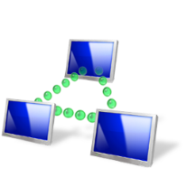
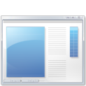





Configuration Manager 2012
Empower Users
Unify Infrastructure
Simplify Administration
Empower people to be productive from anywhere on whatever device they choose
Reduce costs by unifying IT management infrastructure
Improve IT effectiveness and efficiency
Device freedom
Optimized, personalized application experience
Application self-service
Mobile, physical, and virtual management
Security and compliance
Service management integration
Comprehensive client management capabilities
Improved administrator effectiveness
Reduced infrastructure complexity

Slide 4
System and User-Centric
Configuration Manager 2007 | Configuration Manager 2012
Optimized for Systems Management scenarios | Still committed and focused on System Management scenarios
Challenging to manage users: Forced to translate a user to a device Explicit: run a specific program on a specific device | Embrace User Centric scenarios: Moving to a state based design, for apps, deployments, content on DPs. Full application lifecycle model. Install, Revision Mgt, Supersedence and Uninstall
Software Distribution is a glorified script execution | Understand and intelligently target the relationships between user systems Management solution tailored for applications

Slide 5
Embracing User Centric: Administrator Promises
Let the administrator think user first
Deploy applications to users
Manage users beyond the desktop
ConfigMgr maintains relationship between users and systems to solve core user targeting
Set conditions to control installations
Schedule ‘Pre-deploy’ to users’ primary devices for WoL, off-hrs, workgroup, etc.
ConfigMgr will remember the relationship between the user and their applications
Application model captures ‘administrative intent’

Slide 6
Application Model
Manage applications; not scripts
Application Management:
Detection method – re-evaluated for presence:
Required application – reinstall if missing
Prohibited application – uninstall if detected
Requirement rules – evaluated at install time to ensure the app only installs in places it can, and should
Dependencies – relationships with other apps that are all evaluated prior to installing anything
Supersedence – relationships with other apps that should be uninstalled prior to installing anything
Update an app – Automatic revision management

Slide 7
User Centric – Operating System Deployment
Support for new software distribution features during operating system deployment
Evaluate application requirement rules, dependencies and supersedence
User Device Affinity support – install applications deployed to the primary user

Slide 8
User Centric – Understanding Virtual Desktop Platform
As Citrix XenDesktop and Microsoft RDS integrates, then
Conditional rules for application deployment are available (Desktop Type, Pool Name)
Gather inventory from Guest VM for Broker Site Name, Desktop Type and Pool Name and exposed for compliance monitoring and inventory reports
ConfigMgr uniqueness is persisted through Pooled VM shutdown and startup
Randomization of schedules automatically for any client:
Hardware Inventory scan
Software Inventory scan
Software Update scan, download and install

Slide 9

User Centric – Device Management
Managing users means managing beyond desktops with “Single pane of glass” administration
Reaching beyond Windows platforms
“Depth”
Broad feature set
Common administration model for mobile devices, desktops, and servers
“Light”
Provides basic management for all Exchange ActiveSync (EAS) connected devices

Slide 10
“Depth” Mobile Device Management
Extend and align mobile device management
Integration of System Center Mobile Device Manager and ConfigMgr 2007 features
Enable secure, compliant mobile devices
Secure over-the-air enrollment
Monitor and remediate out-of-compliance devices
Deploy and remove applications
Inventory

Slide 11
“Light” management via Exchange
Provide basic management for all Exchange ActiveSync (EAS) connected devices
Features Supported:
Discovery/Inventory
Settings policy
Remote Wipe
Supports on-premise Exchange 2010 and hosted Exchange

Slide 12

Embracing User Centric: End-User Promises
“A Fitting End-User Experience”
Web based ‘Software catalog’
Easily search, install or request software
Choose software intelligently:
Clear, consistent information about applications and their impact, supported by App model
User preferences to control ConfigMgr behaviors:
“My business hours” – used to control when to install software
Presentation mode – don’t notify when presenting
Remote control settings – when allowed, end user can control their experience

Slide 13
User Centric Client Management: The Application Model
demo

Slide 14
Configuration Manager 2012
Empower Users
Unify Infrastructure
Simplify Administration
Empower people to be productive from anywhere on whatever device they choose
Reduce costs by unifying IT management infrastructure
Improve IT effectiveness and efficiency
Device freedom
Optimized, personalized application experience
Application self-service
Mobile, physical, and virtual management
Security and compliance
Service management integration
Comprehensive client management capabilities
Improved administrator effectiveness
Reduced infrastructure complexity

Slide 15
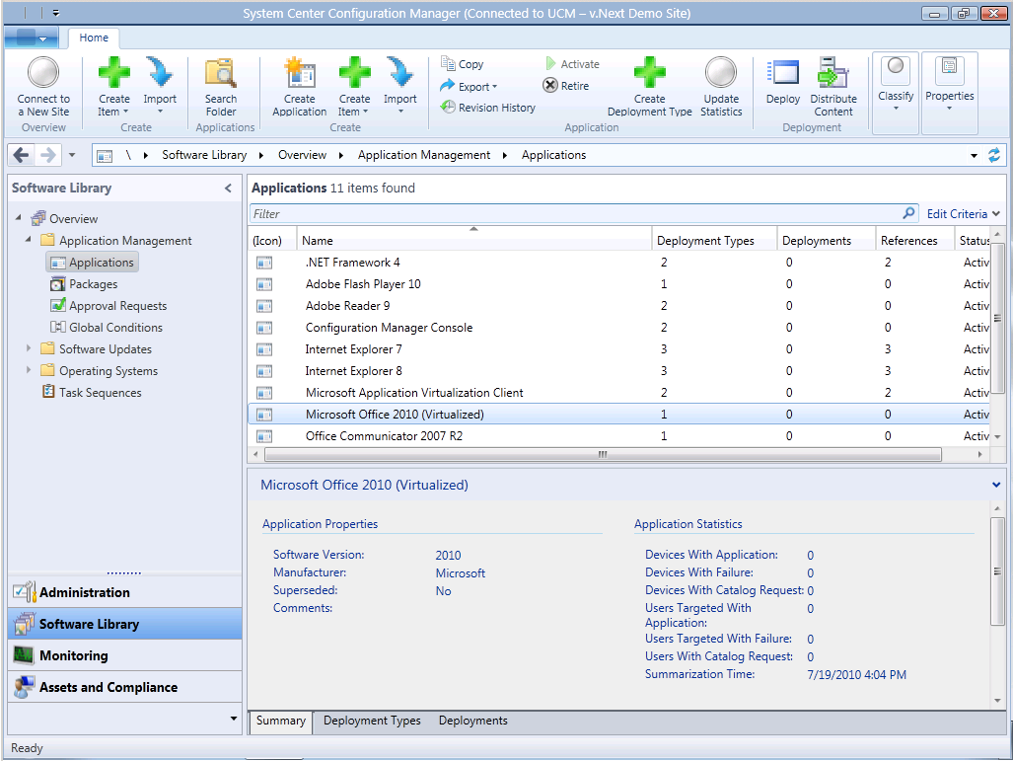
Administrator Experience
Common look and feel across System Center products
Improved discoverability
Only show what is relevant to the administrative role
Complete scenarios within the console
Simplified navigation

Slide 16
Role-Based Administration
Central management for security
Role-Based Administration lets you map the organizational roles of your administrators to defined security roles:
Removes clutter from the console
Supports “Show me what’s relevant to me” based on my Security Role and Scope
Functionality | ConfigMgr 2007 | ConfigMgr 2012
What types of objects can I see and what can I do to them? | Class rights | Security roles
Which instances can I see and interact with? | Object instance permissions | Security scopes
Which resources can I interact with? | Site specific resource permissions | Collection limiting

Slide 17
Collection Enhancements
Easier to organize collections
Organizational folders for collections
Reduce complex query logic
New membership rules: Exclude and include other collections
Resources security based on collection, not site
Collection scopes
Improved UI validation for user centric scenarios
Device and User Collections

Slide 18
Collections
demo

Slide 19
Infrastructure Promises
Modernizing Architecture
Minimizing infrastructure for remote offices
Consolidating infrastructure for primary sites
Scalability and Data Latency Improvements
Central Administration Site is just for administration and reporting – Other work distributed to the primaries as much as possible
File processing occurs once at the Primary Site and uses replication to reach other sites (no more reprocessing at each site in the hierarchy)
System-generated data (HW Inventory and Status) can be configured to flow to CAS directly
Be Trustworthy
Interactions with SQL DBA are consistent with ConfigMgr 2007
ConfigMgr admin can monitoring and troubleshoot new replication approach independently

Slide 20



When Do I Need a Primary Site?
To manage any clients
Add more primary sites for:
Scale (more than 100,000 clients)
Reduce impact of primary site failure
Local point of connectivity for administration
Political reasons
Content regulation
Decentralized administration
Logical data segmentation
Client settings
Language
Content routing for deep hierarchies

Slide 21
Reducing Primary Sites
Unique ConfigMgr 2007 Primary Site for: | ConfigMgr 2012 solutions (no unique primary sites):
Decentralized administration | Role Based Administration
Logical data segmentation | Role Based Administration
Client settings | Client settings for the hierarchy and unique collections
Language | Language packs
Content routing for deep hierarchies | Secondary Sites or Distribution Points

Slide 22
Infrastructure Changes: Content
ONE Distribution Point
PXE Service Point – Increased scalability beyond the ConfigMgr 2007 limit of 75 PXE service points per site
Multicast option
Throttling and scheduling of content to that location
Pre-stage of content and specify specific drives for storage
Improved Distribution Point Groups
Manage content distribution to individual Distribution Points or Groups
Content automatically added or removed from Distribution Points based on Group membership
Associate Distribution Point Groups with a collections to automate content staging for software targeted to the collection
No Branch DPs - DPs can be installed on clients and servers now

Slide 23

Boundaries
Boundaries represent network topology – used to optimized network utilization
Clients use boundaries to:
Automatically determine site assignment
Locate the best management point (MP)
Locate the best distribution point (DP) or state migration point (SMP)
Define separate boundaries for client activities versus content

Slide 24
Boundary Management
Automatically created with the Forest Discovery method
Discovers AD Sites, IP Subnets, IPv6 Prefix type boundaries
Can automatically add as boundaries immediately or add later
Boundaries are members of one or more groups:
Groups support: site assignment, site system look-ups or both
Create group with boundaries in one step
Add boundaries to an existing group
Multi-select and reflective views supported

Slide 25
Hierarchy View and Site Status
demo

Slide 26
Configuration Manager 2012
Empower Users
Unify Infrastructure
Simplify Administration
Empower people to be productive from anywhere on whatever device they choose
Reduce costs by unifying IT management infrastructure
Improve IT effectiveness and efficiency
Device freedom
Optimized, personalized application experience
Application self-service
Mobile, physical, and virtual management
Security and compliance
Service management integration
Comprehensive client management capabilities
Improved administrator effectiveness
Reduced infrastructure complexity

Slide 27
Client Activity and Health
Product integrated health and remediation solution
Server side metrics for evaluating client activity:
Policy Requests
Hardwate and software Inventory
Heartbeat DDRs
Status Messages
Client side monitoring/remediation for:
Dependent Windows components and services
ConfigMgr client prerequisites
WMI Repository and namespace evaluation
In console and Web reporting
‘In-console’ alerts when healthy/unhealthy ratio drops below configurable threshold

Slide 28
Client Activity and Health
demo

Slide 29
Software Updates
Auto Deployment Rules
Use search criteria to identify class of updates to automatically deploy: category, products, language, date revised, article id, bulletin id, etc.
Schedule content download and deployment based on sync schedule or define a separate schedule per rule
State-based Update Groups
Deploy updates individually or in groups
Updates added to an update group automatically deploy to collections targeted with the group

Slide 30
Operating System Deployment
Offline Servicing of Images
Support for Component Based Servicing compatible updates
Uses updates already approved
Boot Media Updates
Hierarchy wide boot media – no longer need one per site
Unattended boot media mode – no longer need to press “next”
Use pre-execution hooks to automatically select a task sequence – no longer see many optional task sequences
USMT 4.0 - UI integration and support for hard-link, offline and shadow copy features

Slide 31
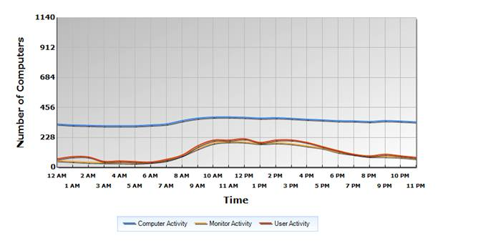
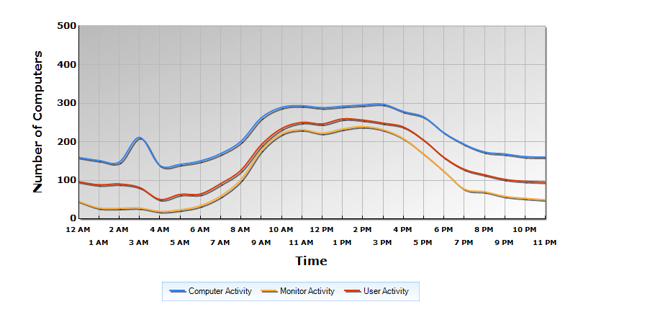
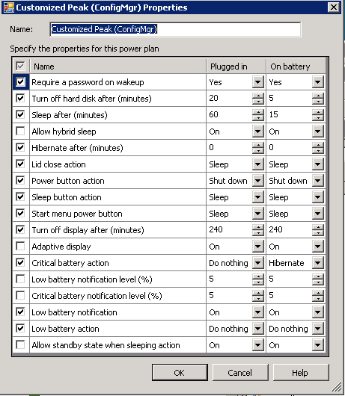
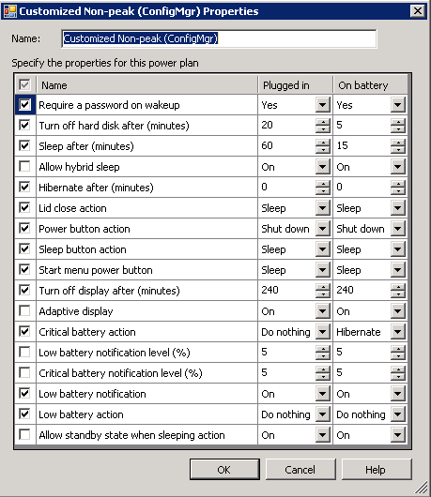
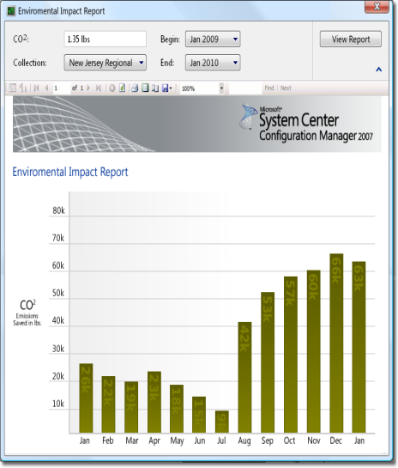
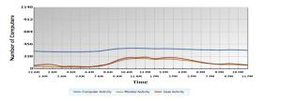
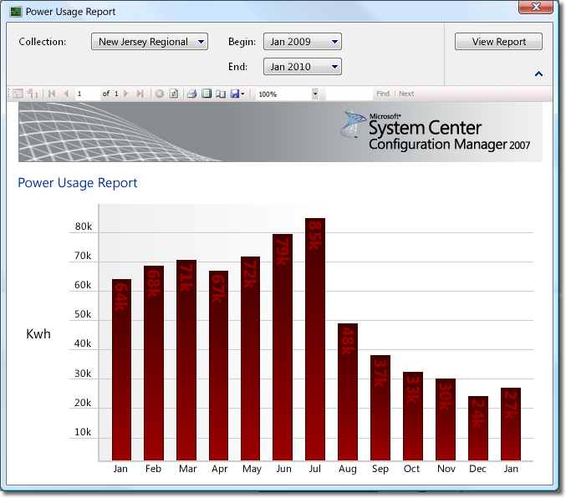
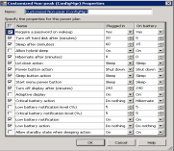
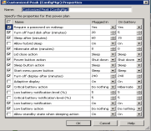


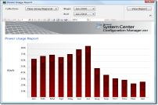
Power Management
Phase 1: Monitor
Enable client management agent
Begin monitoring usage and activity
Phase 2: Plan
Continue monitoring on usage and activity
Begin to develop Power Plan
Mid-Month:
Power Plan has been confirmed
Phase 3: Apply Power policy
Begin applying Power Plan
Phase 4: Compliance & Analyze
Review before and after usage and activity
Determine savings in Kwh and Co2 saved
Non-Peak & Peak

Slide 32
Settings Management
Unified settings management across servers, desktops and mobile devices
ConfigMgr 2007 reports configuration drift – ConfigMgr 2012 can “set” for Registry, WMI and Script-Based
Improved functionality:
Copy settings
Define compliance SLAs for Baselines to trigger console alerts
Richer reporting to include troubleshooting, conflict, remediation information
Enhanced versioning and audit tracking
Ability to specify specific versions to be used in baselines
Audit tracking includes who changed what

Slide 33
Settings Management
demo

Slide 34
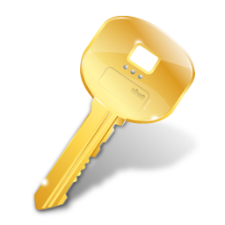
Remote Control
IS BACK!
Send Ctrl-Alt-Del to host device to regain previous feature parity

Slide 35
Migration from ConfigMgr 2007 to 2012
Assist with Flattening of Hierarchy
Assist with Migration of Objects
Assist with Migration of Clients
Maximize Re-usability of x64 Server Hardware
Minimize WAN impact

Slide 36
Built-in Migration Feature
Migration Job Types:
Object Migration (Collections, software distribution packages, boundaries, metering rules etc.)
Collection based Migration (Select a collection and migrate associated objects)
Content functionality:
Re-use of existing ConfigMgr 2007 content (Distribution Point sharing)
Distribution Point upgrade
Import of ConfigMgr 2007 inventory MOF files

Slide 37
Minimum System Requirements:
Component | Minimum Requirement
Site Server and Site Roles | Windows Server 2008 (64-bit ) Windows Server 2008 R2 (64-bit)
Database | SQL Server 2008 SP1 & Cumulative Update 10+ (64-bit)
Distribution Point | Windows Server 2003 (including 32-bit) with limited functionality Windows Vista SP2 and later (including 32-bit)
Client | Windows XP SP2 & SP3 (32-bit & 64-bit) Windows 2003 Server SP2 (32-bit & 64-bit) Vista SP2 (32-bit & 64-bit) Windows 7 RTM (32-bit & 64-bit) Windows 7 SP1 (32-bit & 64-bit) Windows 2008 SP2 (32-bit & 64-bit) Windows 2008 R2 RTM (64-bit) Windows 2008 R2 SP1(64-bit)
Admin Console | Vista SP2 (32-bit & 64-bit) Windows 7 RTM (32-bit & 64-bit) Windows 7 SP1 (32-bit & 64-bit) Windows 2008 SP2 (32-bit & 64-bit) Windows 2008 R2 RTM (64-bit) Windows 2008 R2 SP1(64-bit)

Slide 38
Prepare for Configuration Manager 2012
Flatten hierarchy where possible
Plan for Windows Server 2008, SQL 2008, and 64-bit
Start implementing BranchCache™ with Configuration Manager 2007 SP2
Move from web reporting to SQL Reporting Services
Avoid mixing user and devices in collection definitions
Use UNC (\\server\myapp\myapp.msi) in package source path instead of local path (d:\myapp)

Slide 39
Things you Can Do Next
Download the beta of ConfigMgr 2012 – here
Download the VHDs – here
Work through the TechNet Virtual Labs – here
Participate in the Community Evaluation Program
Join the Conversation on Twitter (#sysctr)
Follow our blog and website
Program overview is here

Slide 40

© 2011 Microsoft Corporation. All rights reserved. Microsoft, Windows, Windows Vista and other product names are or may be registered trademarks and/or trademarks in the U.S. and/or other countries.
The information herein is for informational purposes only and represents the current view of Microsoft Corporation as of the date of this presentation. Because Microsoft must respond to changing market conditions, it should not be interpreted to be a commitment on the part of Microsoft, and Microsoft cannot guarantee the accuracy of any information provided after the date of this presentation. MICROSOFT MAKES NO WARRANTIES, EXPRESS, IMPLIED OR STATUTORY, AS TO THE INFORMATION IN THIS PRESENTATION.

