Slide 1
SCCM OSD
Richard Zuraff
General Mills
Richard.Zuraff@genmills.com

Slide 2
Task Sequence
SCCM Task Sequence
Install Existing Image Package
Build and Capture OS
Custom Task Sequence
MDT Integrated Task Sequence
Client Task Sequence
Client Replacement Task Sequence
OEM reload Task Sequence (Pre-OEM)
OEM reload Task Sequence (Post-OEM)
MDT Custom Task Sequence
Server Task Sequence

Slide 3
General Mills Image
Three Images
Granite Image (Desktops & Laptops)
Developer Image (Granite Image + Developer Apps)
Citadel Image (Used for Plant Floor Forklifts)
Three Step Build and Deploy method using SCCM
Base Image build
Granite or Developer Image Build
Deployment phase

Slide 4
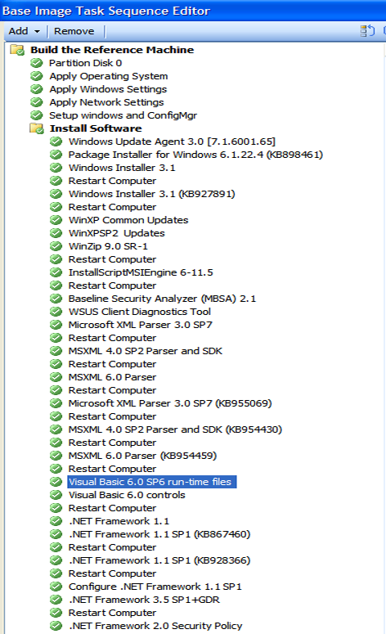

Slide 5
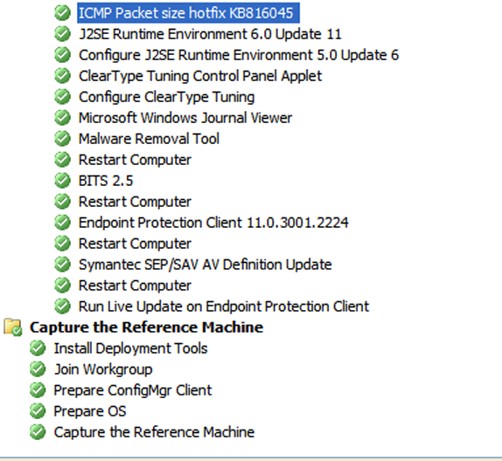
Base Image Continued

Slide 6
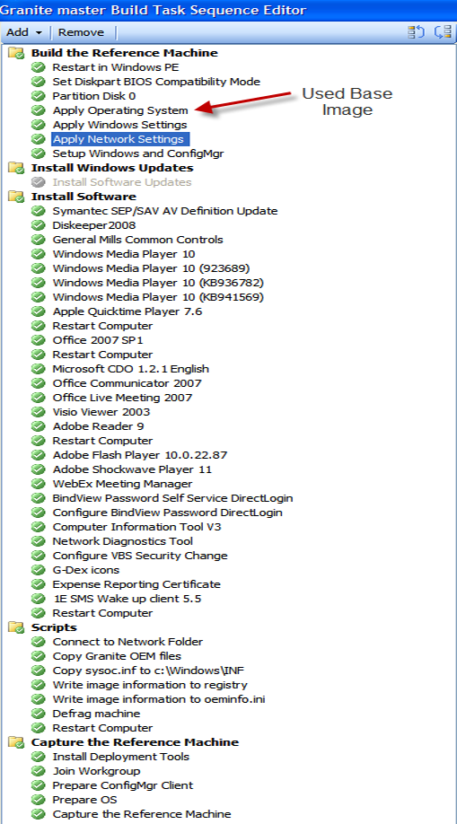

Slide 7
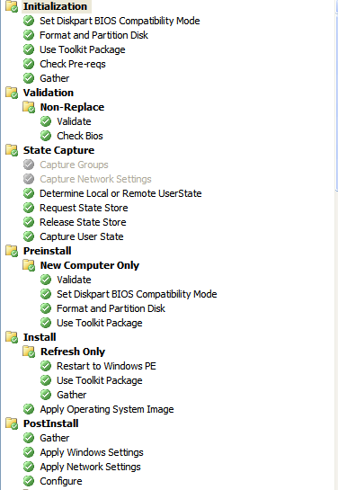
Deployment Task Seq

Slide 8
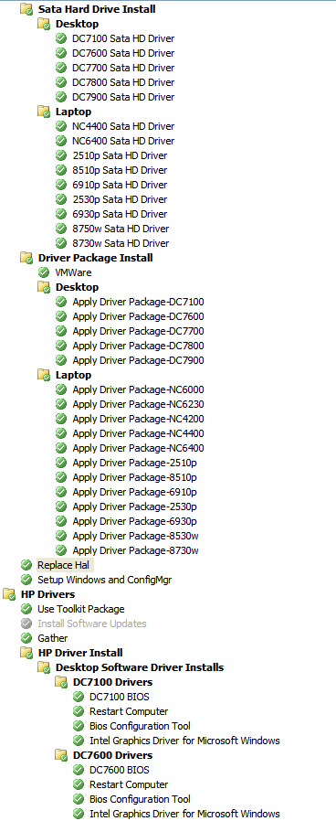

Slide 9
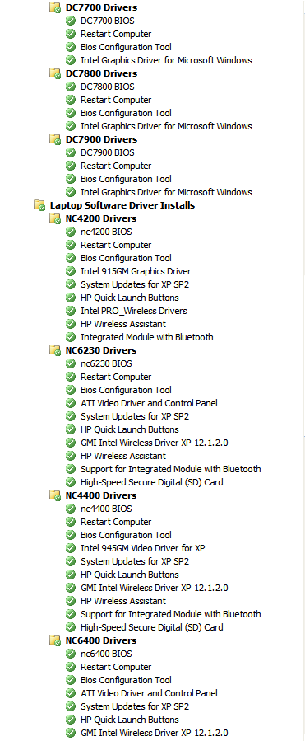

Slide 10
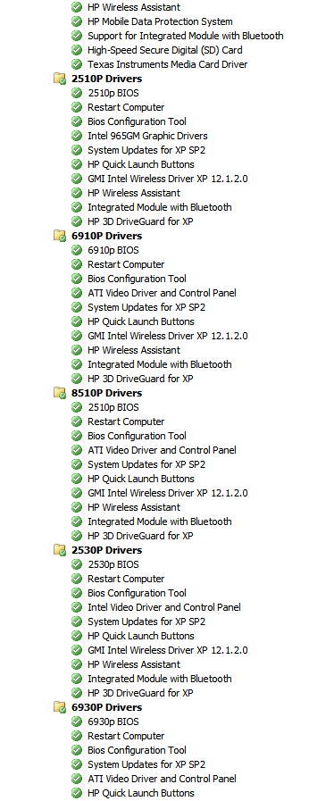

Slide 11
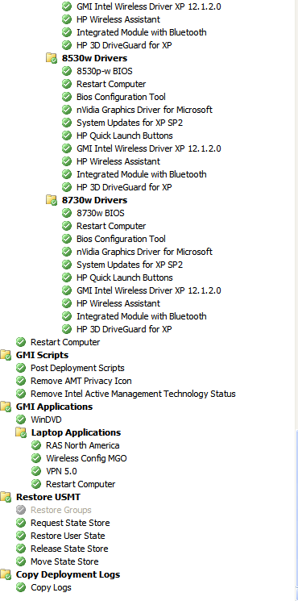

Slide 12
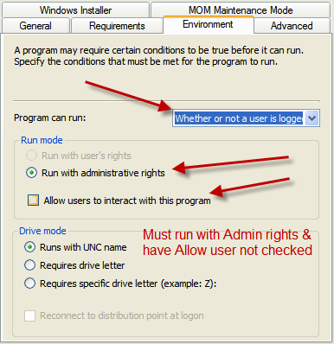
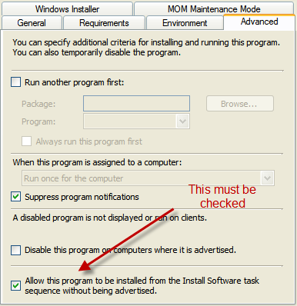
Requirements for Task seq Program

Slide 13
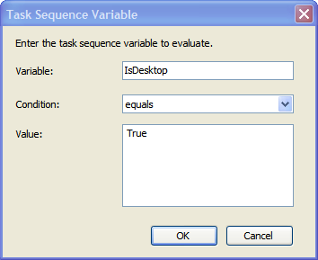
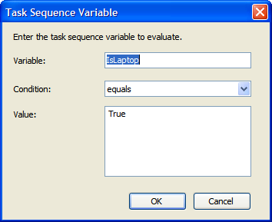
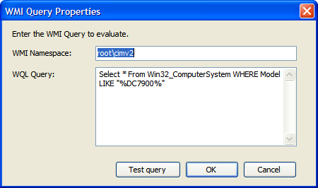
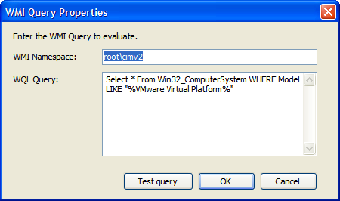
WMI & Task Seq Variables

Slide 14
Force Auto Detect Site Code
VBScript code below
Set oSMSClient = CreateObject ("Microsoft.SMS.Client") oSMSClient.SetAssignedSite oSMSClient.AutoDiscoverSite,0

Slide 15
Drivers
Software Based
INF Based
Boot CD
Importing drivers vs. not importing drivers

Slide 16
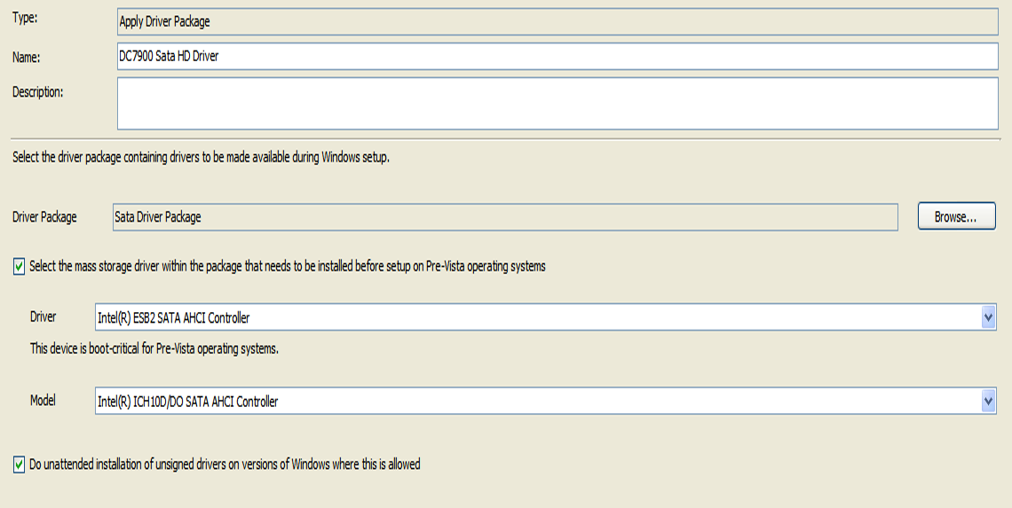
Injecting SATA HD Drivers

Slide 17
Applications
Mapping table
Role based
User based

Slide 18
Good Places for help
MYITFORUM.COM
command@lists.myitforum.com
Put Subscribe mssms in body of e-mail
DeployVista.com
Using Roles to deploy Applications based on previous Applications
http://www.myitforum.com/articles/42/view.asp?id=12472
OSD App Chooser
http://myitforum.com/cs2/blogs/jsandys/archive/2008/11/28/osd-application-chooser.aspx
http://blogs.technet.com/mniehaus/

Slide 19
Hal Replacement Script
http://www.myitforum.com/articles/15/view.asp?id=8997
Microsoft Deployment Toolkit Wizard Editor
http://myitforum.com/cs2/blogs/hemsell/archive/2009/03/20/microsoft-deployment-toolkit-wizard-editor-part-1-introduction.aspx
Sample Operating System Deployment Task Sequence Scenario
http://technet.microsoft.com/en-us/library/bb633208.aspx
MDT – quick start guide
http://www.microsoft.com/downloads/details.aspx?FamilyId=3BD8561F-77AC-4400-A0C1-FE871C461A89&displaylang=en - Getting Started with MDT 2008 Update 1.zip
MyItForum – Wiki on OSD
http://www.myitforum.com/myITWiki/OSD.ashx
Deployment Guys
http://blogs.technet.com/deploymentguys/
Michael Niehaus blog
http://blogs.technet.com/mniehaus/
Johan blog
http://deployvista.com
Deploymentforum
www.deploymentforum.com
Richard Scott – webcast demo
http://www.deploymentforum.com/Library/Webcasts/tabid/202/articleType/ArticleView/articleId/18/Using-MDT-2008-and-SCCM-2007-for-ZTI.aspx
Article on PXE Service Point
http://technet.microsoft.com/en-us/library/bb680753.aspx
http://technet.microsoft.com/en-us/library/bb632928.aspx
This blog talks about the difference between thick and thin images - http://ihaveablog.wordpress.com/

Slide 20
Things I’ve Learned along the way
WMI issue with server 2003
Task seq will error when opening TS to edit due to many steps in TS
Set WMI like server 2008
Task seq is ran as system account not local admin
Anything applied against local admin profile will not take due to running as system account.
90 sec delay between software install task seq
http://support.microsoft.com/kb/955955

Slide 21
Getting error 256 in the log, but package installs or errors out.
Due to package trigger not reporting an exit code
Wrap the package or use batch\VBScript to trigger with exit code.
Imported drivers into SCCM
You can only delete one driver at a time.

