Slide 1
ITL – Project
Topic :- COVID-19 Tracker
Prasad Labade (SYCO-A3) : 22120234
Manish Tambe (SYCO-A3) : 22120186
Pratiksha Gurram (SYCO-A3) : 22120206
Shrutika Wagh (SYCO-A3) : 22120219

Slide 2
COVID-19 Tracker
The Covid-19 Tracker is a project made using Python and Tkinter. This projects intends to acquire present (live) information about coronavirus disease (COVID-19) using an API and displaying the information on various tkinter windows. The project displays information for approximately more than 200 countries.
The project also has a user authentication. In order to use the application a user has to signup to the application and use the credentials to access the application further. The project is binded with validations and local database server for better authentication.

Slide 3
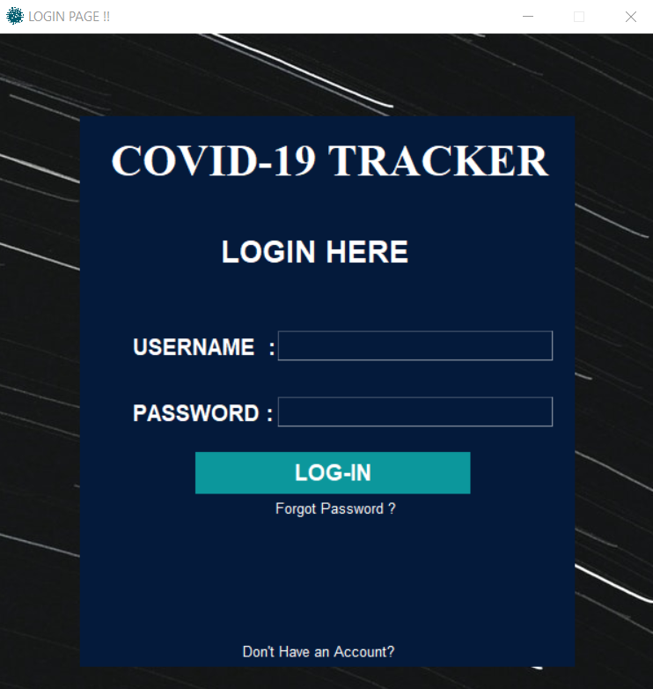
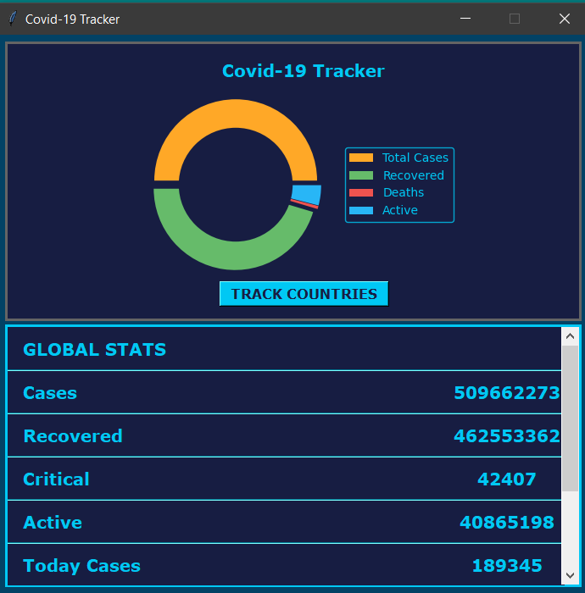
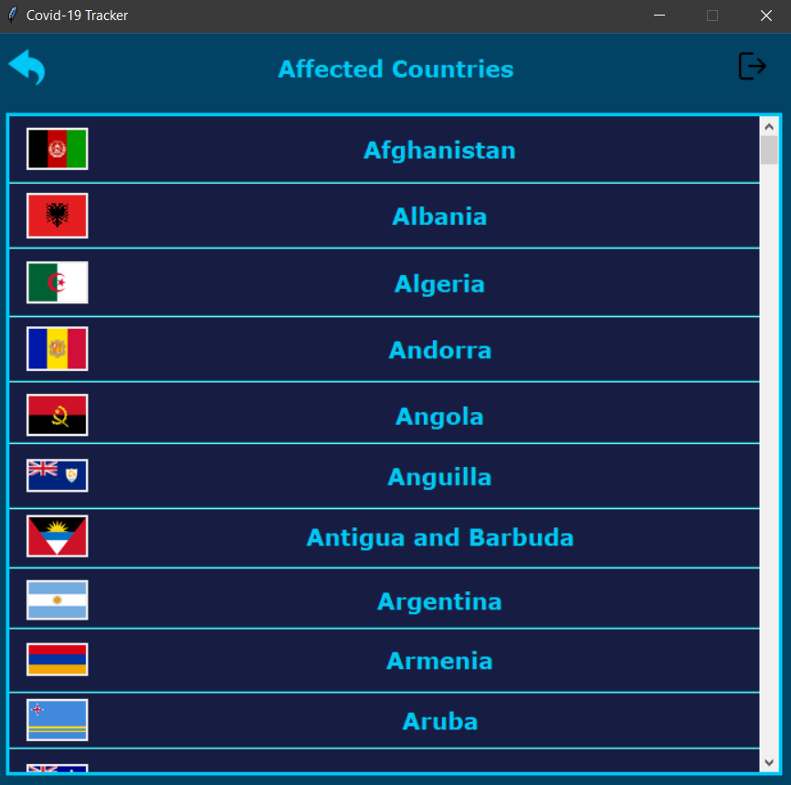
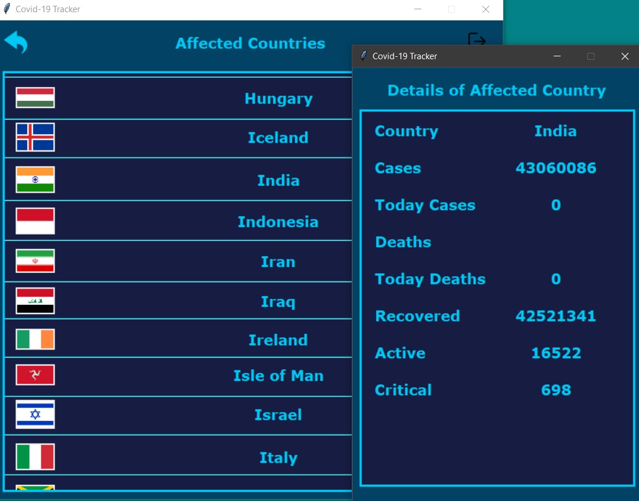
Snapshots

Slide 4
Conclusion
Thus , we can conclude that the development of COVID-19 Tracker helped us to learn multiple aspects of python as well tkinter. We learnt to fetch and use data from an API in our project. We learnt to use tkinter with python to create attractive User interfaces. We learnt to embed authentication for different textfeilds. We also learnt to use database with python to enrich the project.
Except technical part we also learnt to work as a team and help other teammates if they face any difficulty.

Slide 5
THANK YOU

