Slide 1
IBM University Engagement Project Submission
“Exploring the Power of Agentic AI with IBM Granite and IBM Bob”

Slide 2

Project Tile – Smart Study Generator Agent
Domain of Project – Students today face an overwhelming flood of information
Student Name | Recent Passport Photo | Email ID | Mobile number [WhatsApp]
GUDIVADA PRASAD |  | gudivadaprasad95@gmail.com | 8712128104
Recommended font style and size:
Font Style: Arial
Font Size (Heading): 28
Font Size (Content): 20

Slide 3
Problem Statement -
Problem Statement : Smart Study Generator Agent
The Challenge
Students today face an overwhelming flood of information—lecture notes, textbooks, research papers, YouTube tutorials, and online resources. This content is scattered, unorganized, and often not personalized to their learning pace or style. As a result, students struggle with finding the right study material, summarizing key concepts, and staying exam-ready. Traditional study tools only provide static notes or flashcards, failing to adapt dynamically to student needs. The challenge is to move beyond static resources toward an intelligent, adaptive study companion.
The Objective
Build an agentic AI-powered Smart Study Generator that personalizes and streamlines learning for students. The solution should:
Fuse Learning Resources: Aggregate content from class notes, textbooks, research articles, and online tutorials into structured, easy-to-digest study material.
Enable Multimodal Input: Allow students to upload notes, voice queries, or images (e.g., textbook pages), and generate concise summaries, flashcards, or concept maps.
Create a Predictive & Agentic Layer: Recommend personalized study plans, highlight important topics based on syllabus or past exams, and provide predictive alerts (e.g., “Focus on Topic X—frequently asked in exams”).
Visualize Study Progress: Offer a real-time dashboard showing learning milestones, weak areas, practice quizzes, and performance forecasts.

Slide 4
Proposed Solution -
Proposed Solution: Smart Study Generator Agent
System Overview
The Smart Study Generator Agent is an AI-powered, multi-modal study companion built with Streamlit and IBM watsonx.ai, using Meta Llama 3.3 70B Instruct as its foundation model. Students upload their study material in any form — PDF, DOCX, plain text, image (via OCR), or voice recording — through the study_material.py ingestion page. That raw content is then passed to the granite_ai.py module, which drives six distinct AI-generation pipelines: smart summarisation (four styles — concise, detailed, ELI5, and exam-ready), flashcard generation (structured Q&A JSON), multiple-choice quiz generation with difficulty levels, concept map extraction, a personalised study plan builder, and topic-aware exam prediction alerts. All model calls are made via the ibm-watsonx-ai SDK with parameter-level control over temperature, top-p, and token limits, and the model client is cached with @st.cache_resource to avoid redundant initialisation across Streamlit reruns.
User Experience & Architecture
The application is structured as a single-file Streamlit router (app.py) that dispatches to eight page modules — Home, Study Material, Flashcards, Quiz, Concept Map, Study Plan, Ask Tutor, and Dashboard — each rendered independently under a shared dark-themed CSS design system. Students navigate through a persistent sidebar that also surfaces live quick-stats (cards reviewed, quizzes taken, streak, and average score) pulled from session state via utils.py. The Ask Tutor page provides a conversational AI interface where students can ask free-form questions with their uploaded material as grounding context, while the Dashboard aggregates quiz scores, study time, and progress trends using plotly charts. The stack is intentionally lightweight — no database, no backend server — making it fully deployable on Streamlit Community Cloud with nothing but a requirements.txt and valid IBM watsonx.ai credentials.

Slide 5
Technology Used
IBM Bob platform -For designing and orchestrating multi-agent workflows visually
IBM Grainte model - for eg – ibm-granite-3-2-8b – For natural language understanding, reasoning, and personalization
IBM Cloud – It provides the infrastructure to build, deploy, and scale the Nutrition Agent efficiently. IBM Cloud enables a reliable, secure, and scalable environment for deploying the Nutrition Agent.
RAG– RAG to fetch real data first, then generate intelligent answers, making the Nutrition Agent more trustworthy and effective.
IBM Watsonx.ai - For model deployment, embeddings, and AI governance
Vector Database (FAISS/Chroma) – For RAG-based nutritional data retrieval

Slide 6
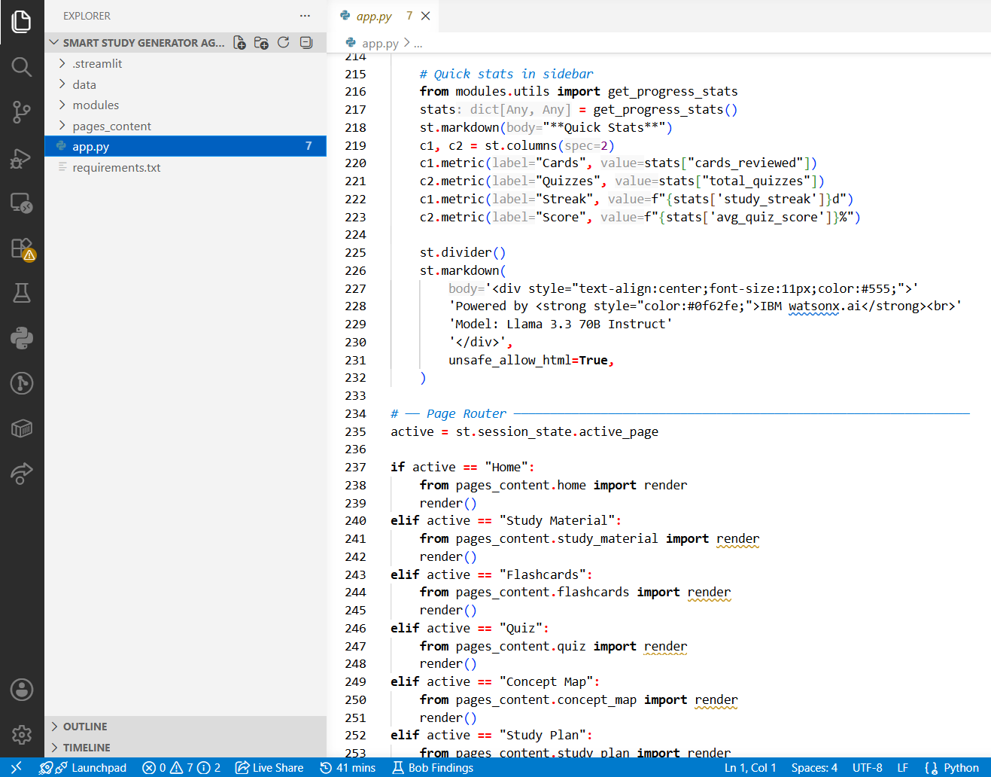
Required Files created using IBM bob -

Slide 7
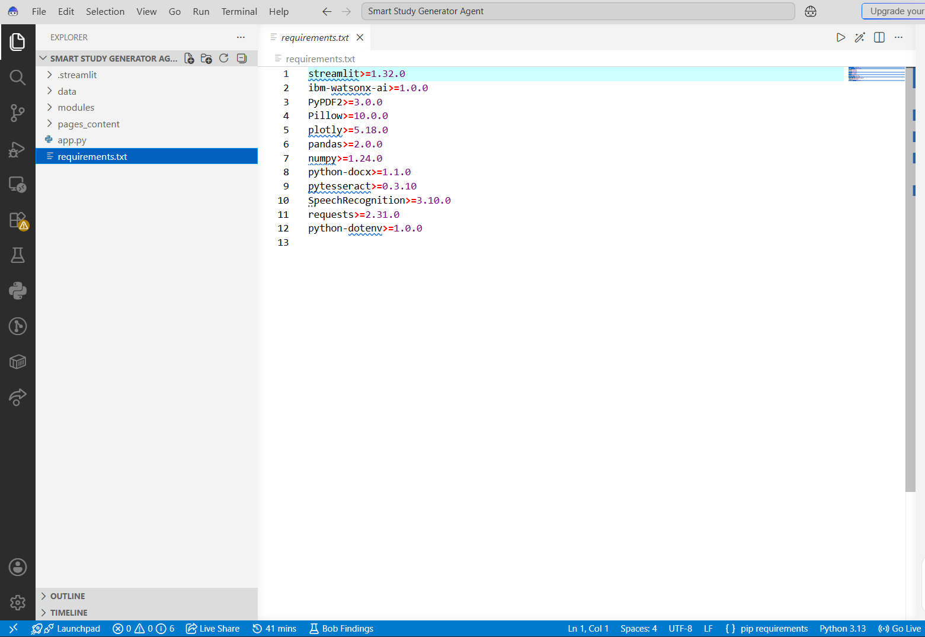
Required Files created using IBM bob -

Slide 8
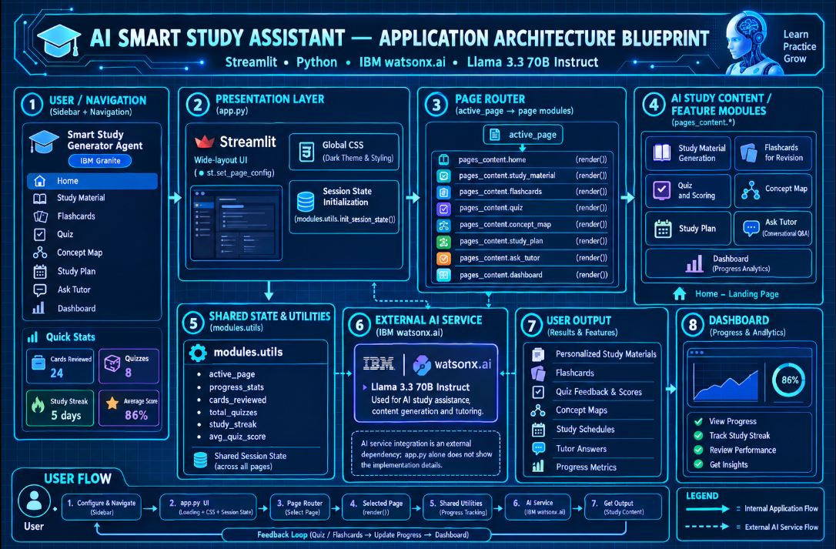
Architecture blueprint for IBM bob:

Slide 9
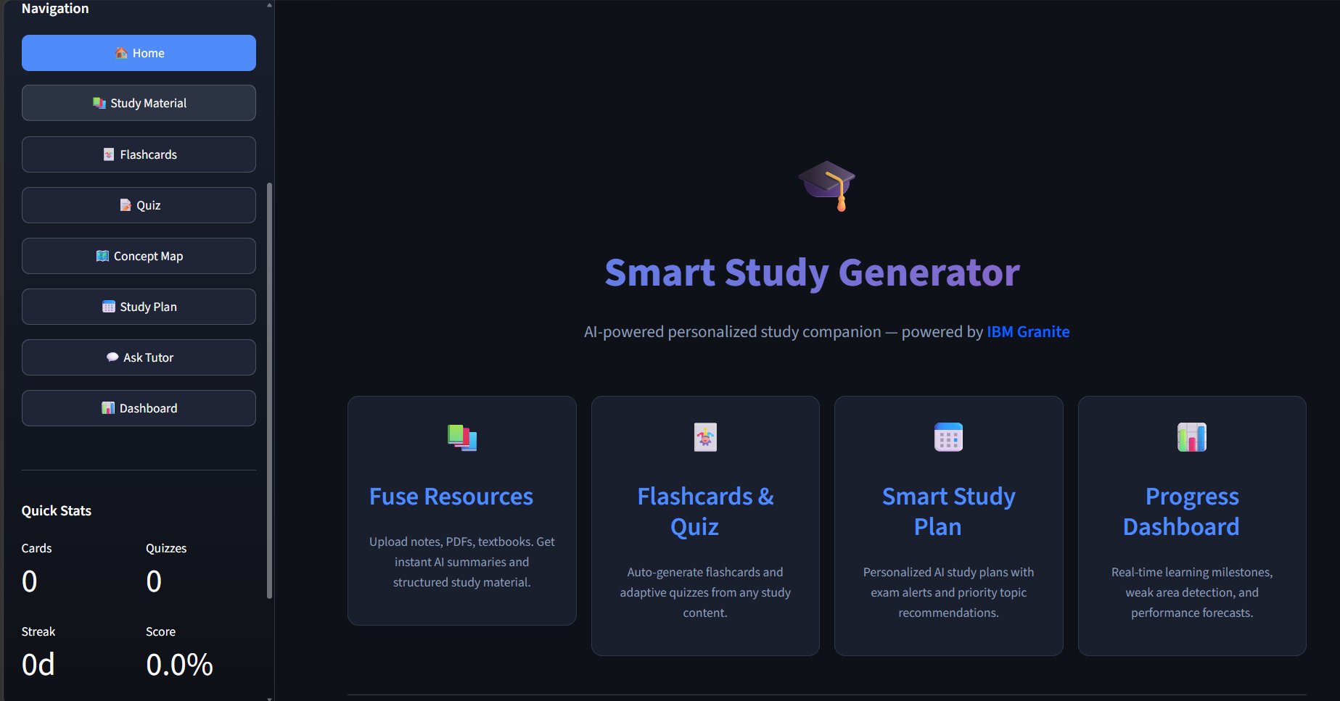
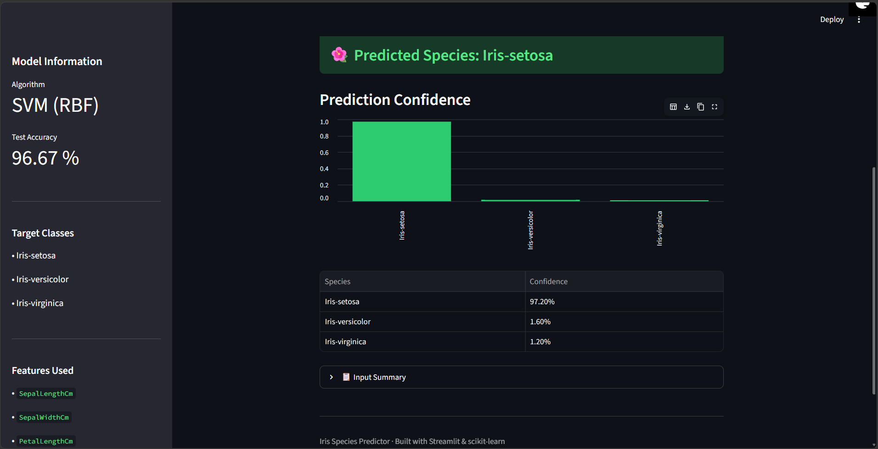

Slide 10

Role of Agentic AI in the solution
Role of Agentic AI in Nutrition Agent
Agentic AI enables the Nutrition Agent to function as an intelligent, autonomous system rather than a simple chatbot. Using IBM watsonx.ai and IBM Granite models, it coordinates multiple specialized agents to deliver personalized nutrition guidance.
Each agent performs a specific role—such as retrieving nutritional data, generating diet plans, providing health advice, and analyzing food logs—while working collaboratively. This multi-agent approach ensures efficient task execution and accurate results.
Agentic AI also brings context awareness, understanding user details like age, health conditions, and fitness goals to generate tailored recommendations. It supports real-time adaptation, continuously updating suggestions based on user inputs like daily meals.
Additionally, agents communicate with each other, enabling better decision-making and improved outcomes.
Overall, Agentic AI makes the system proactive, personalized, and goal-driven, acting like a smart digital nutritionist that helps users maintain a healthy lifestyle.

Slide 11
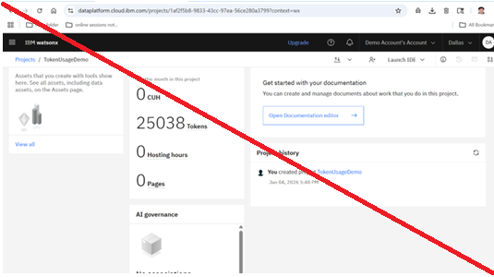
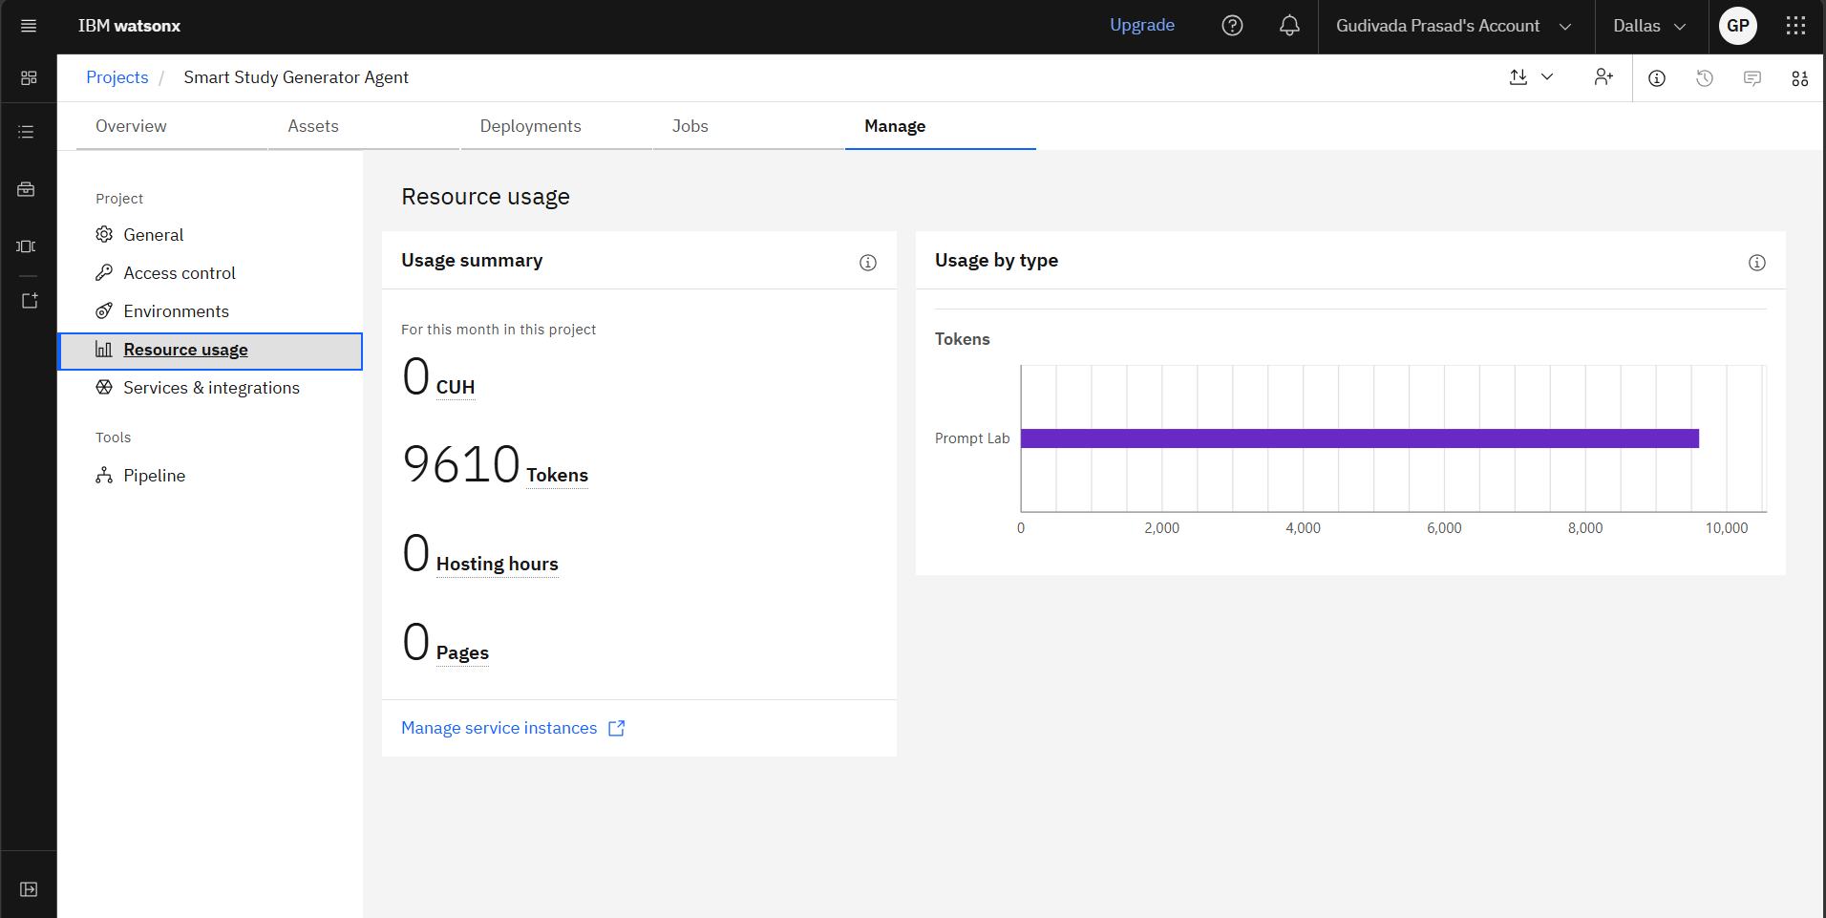
Token Usage
11,761 token are used
Before Prompt
After the Prompt
·
·
·

Slide 12
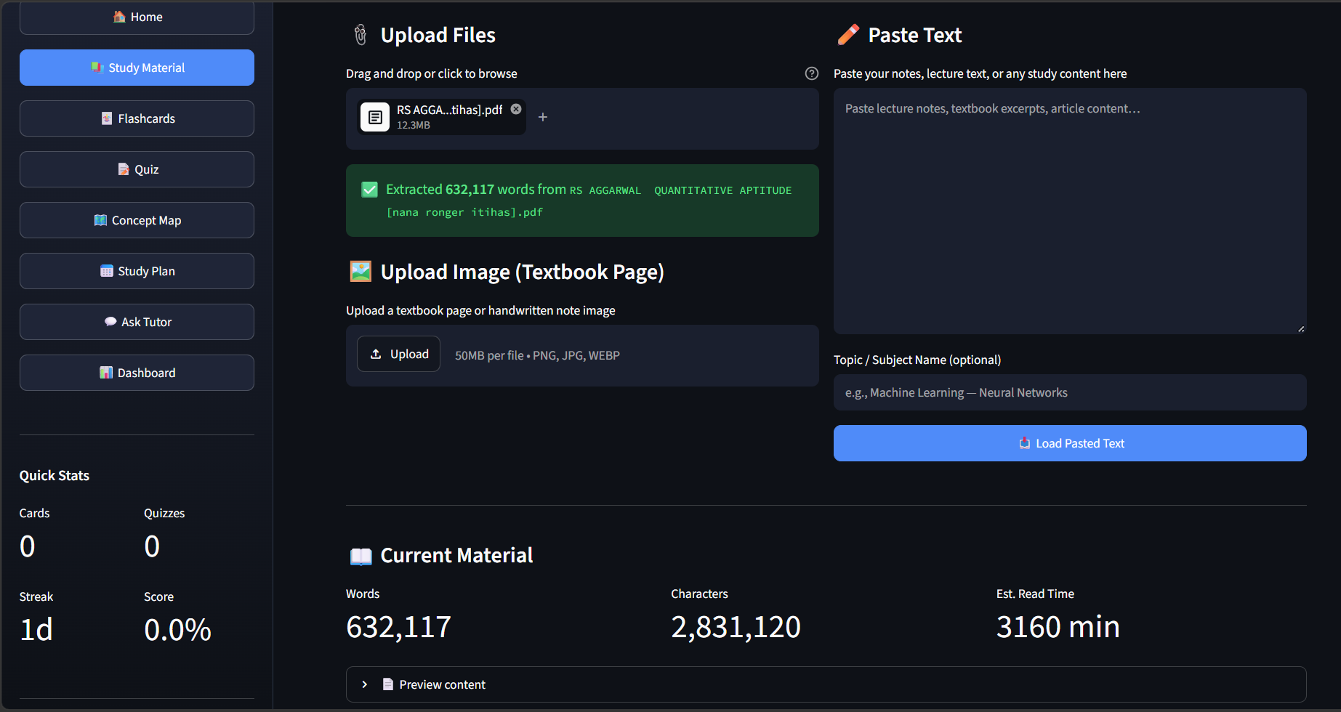
Project Output Screenshot
Please put IBM Bob output screenshots with 2-3 prompts.
You can take 2-3 more slides for each screenshot
·
·
·

Slide 13
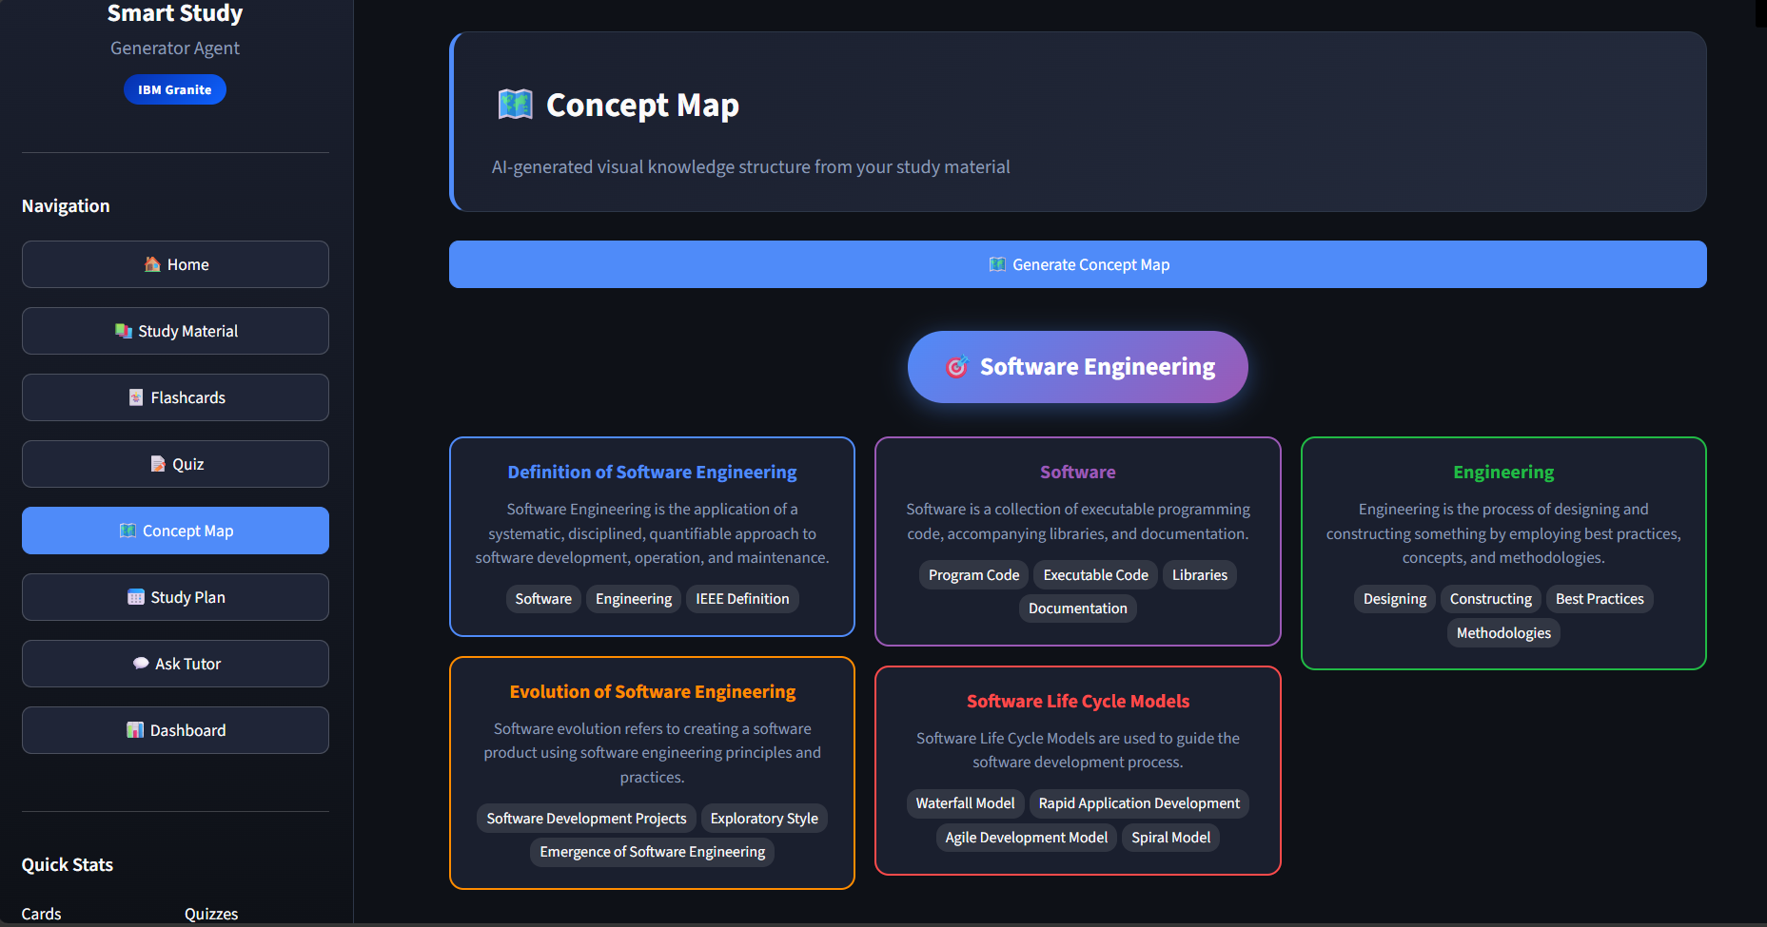
Project Output Screenshot
Please put IBM Bob output screenshots with 2-3 prompts.
You can take 2-3 more slides for each screenshot
·
·
·

Slide 14
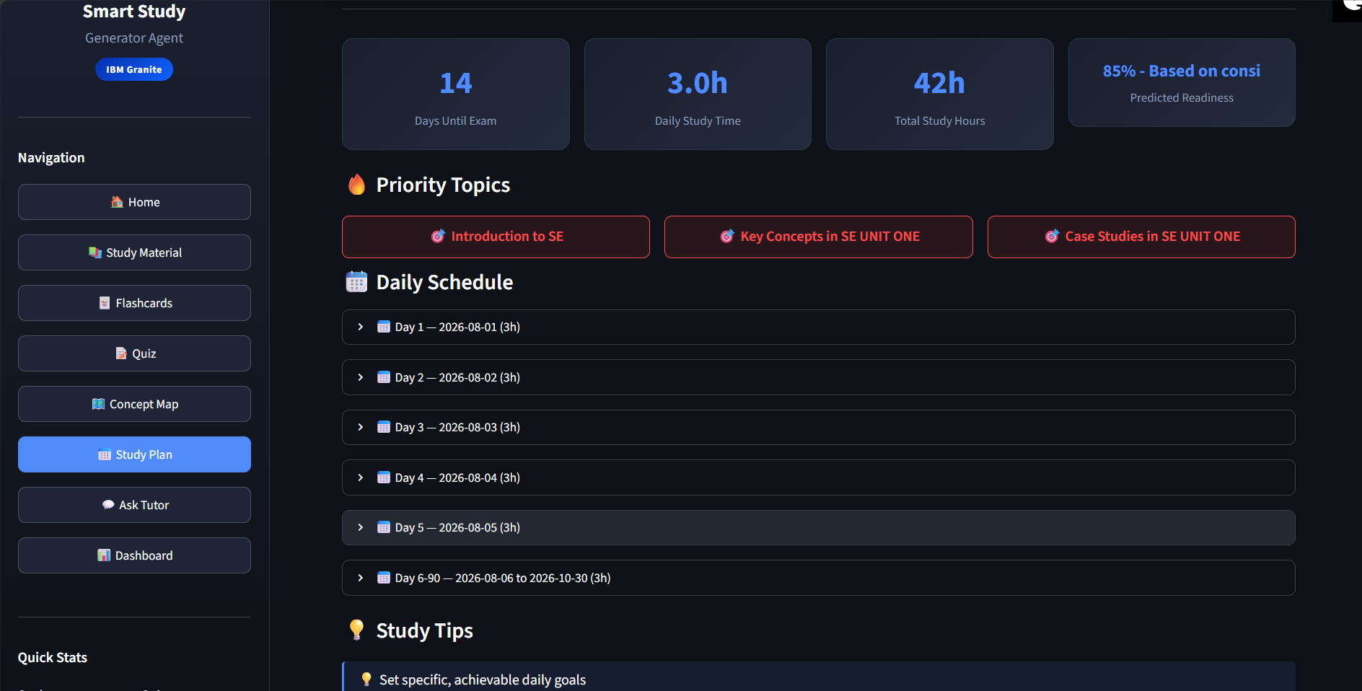
Project Output Screenshot
Please put IBM Bob output screenshots with 2-3 prompts.
You can take 2-3 more slides for each screenshot
·
·
·

Slide 15
Novelty and Uniqueness
The proposed Nutrition Agent stands out by combining Agentic AI, RAG, and personalization into a single intelligent system.
Multi-Agent Intelligence – Instead of a single chatbot, multiple specialized agents collaborate to deliver accurate and context-aware nutrition guidance.
RAG-Based Accuracy – Integrates real-time data retrieval with AI generation, reducing misinformation and ensuring trustworthy recommendations.
Hyper-Personalization – Tailors diet plans based on health conditions, cultural preferences, and fitness goals.
Real-Time Feedback Loop – Continuously adapts recommendations based on daily food logs and user behavior.
Multi-Modal Input – Supports text, voice, and image-based meal tracking for better usability.
Preventive Healthcare Focus – Goes beyond diet planning to provide disease-specific nutrition advice.
Scalable & Enterprise-Ready – Built on IBM watsonx.ai with IBM Granite models, ensuring reliability and governance.
This makes the solution a smart, adaptive, and proactive digital nutritionist, not just a static diet recommendation tool.

Slide 16
Git Hub Link
· Please create public github repository (Enable Add README button while creating repository) with format –
Please test and Paste the working Github URL –
Make sure you have Uploaded following three files into your github repository
1) All Agent relevant files of IBM Cloud , 2) yourproblemstatement.pdf file 3) your projectpresntation.pptx file 4)any other files
·
·
·

Slide 17
Future Scope
1.Integration with Wearables & Health Devices –
The system can be integrated with smartwatches and fitness trackers to collect real-time data such as steps, calories burned, heart rate, and sleep patterns. This will enable the Nutrition Agent to provide more accurate and dynamic diet recommendations based on actual user activity and health metrics.
2.AI-Powered Voice Assistant & Multilingual Support –
Enhancing the system with a voice-enabled assistant and support for multiple languages will improve accessibility. Users can interact naturally in their preferred language, making the solution more inclusive and suitable for diverse populations, especially in regions with varied linguistic backgrounds.
·
·
·

Slide 18
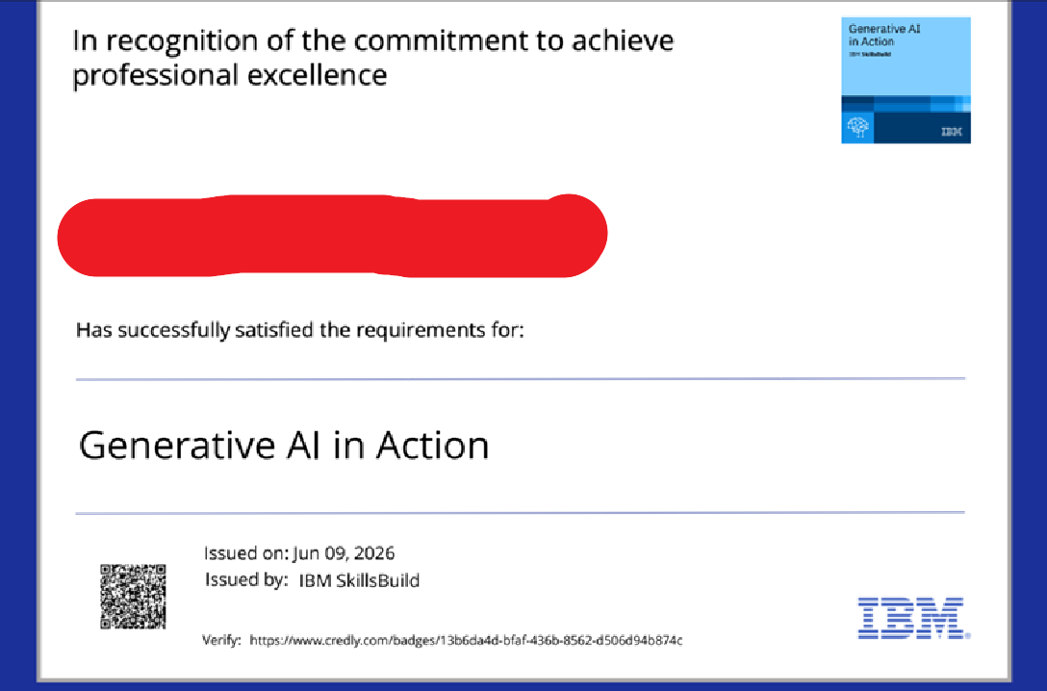
Certificates Earned:
Please add your credly certificate

Slide 19
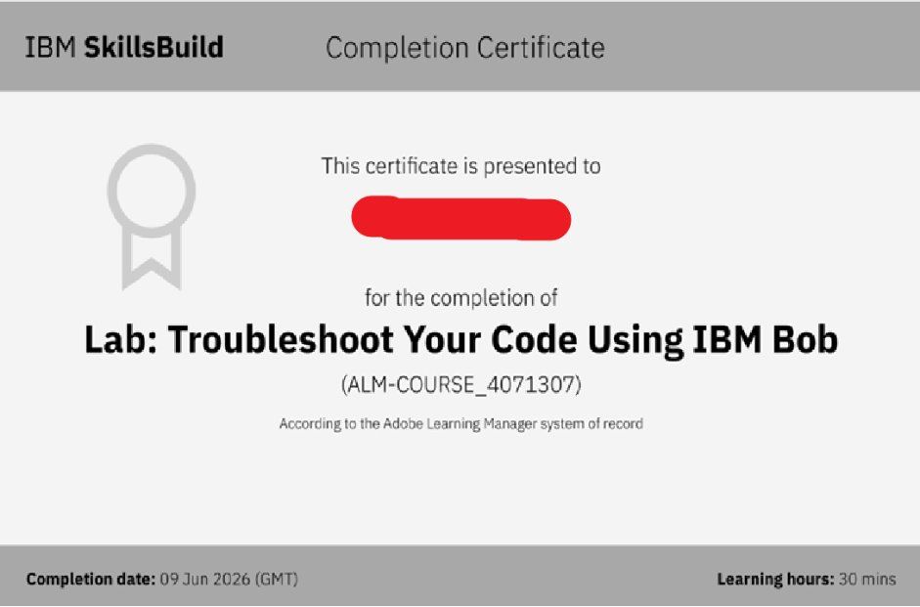
Certificates Earned:​
Add your IBM BOB Certificate

Slide 20


