Slide 1
Team Phoenix Income Statement of a Company
By:
Prasad Aroskar - 1305905
Quan Peng - 1795301
Leela Venkata Ravi Kumar Kanthi- 1023809
Ziye Lu - 1688853

Slide 2
Index
Idea
E-R Diagram
Stored Procedure
Triggers
Views
Tableau Dashboards
Front – End Web Page

Slide 3
Idea
Abstract
Purpose
Scope

Slide 4
E-R Diagram

Slide 5
Stored Procedures
Triggers
Depreciation Calculation
Currency Conversion
Generate Income
FGMapHistory
CurrConversion

Slide 6
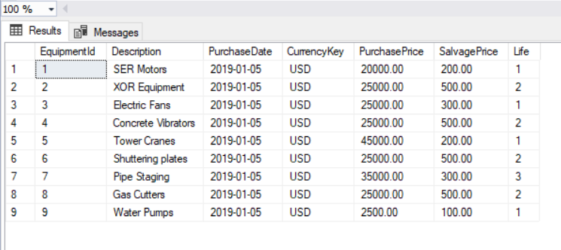
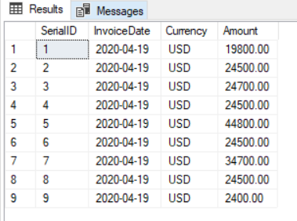
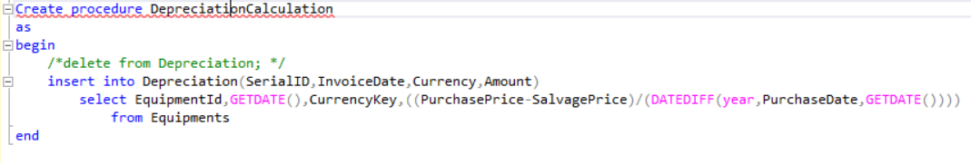
Depreciation Calculation
Equipment's
Depreciations

Slide 7
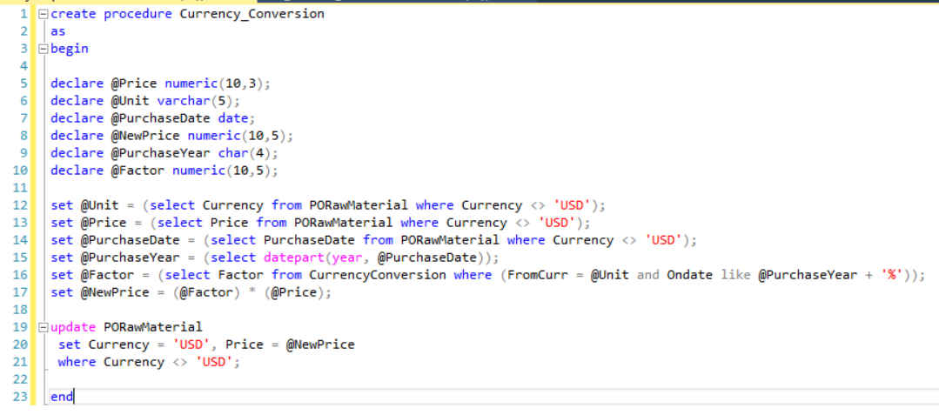
Currency Conversion

Slide 8

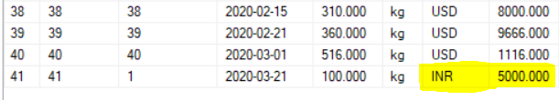
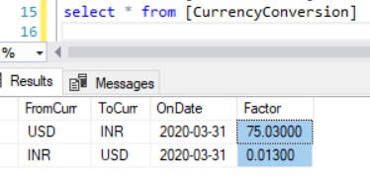
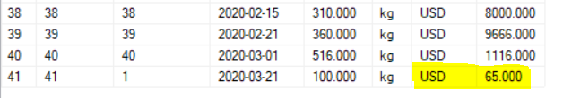
Currency Conversion
Executing stored procedure

Slide 9
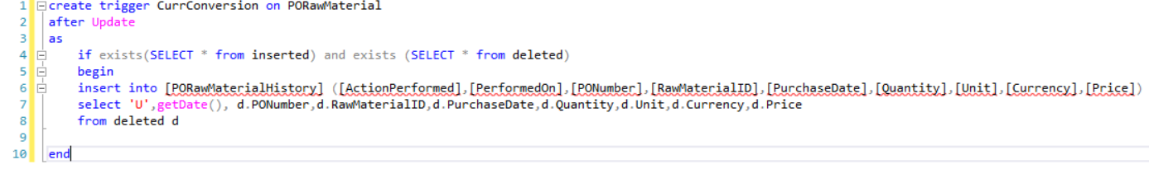
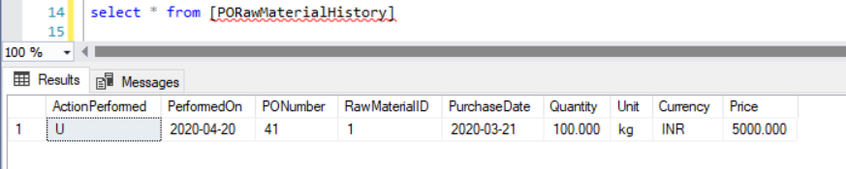
Trigger -Currency Conversion

Slide 10
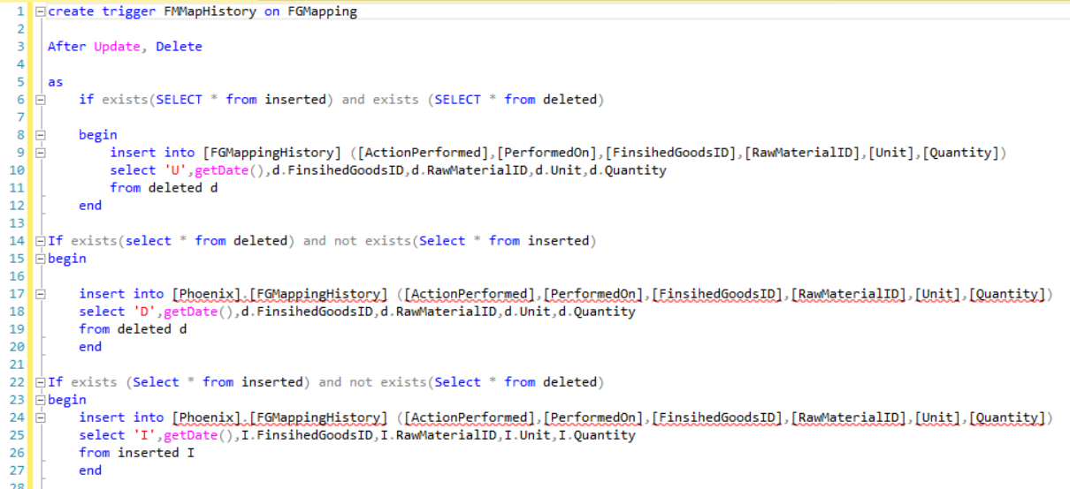
FGMapHistory

Slide 11
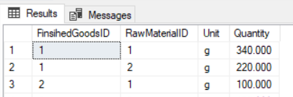

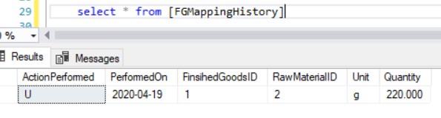
FGMapHistory
FGMapping

Slide 12
Generate Income – Stored Procedure

Slide 13
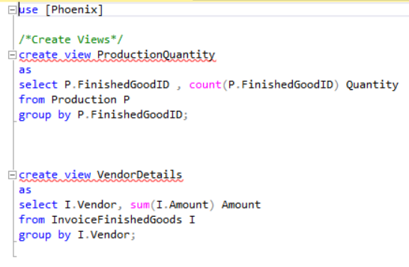
Views
ProductionQuantity
VendorDetails

Slide 14
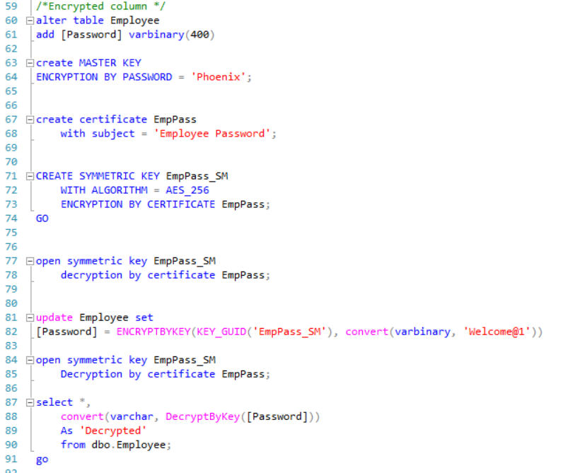
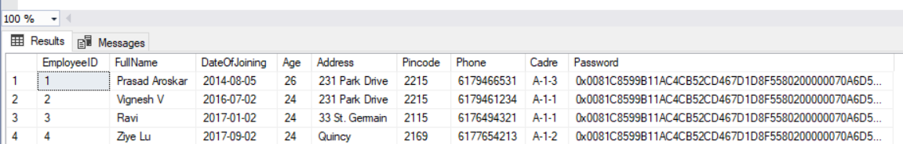
Encrypted Column

Slide 15
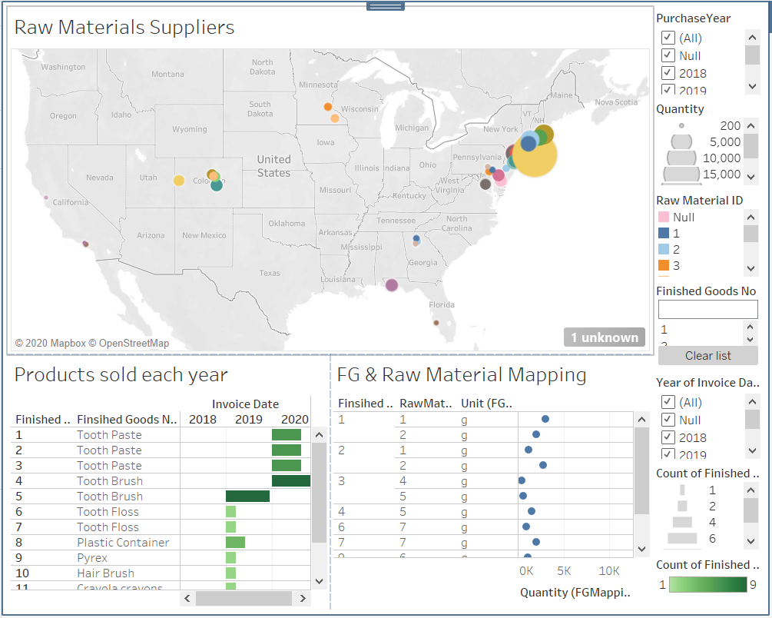
Tableau Dashboards

Slide 16
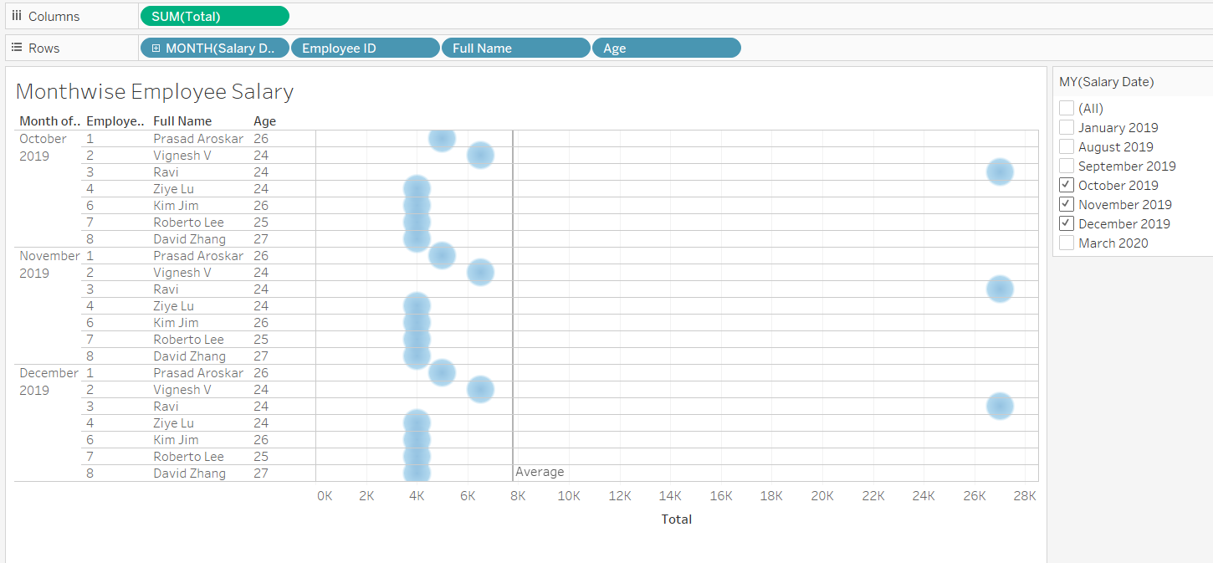
Tableau Dashboards

Slide 17
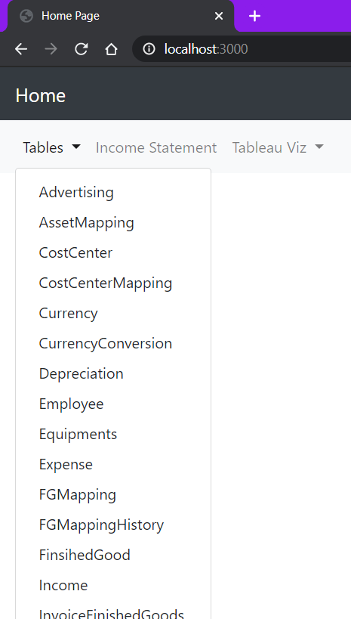
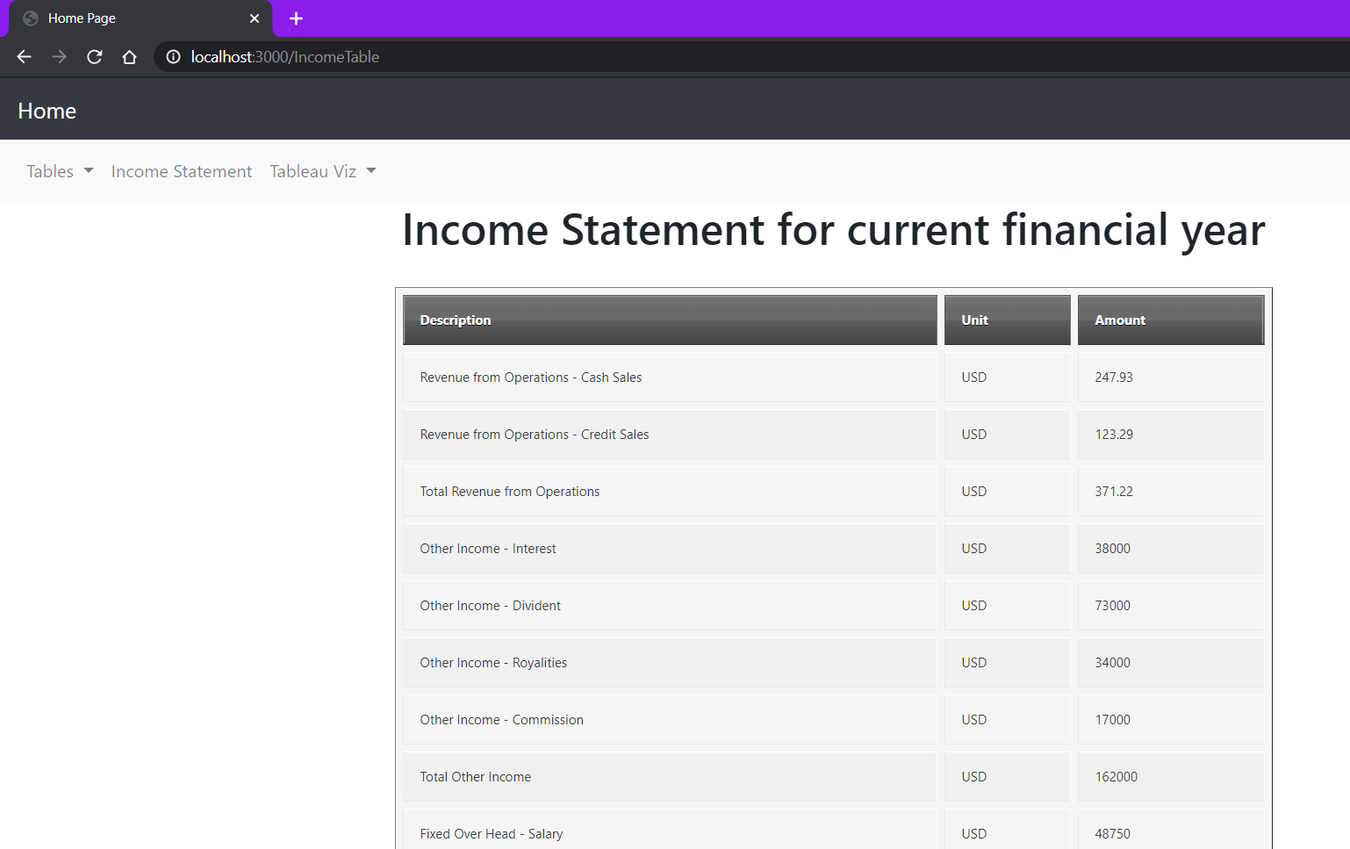
Front – End Web Page

Slide 18
Thank you
Any Questions ?

