Slide 1
Auto-Scaling Compute Resources
Using Local VM and Google Cloud Platform

Slide 2
Project Objective
Run compute tasks on local Alpine VM
Monitor CPU and RAM usage
Trigger GCP VM when usage > 75%
Stop local load after scaling
Cost-efficient, demo-ready setup

Slide 3
Tools & Technologies
VirtualBox & Alpine Linux
Python 3 & Paramiko
NumPy (CPU Load Simulation)
Google Cloud SDK (gcloud CLI)
Windows Host as control system

Slide 4
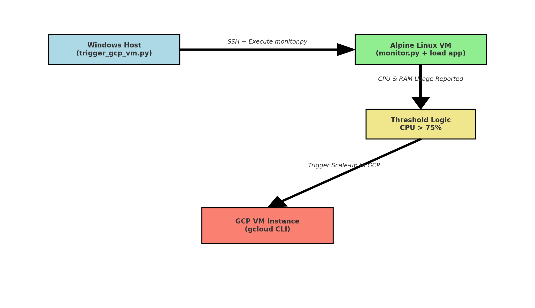
Architecture Overview

Slide 5

Demo Walkthrough
1. Start Alpine VM
2. Trigger CPU load remotely
3. Run trigger script on host
4. Monitor GCP instance status
5. Stop cloud VM after demo

Slide 6
Results & Outcome
GCP triggered on high CPU load
Real-time monitoring worked
Load stopped post-scale
Setup was scriptable and repeatable

