Slide 1
Operating Systems

Slide 2
Objectives and scope of this session
To provide understanding of the functions of operating systems
To provide insight into functional modules of operating systems
To study the concepts underlying the design and implementation of operating systems

Slide 3
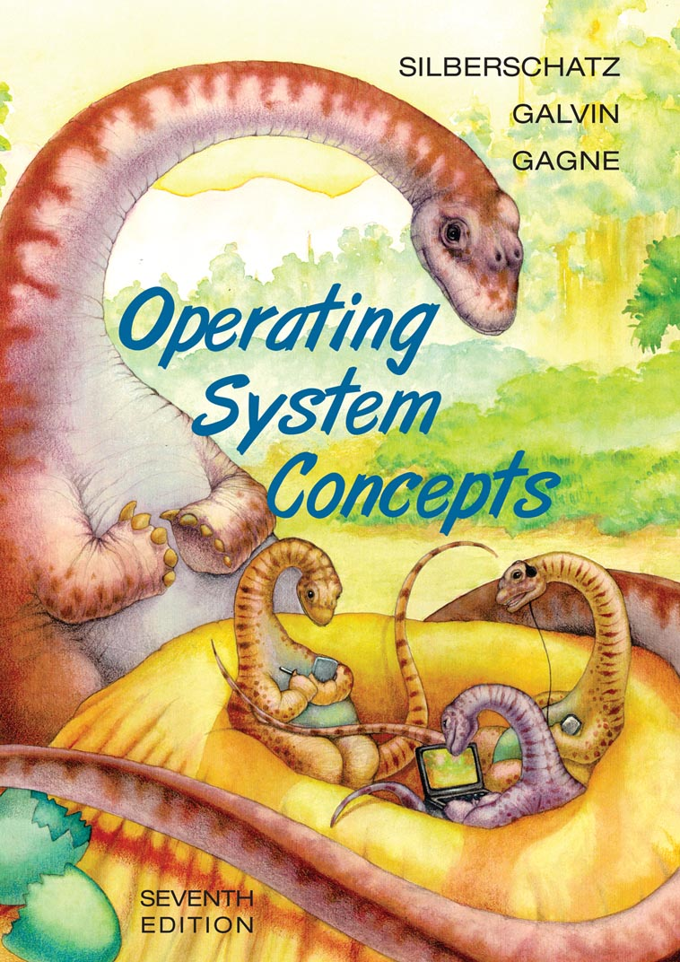
Text book
Operating System Principles
By
ABRAHAM SILBERSCHATZ
PETER BAER GALVIN
GREG GAGNE
Seventh Edition
(WILEY STUDENT EDITION)

Slide 4
Reference books
OPERATING SYSTEMS, Internals and Design Principles, Fifth Edition by William Stallings
Modern Operating Systems by Andrew Tanenbaum
Internet, class notes and slides

Slide 5
So, let us begin…

Slide 6
INTRODUCTION

Slide 7
Objectives of this chapter
To provide a grand tour of the major operating systems components
To provide coverage of basic computer system organization
Reference: Chapters 1 and 2 of Galvin

Slide 8
What is an Operating System?
A program that acts as an intermediary between a user of a computer and the computer hardware.
Operating system goals:
  Execute user programs and make solving user problems easier.
  Make the computer system convenient to use.
Use the computer hardware in an efficient manner.

Slide 9
Computer System Structure
Computer system can be divided into four components:
Hardware – provides basic computing resources
  CPU, memory, I/O devices
Application programs – define the ways in which the system resources are used to solve the computing problems of the users
  Word processors, compilers, web browsers, database systems, video games

Slide 10
Computer System Structure
(Contd…)
Operating system
  Controls and coordinates use of hardware among various applications and users
Users
  People, machines, other computers

Slide 11

Four Components of a Computer System

Slide 12
Operating System Definition
OS is a resource allocator
  Manages all resources
  Decides between conflicting requests for efficient and fair resource use
OS is a control program
  Controls execution of programs to prevent errors and improper use of the computer

Slide 13
Operating System Definition
(Contd…)
No universally accepted definition
“Everything a vendor ships when you order an operating system” is good approximation
    But varies wildly
“The one program running at all times on the computer” is the kernel. Everything else is either a system program (ships with the operating system) or an application program

Slide 14
Computer System Organization
Computer-system operation
  One or more CPUs, device controllers connect through common bus providing access to shared memory
  Concurrent execution of CPUs and devices competing for memory cycles

Slide 15

Computer System Organization
(Contd…)

Slide 16
Computer-System Operation
I/O devices and the CPU can execute concurrently
Each device controller is in charge of a particular device type
Each device controller has a local buffer
CPU moves data from/to main memory to/from local buffers
I/O is from the device to local buffer of controller
Device controller informs CPU that it has finished its operation by causing an interrupt

Slide 17
Common Functions of Interrupts
Interrupt transfers control to the Interrupt Service Routine (ISR) generally, through the interrupt vector, which contains the addresses of all the service routines
Interrupt architecture must save the address of the interrupted instruction

Slide 18
Common Functions of Interrupts
(Contd…)
Incoming interrupts are disabled while another interrupt is being processed to prevent a lost interrupt
A trap is a software-generated interrupt caused either by an error or a user request
An operating system is interrupt driven

Slide 19
Interrupt Handling
The operating system preserves the state of the CPU by storing registers and the program counter
Separate segments of code determine what action should be taken for each type of interrupt

Slide 20
I/O Structure
After I/O starts, control returns to user program only upon I/O completion
  wait instruction idles the CPU until the next interrupt
  At most one I/O request is outstanding at a time, no simultaneous I/O processing

Slide 21
I/O Structure
(Contd…)
After I/O starts, control returns to user program without waiting for I/O completion
  System call – request to the operating system to allow user to wait for I/O completion
  Device-status table contains entry for each I/O device indicating its type, address, and state
  Operating system indexes into I/O device table to determine device status and to modify table entry

Slide 22

Two I/O Methods
Synchronous
Asynchronous

Slide 23

Device-Status Table

Slide 24
Direct Memory Access (DMA)Structure
Used for high-speed I/O devices able to transmit information at close to memory speeds
Device controller transfers blocks of data from buffer storage directly to main memory without CPU intervention
Only one interrupt is generated per block, rather than the one interrupt per byte

Slide 25
Storage Structure
Main memory – it is the only large storage media that the CPU can access directly.
Secondary storage – extension of main memory that provides large nonvolatile storage capacity.
Magnetic disks – rigid metal or glass platters covered with magnetic recording material
  Disk surface is logically divided into tracks, which are subdivided into sectors.
  The disk controller determines the logical interaction between the device and the CPU.

Slide 26
Storage Hierarchy
Storage systems organized in hierarchy:
    Speed
    Cost
    Volatility
Caching – copying information into faster storage system; main memory can be viewed as a last cache for secondary storage.

Slide 27

Storage-Device Hierarchy

Slide 28
Caching
Important principle, performed at many levels in a computer (in hardware, operating system, software)
Information in use is copied from slower to faster storage temporarily

Slide 29
Caching
(Contd…)
Faster storage (cache) checked first to determine if information is there
  If it is, information used directly from the cache (fast)
  If not, data copied to cache and used from there
Caches have limited size
  Cache management is an important design problem
  Cache size and replacement policy

Slide 30

Performance of Various Levels of Storage

Slide 31

Migration of Integer “A” from Disk to Register
Multitasking environments must be careful to use most recent value, no matter where it is stored in the storage hierarchy
Multiprocessor environment must provide cache coherency in hardware such that all CPUs have the most recent value in their cache
Distributed environment situation is even more complex
  Several copies of a datum can exist
  Various solutions exist

Slide 32
Computer-System Architecture
Single-Processor Systems
Multiprocessor Systems
    amount of work done (increased throughput)
    decrease in cost
    reliability is increased
    two types (asymmetric and symmetric)
Clustered Systems

Slide 33
Operating System Structure
Simple Batch Systems:
  No user interaction with the system.
  Jobs with similar needs were grouped into Batches.
  Reads a stream of jobs, operates on it, generates output.
  First Come, First Served.
  Can use Spooling.
O.S.
Memory layout of a Batch system
User program
area

Slide 34
Operating System Structure
(Contd…)
Multi-programmed Batched Systems:
  Spooling results in several jobs waiting to get processed.
  If several jobs are available on Direct Access device, Job Scheduling becomes possible.
  An important aspect of Job Scheduling is ability to MULTIPROGRAM.
  Multiprogramming increases CPU utilization.
  When a job needs to wait, CPU switches to another job.
  CPU never sits idle.

Slide 35
Operating System Structure
(Contd…)
O.S.
Memory layout of a Multiprogramming system
Job 1
Job 2
Job 3
Job 4

Slide 36
Operating System Structure
(Contd…)
Time Sharing Systems:
  Also called as Multi-tasking systems.
  Logical extension of Multiprogramming systems.
  Multiple jobs are executed by CPU switching between them.
  Switching is very frequent, so that users can interact with programs while it is running.
  An interactive or hands-on computer system.
  Allows many users to share the computer resources simultaneously.

Slide 37
Just for laffs

Slide 38
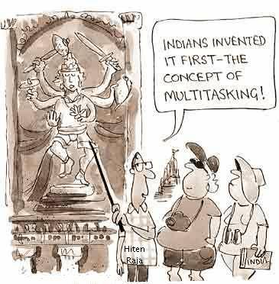
Who invented MULTI-TASKING?

Slide 39
Operating-System Operations
O.S. is interrupt driven (by hardware)
Software error or request creates exception or trap
  Division by zero, invalid memory access, request for operating system service
Other process problems include infinite loop, processes modifying each other’s code or the operating system code
Notes:
Pages 17 and 18 of Galvin

Slide 40
Operating-System Operations
(Contd…)
Dual-mode operation allows OS to protect itself and other system components
  User mode and kernel mode
  Mode bit provided by hardware
    Provides ability to distinguish when system is running user code or kernel code
    Some instructions designated as privileged, only executable in kernel mode
    System call changes mode to kernel mode, return from call resets it to user

Slide 41

Transition from User to Kernel Mode

Slide 42
Timer
Timer to prevent infinite loop / process hogging resources
  Set interrupt after specific period
  Operating system decrements counter
  When counter = zero, generate an interrupt
  Set up before scheduling process to regain control or terminate program that exceeds allotted time

Slide 43
Process Management
A process is a program in execution. It is a unit of work within the system. Program is a passive entity, process is an active entity.
Process needs resources to accomplish its task:
  CPU, memory, I/O, files
  Initialization data

Slide 44
Process Management Activities
The operating system is responsible for the following activities in connection with process management:
Creating and deleting both user and system processes
Suspending and resuming processes
Providing mechanisms for process synchronization
Providing mechanisms for process communication
Providing mechanisms for deadlock handling

Slide 45
Memory Management
All data is present in the memory before and after processing
All instructions are present in the memory in order to execute
Memory management determines what is in memory and when

Slide 46
Memory Management
(Contd…)
Memory management activities:
  Keeping track of which parts of memory are currently being used and by whom
  Deciding which processes (or parts thereof) and data to move into and out of memory
  Allocating and deallocating memory space as needed

Slide 47
Storage Management
OS provides uniform, logical view of information storage
  Abstracts physical properties to logical storage unit - file
  Each medium is controlled by device (i.e., disk drive, tape drive)
    Varying properties include access speed, capacity, data-transfer rate, access method (sequential or random)

Slide 48
Storage Management
(Contd…)
File-System management
  Files usually organized into directories
  Access control on most systems to determine who can access what
  OS activities include:
    Creating and deleting files and directories
    Primitives to manipulate files and directories
    Mapping files onto secondary storage
    Backup files onto stable (non-volatile) storage media

Slide 49
Mass-Storage Management
OS activities
  Free-space management
  Storage allocation
  Disk scheduling
Some storage need not be fast
  Tertiary storage includes optical storage, magnetic tape
  Still it must be managed
  Varies between WORM (write-once, read-many-times) and RW (read-write)

Slide 50
I/O Subsystem
One purpose of OS is to hide peculiarities of hardware devices from the user
I/O subsystem responsible for:
  Memory management of I/O including buffering (storing data temporarily while it is being transferred), caching (storing parts of data in faster storage for performance)
  General device-driver interface
  Drivers for specific hardware devices

Slide 51
Protection and Security
Protection – any mechanism for controlling access of processes or users to resources defined by the OS
Security – defense of the system against internal and external attacks
  Huge range, including denial-of-service, worms, viruses, identity theft, theft of service

Slide 52
Protection and Security
(Contd…)
Systems generally first distinguish among users, to determine who can do what
  User identities (user IDs, security IDs) include name and associated number, one per user
  User ID then associated with all files, processes of that user to determine access control
  Group identifier (group ID) allows set of users to be defined and controls managed, then also associated with each process, file

Slide 53
Special-Purpose Systems
Real-Time Embedded Systems
  soft-real time systems
  hard-real time systems
Multimedia Systems
Handheld Systems

Slide 54
Open-Source Operating Systems
What are Open-Source Operating Systems?
Examples

Slide 55
Windows O.S. from scratch till now…

Slide 56
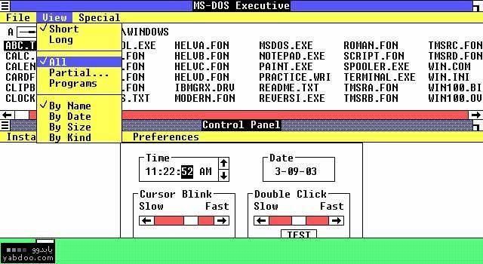
Windows_1.01

Slide 57
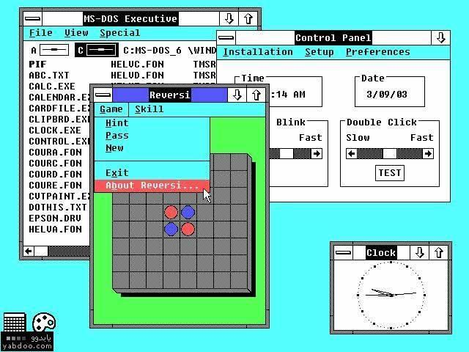
Windows_2.03

Slide 58
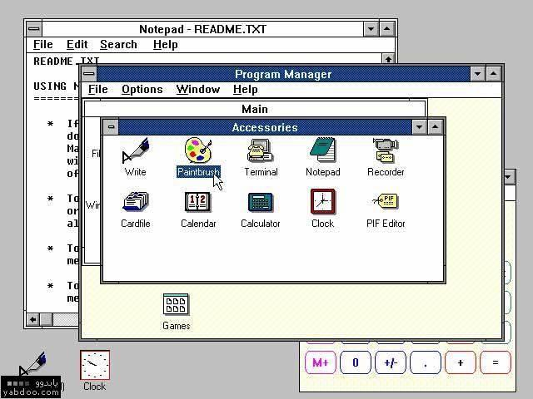
Windows_3.00

Slide 59
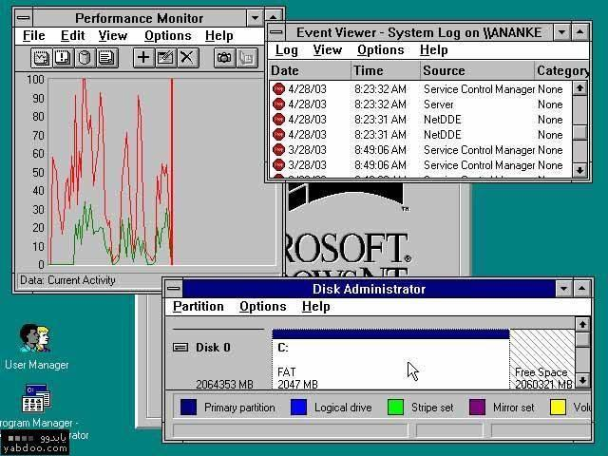
Windows_NT _3.0

Slide 60
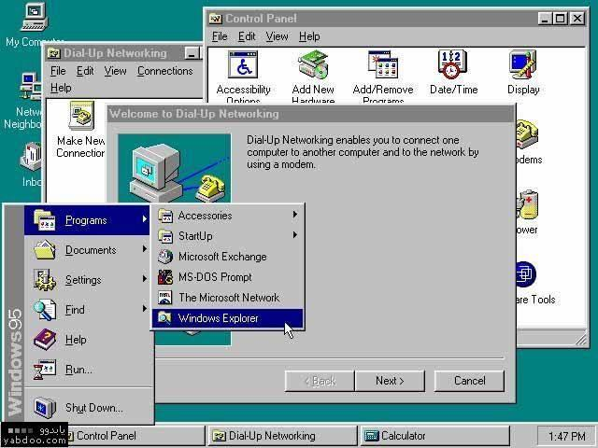
Windows_95

Slide 61
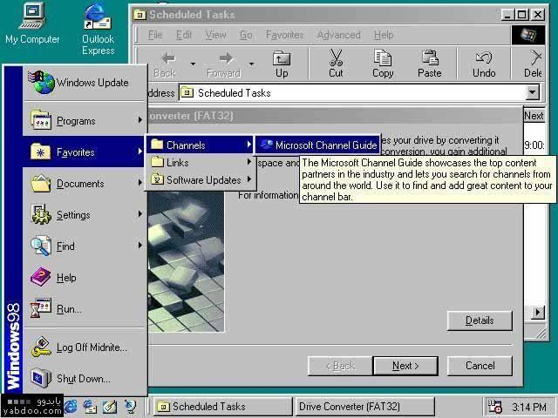
Windows_98

Slide 62
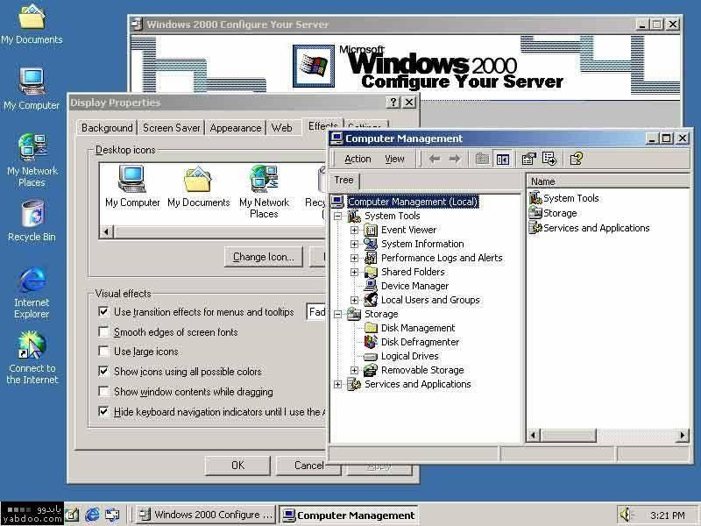
Windows_2000

Slide 63
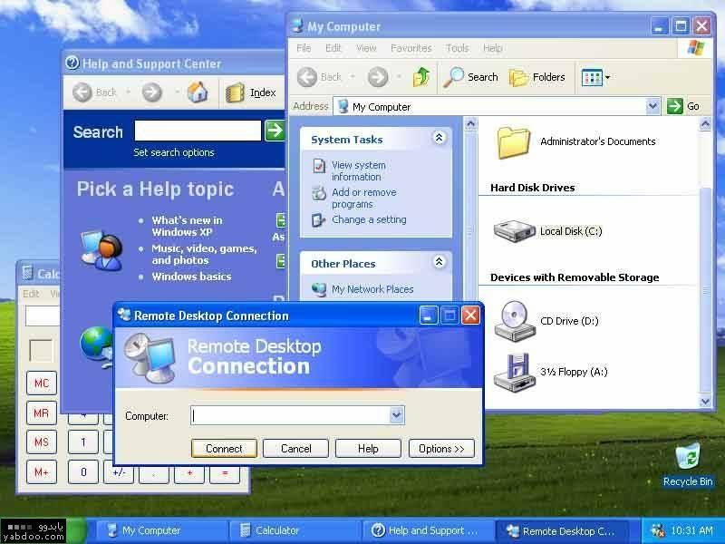
Windows_XP

Slide 64
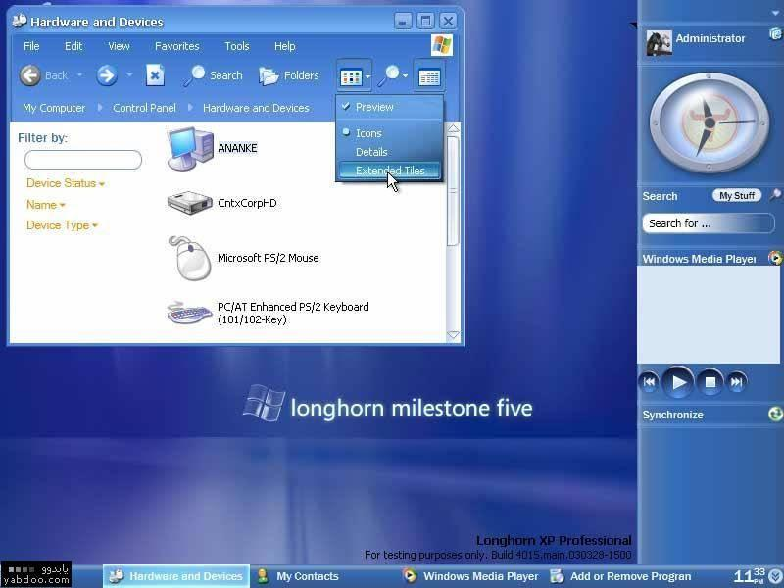
Windows_Longhorn

Slide 65

Windows_Surface_Computing

Slide 66
But the bottom line is that LINUX rocks…
Infact, it rocks big time…
OB! ☺

Slide 67
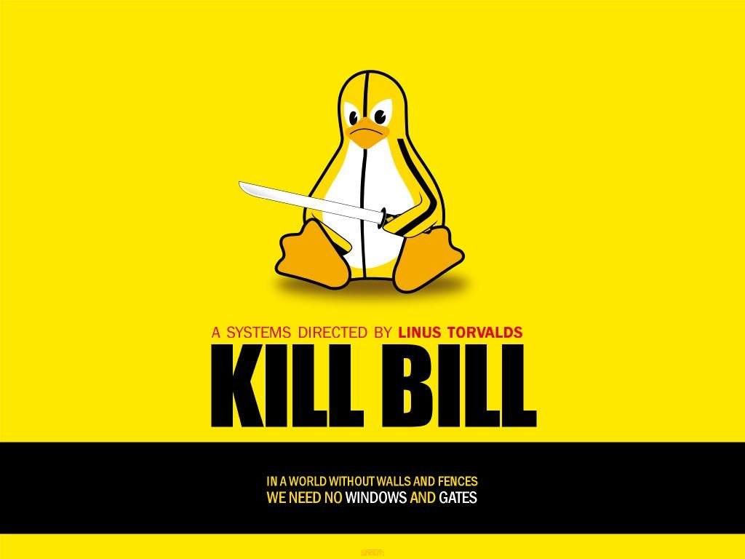

Slide 68


Slide 69
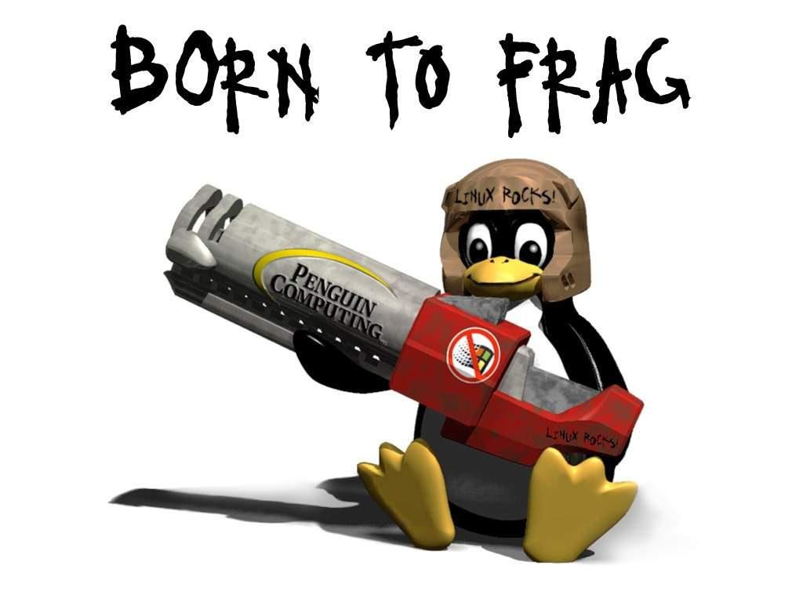

Slide 70
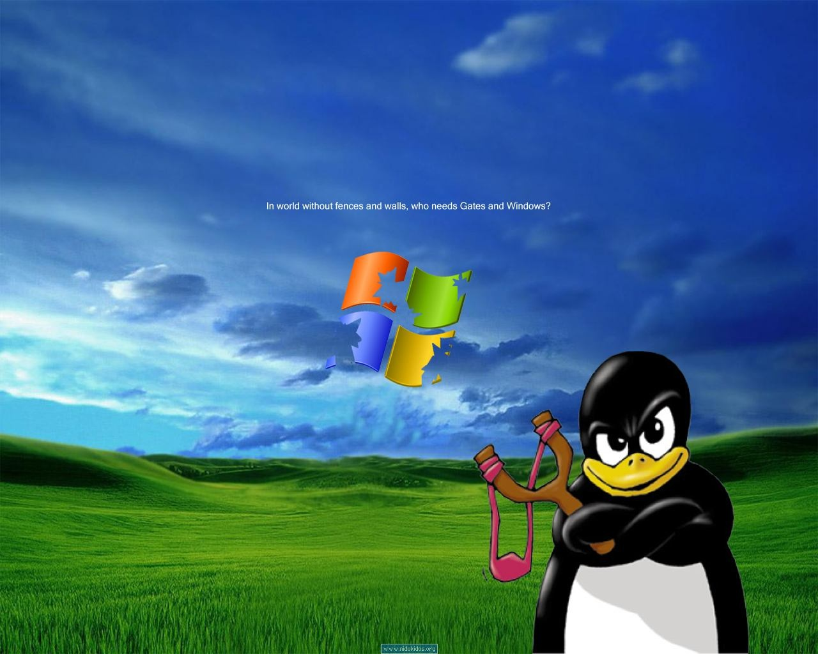

Slide 71
Linux Flavors
Examples

Slide 72
OPERATING-SYSTEM STRUCTURE

Slide 73
Simple Structure
MS-DOS – written to provide the most functionality in the least space
  Not divided into modules
  Although MS-DOS has some structure, it’s interfaces and levels of functionality are not well separated
Notes:
Pg 57 of galvin

Slide 74

MS-DOS Layer Structure

Slide 75
UNIX
UNIX – limited by hardware functionality, the original UNIX operating system had limited structuring. The UNIX OS consists of two separable parts:
  Systems programs
  The kernel:
    consists of everything below the system-call interface and above the physical hardware
    provides the file system, CPU scheduling, memory management, and other operating-system functions; a large number of functions for one level

Slide 76

UNIX System Structure

Slide 77
Layered Approach
The operating system is divided into a number of layers (levels), each built on top of lower layers. The bottom layer (layer 0), is the hardware; the highest (layer N) is the user interface.
With modularity, layers are selected such that each uses functions (operations) and services of only lower-level layers

Slide 78

Layered Operating System

Slide 79
Microkernel System Structure
Moves as much from the kernel into “user” space
Communication takes place between user modules using message passing
Benefits:
  Easier to extend a microkernel
  Easier to port the operating system to new architectures
  More reliable (less code is running in kernel mode)
  More secure
Detriments:
  Performance overhead of user space to kernel space communication

Slide 80
Modules
Most modern operating systems implement kernel modules
  Uses object-oriented approach
  Each core component is separate
  Each talks to the others over known interfaces
  Each is loadable as needed within the kernel
Overall, similar to layered and micro-kernel based approaches

Slide 81

Solaris Modular Approach

Slide 82
Any Questions?

