Slide 1
Process Scheduling

Slide 2
Session Outline
Basic Concepts
Scheduling Criteria
Scheduling Algorithms
Scheduling under Linux
Reference: Chapter 5 of Galvin

Slide 3
Basic Concepts
Scheduling: The assignment of CPU to a process
Preemption: Removal of CPU control from a process
Context Switch: Switching the CPU to another process
    Save the state of old process
    Load the saved state of new process
PCB is used to save and load the information/context of a process

Slide 4
Basic Concepts
(Contd…)
Maximum CPU utilization obtained with multiprogramming
CPU–I/O Burst Cycle: a running process can be modeled as alternating series of CPU bursts and I/O bursts
  During a CPU burst, a process is executing instructions
  During an I/O burst, a process is waiting for an I/O operation to be performed and is not executing instructions

Slide 5

Alternating Sequence

Slide 6
CPU Scheduler
Selects from among the processes in memory that are ready to execute, and allocates the CPU to one of them

Slide 7
CPU Scheduler
(Contd…)
CPU scheduling decisions may take place when a process:
  1. Switches from running to waiting state
  2. Switches from running to ready state
  3. Switches from waiting to ready state
  4. Terminates
Scheduling under 1 and 4 is nonpreemptive
All other scheduling is preemptive

Slide 8
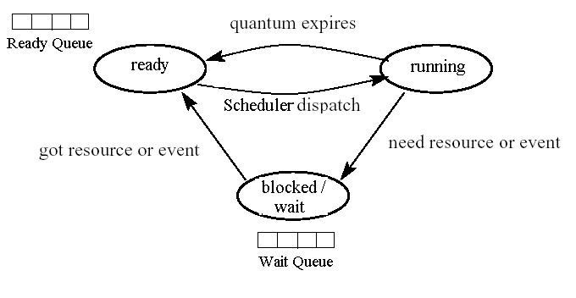
Process Life Cycle
new
admitted
exit
terminated
Simple Process State Transition Diagram

Slide 9
Dispatcher
Dispatcher module gives control of the CPU to the process selected by the short-term scheduler; this involves:
  switching context
  switching to user mode
  jumping to the proper location in the user program to restart that program
Dispatch latency – time taken for the dispatcher to stop one process and start running another

Slide 10
Scheduling Criteria
Objectives:
  Maximize CPU Utilization
  Maximize System Throughput
    Number of processes completed in unit time.
  Minimize Turnaround Time
    Time measured from process creation to termination.
  Minimize Waiting Time
    Amount of time a process has been waiting in the ready queue.
  Minimize Response Time
    Time measured from process creation to the time of first output (response).
  Ensure Fairness (No starvation)

Slide 11
Pre-emptive and Non-Pre-emptive Scheduling
The job of the CPU scheduler is to select a process from the ready queue, based on some scheduling policy (or algorithm)

Slide 12
Pre-emptive and Non-Pre-emptive Scheduling
(Contd…)
The policy could be preemptive or non-preemptive:
  A Non-preemptive scheduler runs only when the running process gives up the processor through its own actions, e.g.,
    The process terminates.
    The process blocks because of an I/O or synchronization operation.

Slide 13
Pre-emptive and Non-Pre-emptive Scheduling
(Contd…)
  A Preemptive scheduler may, force a running process to stop running.
    Can bring process from Running State to Ready State.
    Can bring process from Waiting State to Ready State.

Slide 14

Scheduling Algorithms
Deals with the problem of deciding which of the processes in the ready queue is to be allocated to the CPU.
Different CPU scheduling algorithms exist:
      First-Come-First-Served (FCFS)
      Shortest-Job-First (SJF)
      Priority Scheduling
      Round-Robin (RR)
      Multi-Level Queue Scheduling
      etc.

Slide 15
First-Come-First-Served
Simplest scheduling algorithm.
Non-pre-emptive type of scheduling.
Process which requests the CPU first is allocated the CPU first.
The implementation of FCFS is managed with a FIFO queue.

Slide 16
First-Come-First-Served
(Contd…)
First Come, First Served (Non-preemptive)
  Process Burst Time
    P1 24
    P2 3
    P3 3
  Suppose that the processes arrive in the order: P1 , P2 , P3
  The Gantt Chart for the schedule is:
P1
P2
P3
0
24
27
30
  Waiting time for P1 = 0, P2 = 24, P3 = 27
  Average waiting time = ( 0 + 24 + 27 ) / 3 = 17 ms.

Slide 17
First-Come-First-Served
(Contd…)
Suppose that the processes arrive in the order
P2 , P3 , P1
  The Gantt chart for the schedule is:
P2
P3
P1
0
3
6
30
  Waiting time for P₁ = 6, P₂ = 0, P₃ = 3
  Average waiting time = ( 6 + 0 + 3 ) / 3 = 3 ms.
  Much better than previous case.
  CONVOY EFFECT: Short process behind long process

Slide 18
Shortest-Job-First (SJF)
Shortest Job First
  Associates with each process the length of its next CPU burst.
  Use these lengths to schedule the process with the shortest time.
  If two processes have the same next CPU burst, FCFS is used.

Slide 19
Shortest-Job-First (SJF)
(Contd…)
Two schemes:
  Non-preemptive.
    Once a CPU is given to the process it cannot be preempted until it completes its CPU burst.
  Preemptive (Shortest-Remaining-Time-First).
    If a new process arrives with CPU burst length less than remaining time of current executing process, then preempt it.
SJF is optimal – gives minimum average waiting time for a given set of processes.

Slide 20
Shortest-Job-First (SJF)
(Contd…)
Example:
Process Burst Time
        P1 6
        P2 8
        P3 7
        P4 3
  The Gantt chart for the schedule is:
P4
P1
P3
P2
16
0
3
9
24
  Waiting time for P4 = 0, P1 = 3, P3 = 9, P2 = 16
  Average waiting time = (0 + 3 + 9 + 16 ) / 4 = 7.

Slide 21
Example of Preemptive SJF
Process Arrival Time Burst Time
P₁ 0.0 7
P₂ 2.0 4
P₃ 4.0 1
P₄ 5.0 4
SJF (preemptive)
Average waiting time = (9 + 1 + 0 +2)/4 = 3
P₁
P₂
P₃
P₂
P₄
P₁
0
2
4
5
7
11
16

Slide 22
Priority Scheduling
Shortest-Job-First (SJF) is a special case of the general priority scheduling algorithm.
A priority number (integer) is associated with each process.
  The CPU is allocated to the process with the highest priority (smallest integer ≡ highest priority).
    Preemptive.
    Non-preemptive.
  Problem: Starvation or indefinite blocking
    Low priority processes may never execute.
  Solution: Aging.
    As time progresses increase the priority of the process.
What if priorities are same?

Slide 23
Priority Scheduling (example)
(Contd…)
Process Priority Burst Time
P1 3 10
P2 1 1
P3 4 2
P4 5 1
P5 2 2

Slide 24
Round-Robin (RR)
Preemptive version of FCFS
Running process is preempted after a fixed time quantum, if it has not already blocked
Preempted process goes to the end of ready queue
Especially designed for time-sharing systems

Slide 25
Round-Robin (RR)
(Contd…)
Example:
  Process Burst Time
    P1 24
    P2 3
    P3 3
  Let time quantum = 4 ms.
P1
P2
P3
P1
P1
P1
P1
P1
0
4
7
10
14
18
22
26
30
  Waiting time for P1= 6, P2 = 4, P3 = 7
  Average Waiting time = (6 + 4 + 7) / 3 = 5.66 ms.
  Typically, higher average turnaround than SJF, but better response.

Slide 26
Example of RR with Time Quantum = 20
Process Burst Time
P₁ 53
P₂ 17
P₃ 68
P₄ 24
The Gantt chart is:
P₁
P₂
P₃
P₄
P₁
P₃
P₄
P₁
P₃
P₃
0
20
37
57
77
97
117
121
134
154
162

Slide 27

Time Quantum and Context Switch Time

Slide 28
Multi-Level Queue Scheduling
Ready queue is partitioned into separate queues
  Foreground (interactive)
  Background (batch)
Each queue has its own scheduling algorithm.
  Foreground – RR
  Background – FCFS
Scheduling must be done between the queues.
  Fixed priority preemptive scheduling: i.e., serve all from foreground then from background. Possibility of starvation
  Time slice – each queue gets a certain amount of CPU time
    80% to foreground in RR
    20% to background in FCFS

Slide 29
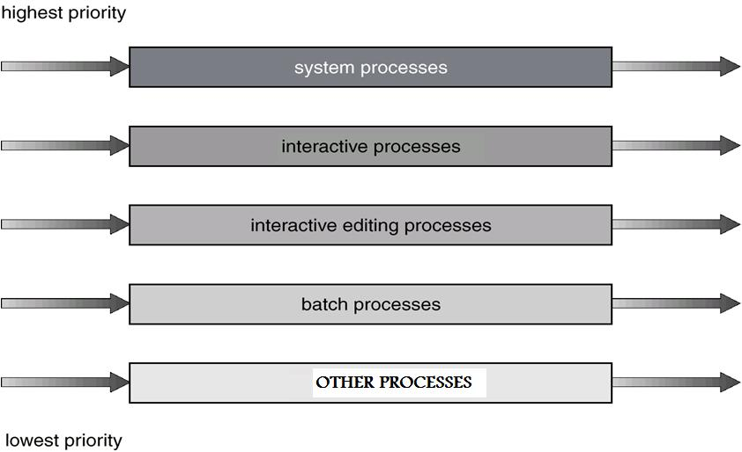
Multi-Level Queue Scheduling
(Contd…)
50%
18%
15%
10%
7%

Slide 30
Multilevel Feedback Queue
A process can move between the various queues; aging can be implemented this way
The idea is to separate processes according to the characteristics of their CPU bursts
If a process uses too much CPU time, it will be moved to a lower-priority queue
This scheme leaves I/O-bound and interactive processes in the higher-priority queues
Also, a process that waits too long in a lower-priority queue may be moved to a higher-priority queue. This form of aging prevents starvation

Slide 31
Multilevel Feedback Queues
(Contd…)
Three queues:
  Q₀ – RR with time quantum 8 milliseconds
  Q₁ – RR time quantum 16 milliseconds
  Q₂ – FCFS
Scheduling
  A new job enters queue Q₀ which is served FCFS. When it gains CPU, job receives 8 milliseconds. If it does not finish in 8 milliseconds, job is moved to queue Q₁.
  At Q₁ job is again served FCFS and receives 16 additional milliseconds. If it still does not complete, it is preempted and moved to queue Q₂.

Slide 32

Multilevel Feedback Queues
(Contd…)
Q0
Q1
Q2

Slide 33
Linux Scheduling
Two algorithms: time-sharing and real-time
The Linux scheduler is a preemptive, priority-based algorithm with two separate priority ranges: a real-time range from 0 to 99 and a nice value ranging from 100 to 140

Slide 34

Relationship Between Priorities and Time-slice length

Slide 35
any questions/doubts?

