Slide 1
Covid-19 Analysis
File created on: 8/2/2022 10:17:33 AM

Slide 2
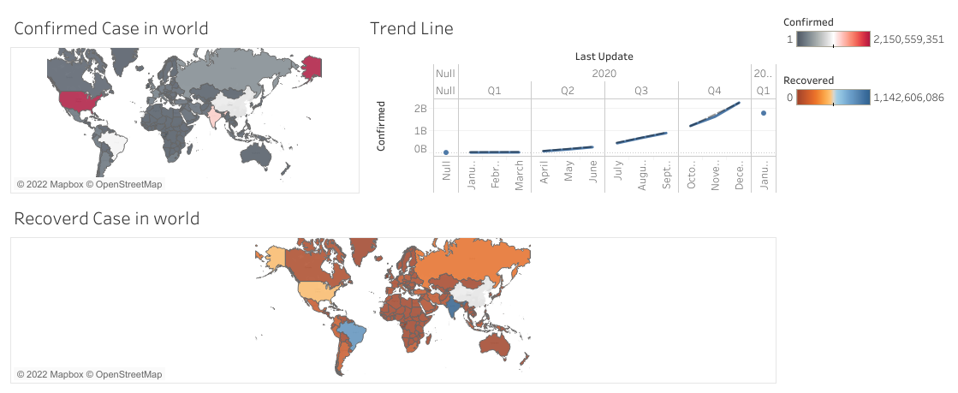

Slide 3
