Slide 1




kubernetes
Advanced Scheduling

Slide 2

AGENDA
Labels & Selectors
1
Labels – Node Level
Selectors – Pod Level
Taints & Tolerations
2
Taints – Node Level
Tolerations – Pod Level
Affinity
3
nodeAffinity – Node Level
podAffinity – Pod Level

Slide 3
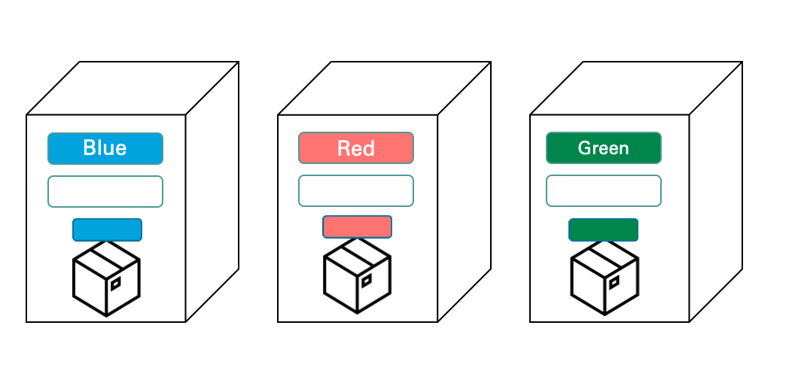

Slide 4

NodeSelector
Blue
Red
Green

Slide 5
NodeSelector
Blue
Red
Green

Slide 6

Taints & Tolerations
It allows rejecting deployment of pods to certain node by adding taints to node.

Slide 7
Taint Effects
Taints & Tolerations
NoSchedule
NoExecute
New pod’s will not be scheduled to the node if they don’t tolerate the taint
Existing pod’s will be evicted from the node, New pod’s will schedule if they have toleration
PreferNoSchedule
It is soft version of NoSchedule, meaning the schedular will try to avoid scheduling the pod to the node, but will schedule it to the node if it can’t schedule it somewhere else

Slide 8
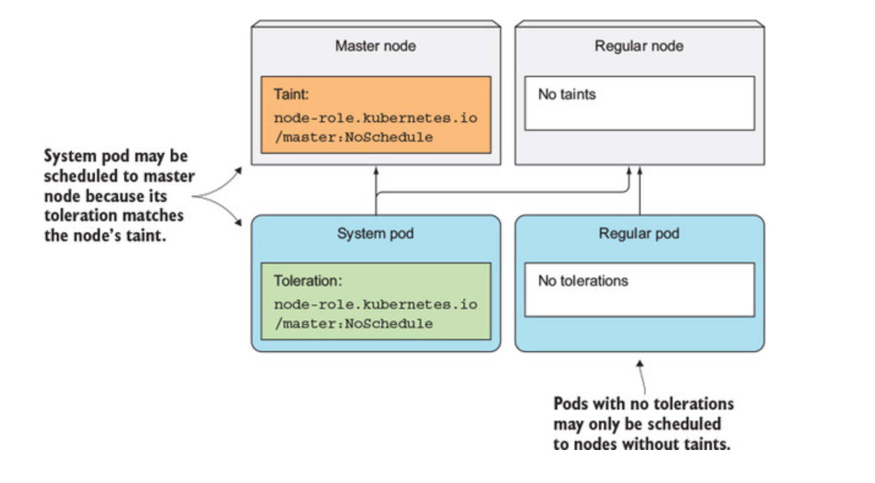

Slide 9
Taints & Tolerations

Slide 10
Taints & Tolerations

Slide 11
Taints & Tolerations

Slide 12
Taints & Tolerations

Slide 13

Taints & Tolerations

Slide 14
Affinity
Affinity is two types
nodeAffinity
podAffinity

Slide 15
nodeAffinity
It specifies that pod should only be deployed on nodes that matched label
Provides scheduling affinity to node based on label
Compared to nodeSelector
It can provide “soft/preference” based affinity. Where as nodeSelector is hard affinity = must
Label selection is more expressive

Slide 16
requiredDuringSchedulingIgnoredDuringExecution
requiredDuringScheduling – the pod must be scheduled to node(s) that match the expressions listed under the matchExpression
IgnoredDuringExecution – indicates that node affinity only applies during the pod scheduling, it doesn’t apply to already running Pods
preferredDuringSchedulingIgnoredDuringExecution
preferredDuringScheduling – the pod can be scheduled to node(s) that match the expressions listed under the matchExpression
IgnoredDuringExecution – indicates that node affinity only applies during the pod scheduling, it doesn’t apply to already running Pods

Slide 17
Taints-Tolerations & Affinity
Blue
Red
Green

