Slide 1
AWS EKS

Slide 2
AWS EKS Cluster - CLIs
AWS CLI
It enables you to interact with AWS services using commands in your command-line shell
CLIs
kubectl
Command Line utility to interact with k8s API. It will allow you control Kubernetes clusters. For configuration
eksctl
eksctl is a simple CLI tool for creating clusters on EKS
It is written in Go.
uses CloudFormation.
Create, update & delete cluster – Control Plane & Data plane

Slide 3
AWS EKS – Core Objects
EKS Cluster
EKS Control Plane
Worker Nodes (or) Node Groups
Fargate Profiles
(Serverless)
VPC
Contains Kubernetes Control Plane components like etcd, kube-apiserver, kube-controller.
It’s a managed service by AWS
Group of EC2 Instances will be part of the control plane to host application.
Instead of EC2 Instances, we can host Application workloads on Serverless using Fargate profiles
Using AWS VPC, we can implement secure networking standards which will allow us to run production workloads on EKS.

Slide 4
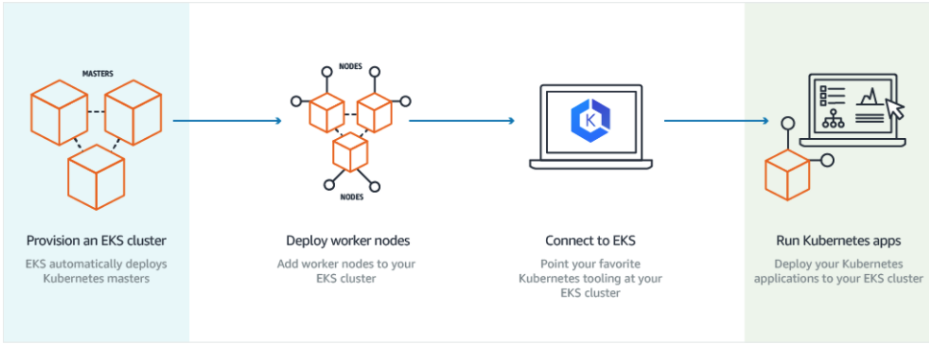
How does EKS work?
© Amazon

Slide 5
EKS Kubernetes - Architecture
Master
Worker Node -1
EKS Controller Manager
Fargate Controller Manager
Kubelet
Kube-Proxy
Container Runtime (Docker)
kube-apiserver
Worker Node - 2
etcd
kube-scheduler
Kubelet
Kube-Proxy
Container Runtime (Docker)
Container Runtime (Docker)
EKS Control Plane
EKS Node Group

