Slide 1
Final Project
Tasks :
Data Discovery , Processing , Loading Task :
Task 1
Move the dataset onto S3.
Create Glue database and 2 crawlers to crawl CSV and JSON folders using AWS CLI only , provide screen shots of using AWS CLI (Please note Console cannot be used to create Database and Crawlers)
Run the Crawlers from CLI
Confirm the data is been able to query from Athena
Task 2
Deploy GLUE locally and not use AWS GLUE. I have shared a walkthrough of this on Last class
Develop a GLUE JOB to convert the CSV files to PARQUET from Local Development only (Do not use AWS GLUE Console). If there are memory limitations then limit the dataset to 100 records only
c. Create crawler using AWS CLI on the parquet file
d. Run the crawler from CLI and confirm data from Athena
Task 3
a. Run basic Analytical queries on the dataset using Athena from AWS Console
Data Versioning Task :
Task 1 Create a repository in github and upload the dataset
a. Create a repository in github.com
Task 2 Generate the Reports and upload them to github
a. Clone the repository that you created in task 1
b. Create a branch for this activity ,Create a file with all the queries from the above tasks.
c. List the version history ( commit history) , status of the local repository
d. Commit the file to the branch
e. Push the changes to the github
Objective:
Integrate and apply the learning outcomes from the various topics covered as part of the Data Engineering course to address the given problem statement along with dataset, design an approach to solution and provide the code and design for one sample solution.
General Tasks:
Understand the data and the problem statement
Understand the features of the dataset
Data Engineering Tasks:
Data Discovery
Data collection from multiple sources
Data wrangling and data preparation
Exploratory data analysis
Data Storage and retrieval

Slide 2
Task 1 : Thought process
Given there were challenges with the AWS lab provided by Jigsaw, I have used my AWS account for the project work.
Data Discovery , Processing , Loading Task :
Task 1
Move the dataset onto S3.
Create Glue database and 2 crawlers to crawl CSV and JSON folders using AWS CLI only , provide screen shots of using AWS CLI (Please note Console cannot be used to create Database and Crawlers)
Run the Crawlers from CLI
Confirm the data is been able to query from Athena
My thought process is as follows:
Create Glue Database -> Created a role that I have used – create CSN and JSON crawlers – run the crawler – check the cloudwatch – go to Atena to check the tables in the database and write a query
There were errors in crawler execution. Though the tables are created; there were no rows.

Slide 3
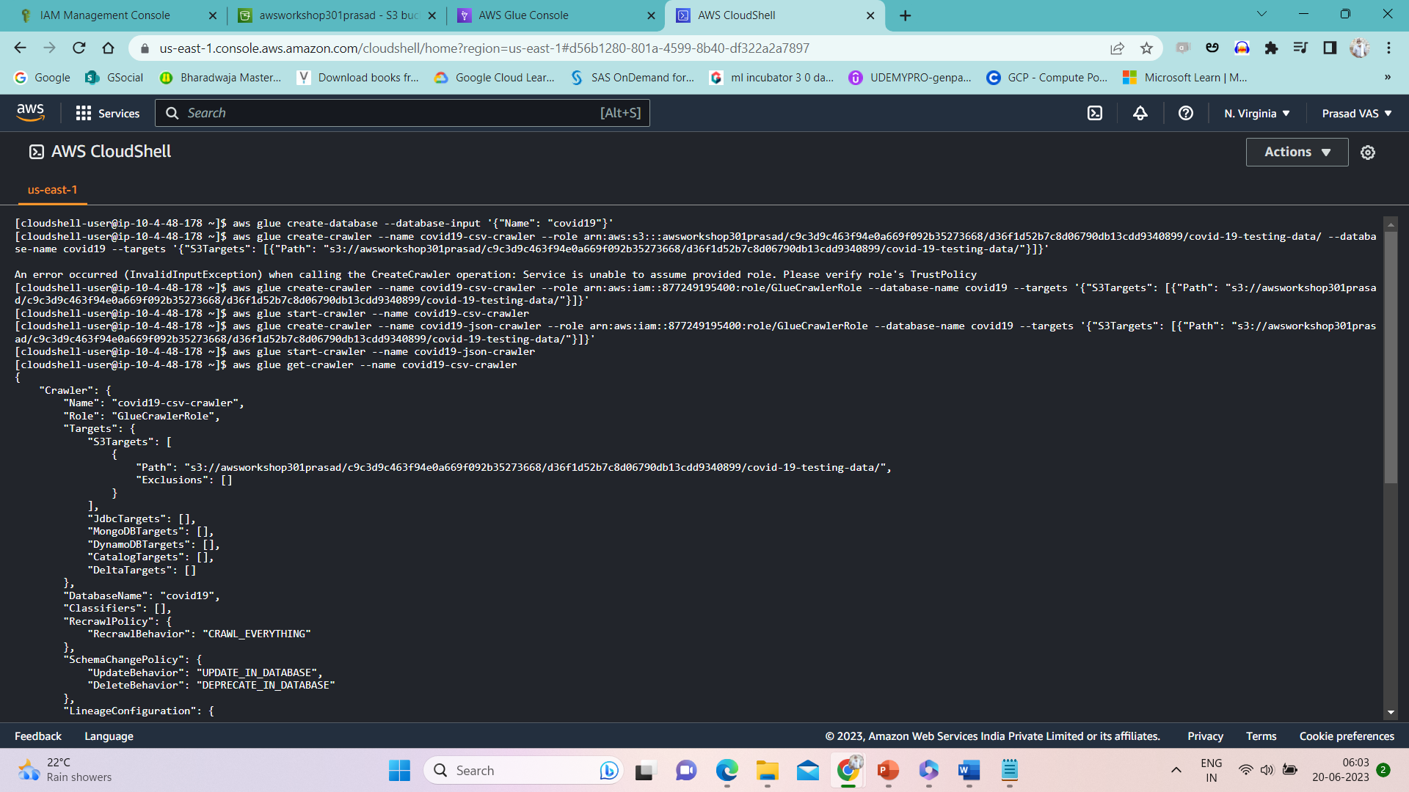
Task 1 : Commands

Slide 4
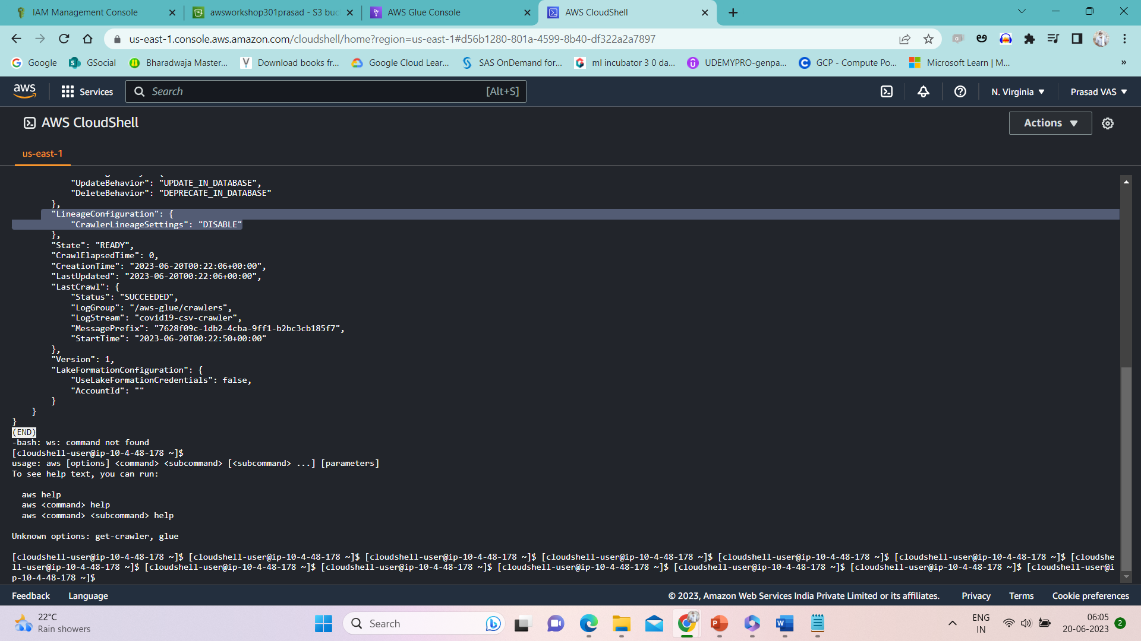
Task 1 : Commands

Slide 5
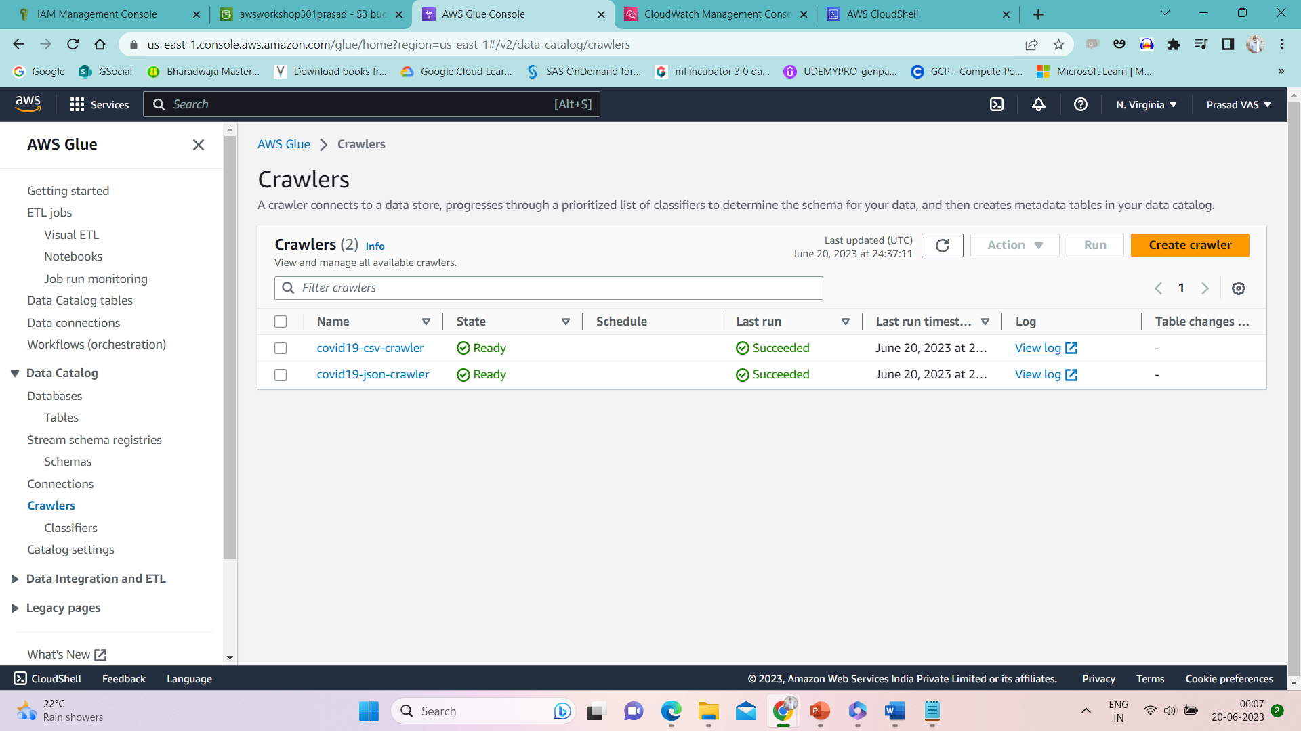
Task 1 : AWS Glue Crawlers

Slide 6
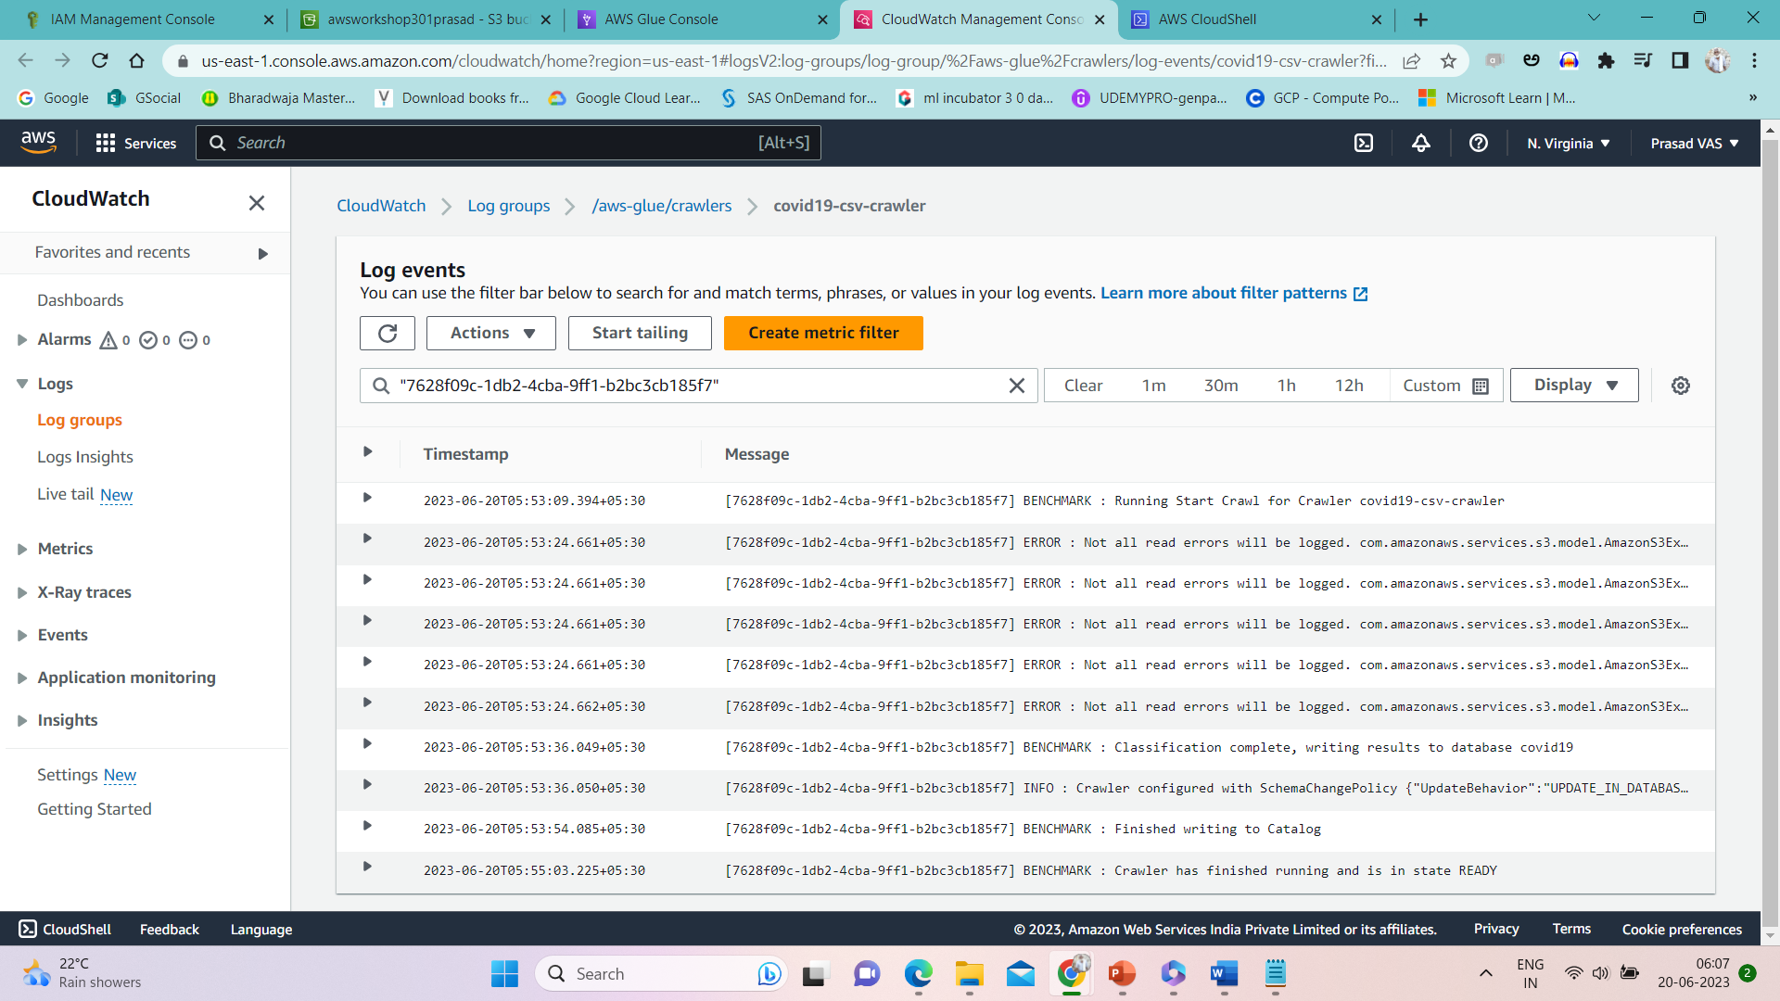
Task 1 : Cloudwatch

Slide 7
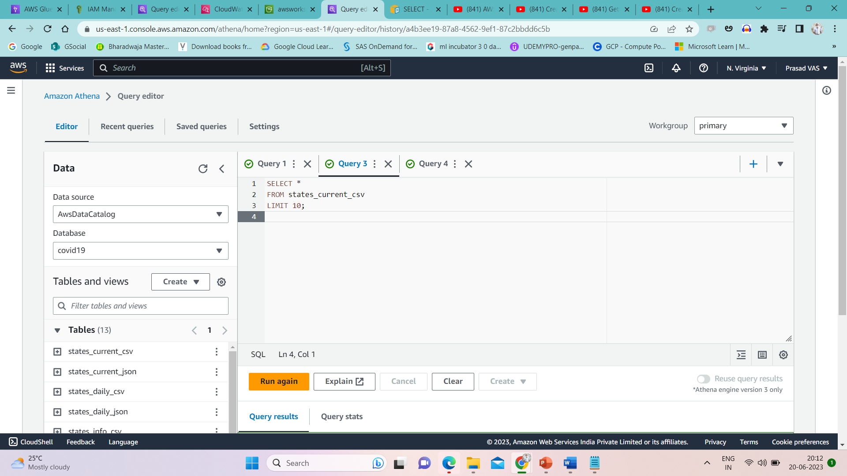
Task 1 : Tables in Athena

Slide 8

Task 1 : Cloudwatch

