Slide 1
Artificial Neural Networks(ANN)
Deep Learning MasterClass

Slide 2
Artificial Neural Networks
The term "Artificial neural network" refers to a biologically inspired sub-field of artificial intelligence modeled after the brain. An Artificial neural network is usually a computational network based on biological neural networks that construct the structure of the human brain. Similar to a human brain has neurons interconnected to each other, artificial neural networks also have neurons that are linked to each other in various layers of the networks. These neurons are known as nodes.

Slide 3
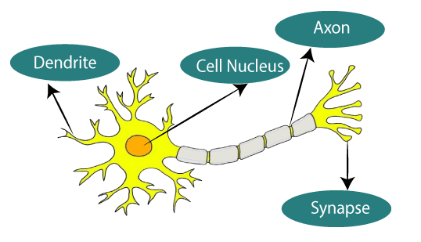

Slide 4
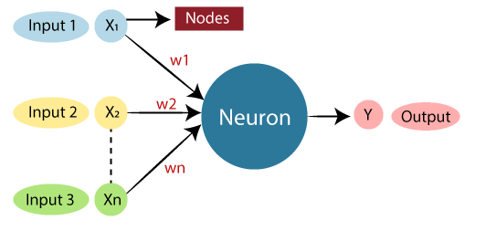

Slide 5
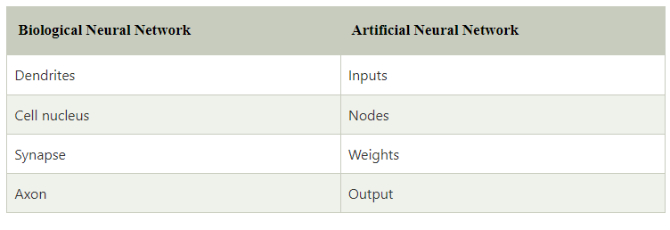

Slide 6
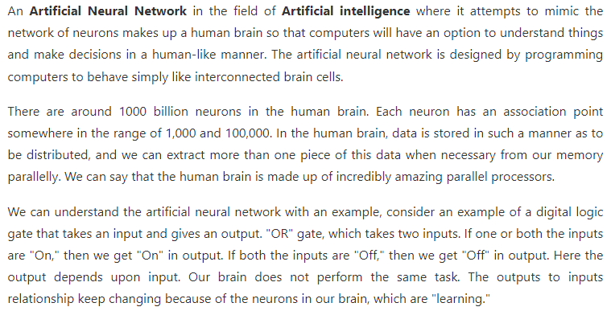

Slide 7
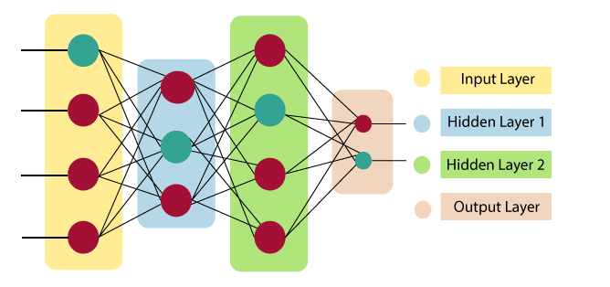
Architecture of ANN

Slide 8
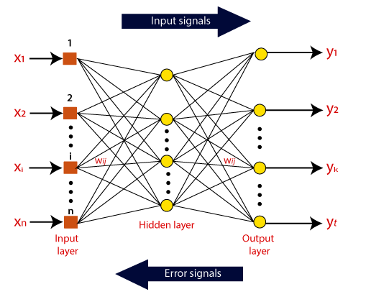

Slide 9
Thank You

