Slide 1
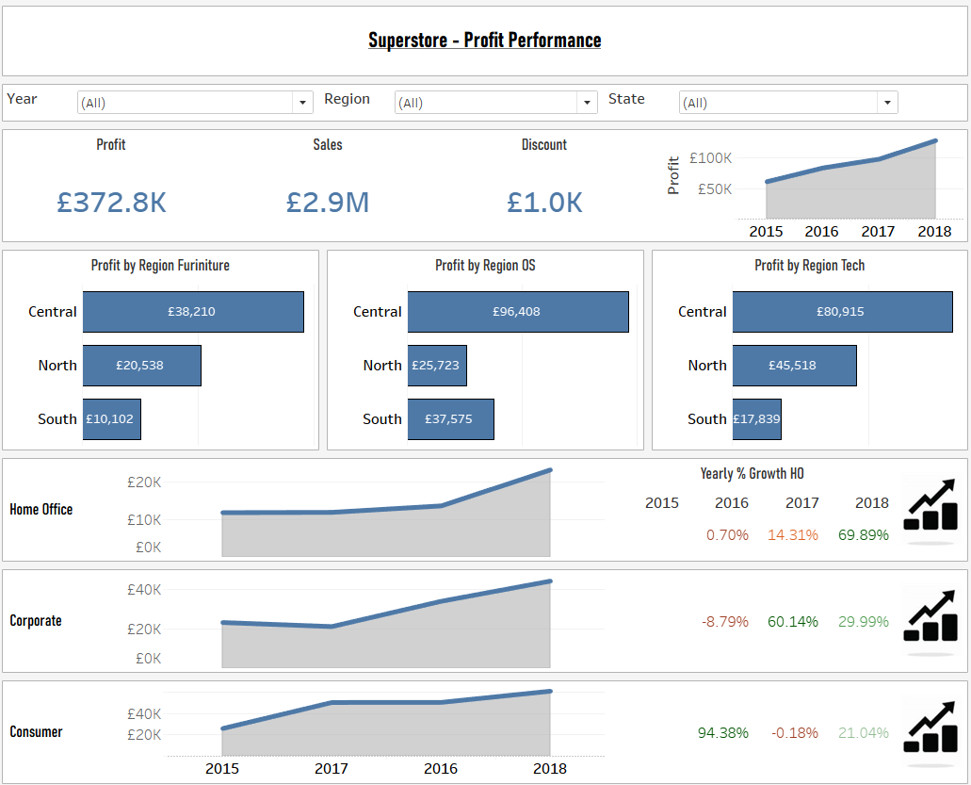
Keep number of fonts to a minimum.
Highest level of detail first.
Be creative.
Keep font sizes consistent.
Keep number of colours to a minimum.
Use images/logos to make it more appealing.
Use containers + borders to make it stand out.
Grey background with white containers.
Lowest level of detail last.

