Slide 1
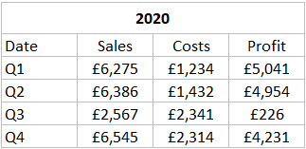
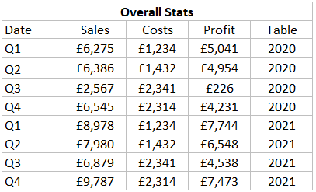
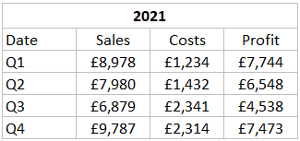
Unions
Unions are an extra method of combining two or more tables in Tableau.
Achieved by appending rows from one table to another.
Can only be successful when the tables contain the same columns.
Example:

