Slide 1

Network Guardian
An Intelligent System That Automatically Protects Computer Networks from Attacks Using Artificial Intelligence
Arya Y P | Adi Narayan Prasad G | Ashrith S Jain | Abhishek
Under the Guidance of Prof. Nalina V
Department of Information Science & Engineering B.M.S. College of Engineering, Bengaluru – 560019
ICWITE 2026 — Accepted Paper
<1 s
2.88 s
99%
Attack Detection
Total Response
Blocking Success
1 / 16

Slide 2
The Cybersecurity Challenge
The Modern Network Threat Landscape
Why We Need Network Guardian
• Cryptic Alerts
IDS shows "ICMP flood from 192.168.1.50 at 150 pps" — no context. Non-experts cannot act on raw technical messages.
• Alert Fatigue
Systems generate thousands of alerts daily. Security teams become desensitized and miss critical threats. [2]
• Manual Response Too Slow
Attacks execute in milliseconds. Average breach detection: 207 days. Containment adds 73 more days. [1]
• Cybersecurity Skills Gap
Organizations lack trained personnel to interpret alerts and respond appropriately under pressure.
✓ Detects attacks in < 1 second
✓ Generates plain-English AI explanations
✓ Autonomously blocks attacker IPs via OS route
✓ 60-second auto-revert — false positives self-heal
✓ 99.96% Wireshark validation agreement
✓ 100% user comprehension vs <30% for raw alerts
✓ Accessible to non-security-expert operators
Research Question:
Can a local LLM be integrated into a live packet-capture pipeline to autonomously detect and mitigate network attacks with sub-second latency?
2 / 16

Slide 3
Related Work
Gap Analysis — Why existing systems are insufficient
Snort [11] — Signature-Based
Anomaly IDS [12] — Behaviour Baseline
Open-source rule-based detection. Cannot generalize to zero-day exploits or novel attack variants. No explanations provided.
Establishes traffic baselines and flags deviations. High false-positive rate: 10–30%, making production deployment challenging.
DNN / ML IDS [13]
LIME / SHAP [14,15]
Deep neural network classifiers achieve 95–99% accuracy on benchmarks. However, black-box — no explanations, limiting trust.
Post-hoc ML explanation methods. Technical output only — not accessible to non-security-expert operators.
LLM for Security [16]
AI-Based IDS [18–24]
Recent work explores LLMs for security tasks. Network Guardian distinguishes itself: LLM for explanation, not detection.
KNN, Naive Bayes, SVM — effective on benchmarks but no single solution covers all attack types or provides autonomous mitigation.
Gap Identified: No existing system combines sub-second sliding-window detection + local LLM plain-English explanations + autonomous OS-level mitigation with auto-revert in a single lightweight Python pipeline.
3 / 16

Slide 4
Network Guardian Solution Overview
🛡
Autonomous Detection
🤖
AI-Powered Explanation
⚡
Autonomous Mitigation
Real-time monitoring of 5 attack types: • ICMP Flood • SYN Flood • UDP Flood • Port Scan • IP Fragmentation Sliding-window counters per source IP. Sub-second detection latency (<1 s). Cooldown 60 s per (IP, attack type) pair. < 0.01 false-positive rate over 100 hours.
Locally hosted TinyLlama 1.1B via Ollama. No cloud — private, offline, fast. Structured JSON prompt → plain-English output: { "attack", "explanation", "mitigation" } temperature=0.1 — near-deterministic. 94% first-attempt success rate. Mean analysis time: 2.46 s.
OS-level route blocking: Windows: route add <IP> mask ... 192.0.2.1 Linux: ip route add blackhole <IP>/32 No shell=True — injection-proof. IP validated before every command. 60-second auto-revert daemon thread. 99% blocking success (198/200 tests).
4 / 16

Slide 5

Proposed System Architecture
5-Layer Modular Queue-Based Pipeline
5-Layer Modular Design
• Web Dashboard
Flask+SocketIO real-time browser UI
• Mitigator
OS route block, 60 s auto-revert
• LLM Analyzer
TinyLlama explains threats in plain English
• Attack Detector
5 sliding-window detectors in parallel
• Network Sniffer
Scapy packet capture, metadata extraction
Shared Queue Bus: packet_queue (5000) | threat_queue (100) | ui_log_queue (500) | active_blocks dict | threat_history list
5 / 16

Slide 6
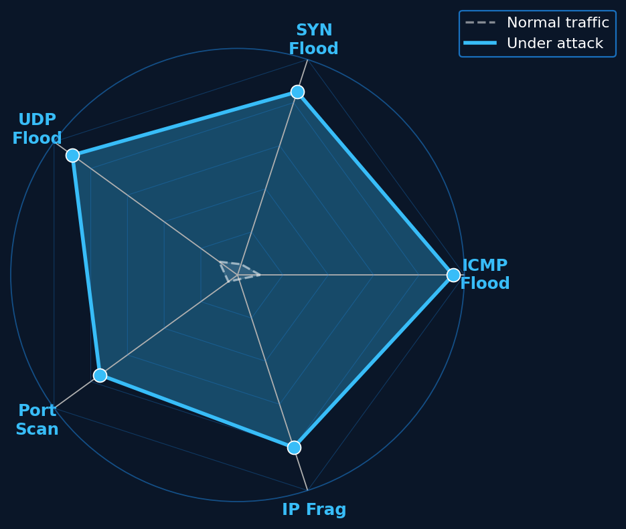
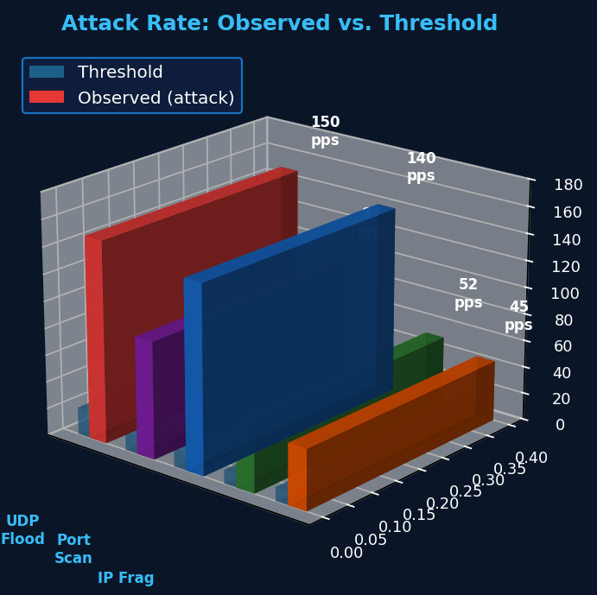
Attack Detection Engine
Five independent sliding-window detectors — sub-second latency
Detection Algorithm Parameters (Table I of paper)
Attack Type
Threshold
Window
Cooldown
ICMP Flood
20 pps
1.0 s
60 s
SYN Flood
20 pps
1.0 s
60 s
UDP Flood
20 pps
1.0 s
60 s
Port Scan
10 ports
5.0 s
60 s
IP Fragmentation
10 pps
1.0 s
60 s
Detection Latency Results (Table IV)
Attack
Min (s)
Mean (s)
Max (s)
ICMP
0.11
0.14
0.19
SYN
0.23
0.27
0.34
UDP
0.12
0.15
0.21
Scan
0.45
0.51
0.62
Frag
0.18
0.21
0.27
6 / 16

Slide 7
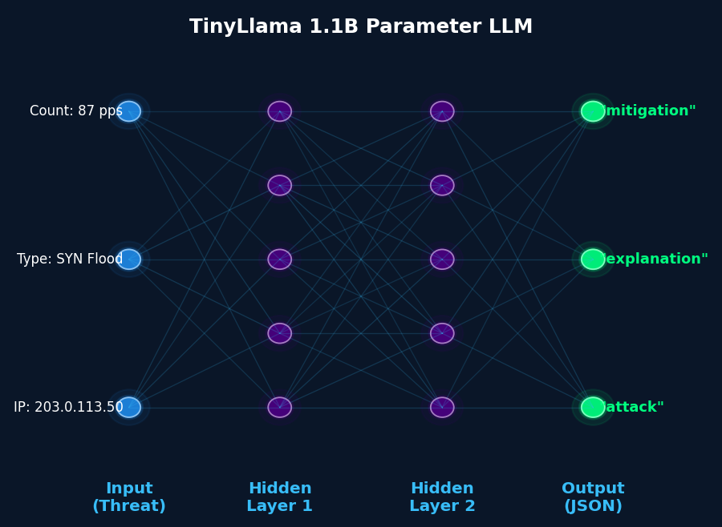
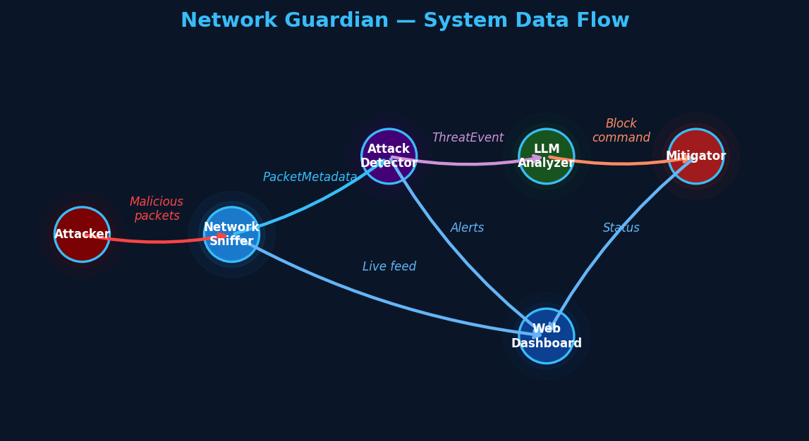
LLM Analyzer — AI-Powered Explanation
TinyLlama 1.1B via Ollama · Local · Private · No cloud
🧠
Key Design Features
• TinyLlama-1.1B via Ollama at localhost:11434
• temperature=0.1 | num_predict=200 (bounded)
• 3-retry policy with 30 s timeout per attempt
• Fallback reasoning if Ollama unreachable
• IP hallucination guard — auto-corrects wrong IP
• 94% first-attempt JSON success | Mean: 2.46 s
Prompt → Ollama → JSON Response
INPUT: Source IP: 203.0.113.50 Attack: SYN Flood Count: 87 pps (baseline < 20 pps) OUTPUT (JSON): "attack": "SYN Flood" "explanation": "Attacker sends SYN packets without completing handshake, exhausting TCP connection queue of 128-512 slots." "mitigation": "route add 203.0.113.50 mask 255.255.255.255 192.0.2.1"
7 / 16

Slide 8
Autonomous Mitigation Layer
Security-first design — injection-proof OS-level route blocking
• Command Injection Prevention
LLM output NEVER passed to shell=True. IP validated with Python ipaddress module before any OS call.
• OS Block Command
Windows: route add <IP> mask 255.255.255.255 192.0.2.1 Linux: ip route add blackhole <IP>/32 Gateway 192.0.2.1 = RFC 5737 TEST-NET (unreachable blackhole).
• Auto-Revert (60 seconds)
Daemon thread sleeps 60 s → runs route delete. False positives self-heal — no permanent routing damage.
• Safety Checks
Refuses to block loopback (dashboard stays accessible). Refuses to block multicast. subprocess.run(shell=False, timeout=10).
• Duplicate Block Prevention
IP marked in active_blocks before route command. Concurrent threats for same IP serialised under lock.
🔄
Mitigation Status Lifecycle
PENDING → APPLIED → auto-revert 60 s
PENDING → FAILED → removed (route error)
198 / 200 successful blocks in testing
Auto-revert: 60.02 ± 0.09 s (100 tests)
100% traffic reduction verified by Wireshark
📡
Wireshark Block Verification
Before block:
Continuous attack traffic with signatures visible.
After block:
Zero packets from blocked IP — 100% reduction.
After auto-revert (60 s):
Traffic resumes — revert mechanism confirmed correct.
99.96% Scapy ↔ Wireshark packet count agreement
across five 10-minute validation sessions.
8 / 16

Slide 9
Real-Time Web Dashboard
Layer 5 — Flask + Socket.IO · http://localhost:5000 · Updates every 500 ms
• Packet Feed
Last 50 packets, colour-coded by protocol (ICMP/TCP/UDP). Live scrolling table with timestamp.
• Threat History
Last 10 ThreatEvents with full LLM reasoning displayed inline.
• Active Blocks + Timers
Blocked IPs with countdown to 60-second auto-revert.
• Attack Injection Buttons
Browser controls: ICMP | SYN | UDP | Port Scan | Frag | ALL.
• Control Actions
Flush All Blocks — removes all active OS routes. Shutdown — graceful exit, flushes blocks.
Socket.IO Events (server → browser push)
packet_feed — new packet batch (up to 50) threat_feed — updated ThreatEvent list log_feed — new system log messages status_update — active_blocks count + IP list
REST API Endpoints
GET /api/status — blocks, threats, queue size POST /api/attack — launch test attack (rate capped 1000 pps) POST /api/flush — remove all active blocks POST /api/shutdown — graceful exit
Background emitter thread reads shared_state every 500 ms → pushes all 4 event types to connected browsers via WebSocket. Memory capped: 500 packets, 200 log lines, 10 threats.
9 / 16

Slide 10
Technical Implementation
🐍
Python Stack
📐
Module Architecture
🔗
Queue-Based Design
Language: Python 3.10+ Packet capture: Scapy + Npcap (Win) libpcap (Linux) LLM inference: TinyLlama-1.1B via Ollama Web framework: Flask + Socket.IO Mitigation: OS routing commands Validation: Wireshark
7 modules — 1,720 lines total main.py 250 lines shared_state.py 80 lines network_sniffer 120 lines attack_detector 350 lines llm_analyzer 280 lines mitigator 240 lines attack_injector 400 lines
Fault isolation: Each layer fully independent packet_queue 5,000 cap threat_queue 100 cap ui_log_queue 500 cap 5-second buffer @ 1,000 pps Single-responsibility principle throughout all 7 modules
10 / 16

Slide 11
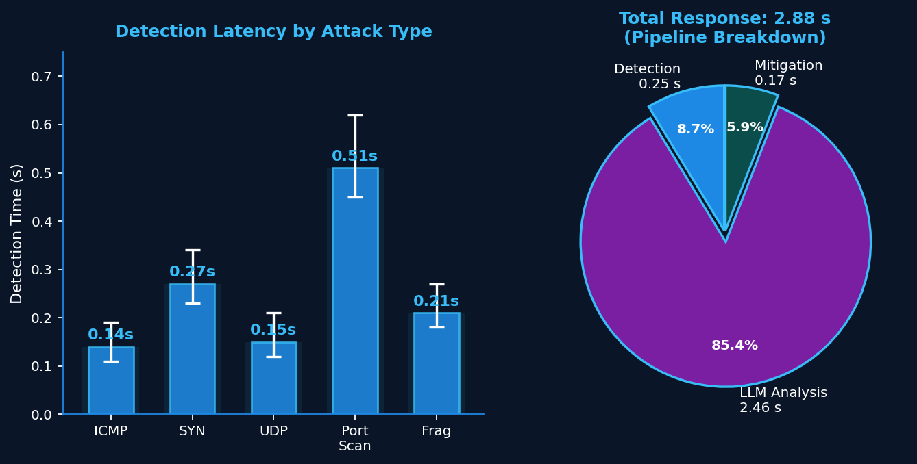
Experimental Results
Tested on Windows 11 | Npcap loopback | TinyLlama CPU inference
📊
Key Numbers
Detection
< 1 second
LLM Analysis
2.46 s mean
Mitigation
0.17 s mean
Total Pipeline
2.88 s end-to-end
Blocking Success
99% (198/200)
False Positive Rate
< 0.01
<1 s
2.88 s
99%
0.01
Attack Detection
Total Response
Blocking Success
False +ve Rate (<)
11 / 16

Slide 12
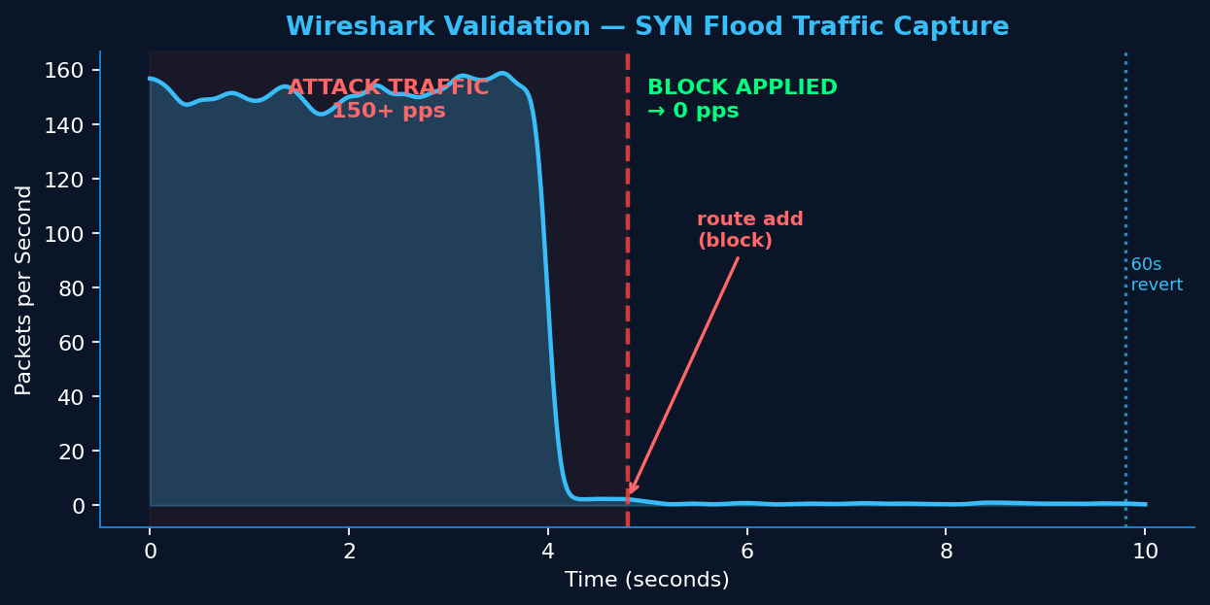
Wireshark Validation
Ground-truth verification — 99.96% Scapy ↔ Wireshark packet agreement
✅
Session Agreement
Session 1: 12,487 vs 12,483 → 99.97%
Session 2: 18,923 vs 18,915 → 99.96%
Session 3: 9,456 vs 9,452 → 99.96%
Session 4: 15,234 vs 15,229 → 99.97%
Session 5: 20,891 vs 20,881 → 99.95%
Mean Agreement: 99.96%
📋
10-Step Workflow
🔍
Wireshark Filters
1. Wireshark capture filters → 2. Start Guardian
3. Inject attack → 4. Observe live capture
5. Apply attack filter → 6. Confirm detection
7. Validate LLM explanation accuracy
8. Verify block via routing table
9. Confirm traffic stops → 10. Wait 60 s revert
ICMP Flood: icmp.type==8
SYN Flood: tcp.flags.syn==1 && tcp.flags.ack==0
Port Scan: tcp.flags.syn==1 (unique dst ports)
Fragmentation: ip.flags.mf==1 || ip.frag_offset>0
12 / 16

Slide 13
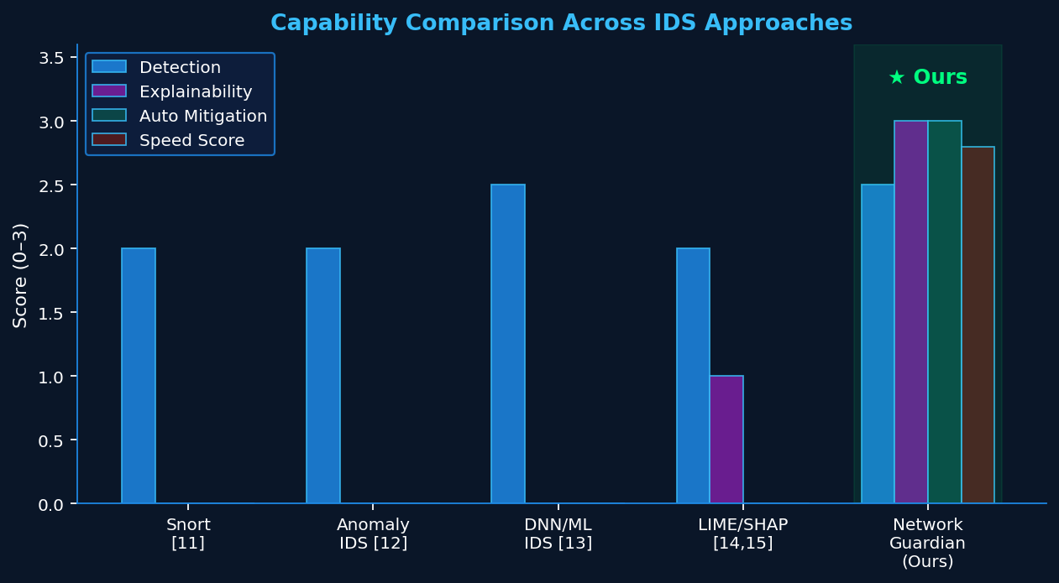
Comparison with Existing Approaches
Network Guardian vs. Snort / Anomaly IDS / DNN/ML / LIME+SHAP (Table VI)
★
What Makes Us Different
Snort [11]
✗ No explainability ✗ No auto-mitigation
Anomaly IDS [12]
✗ 10–30% false positives ✗ No mitigation
DNN/ML IDS [13]
✗ Black-box ✗ No explanation ✗ No action
LIME/SHAP [14,15]
✗ Technical only ✗ No mitigation
Network Guardian
✓ Plain English ✓ Auto-block ✓ 2.88 s ✓ Revert
Approach
Explainability
Auto Mitigation
Response
Snort
None
No
Manual
Anomaly IDS
None
No
Manual
DNN/ML IDS
None (black box)
No
Manual
Network Guardian
Plain English
Yes (60s revert)
2.88 s
13 / 16

Slide 14
Challenges & Limitations
⏱
Technical Challenges
⚖
Ethical Considerations
🌐
Scope Limitations
LLM response randomness: ~2% responses had formatting errors. Solved: exponential backoff + retry. CPU-only inference: 2.46 s per explanation. GPU deployment → < 0.5 s. Single-host only — no distributed or multi-network support yet. IPv6 not yet supported.
False positive risk: Legitimate traffic could be blocked. Mitigated by 60 s auto-revert. LLM explanations are AI-generated: Should not replace human judgment for critical security decisions. Balancing autonomous action with human oversight in production.
Tested on local loopback only (RFC 5737 TEST-NET source IPs). 5 attack types only: DNS amplification and HTTP slowloris not yet covered. Adversarial disinformation evolves: Thresholds need continuous recalibration for new patterns.
14 / 16

Slide 15
Conclusion & Future Scope
🛡
Summary
🚀
Future Roadmap
Network Guardian proves that integrating local LLMs into network security is feasible, practical, and valuable.
✓ Detects attacks in < 1 second
✓ Explains in plain English — 2.5 s
✓ Blocks in 0.17 s with 60 s auto-revert
✓ 99% blocking success rate
✓ < 0.01 false positive rate — 100 hours tested
✓ 99.96% Wireshark validation agreement
✓ 100% user comprehension of AI explanations
vs. < 30% for raw technical alerts
Especially valuable as an educational tool: students launch attacks against themselves and immediately observe AI-driven detect+explain+block.
GPU-Accelerated LLM
Llama-3 / Mistral on GPU → < 0.5 s analysis.
Adaptive Thresholds
EWMA + Bayesian traffic baseline recalibration.
Multi-Host Deployment
Distributed agents with centralised control.
SIEM Integration
ThreatEvents → Elasticsearch / Splunk / syslog.
Threat Intelligence Feeds
VirusTotal + MITRE ATT&CK + PostgreSQL.
Extended Attack Coverage
DNS amplification, HTTP slowloris, multiple LLM workers for parallelism.
15 / 16

Slide 16
?
Questions?
Thank you for your attention.
Arya Y P | Adi Narayan Prasad G | Ashrith S Jain | Abhishek
Dept. of ISE | B.M.S. College of Engineering, Bengaluru | ICWITE 2026

