Slide 1

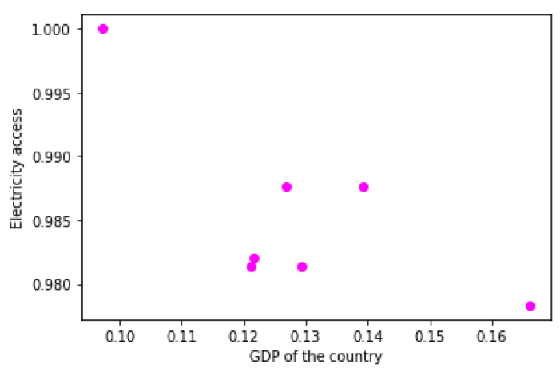
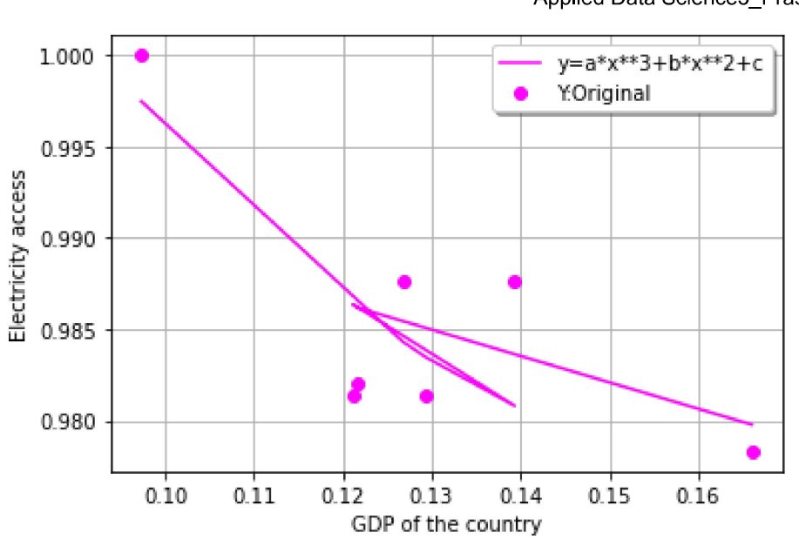
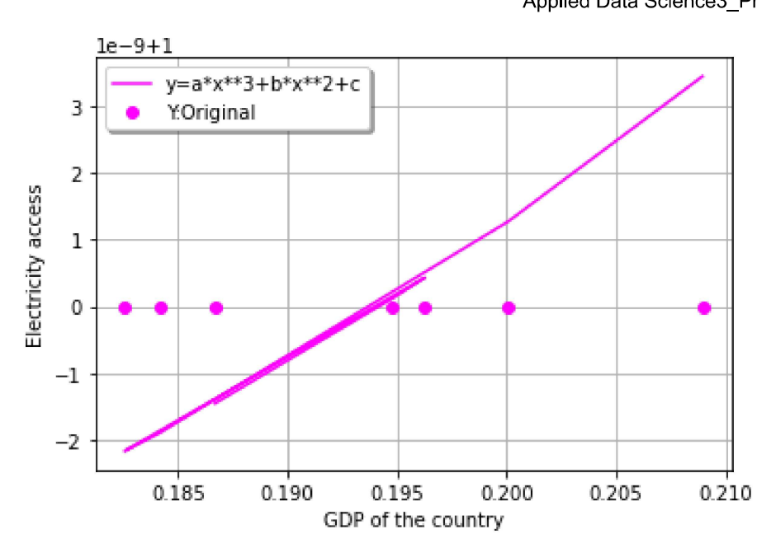

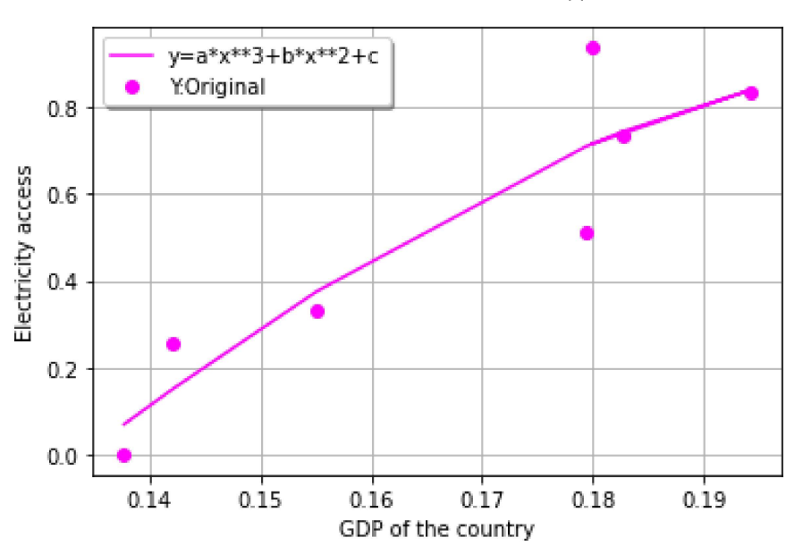

“Relationship between electricity access and GDP of nation”
Introduction
The report presents relationship between economic growth and energy consumption. Changing electricity during lockdowns that has resulted in important decrease in electricity demand with patterns and consumption levels. The analysis use tools as well as techniques in order to find unforeseen patterns of correlation in making of the decision. Data science practises complex machine learning algorithms so that they can be creation of predictive models.
There is an negative or high negative relationship between GDP and electricity access. Even with the lower GDP, there is an higher use of electricity and its has higher access. On the other hand, when GDP of the nation increases then electricity access decreases (Mendonca, Barni, Moro, Bornia, Kupek, and Fernandes, 2020).
Brazil shows negative correlation between GDP and electricity access. It shows when on variable increases then other variable decreases. However, investing in renewable energy can lead to accelerate growth of GDP. Thanking to development of the interconnections within Brazil and other neighbouring nations. It can contribute intelligent distribution networks which will be indispensable for management of energy flows of the new energy systems through the digital platforms as being marked by increasing penetration of electricity (Lima, and Bacchi, 2019).
GBR (united kingdom) that has higher consumption of electricity. Even when it has least accessibility of electricity and lower energy demand because of COVID-19 pandemic. It has contributed to decrease of nearly 30 percent in overall energy imports in 2020. UK has imported lesser petroleum, coal, natural gas, and other liquids including electricity. Full lockdown generally pushes the overall electricity demand to 20% with least impact from partial lockdown. It is because UK has stepped away from energy intensive industries and focused more on service based industry. The nation`s move far from fossil fuels to the renewable energy.
Conclusion
For the nation, it shows India has lower electric power consumption. The correlation is quite lower between 0.14-0.19 which shows that there is an positive relationship between accessing of energy and GDP of nation but it is quite poor.
From the above discussion, it is seen that there is an comparison between country with higher or lower electric power consumption. It shows that the relationship is direct between electricity access in percentage and GDP of nation. For the countries with medium electric power, the overall relationship between electricity access (in percentage) and GDP of nation is indirect.
References
de Souza Mendonca, A.K., Barni, G.D.A.C., Moro, M.F., Bornia, A.C., Kupek, E. and Fernandes, L., 2020. Hierarchical modeling of the 50 largest economies to verify the impact of GDP, population and renewable energy generation in CO2 emissions. Sustainable Production and Consumption, 22, pp.58-67.
de Lima, L.M. and Bacchi, M.R.P., 2019. Assessing the impact of Brazilian economic growth on demand for electricity. Energy, 172, pp.861-873.

