Slide 1
Tandem-Rotor Interference in Forward Flight
Free-vortex wake model of the forward-rotor wake acting on the aft rotor, applied to a CH-47 Chinook class baseline
• Rotary-Wing Aerodynamics: Advanced Concept Modeling Project, Team 6
• Special topic: coaxial / multirotor interference (handout example list)
• Team members (name, roll number):
  – Prasad — Roll No. [FILL IN]
  – Member 2 name — Roll No. [FILL IN]
  – Member 3 name — Roll No. [FILL IN]
  – Member 4 name — Roll No. [FILL IN]
• 18 October 2026

Slide 2
Background: what the phenomenon is
• A tandem helicopter has two counter-rotating rotors in line; the aft rotor works partly or wholly in the wake of the forward rotor.
• Hover: the wakes interact mainly in the overlap lens (14.9 % of one disk for the CH-47 class); each rotor induces velocity on the other.
• Forward flight: the forward wake is skewed rearward and swept through the aft disk. The aft rotor then flies in a downwash comparable to the forward rotor's own far-wake value (up to ~2v_i).
• Extra downwash on the aft rotor = extra induced power, an aft-heavy power split, and changed trim (differential collective, cyclic).
• Design response seen on real aircraft: the CH-47 aft rotor is raised on a tall pylon and the shafts are spaced ~1.5R apart to reduce interference.
• Single-rotor BEMT / momentum tools assume each rotor sees only the free stream, so they under-predict tandem power. That is the gap this project fills.
Background | Team 6
Notes:
Significance: tandem interference is a major power penalty for tandems in low-to-moderate speed forward flight. It sets engine sizing, fuel burn and the fwd/aft load share.

Slide 3
Background: applicability to our CH-47 class baseline
Parameter | Value
Rotor radius R | 9.14 m
Shaft separation d | 13.60 m (1.487 R)
Disk overlap | 14.94 % of one disk
Aft rotor height above fwd | 1.30 m
MTOW | 22 680 kg
Blades fwd / aft | 3 / 3, counter-rotating
Tip speed | 220 m/s
Fuselage flat-plate area f | 3.7 m² (assumed)
• Hand check (momentum, sea-level ISA, equal split): disk loading ≈ 424 N/m² per rotor, ideal hover v_i ≈ 13.2 m/s, ideal induced power ≈ 2.93 MW total, with no interference.
• Any interference model must raise this. Our target question: how much, and on which rotor, across the speed range?
• Applicable regime: hover to cruise transition and low/moderate speed (μ ≈ 0.1–0.2), where induced power is a large share of total power and the forward wake passes close to the aft disk.
Background | Team 6

Slide 4
Background: the key physical relations
• Momentum theory (actuator disk): T = ṁ·w, ideal power P = T·(V_c + v_i). Air already moving down through the disk at V_c costs extra power T·V_c, exactly as in climb.
  – A rotor in another rotor's downwash is therefore a rotor "in climb": same thrust, more collective, more induced power.
• Forward flight (Glauert): v_i = T / (2ρA·√(V² + v_i²)) ≈ T/(2ρAV) at moderate speed, so induced velocity and induced power fall roughly as 1/V.
• Wake skew angle from the shaft axis: χ = arctan(μ / (μ_z + λ_i)). Hover χ = 0 (wake straight down); as μ rises χ → 90° and the wake trails back almost in the rotor plane, over anything behind it.
  – Hover: interaction only where the disks overlap, and mutual. Forward flight: the forward wake reaches the whole aft disk, even with no overlap; one-sided.
• Power-required "bucket": induced (falls ~1/V) + profile (rises slowly, ~1 + 4.65μ²) + parasite (rises ~V³). Minimum = best endurance and best climb speed.
• Hover: P ∝ T·√(T/2ρA), so power grows with √(disk loading); figure of merit FM = P_ideal / P_actual measures losses. Interference acts like a loss of FM for the rotor pair.
Background | Team 6

Slide 5
Background: blade–wake interaction and tandem design features
• Tip vortex: concentrated vorticity with a small viscous core; induced velocity is large near it and changes sign across it (upwash on one side, downwash on the other).
• Blade–vortex interaction (BVI): an aft blade passing close to a forward tip vortex sees a rapid swing in local angle of attack → impulsive lift, BVI noise ("blade slap") and vibratory hub loads.
  – Encounter strength set by vortex circulation (forward-rotor thrust), miss distance and blade–vortex angle (parallel = most impulsive).
  – Miss distance set by vertical stagger, wake skew and descent (advance ratio, inflow, shaft tilt) and longitudinal separation; blade phasing sets where encounters occur.
• Non-uniform, laterally asymmetric downwash on the aft disk adds roll and pitch moments that the aft rotor's cyclic must trim out.
• Tandem design features driven by the interaction:
  – Counter-rotation: torques cancel (no tail rotor); blades in the overlap move in the same direction, which eases interleaving.
  – Blades interleave in the overlap, so the rotors are synchronised at a fixed phase through a cross-shaft; loss of synchronisation means blade collision.
  – Aft rotor raised on a tall pylon and shafts ~1.5R apart: keeps the aft rotor above most of the forward wake and increases miss distance, at a weight and drag cost.
  – Longitudinal trim by differential collective between the rotors.
Background | Team 6

Slide 6
Literature review: modelling methods for rotor–rotor interference
• Momentum / overlap corrections: empirical induced-power factor applied to the overlap area. Instant, but no wake geometry and no forward-flight sweep.
• Vortex cylinder (Coleman, Feingold & Stempin 1945): uniformly loaded, non-contracting wake; v grows from v_i at the disk to 2v_i far downstream. Used for tandems by Tate (1958). This is what our teammate's BEMT tool uses on the overlap area.
• A. Rigid helical wake: discrete tip vortices on a fixed helix, Biot–Savart. Adds blade number and correct sign above/below the disk; no contraction.
• B. Prescribed wake (Landgrebe 1969; Kocurek & Tangler 1976; Young 1976 with strip theory; Egolf & Landgrebe 1983 for forward flight): empirical tip-vortex geometry fitted to isolated-rotor tests.
• C. Free-vortex wake (Bhagwat & Leishman 2001; Leishman & Bagai 1994 twin rotors; Griffiths & Leishman 2002; Tonkal et al. 2010 rear rotor in front rotor wake): markers convected by the local velocity, mutual wake distortion captured.
• D. Viscous vortex particle method (Tan, Sun & Barakos 2018 CH-47D tandem; DUST, Zanotti et al. 2021): particles, handles wake merging; separate solver, hours per case.
• CFD (e.g. Chen et al. 2019 extracting tandem/coaxial inflow models) sits at the top of the fidelity ladder.
Literature Review | Team 6

Slide 7
Literature review: model comparison
Model | Captures (fwd → aft) | Misses | Cost | Tandem evidence
Coleman cylinder | Mean Δv, v_i → 2v_i growth | Contraction, tip vortices, wake skew outside overlap | Trivial | Tate 1958
A. Rigid helix | Off-axis tip-vortex field, sign above/below | Contraction | < 1 s | None specific
B. Prescribed wake | + contraction, two-rate descent, Δv(r) | Mutual distortion; isolated-rotor hover fits | < 1 s | Young 1976 (single rotor)
C. Free-vortex wake | Mutual distortion, unsteady, forward flight skew | Viscous merging only via core model | Minutes | Leishman & Bagai 1994; Tonkal 2010
D. Viscous VPM | All above + wake merging, ground effect | Cost; external solver | Hours | Tan, Sun & Barakos 2018 (CH-47D)
• Data sources for comparison: Dingeldein NACA TN-3236 (1954) tandem wind-tunnel power vs μ; Sweet NASA TN D-534 (1960) overlapped hover; Tan et al. (2018) CH-47D model.
• Foundational: Coleman 1945, Landgrebe 1969. Recent archival: Tan et al. 2018 (J. Aircraft), Zanotti et al. 2021, Chen et al. 2019.
Literature Review | Team 6

Slide 8
Model selection (1/2): free-vortex wake, judged on the rubric criteria
Criterion | Coleman cylinder (original tool) | Prescribed-wake hybrid (survey's first choice) | Free-vortex wake → Δv map (selected) | Vortex particle method
Physical fidelity | Uniform Δv on overlap only; zero for separated disks | Contracted tip vortices; isolated-rotor hover geometry | Both wakes free and mutually distorted; skewed forward-flight wake; correct sign above/below disk | Highest; wake merging, viscous effects
Required inputs | v_i, overlap, stagger | + empirical wake constants fitted to untapered blades | Same blade geometry and airfoil as BEMT; core-model constants | + solver and particle setup
Cost in the tool | ≈ 0 | < 1 s per BEMT call | Minutes per μ offline, then < 1 s per trim | Hours per case
Validation data we hold | Predicts 0 for TN-3236: fails | Hover only; no verifiable hover overlap data | TN-3236 Fig. 6 forward flight, digitised | No tandem forward-flight results
Compatibility with our code | Already in | Needs per-station inflow; hover only | Enters azimuth-resolved edgewise BEMT via one external_inflow argument | External solver only
Fit to CH-47 question | Small hover effect (+2.7 %) | Hover only | Forward flight, where the CH-47 spends its mission | Benchmark only
Model Selection | Team 6
Notes:
Source: modeling_project/model_selection.md.

Slide 9
Model selection (2/2): why the plan changed after the survey
• The data decided it. The only tandem data set we could obtain and digitise is Dingeldein, NACA TN-3236 Fig. 6: level forward flight, two rotors 1.03 D apart, no disk overlap. A model has to work in forward flight to be validated at all.
• Overlap models miss the effect. Coleman's overlap model predicts zero interference for that rig, yet the rear rotor needs 6–9 hp (60–70 %) more than a single rotor. In forward flight the forward wake is swept over the whole aft disk.
• A prescribed wake cannot do this either: Landgrebe / Kocurek–Tangler fits are isolated-rotor hover geometries, and forward-flight prescribed wakes (Egolf & Landgrebe) also leave out the mutual distortion of the two wakes, which is the phenomenon itself.
• The survey's hover hybrid relied on an overlap-hover data file whose source could not be verified; it was removed, leaving no hover overlap data we could defend.
• The cost is paid offline: the free wake runs once per advance ratio (minutes); the tool stores Δv(r, ψ) and the BEMT reads it in < 1 s per trim.
• Highest fidelity was not chosen: VPM adds wake merging but costs hours per case and has no forward-flight tandem data to check it against.
Model Selection | Team 6

Slide 10
Implementation: model structure (tandem_fvw.py, ~540 lines, Python + numba)
• Blades: lifting line, 8 spanwise panels per blade, rigid blades; section lift and drag from the same linear airfoil constants as the BEMT tool (NACA 0012 polar cd = 0.0087 − 0.0216α + 0.400α²).
• Wake: vortex lattice of trailed and shed filaments behind every blade. Lagrangian markers released every 10° of azimuth, 5 revolutions of wake kept.
• Convection: each marker moves with free stream + induced velocity of both rotors' bound vortices and wakes; 2nd-order Adams–Bashforth time marching.
• Induced velocity: exact straight-segment Biot–Savart with a Vatistas n = 2 core (removes the Biot–Savart singularity at the filament and stands in for the real viscous core):
  – v = (Γ/4π)·(r₁×r₂)·[r₀·(r₁/|r₁| − r₂/|r₂|)] / (|r₀|²·√(r_c⁴ + h⁴))
• Viscous core growth with wake age stands in for viscous diffusion (Squire / Bhagwat & Leishman): r_c² = r₀² + 4α_L δ ν ζ/Ω, δ = 1 + a₁Γ/ν, a₁ = 6.5×10⁻⁵; r₀ = 0.1c at tip, 0.3c inboard.
• Both rotors are solved together in one time-marching loop, so the interaction is two-way (forward wake on aft rotor, aft upwash on forward rotor).
Implementation | Team 6

Slide 11
Implementation: trim, tandem layout and outputs
• Trim per rotor: collective for thrust = W/2; cyclic to drive hub roll and pitch moments to zero (equivalent to zero flapping for an articulated rotor).
• Shaft tilt set so the two rotors balance fuselage drag ½ρV²f (f = 3.7 m² CH-47 class, assumed; 2 ft² per rotor for the Dingeldein rig, as tested).
• Layout: aft hub 13.60 m behind and 1.30 m above the forward hub; forward rotor CCW, aft CW from above; blades phased to interleave.
• Each operating point run three ways: isolated rotor, tandem forward, tandem aft → interference = tandem − isolated, same trim and same code.
• Interference map: forward rotor's bound + wake velocity evaluated on a 12 × 36 polar grid over the aft disk every step, averaged over the last 2 revolutions → Δv(r, ψ) for the BEMT tool.
• Power split: shaft = profile + induced + propulsive (T·sin tilt).
• One command, from the repository root: python run_all_mp.py regenerates every figure and table in this deck (cached wake runs). python run_all_mp.py --recompute-fvw also re-runs the free-vortex wake (src/tandem_fvw.py; --quick on that file gives a < 1 min smoke test).
Implementation | Team 6

Slide 12
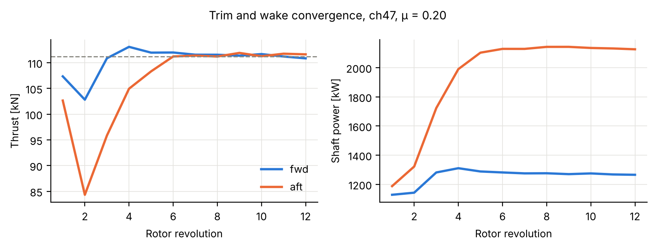
Validation (1/3): code verification
• Convergence: thrust within 0.1–3 % of target, hub moments ≈ 0; power varies < 1.5 % over the last 4 revs.
• Momentum limit: isolated CH-47 rotor induced power = 1.08× (μ 0.1) and 1.21× (μ 0.2) the Glauert value, inside the usual 1.1–1.3 range.
• Baseline recovery: the tandem forward rotor ≈ isolated rotor (−0.2 to −0.9 hp on Dingeldein rig), as measured.
• Bug found and fixed: tip panels finer than the vortex core caused ±20 % saw-tooth power; near-uniform panels removed it.
• Hand calc: ideal hover induced power 2.93 MW (slide 3); the BEMT tool gives 4357 kW hover shaft power at MTOW, i.e. FM ≈ 0.67, a realistic value.
Fig. 1 Trim and wake convergence, CH-47 class, μ = 0.2, MTOW, sea-level ISA, each rotor trimmed to W/2 with zero hub moments.
Validation | Team 6

Slide 13
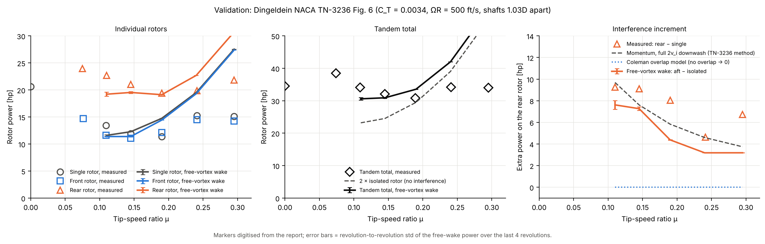
Validation (2/3): standalone free-vortex wake vs Dingeldein NACA TN-3236, Fig. 6
Fig. 2 Two 15 ft, 2-blade untwisted NACA 0012 rotors, σ = 0.054, coplanar, shafts 1.03D apart (no overlap), C_T = 0.0034, ΩR = 500 ft/s, f = 2 ft² per rotor. Markers digitised from the report (±0.5 hp).
μ | 0.11 | 0.145 | 0.19 | 0.24 | 0.295
Rear − single, measured [hp] | 9.3 | 9.1 | 8.0 | 4.6 | 6.7
Rear − single, FVW [hp] | 7.6 | 7.3 | 4.4 | 3.2 | 3.2
Coleman overlap model [hp] | 0 | 0 | 0 | 0 | 0
• μ 0.11–0.145: rotor powers within 15 %, increment within 20 %.
• μ ≥ 0.19: increment under-predicted; above 0.2 isolated power over-predicted (blade stall model), so trust only μ ≲ 0.2.
Validation | Team 6

Slide 14
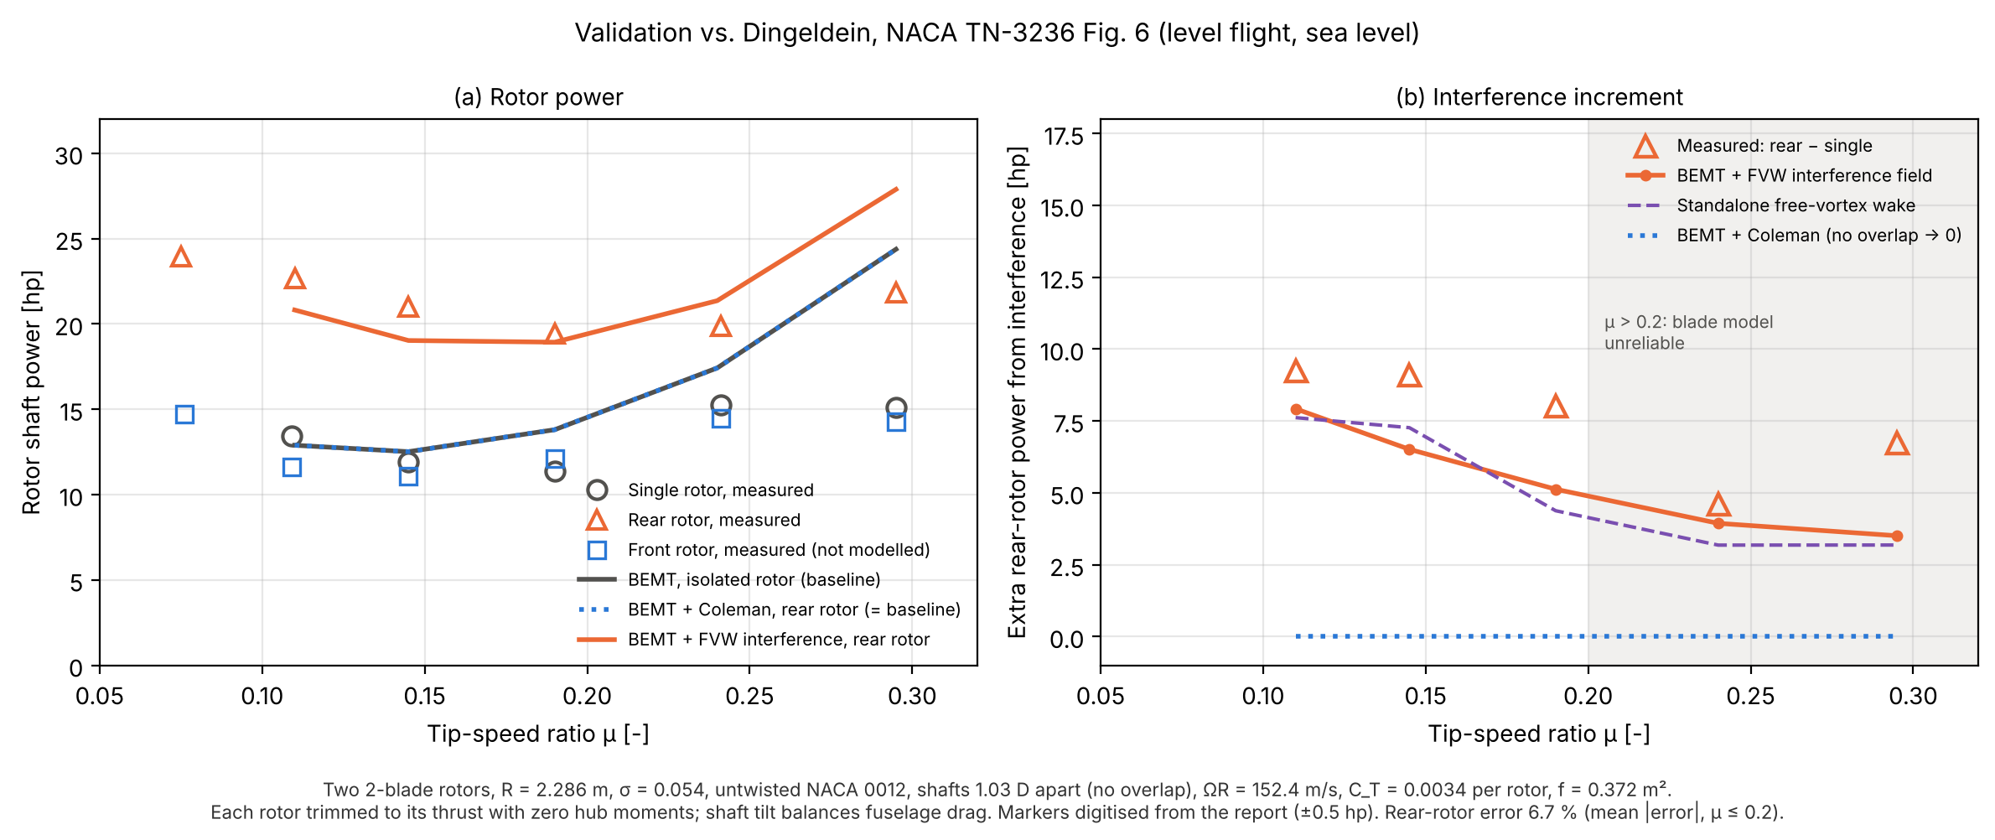
Validation (3/3): integrated BEMT + free-wake tool vs Dingeldein
μ | Rear meas. [hp] | Rear tool [hp] | Error | Δ meas. | Δ tool
0.110 | 22.7 | 20.8 | −8 % | 9.3 | 7.9
0.145 | 21.0 | 19.0 | −9 % | 9.1 | 6.5
0.190 | 19.4 | 18.9 | −2 % | 8.0 | 5.1
0.240 | 19.9 | 21.4 | +8 % | 4.6 | 3.9
0.295 | 21.8 | 27.9 | +28 % | 6.7 | 3.5
• Rear-rotor power: mean |error| 6.7 % for μ ≤ 0.2.
• Interference increment Δ = rear − single: under-predicted by ~26 % for μ ≤ 0.2. Interference penalties in the assessment are therefore likely conservative (low).
• Coleman overlap model: 0 hp at every μ.
Fig. 3 Integrated tool (team BEMT, model="fvw") vs TN-3236 Fig. 6. Rig as Fig. 2; each rotor trimmed to its thrust with zero hub moments; shaft tilt balances fuselage drag. Shaded: μ > 0.2, blade model unreliable.
Validation | Team 6

Slide 15
Integration: how the free wake plugs into our BEMT tool
Offline: tandem_fvw.py
free-vortex wake run once per μ (0.05, 0.10, 0.15, 0.20, 0.25)
Cached map Δv(r, ψ) of forward-rotor downwash on the aft disk; linear in μ between cases
Edgewise BEMT (Milestone 2), aft rotor: external_inflow = Δv(r, ψ) added to each blade element
Trim (collective + cyclic, zero hub moments) → power, controls, climb margin
• Why an external inflow term: BEMT assumes independent annuli whose inflow is set by the rotor's own momentum balance and quasi-steady 2D sections; another rotor's wake breaks the inflow assumption, so the wake model supplies it.
• Switch: model = "none" (isolated rotors) | "coleman" (original tool, overlap cylinder) | "fvw" (new). With the switch off, the original tool runs bit for bit unchanged; a regression test checks this.
• Coupling is one-way: forward wake → aft rotor. The forward rotor is solved as isolated.
• Fixes to the existing tool: Coleman stagger sign corrected (raising the aft pylon now lowers power, as physics requires); Coleman reference corrected to NACA ARR L5E10 (1945).
• The original tool's tandem validation CSV, whose source could not be verified, was removed; validation uses Dingeldein Fig. 6 only.
• All 127 unit tests pass; python run_all_mp.py regenerates every figure in this deck from the tool.
Integration | Team 6

Slide 16
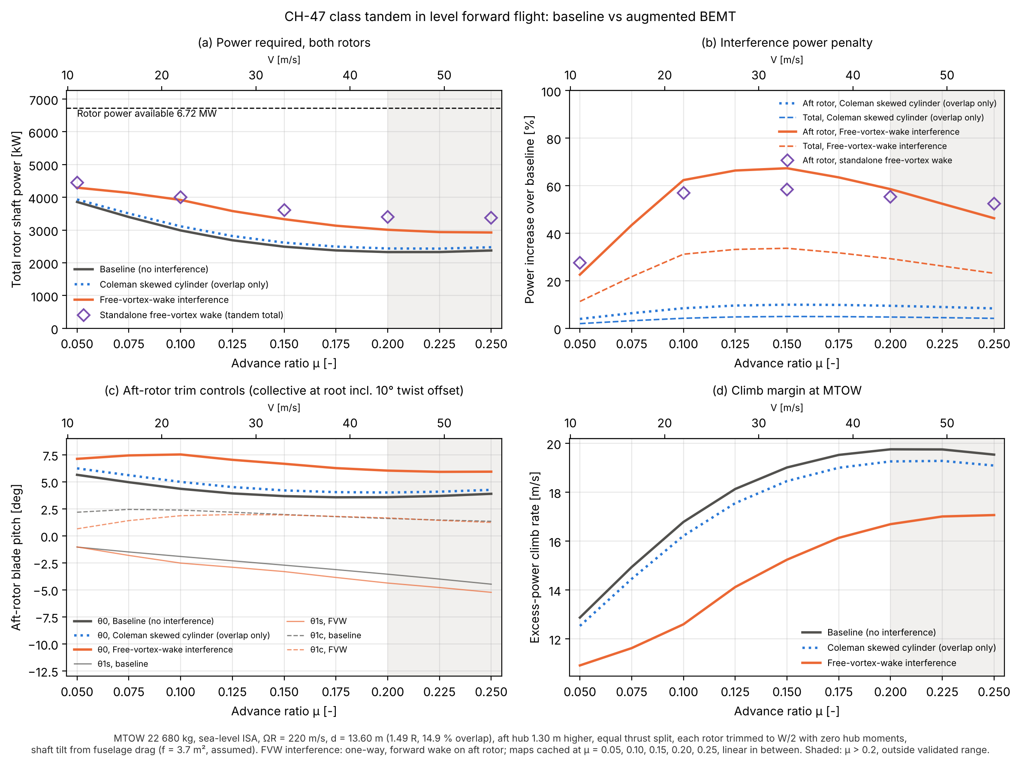
Rotorcraft assessment (1/4): forward flight, baseline vs augmented
μ | Base [kW] | Coleman | FVW | ΔP FVW
0.05 | 3858 | 3934 | 4293 | +11 %
0.10 | 2988 | 3114 | 3919 | +31 %
0.15 | 2492 | 2616 | 3331 | +34 %
0.20 | 2327 | 2437 | 3008 | +29 %
0.25 | 2375 | 2475 | 2925 | +23 %
• Peak penalty +34 % at μ ≈ 0.15; almost all on the aft rotor (+59 to +67 %).
• Coleman (original tool) gives only ~4–5 %.
• Aft collective +2.5° to +3.2°; climb margin at μ 0.1 drops from 16.8 to 12.6 m/s.
• Bucket shifts: baseline minimum power near μ 0.2; with interference power still falls at μ 0.25, so the best-endurance speed moves higher.
Fig. 4 Integrated tool. MTOW 22 680 kg, SL ISA, ΩR = 220 m/s, equal thrust split, zero hub moments, f = 3.7 m² (assumed). One-way FVW interference. Shaded: μ > 0.2.
Rotorcraft Assessment | Team 6

Slide 17
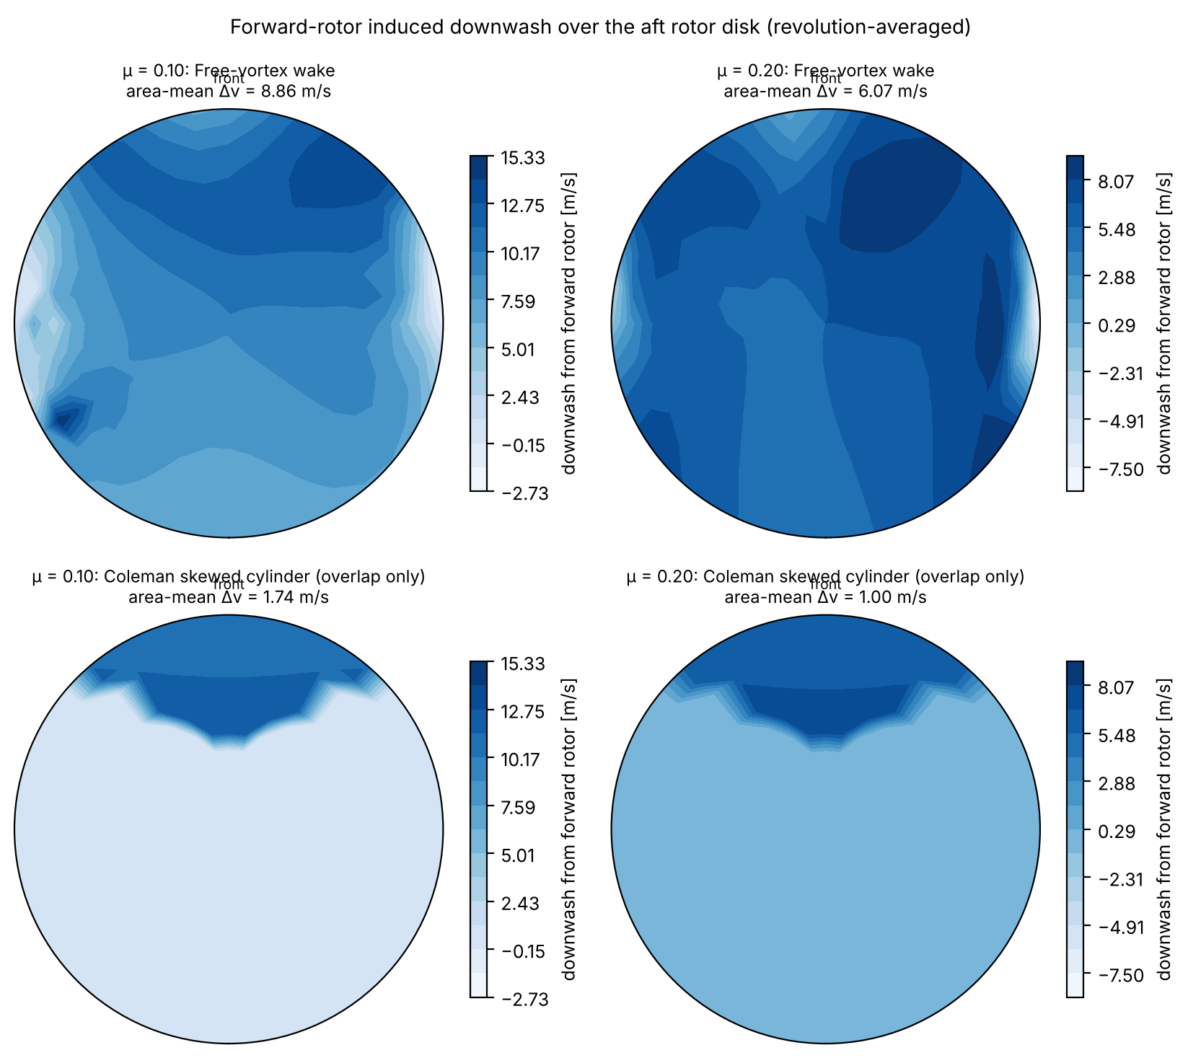
Rotorcraft assessment (2/4): why the aft rotor pays
• FVW: the forward wake covers the whole aft disk. Mean Δv = 8.9 m/s (μ 0.1), 6.1 m/s (μ 0.2).
• Coleman on the overlap lens only: 1.7 and 1.0 m/s, about 5–6× too small.
• The pattern is non-uniform and laterally asymmetric (the forward rotor's advancing- and retreating-side tip vortices differ), so the aft rotor also gets roll and pitch disturbances to trim with cyclic.
• Forward rotor Glauert v_i = 7.4 and 3.9 m/s: the aft rotor sits in roughly the forward rotor's far-wake downwash, so it behaves as if climbing.
• Conclusion: an overlap-area correction misses most of the forward-flight penalty.
Fig. 5 Revolution-averaged forward-rotor downwash over the aft disk (front at top), CH-47 class, MTOW. Top: free-vortex wake (the map the tool uses). Bottom: Coleman cylinder on overlap only.
Rotorcraft Assessment | Team 6

Slide 18
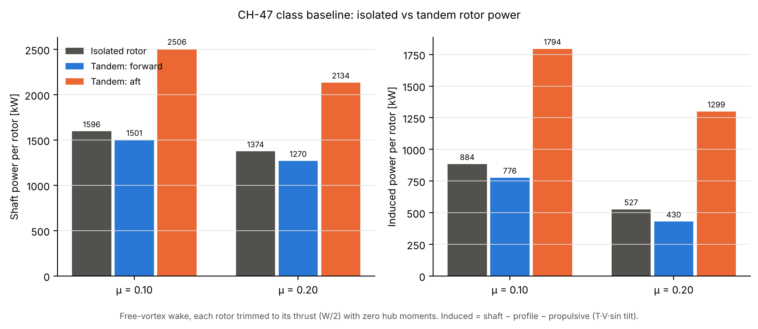
Rotorcraft assessment (3/4): tool vs standalone two-way free wake
Tandem penalty | μ = 0.1 | μ = 0.2
Integrated tool (one-way) | +31.2 % | +29.3 %
Standalone FVW (two-way) | +25.5 % | +23.8 %
Standalone: fwd rotor | −6 % | −8 %
Standalone: aft rotor | +57 % | +55 %
Tool: aft rotor | +62 % | +59 %
• All assessment numbers in this deck come from the integrated tool unless labelled "standalone".
• The gap (~6 points) is mainly the forward rotor's 6–8 % saving from the aft rotor's upwash, which the one-way tool omits; the two runs also use different blade models (BEMT vs lifting line).
• So the tool slightly over-predicts the total, while Dingeldein says the increment is under-predicted: the true penalty is likely 24–31 %.
Fig. 6 Standalone free-vortex wake (two-way, both rotors free), same CH-47 condition as Fig. 4.
Rotorcraft Assessment | Team 6

Slide 19
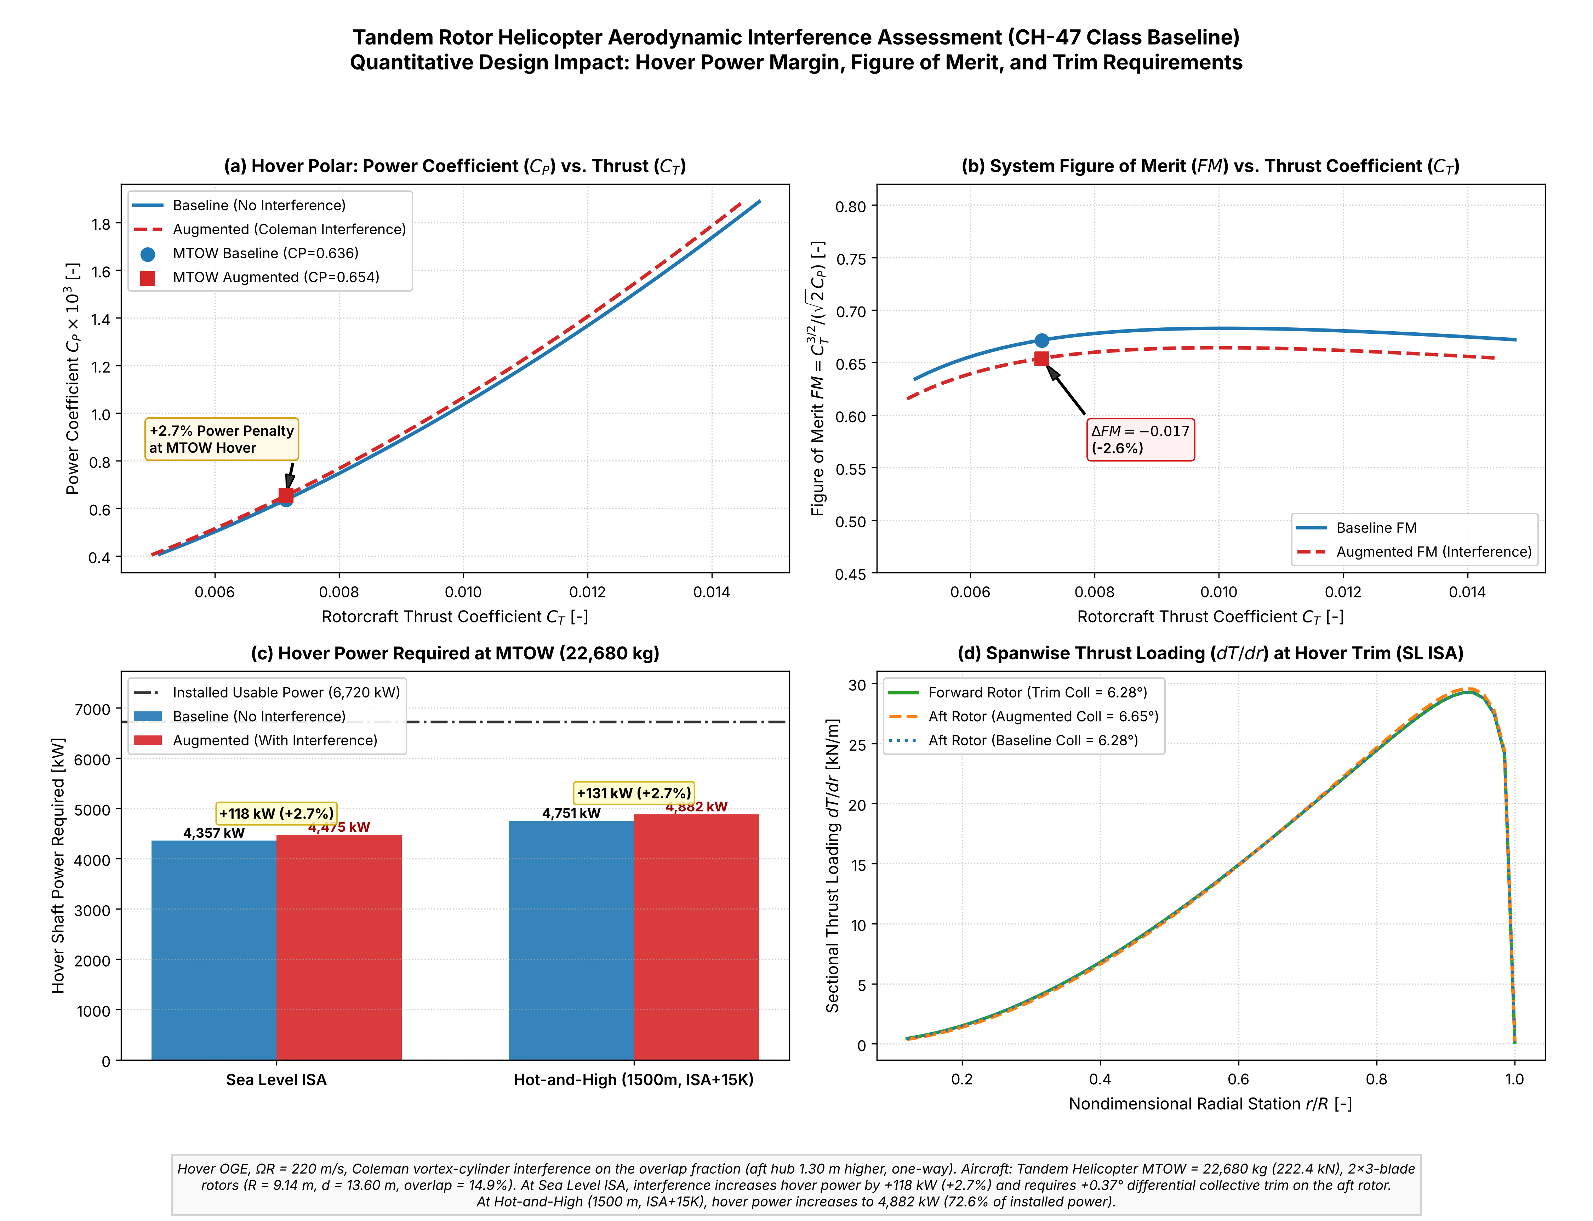
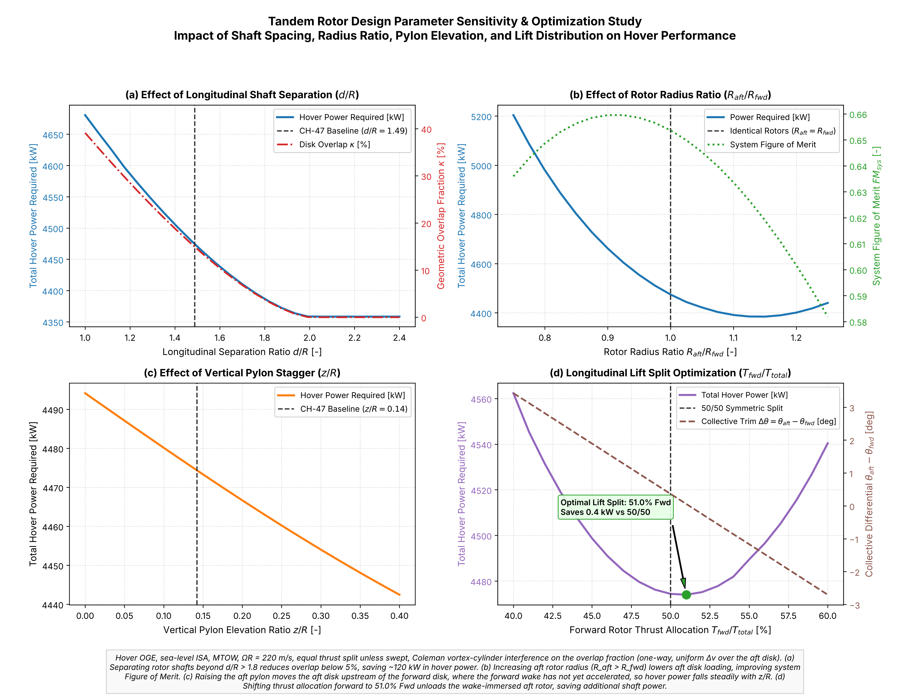
Rotorcraft assessment (4/4): hover, layout study and design implications
• Hover penalty is small (+2.7 %, FM 0.67 → 0.65); forward flight is where interference matters (+23 to +34 %).
• Power: 3.0–3.9 MW needed vs 6.72 MW available, so not power-limited in level flight; the penalty is fuel flow (~+30 % at equal SFC, inferred) → range, endurance, payload.
• Aft drivetrain and engine margin are sized by the aft rotor (+59–67 %).
• Trim: aft collective +2.5–3.2°; pitch trim and c.g. range shift.
• Layout levers: larger spacing and taller aft pylon reduce the penalty, at structural weight and drag cost.
Fig. 7 Hover OGE, MTOW, Coleman interference (stagger sign fixed): +118 kW (+2.7 %) SL ISA.
Fig. 8 Hover parameter study, Coleman model: shaft spacing, radius ratio, pylon height, lift split.
Rotorcraft Assessment | Team 6

Slide 20
Limitations and future work
• In the integrated tool only the forward rotor's wake acts on the aft rotor (one-way); the aft rotor's 6–8 % benefit to the forward rotor is omitted, so the total is slightly over-predicted.
• The tool uses the revolution-averaged Δv map, so unsteady blade–vortex interaction loads, vibration and noise are not predicted; only mean power and trim.
• Δv maps belong to one geometry: a new d/R or stagger needs new free-wake runs. Hover still uses the Coleman model.
• Rigid blades, no flapping dynamics; no fuselage, hubs, ground or tunnel walls.
• Quasi-steady 2D lifting-line aerodynamics: no dynamic stall, compressibility or reverse flow. Main error source above μ ≈ 0.2.
• Equal thrust split W/2; a real CH-47 trims pitch with differential collective, so the split varies with c.g.
• 10° time step and 5 revolutions of wake: wake geometry is noisy although integrated loads converge.
• Fuselage flat-plate area for the CH-47 class is assumed (3.7 m²).
• Not compared with a vortex-particle method: no forward-flight tandem VPM data available. Hover overlap validation against Sweet TN D-534 is the next step.
• Future: stall/tip-loss model on the blades, overlap/separation parameter study, hover case, and cheaper reduced-order Δv fits for the sizing loop.
Rotorcraft Assessment | Team 6

Slide 21
Acknowledgements
• Generative AI: Claude (Anthropic), used through the Claude app, assisted with: the literature search and reference checking, writing and debugging the free-vortex wake code and plotting scripts, digitising Dingeldein Fig. 6, reviewing the teammate's BEMT code, and drafting these slides and the conceptual-question document. All results were run and checked by the team; the team is responsible for every number shown.
• The team's Milestone 1–2 BEMT code was used as the existing prediction tool; the AI assistant also wrote the free-wake integration, stagger-sign fix and tests in it.
• People outside the team: [FILL IN or write "None"]
• External packages: NumPy, Numba, Matplotlib (Python).
Acknowledgements | Team 6

Slide 22
References
[1] Coleman, R. P., Feingold, A. M., Stempin, C. W., "Evaluation of the Induced-Velocity Field of an Idealized Helicopter Rotor," NACA ARR L5E10, 1945.
[2] Dingeldein, R. C., "Wind-Tunnel Studies of the Performance of Multirotor Configurations," NACA TN-3236, 1954.
[3] Sweet, G. E., "Hovering Measurements for Twin-Rotor Configurations With and Without Overlap," NASA TN D-534, 1960.
[4] Tate, G. D., Jr., "Determination of the Normal Component of Induced Velocity ... for Multi-Rotor Helicopters," M.S. thesis, Georgia Tech, 1958.
[5] Landgrebe, A. J., "An Analytical Method for Predicting Rotor Wake Geometry," J. AHS 14(4), 1969.
[6] Kocurek, J. D., Tangler, J. L., "A Prescribed Wake Lifting Surface Hover Performance Analysis," 32nd AHS Forum, 1976.
[7] Young, C., "The Prediction of Helicopter Rotor Hover Performance using a Prescribed Wake Analysis," ARC CP-1341, 1976.
[8] Egolf, T. A., Landgrebe, A. J., "Helicopter Rotor Wake Geometry and Its Influence in Forward Flight," NASA CR-3726, 1983.
[9] Bhagwat, M. J., "Transient Dynamics of Helicopter Rotor Wakes Using a Time-Accurate Free-Vortex Method," Ph.D. thesis, Univ. of Maryland, 2001.
[10] Leishman, J. G., Bagai, A., "Free-Wake Analysis of Twin-Rotor Systems," 20th ERF, Paper 28, 1994.
[11] Griffiths, D. A., Leishman, J. G., "A Study of Dual-Rotor Interference and Ground Effect Using a Free-Vortex Wake Model," AHS 58th Forum, 2002.
[12] Tonkal, O. C., et al., "Investigation of Rotor-Rotor Interactions for Two Helicopters in Forward Flight Using Free Vortex Wake Methodology," AIAA 2010-4558.
[13] Tan, J. F., Sun, Y. M., Barakos, G. N., "Vortex Approach for Downwash and Outwash of Tandem Rotors in Ground Effect," J. Aircraft 55(6), 2018.
[14] Zanotti, A., Piccinini, R., Tugnoli, M., "Numerical Investigation of the Rotor-Rotor Aerodynamic Interaction of eVTOL Configurations by a Mid-Fidelity Approach," ERF 2021.
[15] Chen, P.-W., et al., "Extraction of Dynamic Inflow Models for Coaxial and Tandem Rotors from CFD Simulations," VFS 75th Forum, 2019.
[16] Leishman, J. G., Principles of Helicopter Aerodynamics, 2nd ed., Cambridge University Press, 2006.
References | Team 6

