Slide 1
AI-POWERED
Healthcare Claims
Validation
RAG • Embeddings • Semantic Search • Vector Database • Intelligent EOB Prediction
DEMO PRESENTATION
Technologies - ReactJs (UI), Python - FastAPI(BE), MS-SQL Server, RAG, LLM, Vector DB, Semantic search
Presented by Jothis Nirmal and Prasad Dhass

Slide 2
13 • OUTCOMES
Real Impact on US Healthcare Industry
Problem | Immediate Impact | Downstream Impact
AR Days Delay | Payment remains outstanding | Cash-flow pressure
Denial Rework | Additional staff effort | Higher RCM operating cost
Missing Mandatory Fields | Claim rejection | Resubmission + payment delay
Documents Required | Manual document collection | Longer adjudication cycle
Incorrect Filing | Rejection/denial | Increased A/R + timely-filing risk
14

Slide 3
01 • OVERVIEW
Business Problem & Objective
BEFORE SUBMISSION
INTELLIGENT VALIDATION
FINANCIAL VISIBILITY
Validate claims before they are sent to the payer and identify issues that may cause rework, rejection or denial.
Combine deterministic rules with AI-powered semantic retrieval of payer/provider agreement information.
Estimate allowed amount, adjustments, member cost share and overall patient responsibility.
• Goal: reduce avoidable denials and improve clean-claim submission quality.
• Provide an explainable summary rather than only a pass/fail result.
• Support claims teams, coders, billers and reviewers with evidence-backed recommendations.
02

Slide 4
02 • VALIDATION
End-to-End Claims Validation
Claim Input
›
Mandatory Fields
›
Clinical / Coding Checks
›
Payer Agreement Retrieval
›
Denial Risk
›
Summary / Action
DETERMINISTIC CHECKS
AI-ASSISTED CHECKS
OUTCOME
Required fields, formats, dates, provider/payer identifiers, timely filing and other rule-based validations.
Semantic matching against payer policies, contracts, procedure guidance and supporting documents.
Prioritized findings with severity, rationale, evidence and recommended next action.
03

Slide 5
03 • VALIDATION
Mandatory Field & Data Quality Validation
Claim-level
Provider-level
Claim ID, patient/member details, payer, policy/member number and billing information.
Billing/rendering provider identifiers such as NPI and required taxonomy/location information.
Service-line level
Diagnosis-level
Service date, procedure code, units, charge, place of service and applicable modifiers.
ICD-10-CM diagnosis codes and required relationships to services.
Date validation
Output
Service date, submission date and payer-specific timely filing window.
Missing / invalid fields are surfaced before downstream payer submission.
04

Slide 6
04 • DENIAL RISK
Potential Denial & Payer Rule Validation
Procedure Not Covered
Procedure ↔ Diagnosis
Modifier Consistency
Determine whether the billed procedure is covered under the applicable payer agreement/policy.
Check whether the procedure is clinically/coding-wise consistent with the submitted diagnosis.
Validate whether the modifier is appropriate for the procedure and claim context.
Prior Authorization
Timely Filing
Other Payer Rules
Identify services that require authorization and flag missing authorization information.
Compare service/submission dates against the payer's filing limit.
Surface policy-specific limitations, exclusions, frequency rules and documentation requirements.
05

Slide 7
05 • AI ARCHITECTURE
AI Architecture – RAG + Semantic Search
PDF / Agreements
›
Text Extraction & Chunking
›
Embeddings
›
Vector DB
›
Semantic Retrieval
›
LLM + Rules
›
Validation Summary
• Payer/provider agreements and policy documents are converted into searchable knowledge.
• Documents are chunked into meaningful sections and transformed into vector embeddings.
• For a claim, relevant clauses are retrieved using semantic similarity rather than exact keyword matching.
• The retrieved evidence is supplied to the validation layer to generate an explainable result.
06

Slide 8
06 • AI CONCEPTS
How Embeddings & Vector Search Help
TRADITIONAL KEYWORD SEARCH
EMBEDDING SEARCH
RAG RESPONSE
May miss semantically equivalent language.
Example: “cosmetic surgery” vs “elective aesthetic procedure”.
Represents text as vectors so conceptually similar passages can be retrieved even when wording differs.
Uses retrieved policy/contract evidence to ground the validation explanation and reduce unsupported conclusions.
• Query example: Procedure code + diagnosis + payer + denial question.
• Top matching document chunks become evidence for the claim-level decision.
• Metadata such as payer, agreement, section, effective date and document version can improve retrieval quality.
07

Slide 9
07 • KNOWLEDGE INGESTION
PDF → Vector Database Pipeline
PDF Upload
›
Extract Text
›
Clean & Chunk
›
Generate Embeddings
›
Store Vectors + Metadata
›
Retrieve Relevant Chunks
TRACEABILITY
RETRIEVAL QUALITY
REUSABLE KNOWLEDGE BASE
Each chunk retains document name, section, page, payer and effective period metadata.
Chunking balances context with retrieval precision.
The same pipeline can ingest provider agreements, payer policies, manuals and other reference material.
08

Slide 10
08 • DEMO
Claim Validation Result – Demo View
CLAIM SUMMARY
VALIDATION FINDINGS
RECOMMENDED ACTION
Claim ID: CLM-100245
Payer: Example Health Plan
Provider NPI: 1234567890
Service Lines: 4
Total Billed: $2,450
✓ Mandatory fields complete
⚠ Procedure coverage: Review
⚠ Diagnosis consistency: Review
✓ Modifier validation passed
⚠ Prior authorization: Required
✓ Timely filing: Within limit
Prioritize authorization review.
Review the flagged procedure/diagnosis relationship against payer guidance.
Display retrieved evidence and document section for reviewer verification.
09

Slide 11
09 • FINANCIAL INTELLIGENCE
EOB / Payment Prediction
• Billed Amount – amount submitted by the provider.
• Allowed Amount – estimated payer-allowed amount based on contract/payer rules.
• Contractual Adjustment – difference between billed and allowed amounts, where applicable.
• Possible Coinsurance – estimated member share based on benefit/contract rules.
• Copay Amount – applicable fixed member contribution.
• Patient Responsibility – estimated total member liability after payer processing.
IMPORTANT
The result is a prediction/estimate and should be clearly distinguished from the final payer-adjudicated EOB.
10

Slide 12
10 • FINANCIAL INTELLIGENCE
Example EOB Calculation – Demo
Billed Amount
CALCULATION NARRATIVE
$2,450.00
The system combines claim data with payer/contract rules to estimate financial outcomes.
It can explain which assumptions contributed to the estimate and identify values that require human review.
Allowed Amount
$1,800.00
Contractual Adjustment
$650.00
Estimated Copay
$50.00
Estimated Coinsurance
$175.00
Estimated Patient Responsibility
$225.00
11

Slide 13
11 • PROJECT JOURNEY
Challenges & Key Learnings
Strategy and approach
Technology Stack
01
02
Exploration of AI concepts such as RAG, Vector DB, Embeddings, Chunks, Semantic search, AI Agents etc..,
Choosing the appropriate LLM model
03
04
API keys
Trial and error
05
06
12

Slide 14
12 • DEMO
Live Demo Flow
Upload Agreement PDF
›
Index into Vector DB
›
Load Sample Claim
›
Mandatory Validation
›
Retrieve Payer Clauses
›
Denial Checks
›
Evidence Summary
›
EOB Estimate
The demo follows the complete journey from document ingestion to claim-level decision support.
13

Slide 15
13 • OUTCOMES
Business Value & Benefits
Fewer Avoidable Denials
Faster Review
Explainable AI
Detect common issues before submission and prioritize high-risk claims.
Bring claim data, payer guidance and validation results into one workflow.
Show relevant evidence and rationale instead of presenting a black-box score.
Financial Forecast
Reusable Platform
Estimate allowed amount and member responsibility to support operational planning.
Extend the knowledge base to new payers, agreements, policies and validation rules.
14

Slide 16
14 • ROADMAP
Future Enhancements
• Confidence scoring for each validation result and denial prediction.
• Human-in-the-loop approval workflow for high-impact decisions.
• Continuous feedback loop using reviewer outcomes to improve retrieval and validation.
• Payer-specific rule packs and effective-date/version management.
• Dashboard for denial trends, top failure reasons and financial impact.
• Integration with claims platforms, clearinghouses and downstream billing workflows.
• Automated audit trail showing claim data, retrieved evidence, rules applied and final decision.
15

Slide 17
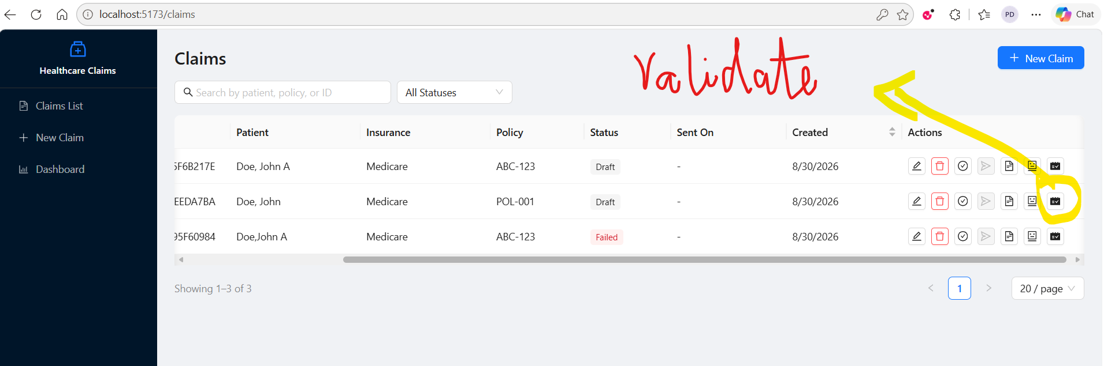
14 • ROADMAP
Outputs
15

Slide 18
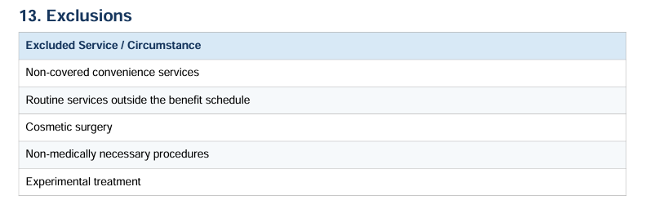
Validate_denial_claim functionality
Denial Prediction
1. It receives the claim details such as Procedure code, description, Diagnosis code, Modifier etc.. to check the below
a) Use the policy document to search for the procedure description (e.g. Plastic surgery) using semantic search approach and produces all the possible matches with the relevance % search.
One of the possible results after we semantic search
Document Reference: SYN_009_BRZ_Value_Health.pdf, Page: 3, Section: 13.Exclusions,
Policy Text: 13. Exclusions Excluded Service / Circumstance Non-covered convenience services Routine services outside the benefit schedule Cosmetic surgery Non-medically necessary procedures Experimental treatment
b) We use DB where we maintain the possible combinations of Procedure and diagnosis. We use this DB table to determines if the procedure is consistent with diagnosis
C) We use DB where we maintain the possible combinations of Procedure and Modifier. We use this DB table to determines if the procedure is consistent with Modifier
Scope: We can extend this by determining other denials reasons such Prior authorization service, Timely filing limit, age of the patient examination and denied the same if required.
15

Slide 19
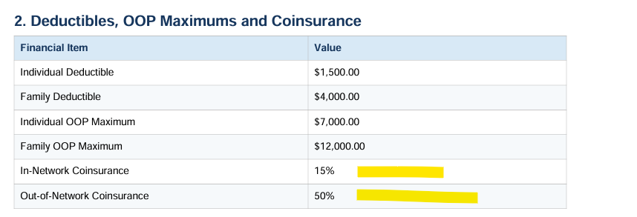
14 • ROADMAP
Validate_denial_claim functionality
EOB Calculation - Prediction
2. We also use the policy document to calculate the potential coinsurance and other patient responsibility to show the possible EOB calculation.
Scope:
1. We can use the Provider document to calculate the Contractual adjustment and same can be included in the EOB calculation
15

Slide 20
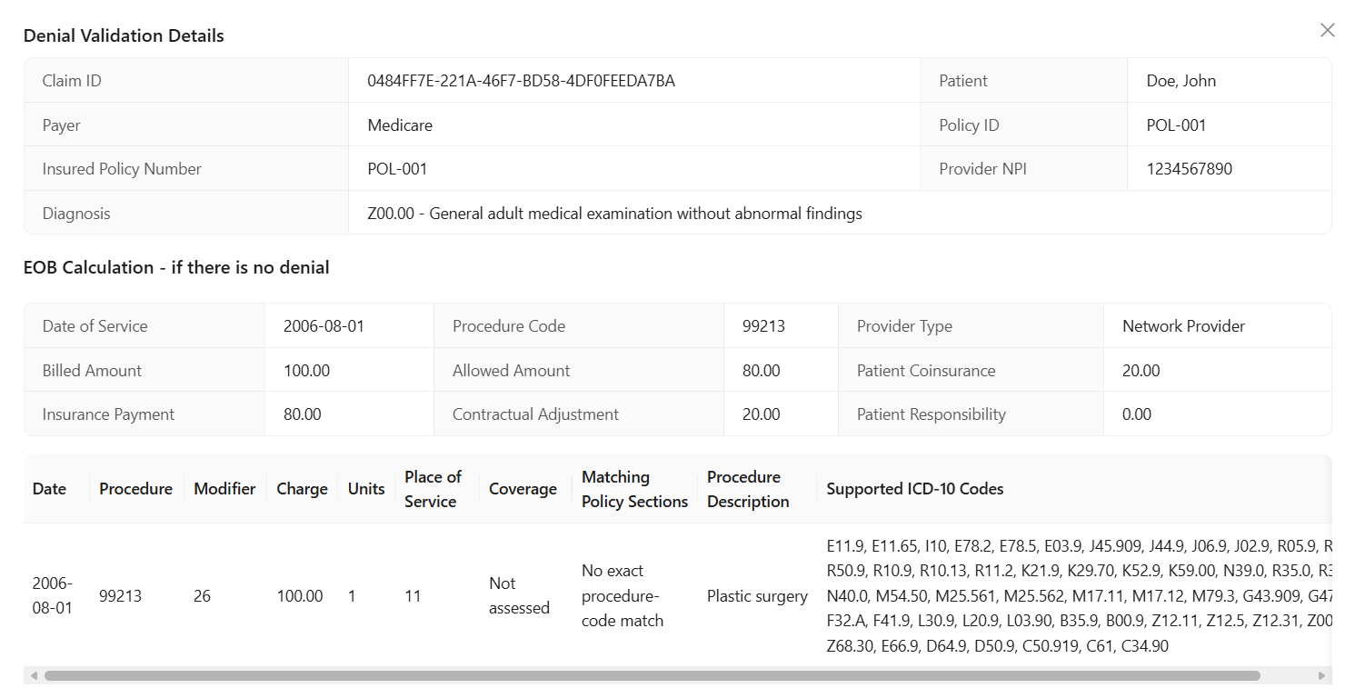
14 • ROADMAP
Outputs
15

Slide 21
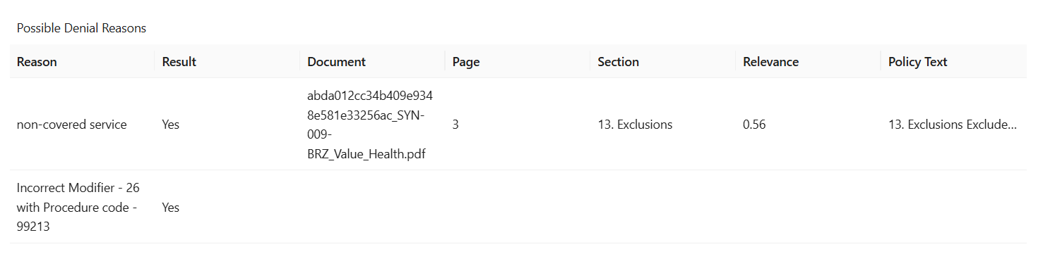
14 • ROADMAP
Outputs
15

Slide 22
14 • ROADMAP
Technical Details
1. Semantic search
- Fetches the claim details by claim_id (that we pass from UI)
- Locate the policy document for the patient (who is associated with claim)
- We use RAGEngine, we set the meta data as follow
policy_pages = []
loader = DocumentLoader()
for document in policy_documents:
path = str(document["FilePath"])
for page in loader.load_pdf(path):
page.metadata.update(
{
"claim_id": claim_id,
"document_id": str(document["DocumentId"]),
"document_tag": "PolicyDocument",
}
)
policy_pages.append(page)
- Retrieve the details by searching the procedure code
15

Slide 23
14 • ROADMAP
Technical Approach
- Retrieve the details by searching the procedure code
rag = RAGEngine()
rag.replace_claim_documents(claim_id, policy_pages)
evidence = rag.retrieve(
(
f"{procedure_code} exclusions limitations excluded services "
"unpaid services non-covered services"
),
top_k=20,
metadata_filter={"claim_id": claim_id},
)
- Iterate each search results using the below code
procedure_pattern = re.compile(rf"(?<![A-Z0-9]){re.escape(procedure_code.upper())}(?![A-Z0-9])")
return [
item
for item in evidence
if procedure_pattern.search(str(item["text"]).upper())
]
15

Slide 24
14 • ROADMAP
Technical Files - embedding_factory.py
- If any sections of the result has the name either “ "limitation", "excluded service", "exclusions","unpaid service", "non-covered service", "non covered service", "not covered service", "exclusion", then it is considered as non-covered service
embedding_factory.py
"""Embedding provider factory for the RAG engine."""
from __future__ import annotations
from langchain_core.embeddings import Embeddings
from langchain_community.embeddings import HuggingFaceEmbeddings
from langchain_openai import OpenAIEmbeddings
from ai_service.config import AISettings, ai_settings
def get_embeddings(settings: AISettings | None = None) -> Embeddings:
cfg = settings or ai_settings
if cfg.EMBEDDING_PROVIDER.lower() == 'huggingface' or not cfg.OPENAI_API_KEY.get_secret_value():
return HuggingFaceEmbeddings(model_name='all-MiniLM-L6-v2')
return OpenAIEmbeddings(
model=cfg.OPENAI_EMBEDDING_MODEL,
api_key=cfg.OPENAI_API_KEY,
base_url=cfg.OPENAI_BASE_URL or None,
)
15

Slide 25
14 • ROADMAP
Technical Files - rag_engine.py
rag_engine.py
"""Simple Chroma-backed retrieval engine for AI features."""
from __future__ import annotations
import logging
from pathlib import Path
from typing import Any
from langchain_text_splitters import RecursiveCharacterTextSplitter
from langchain_core.documents import Document
from langchain_community.vectorstores import Chroma
from ai_service.config import AISettings, ai_settings
from ai_service.rag.embedding_factory import get_embeddings
logger = logging.getLogger(__name__)
CHUNK_SIZE = 512
CHUNK_OVERLAP = 64
COLLECTION_NAME = 'healthcare-claims-kb'
15

Slide 26
14 • ROADMAP
Technical Files - rag_engine.py
rag_engine.py
class RAGEngine:
def __init__(self, settings: AISettings | None = None, embeddings: Any | None = None, vector_store: Any | None = None) -> None:
self._settings = settings or ai_settings
self._embeddings = embeddings or get_embeddings(self._settings)
self._vector_store = vector_store or Chroma(collection_name=COLLECTION_NAME, embedding_function=self._embeddings, persist_directory=self._settings.CHROMA_PERSIST_DIR)
def ingest(self, docs: list[Document]) -> int:
if not docs:
return 0
Path(self._settings.CHROMA_PERSIST_DIR).mkdir(parents=True, exist_ok=True)
splitter = RecursiveCharacterTextSplitter(chunk_size=CHUNK_SIZE, chunk_overlap=CHUNK_OVERLAP)
chunks = splitter.split_documents(docs)
self._vector_store.add_documents(chunks)
persist = getattr(self._vector_store, 'persist', None)
if callable(persist):
persist()
return len(chunks)
15

Slide 27
14 • ROADMAP
Technical Files - rag_engine.py
rag_engine.py
def replace_claim_documents(self, claim_id: str, docs: list[Document]) -> int:
"""Replace a claim's indexed policy document chunks."""
self._vector_store.delete(where={'claim_id': claim_id})
return self.ingest(docs)
15

Slide 28
14 • ROADMAP
Technical Files - rag_engine.py
rag_engine.py
def retrieve(
self,
query: str,
top_k: int = 5,
metadata_filter: dict[str, str] | None = None,
) -> list[dict[str, Any]]:
try:
results = self._vector_store.similarity_search_with_relevance_scores(
query,
k=top_k,
filter=metadata_filter,
)
except Exception as exc:
logger.error('RAG retrieval failed: %s', type(exc).__name__)
raise RuntimeError('Vector search failed') from exc
payload: list[dict[str, Any]] = []
for document, score in results:
source = document.metadata.get('source') or document.metadata.get('file_path') or 'unknown'
payload.append(
{
'text': document.page_content,
'source': str(source),
'page': document.metadata.get('page'),
'section': str(document.metadata.get('section', 'Uncategorized')),
'relevance': float(score),
}
)
return payload
15

Slide 29
FROM REACTIVE
Denial Management
TO PROACTIVE
AI-Assisted Claims Validation
RAG + Embeddings + Semantic Search + Vector DB + Rules + EOB Prediction
THANK YOU

