Slide 1

PROJECT: ADVENTURE WORKS CYCLES
P-57, GROUP 1
Mr. Prathamesh Dhoke
Mr. Lakhan Gaikwad
Mr. Swanand Bhatkar
Mr. Amey Shirke
Mr. Nadeem Budihal
Mr. Prasad Emmi

Slide 2
DETAILS ABOUT CLIENT COMPANY
Company Name – Adventure Works Cycles
Manufacturing Plant – Bothell , Washington, North America.
Subcomponent Mfg. Plant – Mexico, North America
Company Type – Production & Selling
Company Product – Metal & Composite Bicycles
Commercial Markets – North American , European & Asian markets

Slide 3
ANALYZING OBJECTIVES
Cleaning up the data with ETL process.
ETL using MS Excel and MySQL.
We visualize data using tools like Pivot table, Tableau, Power BI
Analyzing outcomes of Sales, Profit and Total Production by creating an interactive Dashboard

Slide 4
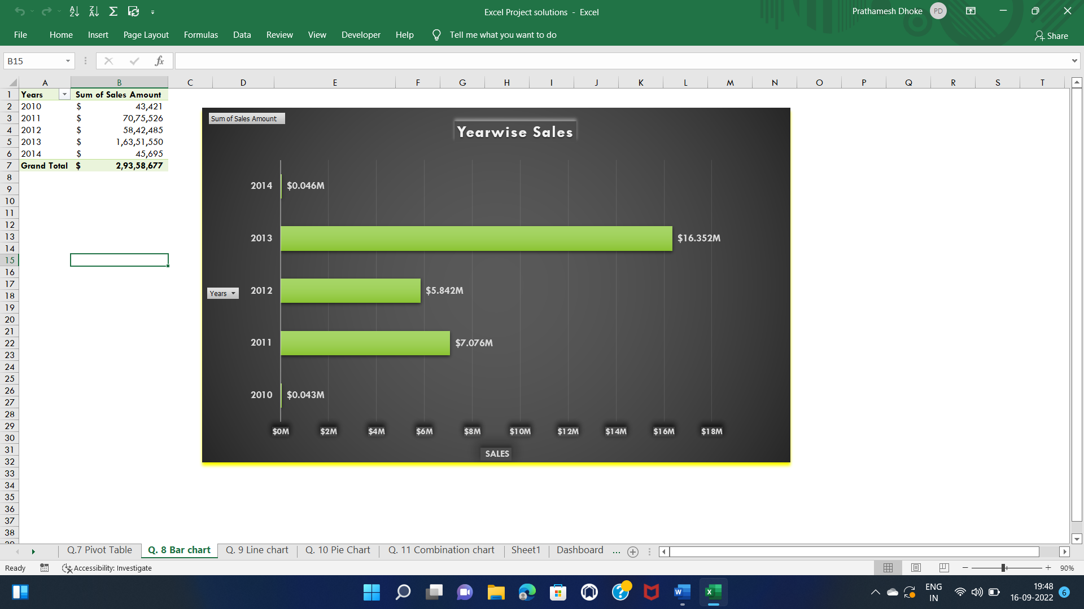
Year-wise Sales - Bar Chart

Slide 5
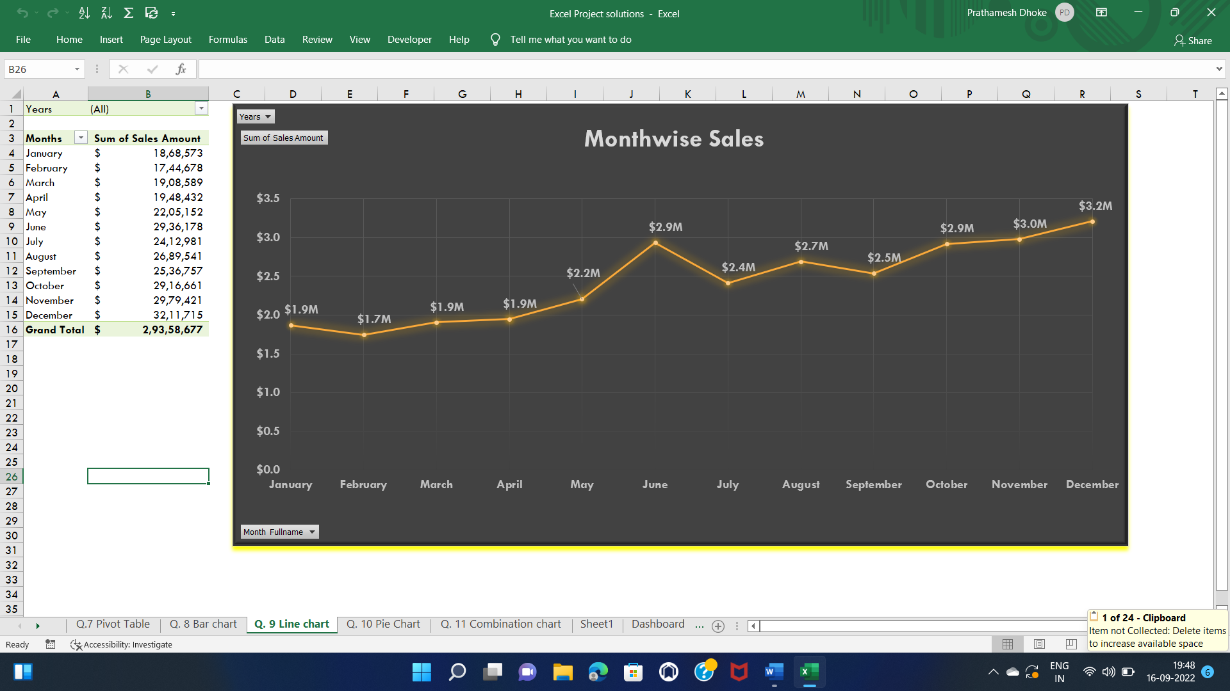
Month-wise Sales - Line Chart Used Slicers to filter year as per requirement

Slide 6
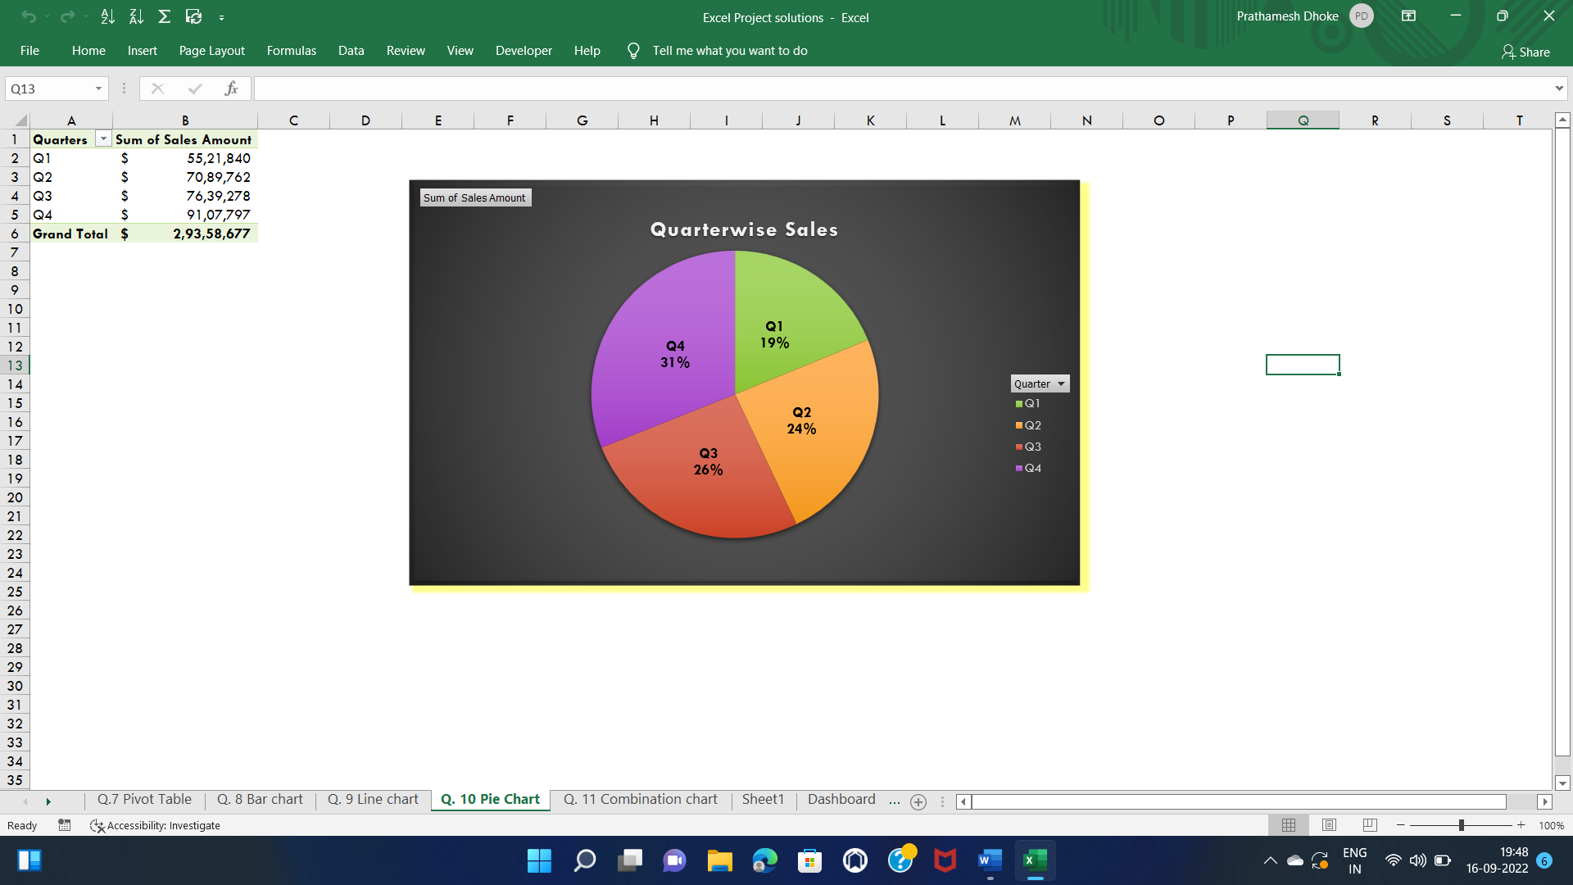
Quarter-wise Sales - Pie Chart

Slide 7
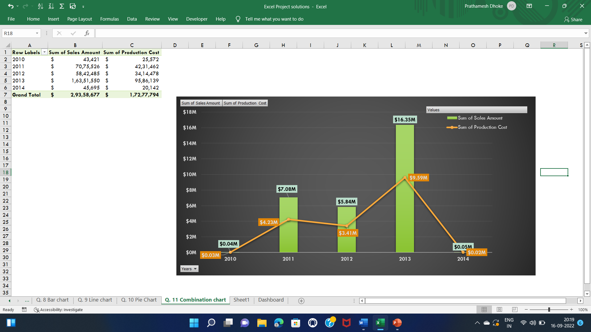
Sales & Production Ratio Compare Production Cost & Sales Amount Year-wise

Slide 8
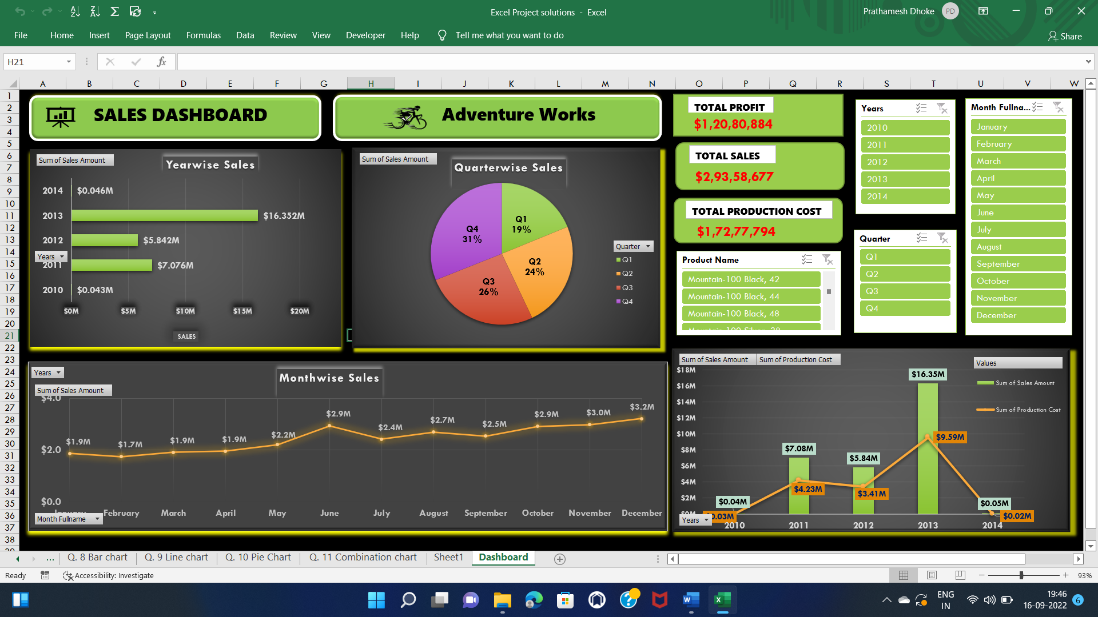
Dashboard Report on Excel

Slide 9
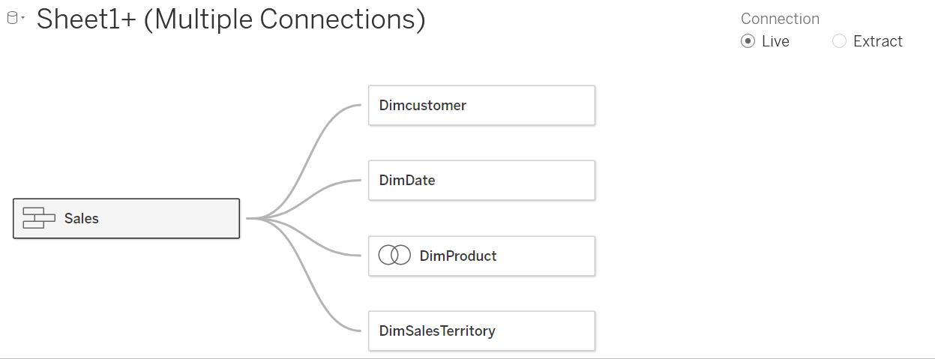
Tableau
By using datasets we create following data model
Using Left join we connected DimProduct table with DimProdSubCategory & DimProdCategory

Slide 10
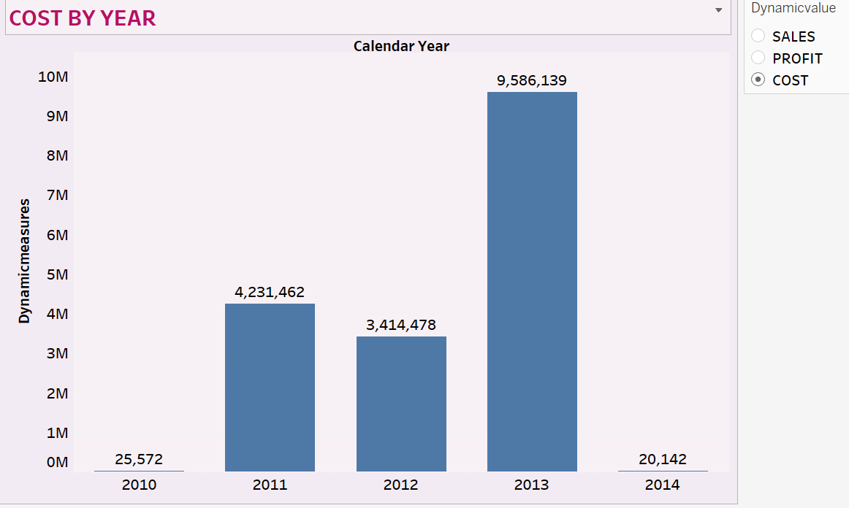
Year-wise Production Cost

Slide 11
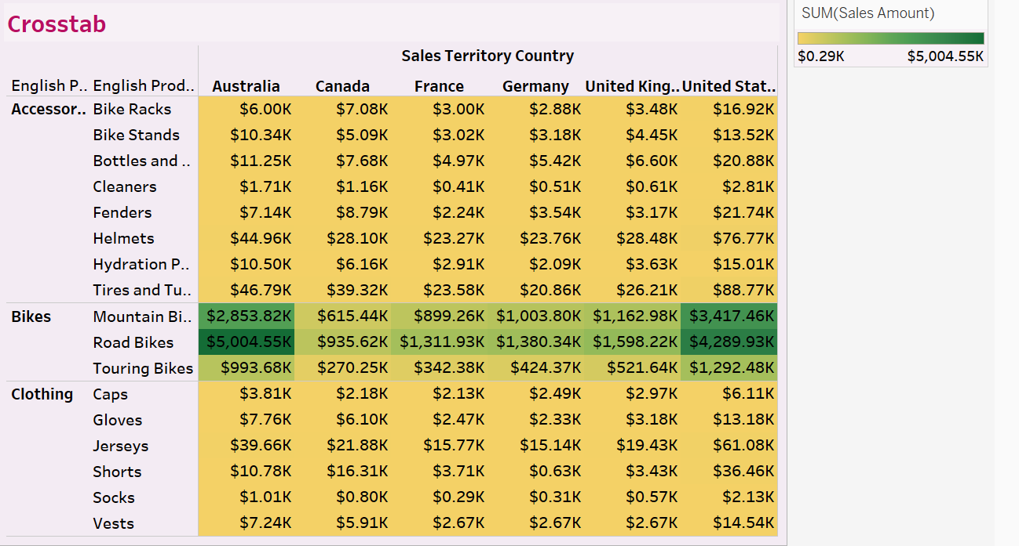
Crosstab Using Crosstab, we analyzed Country wise Sales Amount of each Products.

Slide 12
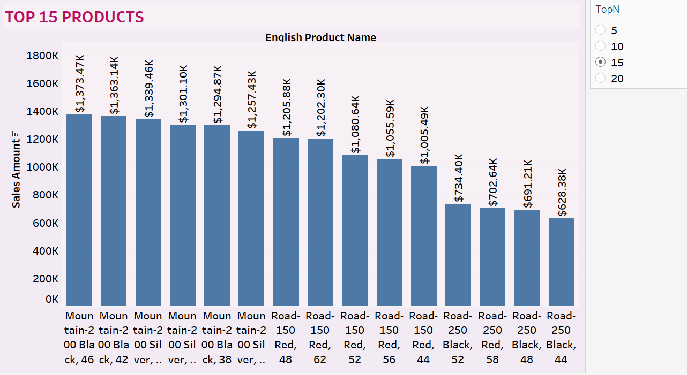
Top 15 product - Top 15 Product with highest Sales amount

Slide 13
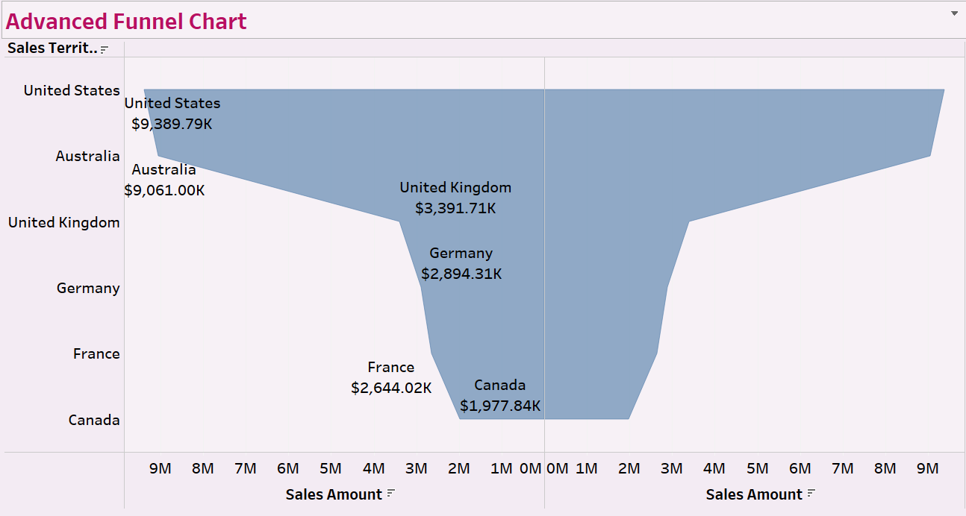
Advanced Funnel Chart - Basically funnel chart represent flow of the quantity, Representing Head country has maximum sales and Tail country has minimum sales

Slide 14
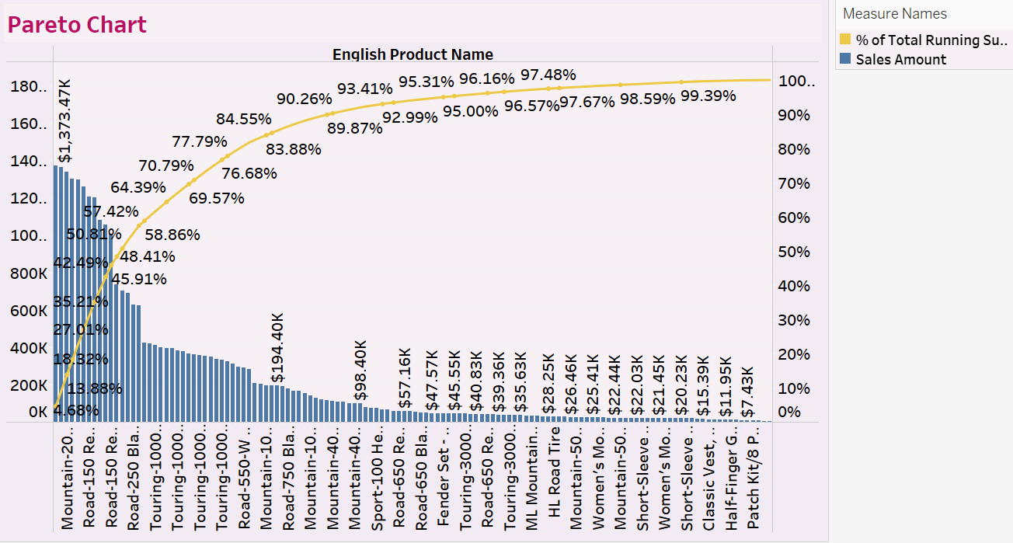
Pareto chart - Pareto chart consist both the bar and line graph. Comparing % Running Sum of Sales and Product wise Total Sales Amount

Slide 15
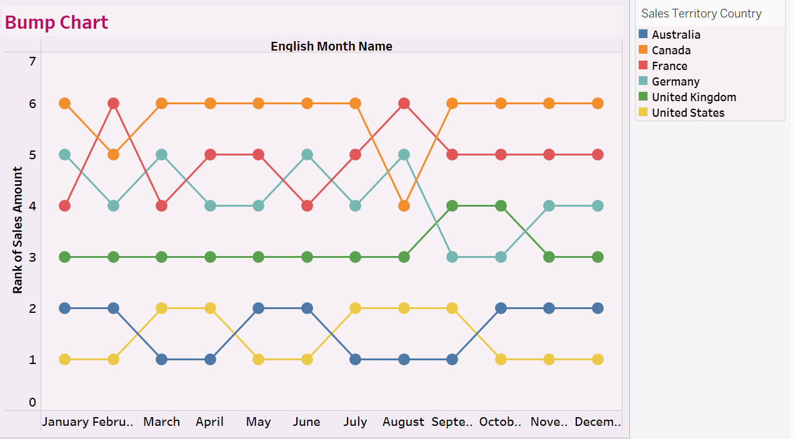
Bump Chart – Representing rank of Country in each Month by Sales amount

Slide 16
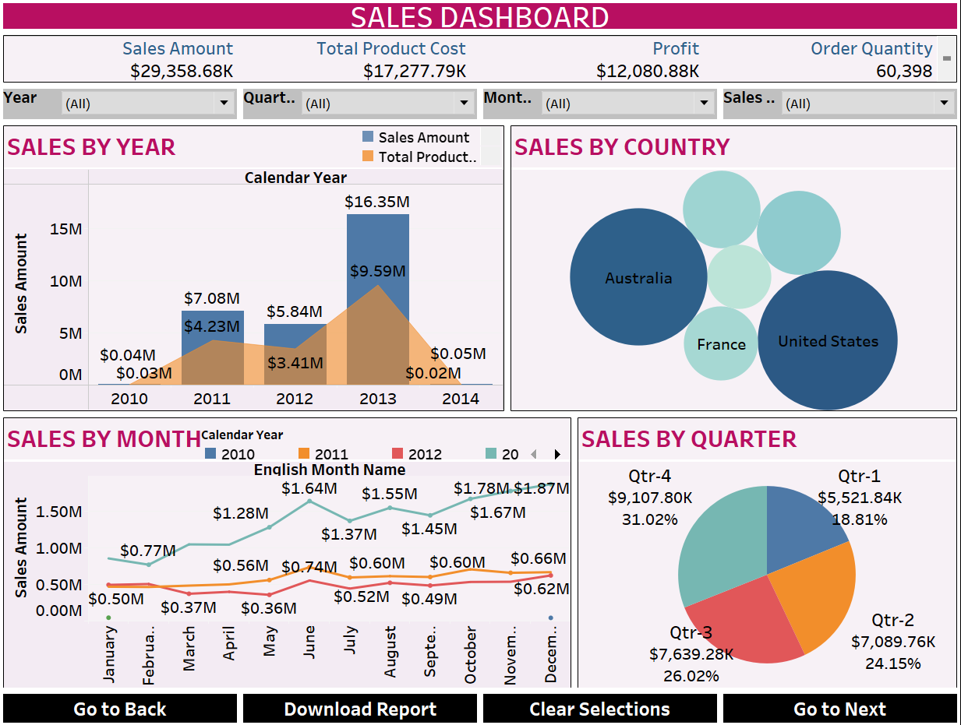
Dashboard Representing Interactive charts, Filters, KPIs and Buttons.

Slide 17
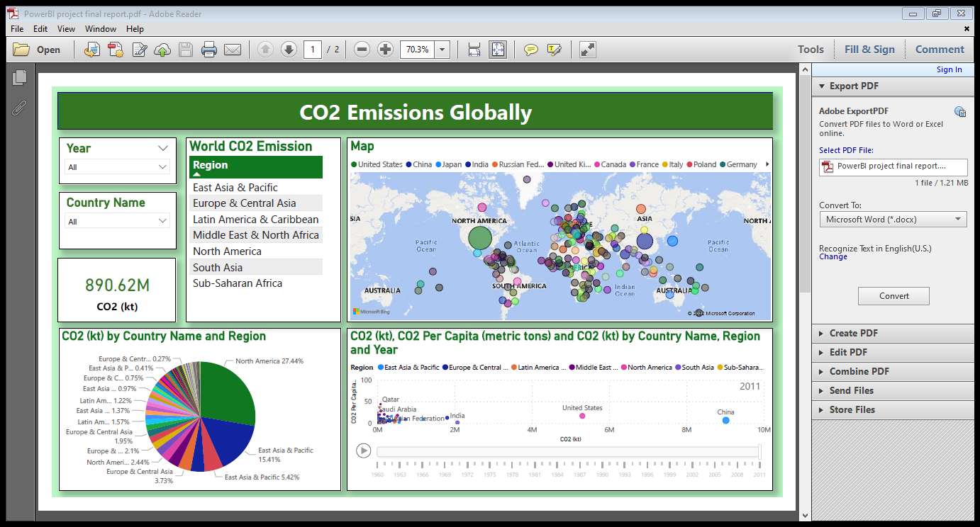
POWER BI - Dashboard Analyzing of CO2 Production Level in each Country and Region in every Year.

Slide 18
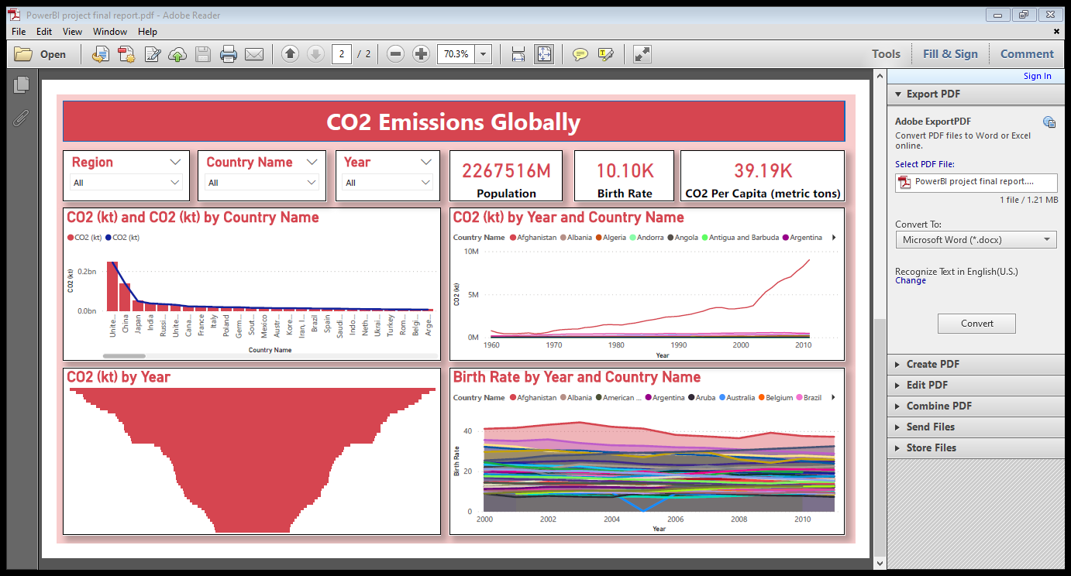
POWER BI - Dashboard Analyzing of CO2 Production Level in each Country and Region in every Year.

