Slide 1

Process Mining Virtual Intership
by
P.PRASAD
Roll No. 214G1A3279
Department of Computer Science and Engineering (Data Science)
Srinivasa Ramanujan Institute of Technology
(Affiliated to JNTUA & Approved by AICTE) (Accredited by NAAC with ‘A’ Grade & Accredited by NBA (EEE, ECE & CSE)
Rotarypuram Village, B K Samudram Mandal, Ananthapuramu – 515701.
2023 - 2024

Slide 2

Contents
Course Objective
Introduction
Technology
Applications
Modules
Real Time applications
Learning outcomes
GitHub Link
Queries

Slide 3
Course Objective
The main objective of Process Mining applies data science to discover, validate and improve workflows. By combining
data mining and process analytics, organizations can mine long data from their information systems to understand the
performance of their processes, revealing bottlenecks and other areas of improvement.
Process mining is the technology at the heart of the Celonis Execution Management System (or EMS), enabling
enterprises to fully understand how their core business processes run and find the hidden value opportunities, before
taking intelligent, automated action to improve performance.

Slide 4
Introduction
Process mining is a technique designed to discover, monitor, and improve real processes (i.e., not assumed processes) by extracting readily available knowledge from the event logs of information systems.
Process mining applies data science to discover, validate and improve workflows. By combining data mining and process analytics, organizations can mine log data from their information systems to understand the performance of their processes, revealing bottlenecks and other areas of improvement. Process mining leverages a data-driven approach to process optimization, allowing managers to remain objective in their decision-making around resource allocation for existing processes.
Information systems, such as Enterprise Resource Planning (ERP) or Customer Relationship Management (CRM) tools, provide an audit trail of processes with their respective log data. Process mining utilizes this data from IT systems to create a process model, or process graph. From here, the end-to-end process is examined, and the details of it and any variations areoutlined. Specialized algorithms can also provide insight into the root causes of deviations from the norm.

Slide 5
Introduction
Process:
A process is very simply a series of linked actions or steps taken to achieve a particular end. It is a series of actions taken from start to finish to complete an activity. In process mining, this set of actions can be individual steps or tasks that define a business operation's start and end points. Processes can be one-time, recurring, or periodic, depending on the nature of the workflow.
For sales, it could be the steps to progress an opportunity from a lead to closure.
Take order management, for example, this could be the steps from a customer ordering goods, to you shipping, and then ultimately getting paid for them.

Slide 6
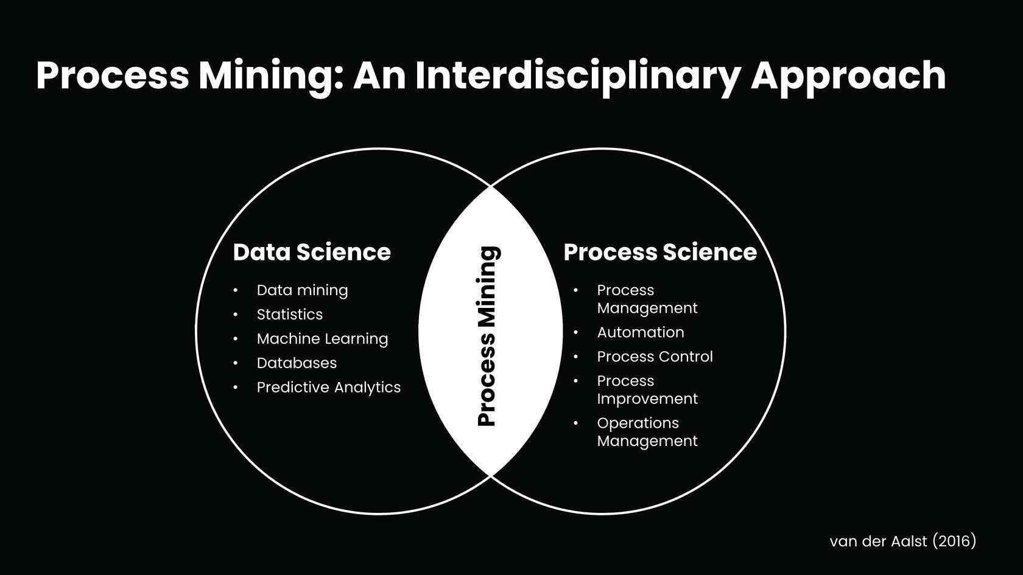
Introduction
Process Mining :
Process Mining is the combination of two disciplines: Data Science and Business Process Management. Process Mining essentially uses Data Science techniques, such as Big Data and AI, to address Process Science problems such as process improvement and automation.

Slide 7
Technology
Process mining techniques benefit companies of any size and workflow. Process mining solutions can focus on various elements like the flow of a process, the organizational or time management with data mining and machine learning integration.
There are three main classes of process mining techniques:
Process Discovery
Conformance Check
Analysis and Enhancement

Slide 8
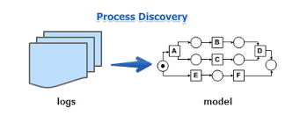
Technology
Process Discovery :
Process discovery uses event log data to create a process model without outside influence. Under this classification, no previous process models would exist to inform the development of a new process model. This type of process mining is the most widely adopted.

Slide 9
Technology
Conformance Check :
Conformance checking is a technique used to check process compliance by comparing event logs for a discovered process
with the existing reference model (target model) of the same process. This technique is used to determine whether the target
process corresponds to the actual process, highlighting deviations between the two.
Analysis and Enhancement :
This type of process mining has also been referred to as extension, organizational mining, or performance mining.
In this class of process mining, additional information is used to improve an existing process model.
Therefore, the objective behind the model analysis and enhancement is to determine how to optimize the target process model to its optimum potential.

Slide 10
Applications
Operational Monitoring and Alerts :
Process mining can be used to monitor ongoing processes in real-time and generate alerts when deviations or anomalies are detected. This allows organizations to take immediate action to address issues and maintain process efficiency.
Dynamic Resource Allocation :
In scenarios where resources need to be allocated dynamically, such as in manufacturing or service industries, real-time process mining can help optimize resource allocation based on the current state of the process and demand.
Customer Support and Service :
Real-time process mining can analyse customer support interactions and service processes as they happen. It helps identify areas where customer queries are getting delayed, allowing support teams to intervene promptly and provide timely assistance.

Slide 11
Applications
Supply Chain Visibility :
Monitoring supply chain processes in real-time using process mining can provide visibility into the movement of goods, inventory levels, and potential disruptions. This enables organizations to respond quickly to changes in demand or supply.
Healthcare Patient Pathway Optimization :
In healthcare settings, real-time process mining can analyse patient pathways, identify delays, and optimize the allocation of medical resources to ensure timely patient care.

Slide 12
Modules
Process mining fundamentals.
PQL
Architecture of software PQL engine
Get data into the EMS

Slide 13
Process Mining Fundamentals
Process mining is a set of techniques used for obtaining knowledge and extracting insights from processes by the means of analyzing the event data, generated during the execution of the process.
This training track provides both the theoretical and applied foundations around Process Mining.
Process mining reads this data, converts it into an event log, and then creates visualizations of the end-to-end process, along with insightful analytics.
An event log contains each step performed during the process (the activity), the time at which the event occurred (the timestamp), and for which instance of the process (the case ID).
Using this event log, algorithms generate a process model that shows the process as it really is - including the timing of each step and all variations

Slide 14
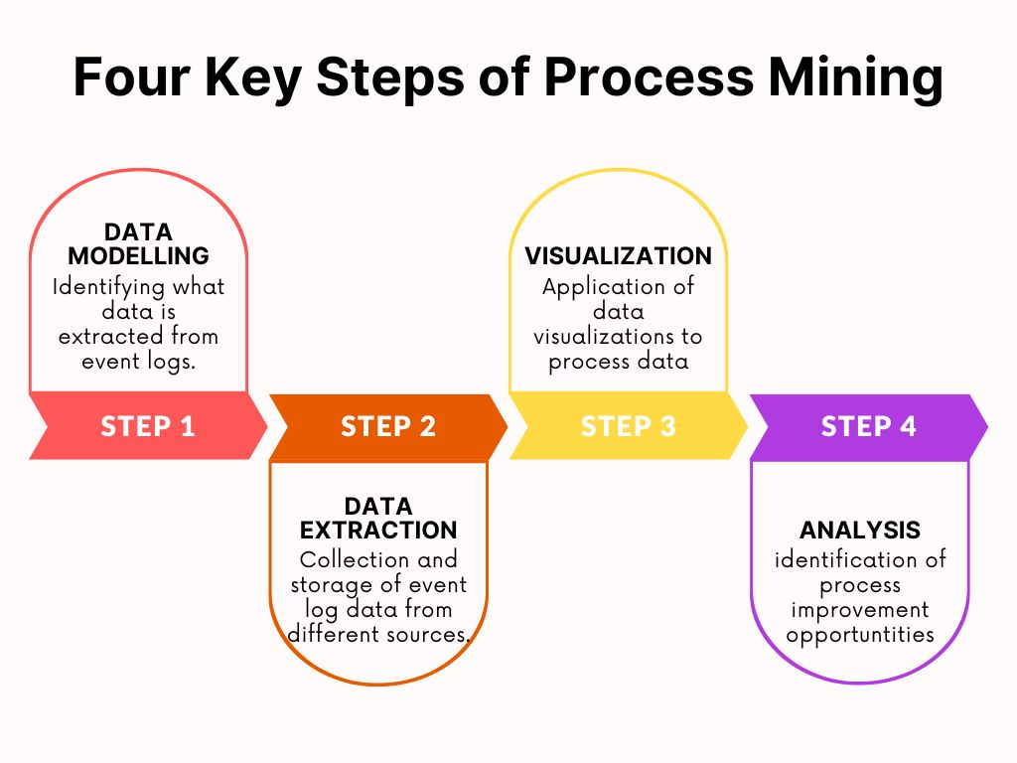
Process Mining Fundamentals
Main Stages in Process Mining:
Data Modelling.
Data Extraction.
Data Visualization.
Data Analysis.

Slide 15
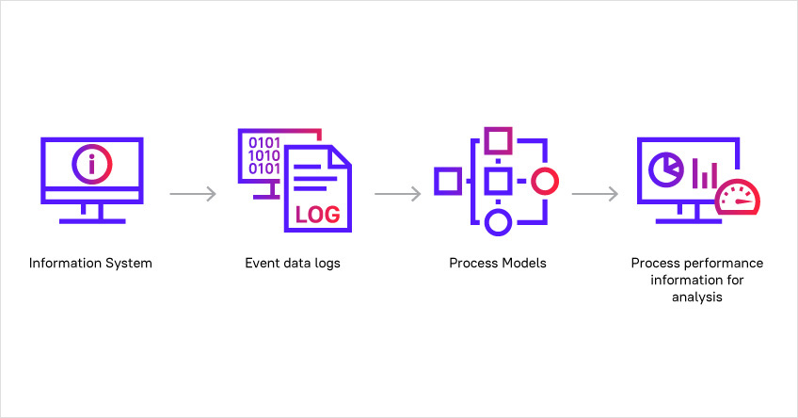
Process Mining Fundamentals
There are a number of ways Process Mining can be applied:
Automated business process discovery/mapping – tracking event logs to identify the activities performed by employees, and defining a process around these activities.
Performance analysis/process optimization – an enterprise can boost performance by analyzing information from the event log to determine opportunities and adapt or improve process models according to the data of the real process.
Operational support – directly influencing and improving the process not by changing the model but by providing data-driven support in the form of warnings, predictions, or recommendations.

Slide 16
PQL
Process Query Language is the important component in process mining.
It is different from the SQL. It is designed based on requirements .If we give a question to it, it processes the data and gives the meaningful answer.
Design goals and the history of the PQL:
1.Simplicity:Easy to use and translates the complete process questions into data queries.
2.Flexibility:Formulates any question, regardless of the process.
3.Event log centered: supports process mining functionalities.
4.Business Focus : Combine process Mining and business intelligence capabilities.
5.Frontend interaction: Support of a graphical user interface(GUI).
PQL are executed in visual and code editors.

Slide 17
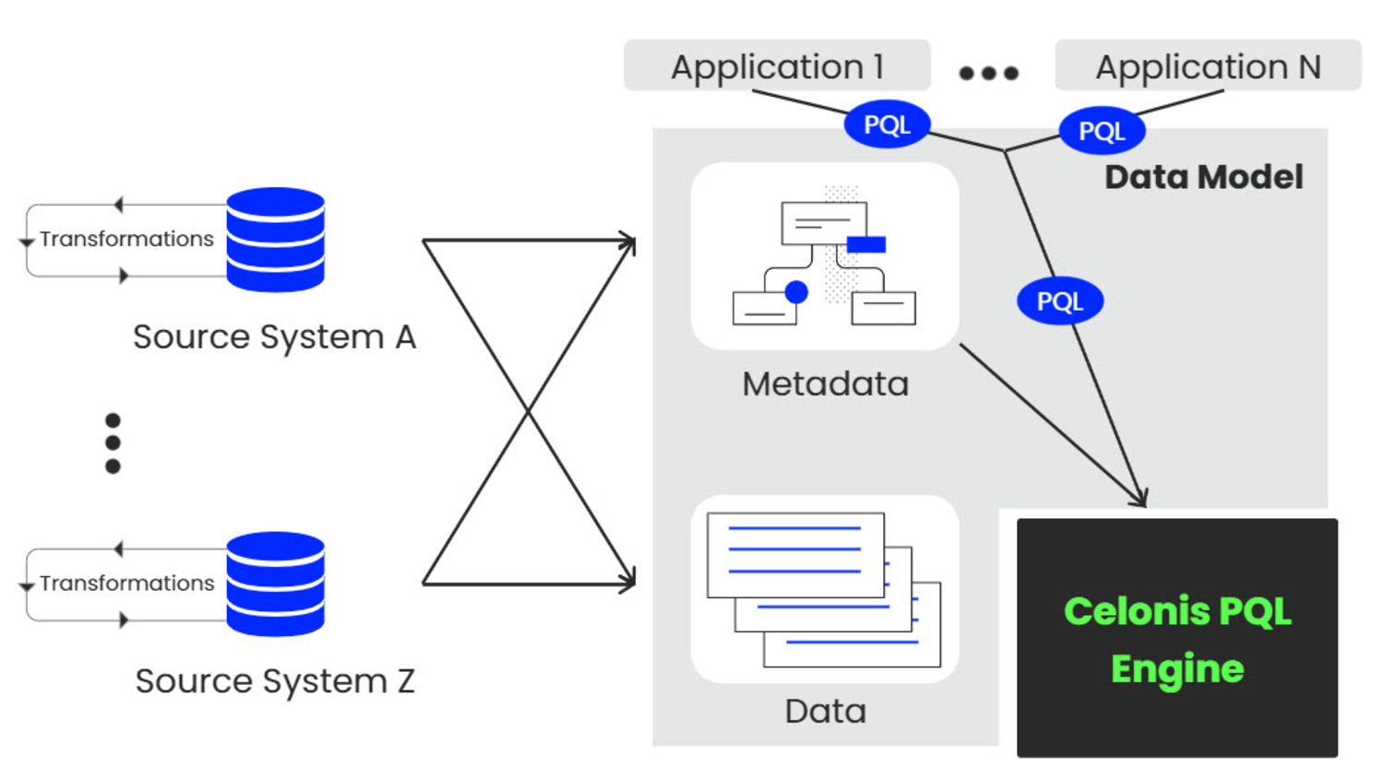
Architecture of software PQL Engine

Slide 18
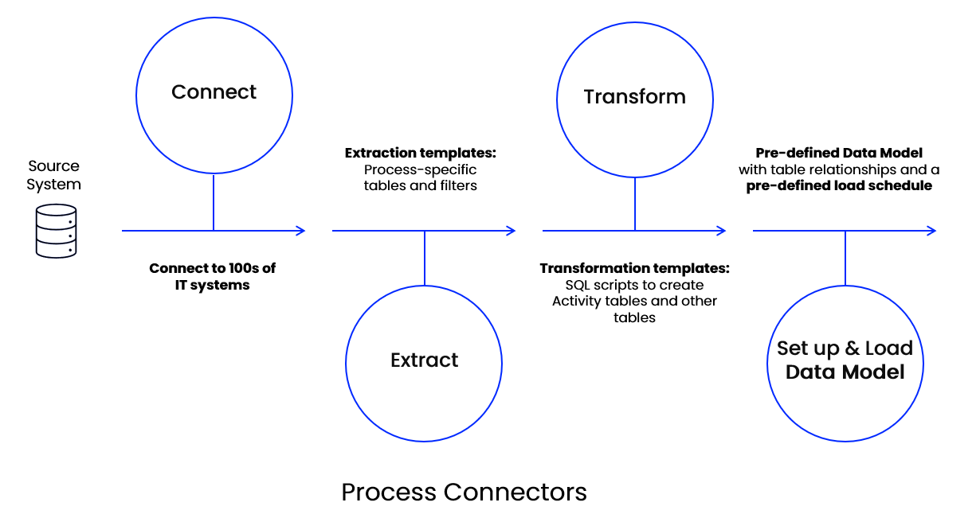
Get Data into the EMS
Process Data is a set of connected activities with timestamps following one specific case, or object. Every activity is an "event", and your task is to collect these events and organize them in the right order.
It helps you connect to source systems, extract the relevant data, transform it to your needs, and load it into a polished Data Model.

Slide 19
Get Data into the EMS
Connect: Connecting to source systems is your very first step to pull process data into the Celonis EMS. The EMS utilizes a broad set of technologies like Restful APIs, Soap APIs, direct database access, to connect.
Extract: It refers to a process of retrieving or collecting specific data from various sources or systems and consolidating it into a unified format or database.
Transform: The goal is to transform your data so it can become a Process Data Model. Your most important task is to create the Activity table, also called the event log. This table is the basis for the Data Model you build to visualize your process flow.
Data Model: It is the process of creating a visual representation of either a whole information system or parts of it to communicate connections between data points and structures.

Slide 20
Real Time applications
Supply Chain Visibility: Monitoring supply chain processes in real-time using process mining can provide visibility into the movement of goods, inventory levels, and potential disruptions. This enables organizations to respond quickly to changes in demand or supply.
Finance: Automation and process enhancement significantly benefits the finance sector. Process mining can optimize audit controls, find root causes for incorrect invoices, mitigate risk, and enhance loan processes.
Sales: Since complex sales processes depend on external factors, process mining allows business leaders to envision discrepancies and resolve them to meet fixed targets. Companies can increase conversion rates, enhance strategies, and improve sales performance across the board.
Customer experience: With process mining technology, businesses can identify which customer processes are taking longer to resolve and pinpoint their root causes while providing solutions to fix the delay.
E-commerce: Organization leaders in the e-commerce sector can boost their conversion rates by getting exclusive insights into buyer behavior, market trends, and growing customer base.

Slide 21
Learning outcomes
After completion of this training, we should be able to:
Understand what Process Mining is and the basics of how it works.
Identify business use cases for Process Mining.
Understanding how to discover, analyze, and improve business process using data driven techniques.
Get a better understanding of PQL quries.
To analyse how getting data into the EMF.

Slide 22
Any Queries?

Slide 23
Thank You!!!

