Slide 1
WIREFRAMES

Slide 2
TYPES
Low Fidelity
Medium Fidelity
High Fidelity

Slide 3
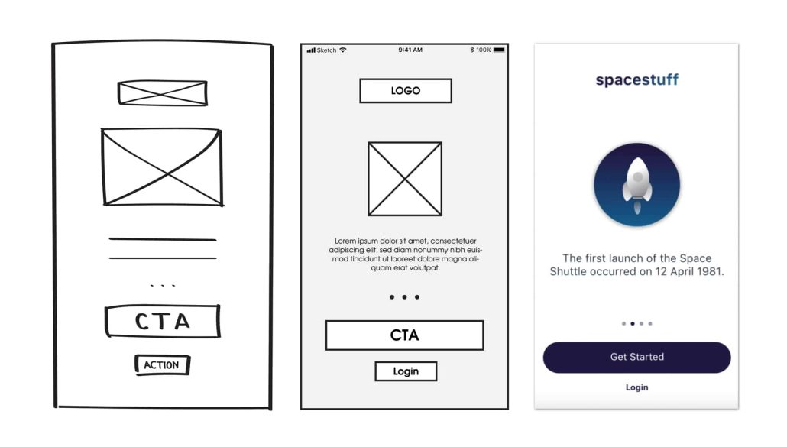

Slide 4
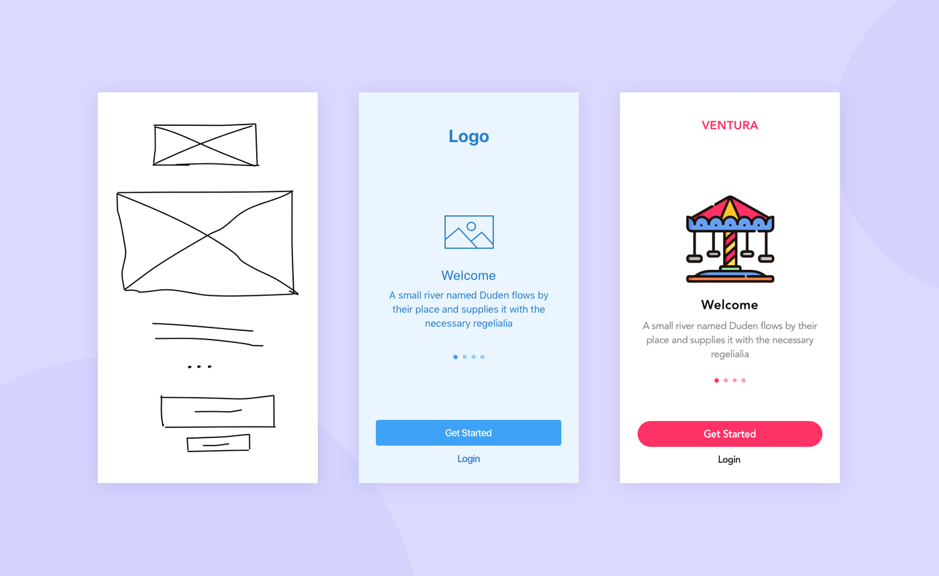

Slide 5
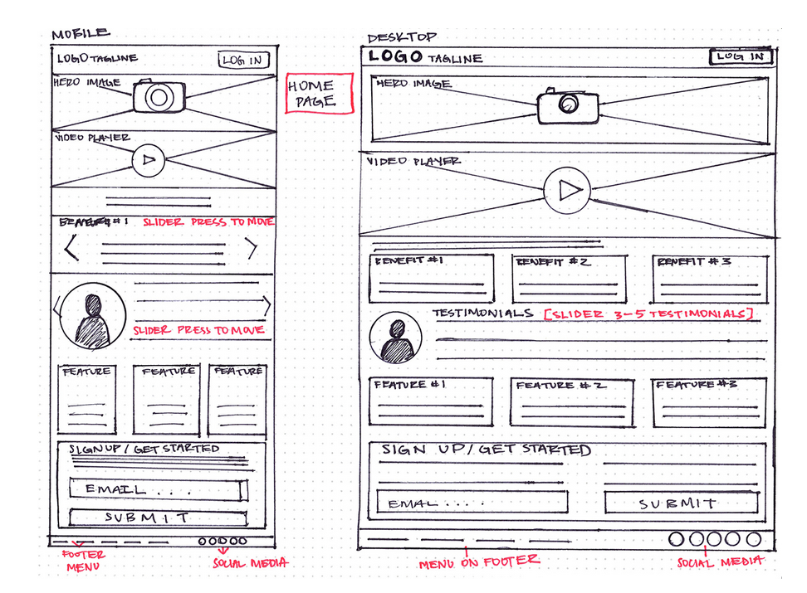

Slide 6
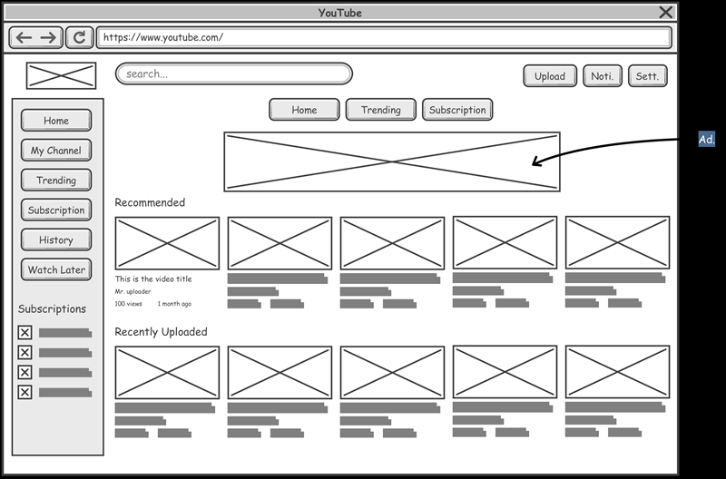

Slide 7
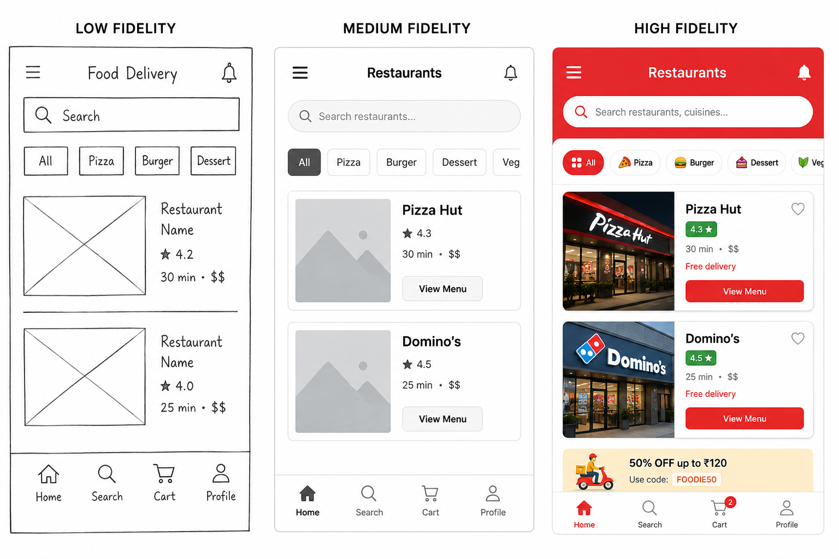

Slide 8
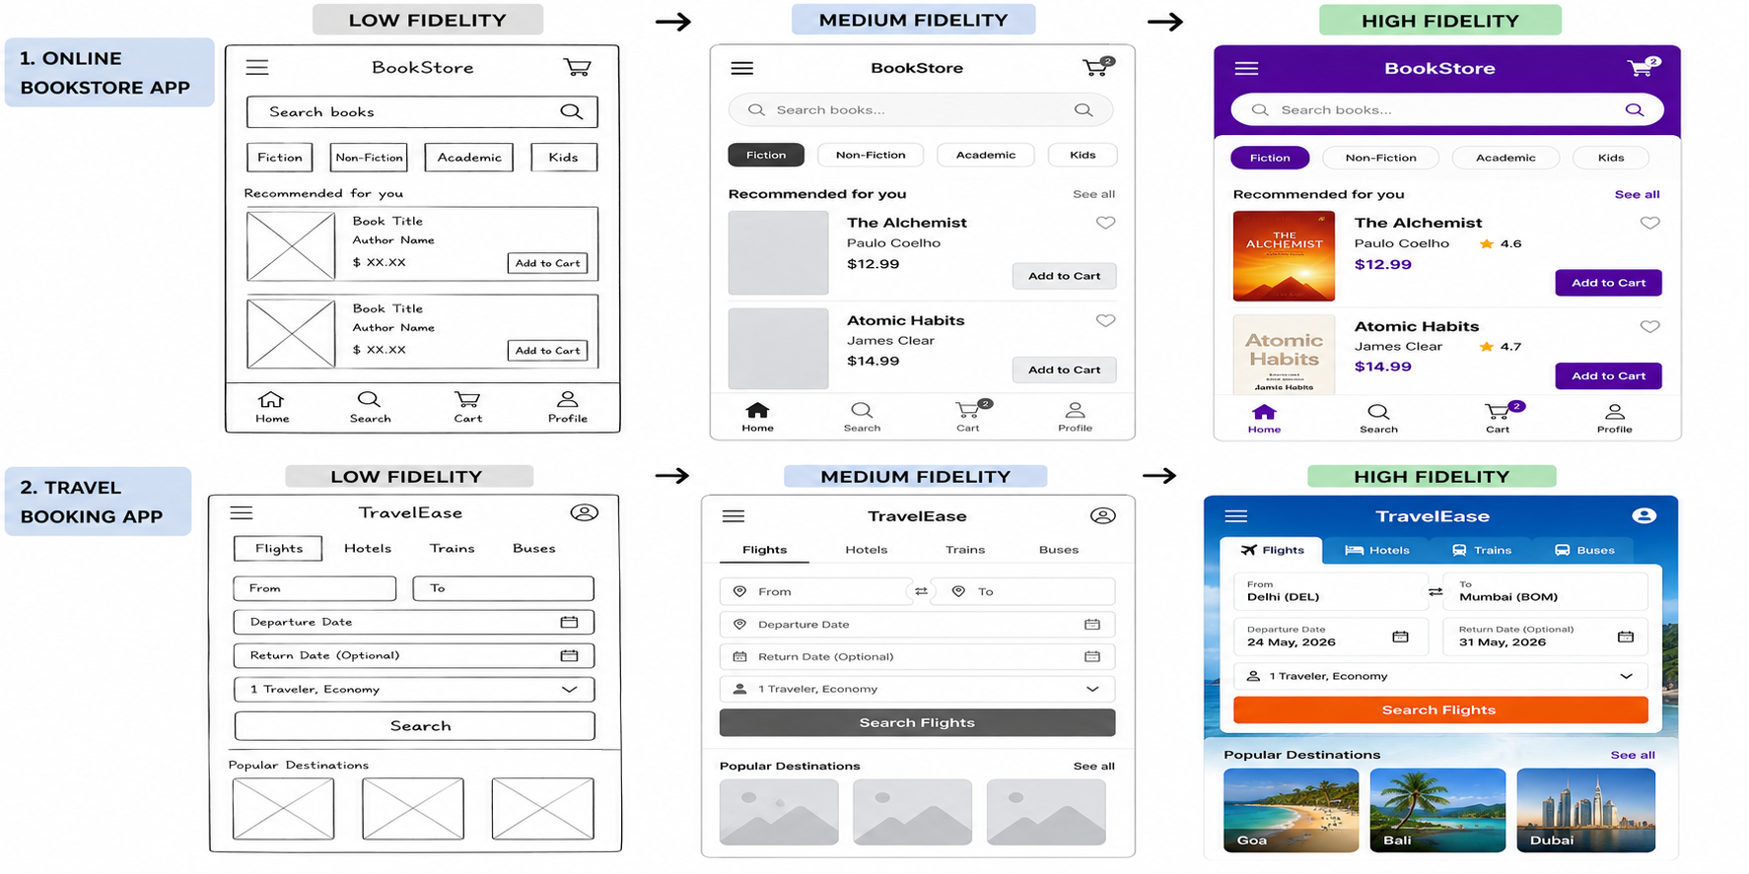

Slide 9
Real-world travel agent | Travel Booking App
Asks Where are you going? | From → To
Checks available flights | Search Flights
Shows different travel options | Flight/Hotel/Train/Bus results
Helps select dates | Departure / Return Date
Discusses number of travelers | 1 Traveler, Economy
Suggests destinations | Popular Destinations
Confirms the booking | Book / Confirm
Gives a ticket | Digital Ticket / Booking Confirmation

Slide 10
Real world: 🧳 Travel Agent ↓ Digital world: 📱 Travel Booking App
Other possible metaphors in the same app:
🧳 Suitcase → My Trips / Saved Trips
🎫 Ticket → Booking confirmation
🗺️ Map → Explore destinations
🛒 Shopping cart → Selected bookings
🏨 Hotel desk → Hotel booking
🔔 Travel notification → Flight reminders

Slide 11
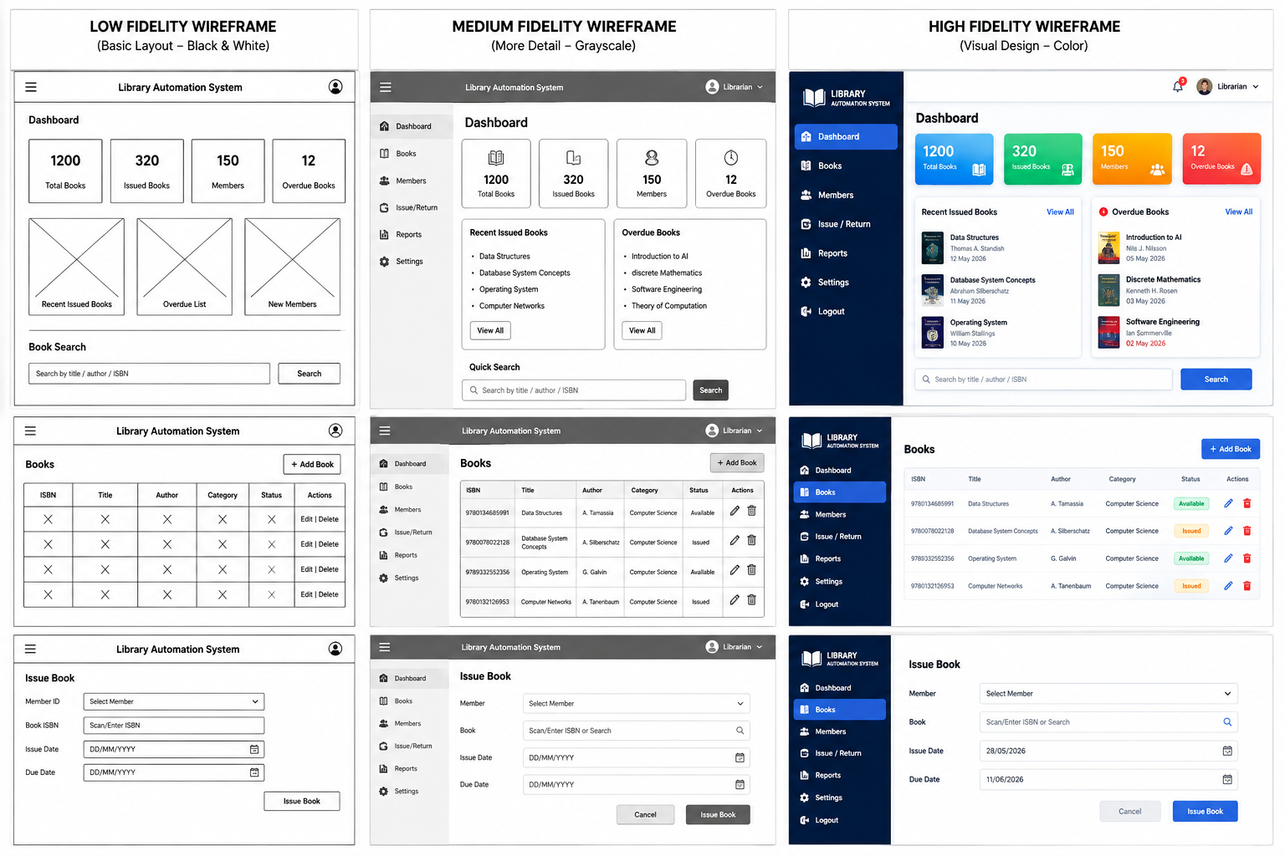

Slide 12
https://www.edrawsoft.com/wireframe-software-symbols.html
https://nulab.com/learn/design-and-ux/10-must-see-wireframe-examples-inspire-next-design/

