Slide 1
HR Analytics –
Employee Performance & Payroll Dashboard
POWER BI · DATA ANALYTICS PROJECT
STUDENT NAME
STUDENT ID
Prasanna U N
AF05331531
BATCH CODE
CENTER ID
ANP-D7635
TNJPM
Attrition · Payroll · Performance · Engagement
Notes:
Welcome. Say your name, student ID, batch and center. Then read the project title and say it is a Power BI dashboard about employees: who leaves, how money is spent, and how people perform.

Slide 2







Industry Selection
STEP 01 OF 11 · INDUSTRY SELECTION
Human Resources (HR) Analytics
Every company runs on people. HR analytics turns employee data into clear answers.
3,400
5
People are the biggest asset
Employees
Departments
Hiring, paying and keeping staff costs a lot.
Attrition is expensive
When people leave, skills and money leave too.
5
5
Data guides decisions
Job Roles
Education Levels
Dashboards show HR where to act.
Notes:
I chose the Human Resources industry. Every company has people, and people cost the most money. HR teams need data to decide. Our data has 3,400 employees, 5 departments and 5 job roles.

Slide 3



Problem Statement
STEP 02 OF 11 · PROBLEM STATEMENT
The company has HR data in a flat CSV file but no clear picture. We need to find out who is leaving, where the payroll goes, and how employees perform.
Employees who left
50.7%
1,724 of 3,400
Who is leaving?
Attrition by role, age, tenure and overtime
Where does the money go?
Payroll by department, role and education
How are employees doing?
Left (1,724)
Stayed (1,676)
Performance, satisfaction and work-life balance
Notes:
Explain the problem in one line: the company has HR data in a plain CSV file, and it is hard to read. We want clear answers to three questions. Point to the 50.7 percent attrition: more than half of the employees in this data have left.

Slide 4





Dataset Collection (CSV)
STEP 03 OF 11 · DATASET COLLECTION
Employee
Job
Age, Gender
Education level
Marital status
Companies worked
Department, Job role
Monthly income
Years at company
Years in role
HR Employee Dataset
Source: Kaggle · Format: CSV
3,400
20
1
Performance
Exit & Work
Rows
Columns
CSV file
Performance rating
Job satisfaction
Work-life balance
Training hours
Attrition (Yes/No)
Overtime
Distance from home
Stock option level
Open dataset on Kaggle
kaggle.com/datasets/justinlimyin/hr-employee-dataset
Notes:
The data comes from Kaggle: the HR Employee dataset. It is one CSV file with 3,400 rows and 20 columns. The columns cover personal details, job details, performance and exit details. Mention the Kaggle link on this slide.

Slide 5








Raw Dataset Backup
STEP 04 OF 11 · RAW DATASET BACKUP
Keep the original safe
The raw file is never edited.
Kaggle CSV
Raw backup
Clean copy
Compare before and after
Dataset / folder
Raw has 20 columns, clean has 28.
HR_Dataset_raw.csv
304 KB
Original
HR_Employee_Clean.csv
477 KB
+8 columns
Dim_Department.csv
1 KB
Lookup
Repeat the work anytime
Dim_JobRole.csv
1 KB
Lookup
Cleaning can always start again.
Dim_Education.csv
1 KB
Lookup
Notes:
Before changing anything, I saved the original Kaggle file as HR_Dataset_raw.csv. I never edit it. The cleaned file is a separate copy. Note the size: raw is 304 KB, clean is 477 KB because I added 8 new columns.

Slide 6




Power BI ETL – Power Query
STEP 05 OF 11 · POWER BI ETL
1
2
3
4
Get Data
Transform
Add lookups
Close & Apply
Home → Get data → Text/CSV. Pick HR_Employee_Clean.csv.
Open Power Query. Rename to Fact_Employee. Check data types.
Load Dim_Department, Dim_JobRole and Dim_Education.
Load all tables into the Power BI model.
Result: 4 clean tables ready in Power BI: Fact_Employee, Dim_Department, Dim_JobRole and Dim_Education.
Notes:
ETL means Extract, Transform, Load. Walk through the 4 simple steps: get the CSV, check it in Power Query, load the three lookup tables, then Close and Apply. Keep it short.

Slide 7


Data Cleaning & Transformation
STEP 06 OF 11 · CLEANING & TRANSFORMATION
Cleaned
New columns added
Data types set
Age_Group
Income_Band
Text trimmed
Tenure_Band
Annual_Income
Duplicates: 0 found
Data_Quality_Flag
+ Sort columns
Blank values: 0 found
Data quality flag
957
608
32
Odd rows were kept and flagged, not deleted.
Tenure exceeds working age
Role tenure exceeds company tenure
Both problems
Notes:
Cleaning was simple: I set data types, trimmed text, and checked for duplicates and blanks. There were none. Then I added 5 helpful columns. Last, I found 1,597 rows with odd years values. I did not delete them, I flagged them so nothing is hidden.

Slide 8



DAX & KPI Creation
STEP 07 OF 11 · DAX & KPI CREATION
~35
3,400
50.7%
1,74,26,235
Total Employees
Attrition Rate
Monthly Payroll
DAX measures
5,125
41.0%
48.2%
Check: Total Employees = 3,400
Avg Monthly Income
High Performer %
Overtime %
Attrition Rate
Monthly Payroll
High Performer %
Employees who left ÷ Total employees
Sum of every monthly income
Rating 4 or 5 ÷ Total employees
Notes:
DAX is the formula language of Power BI. I made about 35 measures. After loading them I checked that Total Employees equals 3,400. Show the six main KPIs and explain three formulas in plain words.

Slide 9
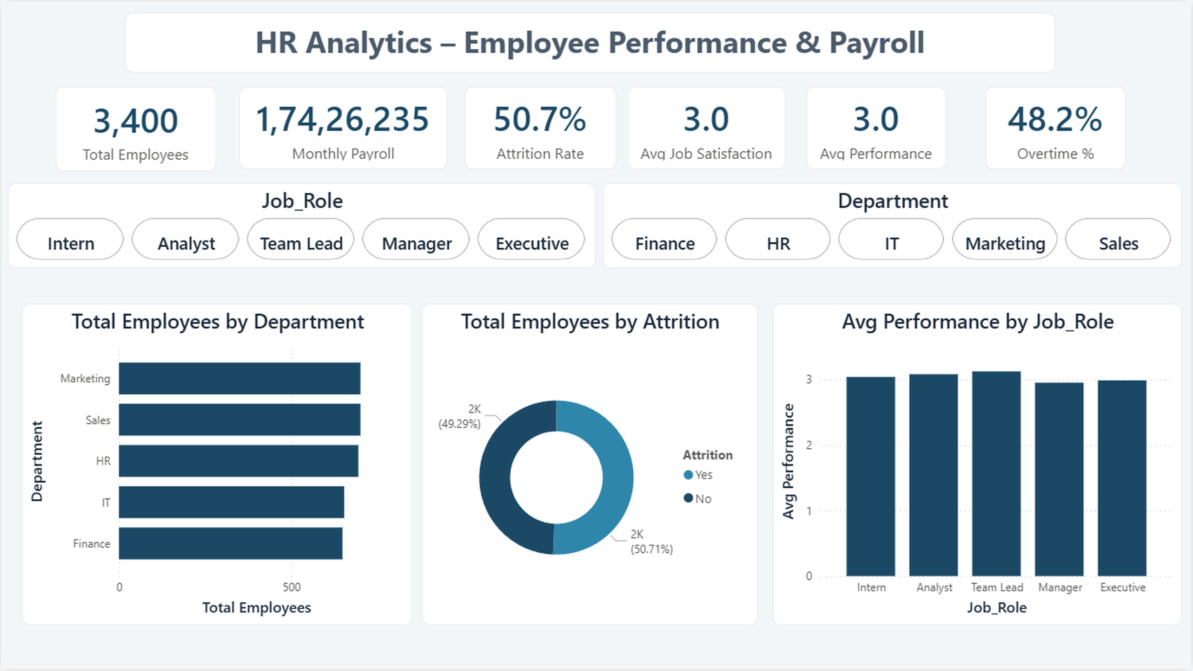
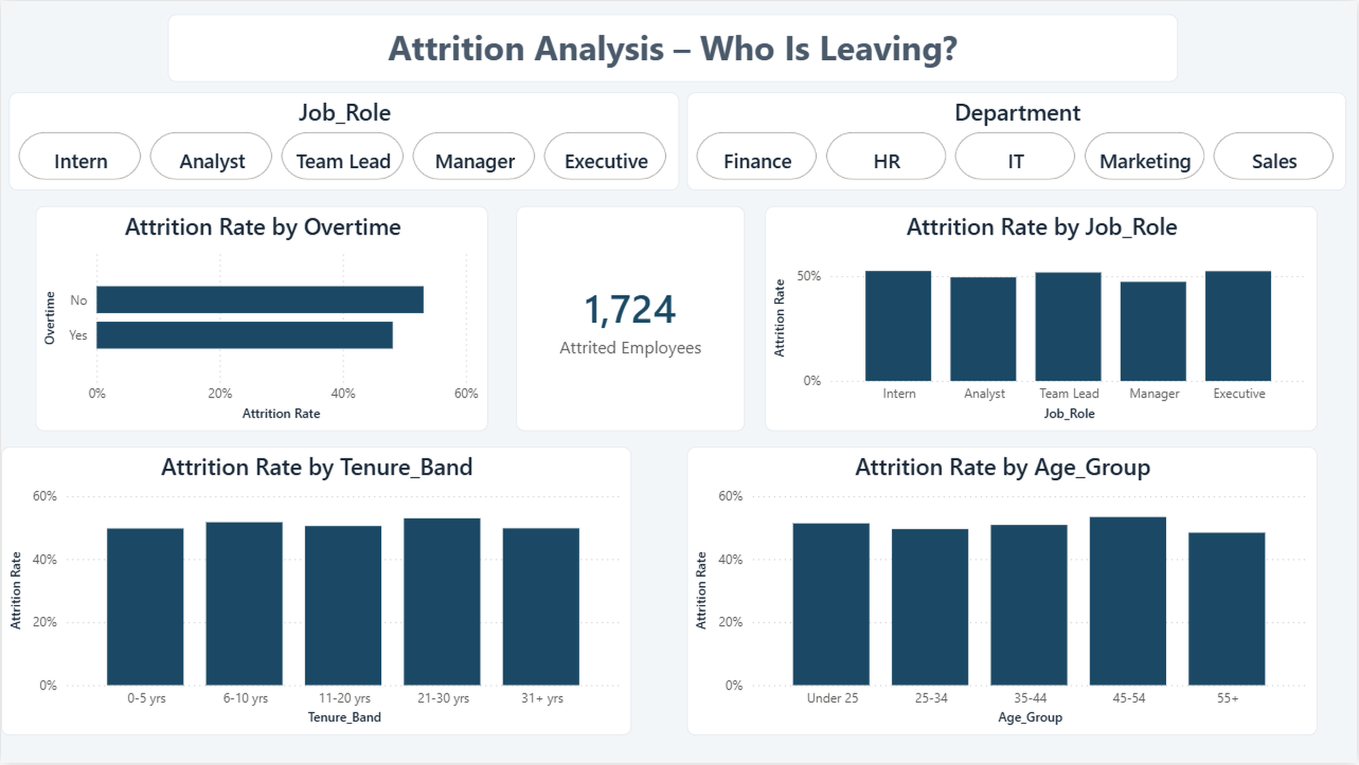
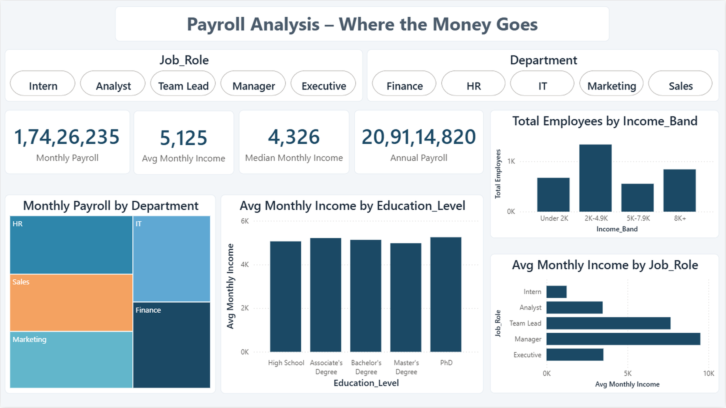
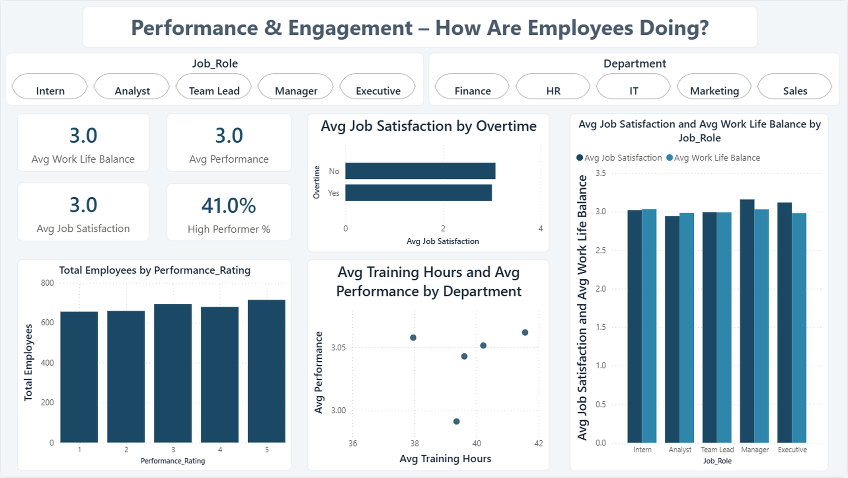
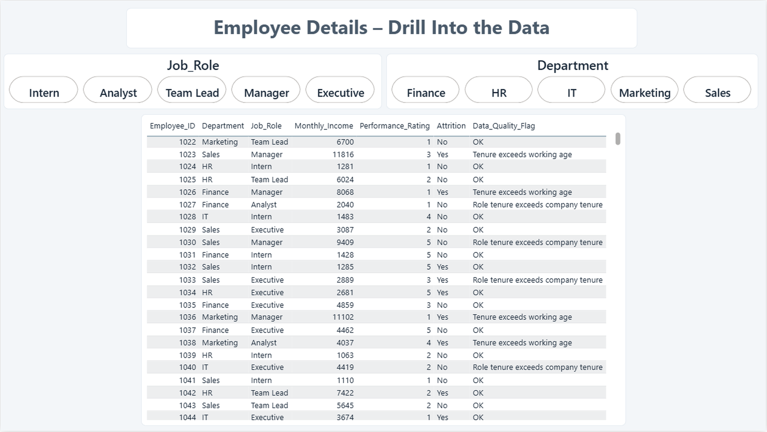
Dashboard Development – 5 Pages
STEP 08 OF 11 · DASHBOARD DEVELOPMENT · OVERVIEW
1
2
3
Executive Overview
Attrition Analysis
Payroll Analysis
4
5
In every page
Job Role slicer
Department slicer
Cross-filtering visuals
Custom colour theme
Performance & Engagement
Employee Details
Notes:
This is the big picture: 5 report pages. Each page has Job Role and Department slicers, and every visual cross-filters. Click any picture in PowerPoint to jump to that dashboard. Next slides explain each page one by one.

Slide 10


Dashboard 1: Executive Overview
STEP 08 OF 11 · DASHBOARD DEVELOPMENT · PAGE 1 OF 5
Six KPI cards
3,400 staff · 50.7% attrition
Department mix
About 650–700 per department
Slicers
Job Role and Department filter all
← Back to dashboard overview
Notes:
Start here. Six KPI cards show employees, payroll, attrition, satisfaction, performance and overtime. Use the slicers to filter every chart. Employees are spread evenly across departments.

Slide 11

Dashboard 2: Attrition Analysis
STEP 08 OF 11 · DASHBOARD DEVELOPMENT · PAGE 2 OF 5
1,724 employees left
Half of all 3,400 staff
Overtime
No overtime 53.1% vs 48.1%
Role, tenure, age
All near 50%, no clear driver
← Back to dashboard overview
Notes:
This page answers: who is leaving? 1,724 employees left. Show the charts by overtime, role, tenure and age. The key point: attrition is near 50 percent in every group. Employees without overtime left slightly more.

Slide 12

Dashboard 3: Payroll Analysis
STEP 08 OF 11 · DASHBOARD DEVELOPMENT · PAGE 3 OF 5
Payroll totals
Monthly 1,74,26,235 · Annual 20,91,14,820
Average vs median
5,125 average · 4,326 median
By job role
Manager 9,505 · Intern 1,243
← Back to dashboard overview
Notes:
This page shows where the money goes. Monthly payroll is about 1.74 crore and annual about 20.9 crore. Managers earn the most. Executives earn less than Managers, which is unusual.

Slide 13


Dashboard 4: Performance & Engagement
STEP 08 OF 11 · DASHBOARD DEVELOPMENT · PAGE 4 OF 5
Average scores
Satisfaction, balance, performance ≈ 3.0
High performers
41.0% rated 4 or 5
Training vs performance
No strong link by department
← Back to dashboard overview
Notes:
This page shows how employees are doing. 41 percent are high performers. Satisfaction and work-life balance are about 3 out of 5 for every role. Training hours show no strong link with performance.

Slide 14


Dashboard 5: Employee Details
STEP 08 OF 11 · DASHBOARD DEVELOPMENT · PAGE 5 OF 5
Employee table
One row per employee
Data quality flag
Shows rows that need care
Drill down
Filter by role or department
← Back to dashboard overview
Notes:
This is the drill-down page. Each row is one employee with department, role, income, rating, attrition and a data quality flag. Use slicers to find a group, then scroll the table.

Slide 15
Business Insights
STEP 09 OF 11 · BUSINESS INSIGHTS
Attrition is about 50% everywhere
Average monthly income by role
Same in every department, role, age and tenure group.
No overtime left slightly more
53.1% without overtime vs 48.1% with overtime.
Executives earn less than Managers
3,516 vs 9,505 per month. This is unusual.
Almost no link between scores
Performance, income and satisfaction barely relate.
Note: the data looks synthetic, so this is a portfolio project, not a real HR study.
Notes:
Share four short findings. 1: attrition is about 50 percent everywhere. 2: people without overtime left slightly more. 3: managers earn most and executives earn less, which is unusual. 4: performance, income and satisfaction are almost unrelated. Say the data looks synthetic, so this is a portfolio project.

Slide 16

Publish to Power BI
STEP 10 OF 11 · PUBLISH TO POWER BI
1
Save the report
HR_Analytics_Dashboard.pbix
2
Publish
Home → Publish, then sign in
3
Choose a workspace
Power BI Service
Pick My workspace or a team one
Interactive slicers
Cross-filtering visuals
4
Open and share
Open the report online, share the link
Shareable link
Notes:
Last step in Power BI: save the report as a .pbix file, then publish it to the Power BI Service. Choose a workspace, open the report online and share the link. Keep this simple: save, publish, choose, share.

Slide 17
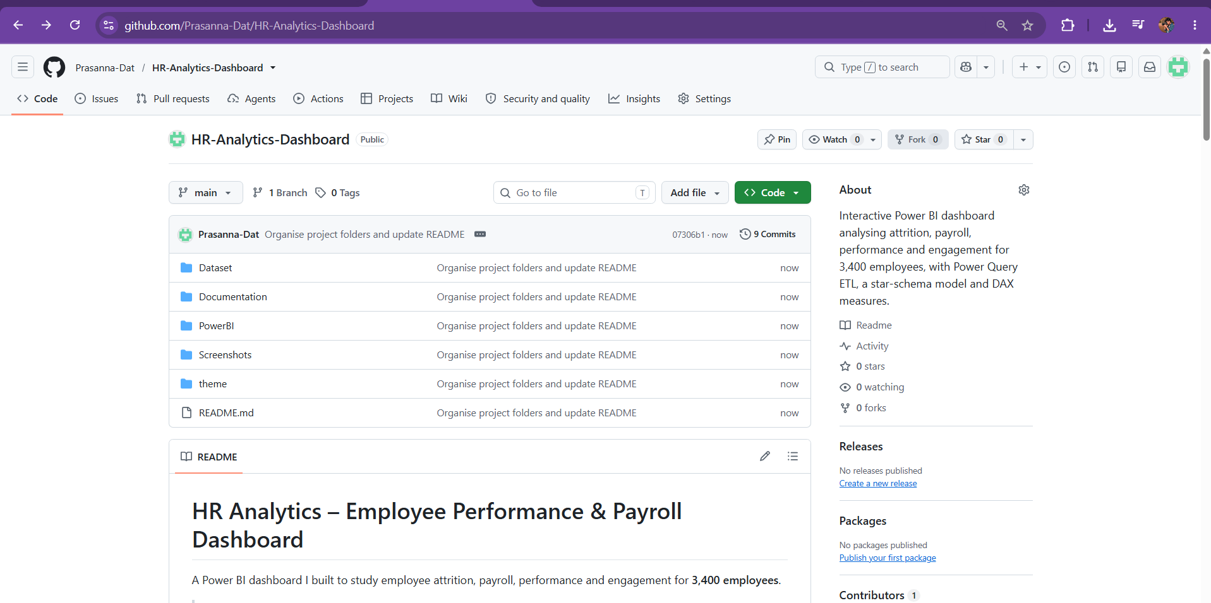



GitHub Documentation
STEP 11 OF 11 · GITHUB DOCUMENTATION
Repository structure
Dataset/
Raw, clean and lookup CSVs
Documentation/
Data dictionary, project report
PowerBI/
HR_Analytics_Dashboard.pbix
Screenshots/
5 dashboard page images
theme/
github.com/Prasanna-Dat/HR-Analytics-Dashboard
HR_Theme.json colours
README.md
Public repository · Click to open
Findings, how to open, limits
Notes:
The whole project is on GitHub: dataset, Power BI file, screenshots, theme and documents. The README explains the findings, how to open the file and the data limits. Click the button to open the repository.

Slide 18


Thank You
Questions and feedback are welcome
Prasanna U N
Student ID: AF05331531 · Batch: ANP-D7635
Center ID: TNJPM
GitHub Repo
Kaggle Dataset
View Dashboards
Back to Start
Notes:
Thank the audience. Say the project is on GitHub and the dataset is on Kaggle. Invite questions. If asked, use the buttons to jump to the dashboards or the first slide.

