Slide 1
Weather-Based Prediction of Wind Turbine Energy Output
Domain: Artificial Intelligence & Machine Learning
Team ID: LTVIP2026TMIDS39254
Team Leader: Lalith Kota
Team Members:
Kovvuru Satya Narayana Raju
Moturi Prasanna Kumar
Patsamatla Sai Sashank Varma
Shivam Kumar Singh

Slide 2
Problem Statement
Wind energy output changes frequently because of varying weather conditions. Therefore, an automated and reliable prediction system is required.

Slide 3
Abstract
This project focuses on predicting wind turbine energy output using weather data such as wind speed, temperature, humidity, and pressure. Wind energy production changes frequently due to varying weather conditions, making accurate forecasting essential. Machine learning models are trained using historical weather and power generation data. The trained model learns the relationship between environmental factors and energy output. It can then predict future power generation with good accuracy.
This helps energy companies plan electricity production more effectively. The system also supports wind farm operators in scheduling maintenance during low-energy periods. This reduces downtime and improves efficiency. Grid operators can use predictions to balance electricity supply. Other energy sources can be adjusted accordingly. A web-based interface is provided for easy usage. Users enter weather values and get instant predictions. The system is simple, fast, and reliable. This project supports renewable energy optimization and sustainable development.

Slide 4
Introduction
Wind energy is one of the most important renewable energy sources used for power generation today. It helps in reducing pollution and dependence on fossil fuels. Wind turbines convert the kinetic energy of wind into electrical energy. However, wind speed and weather conditions change continuously. These changes cause fluctuations in power generation. Accurate prediction of wind energy output is therefore essential. Machine learning techniques can analyze large volumes of data. They help in forecasting wind power more efficiently and reliably.

Slide 5
Objectives
• To build a wind energy output prediction system. • To use weather data for predicting power generation. • To implement machine learning models using Python. • To develop a web application using Flask. • To create an API for prediction service. • To provide fast and accurate energy forecasts. • To support efficient renewable energy management.

Slide 6
Technology Stack
• Programming Language: Python • Web Framework: Flask • Machine Learning Library: Scikit-learn • Data Processing: Pandas, NumPy • API Integration: Flask REST API • Frontend: HTML, CSS • Development Tools: VS Code

Slide 7
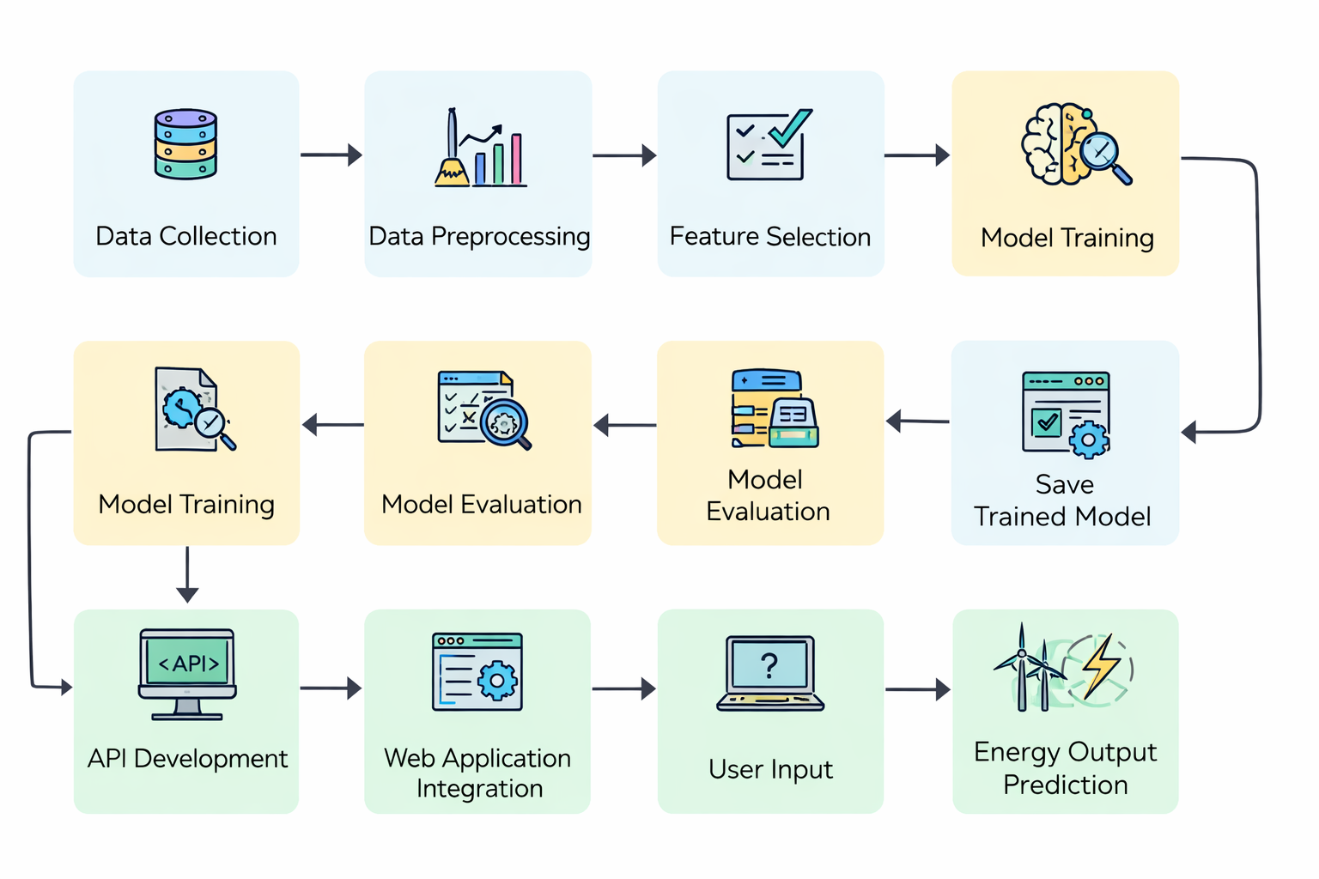
Workflow

Slide 8
Results
• The system accurately predicts wind turbine energy output. • Predictions are generated in real time. • Machine learning model performs well on test data. • Web application provides user-friendly interface. • Helps in efficient energy planning.

Slide 9
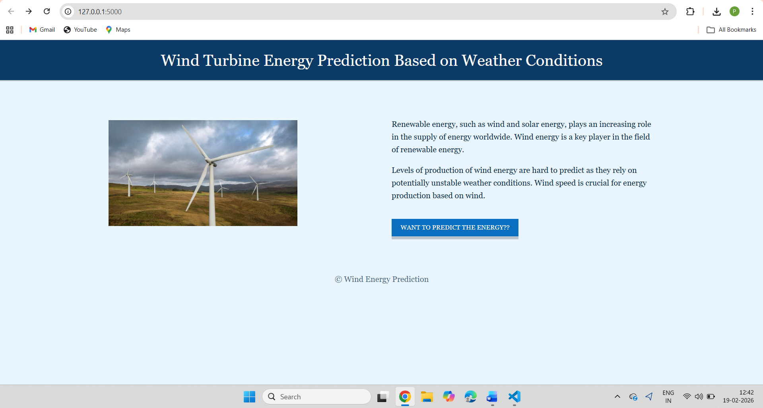
Output Screenshots – 1 (Web Interface)

Slide 10
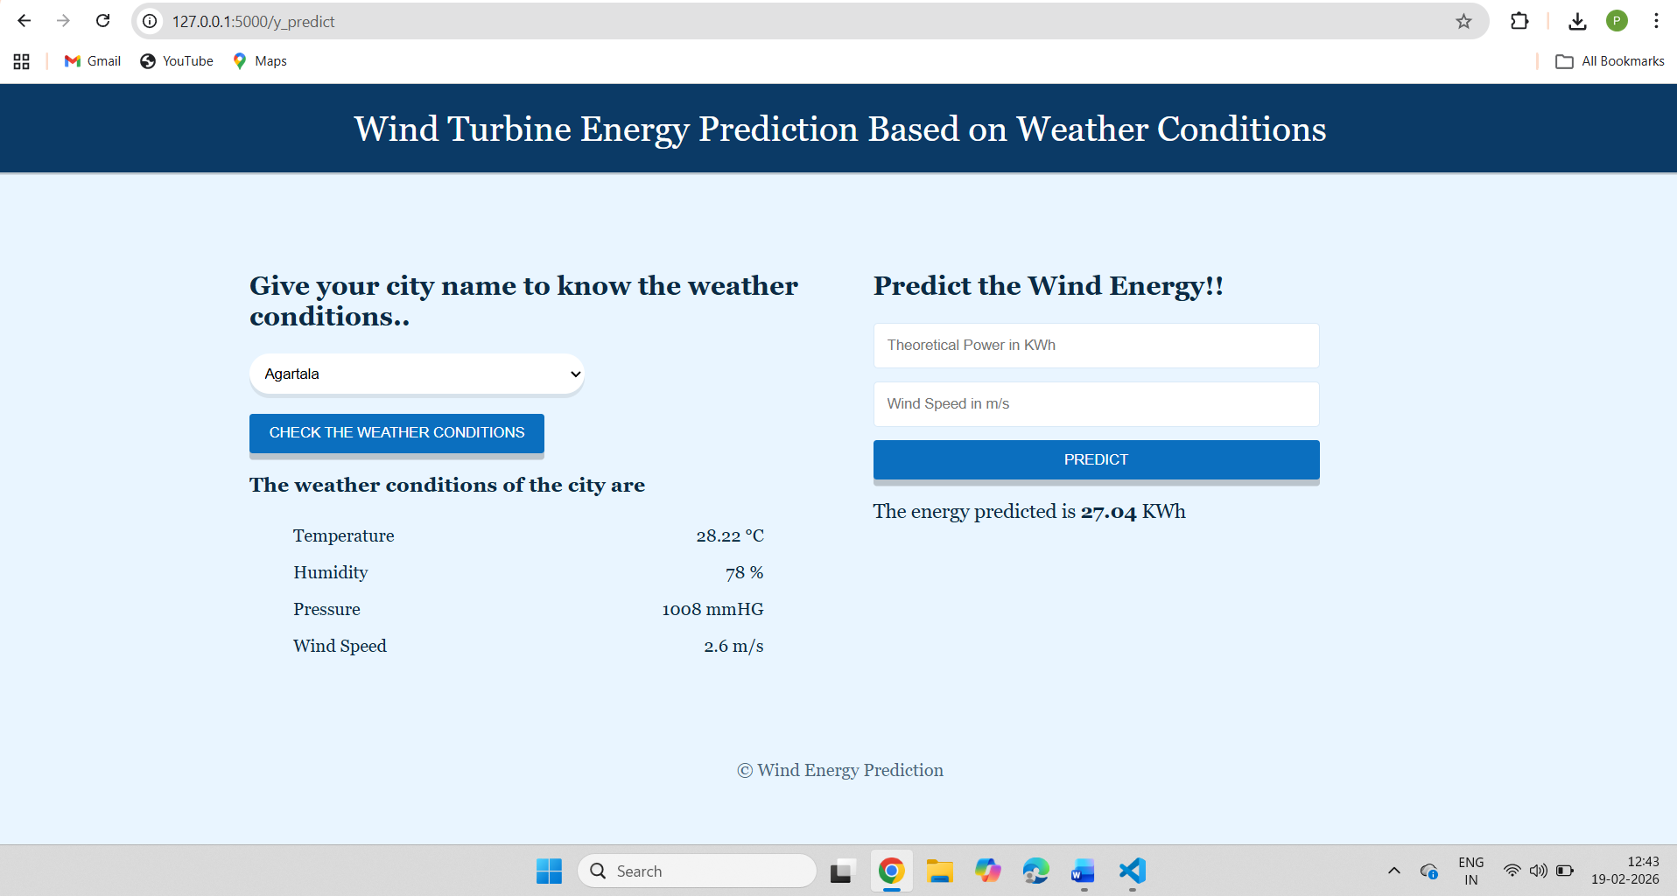
Output Screenshots – 2 (Prediction Results)

Slide 11
Conclusion
• Machine learning is effective for wind energy prediction. • The system improves forecasting accuracy. • It supports renewable energy management. • Helps reduce power loss and wastage. • Can be extended with real-time weather APIs.

Slide 12
Thank you

