Slide 1

C++ PROJECT
TOPIC : MACHINE LEARNING WITH C++!!!
SEM 3 SEC C
Presented by: Prasanna MG
USN:1NT18CS116

Slide 2
Converting the data set as per requirements
The data set I have used is MNIST data set.It is a data set of hand written digits each of 28 by 28 pixels converted to binary format.
The MNIST data set is in the Big endian format and for proceeding with intel processors it is needed to be converted to little endian.

Slide 3
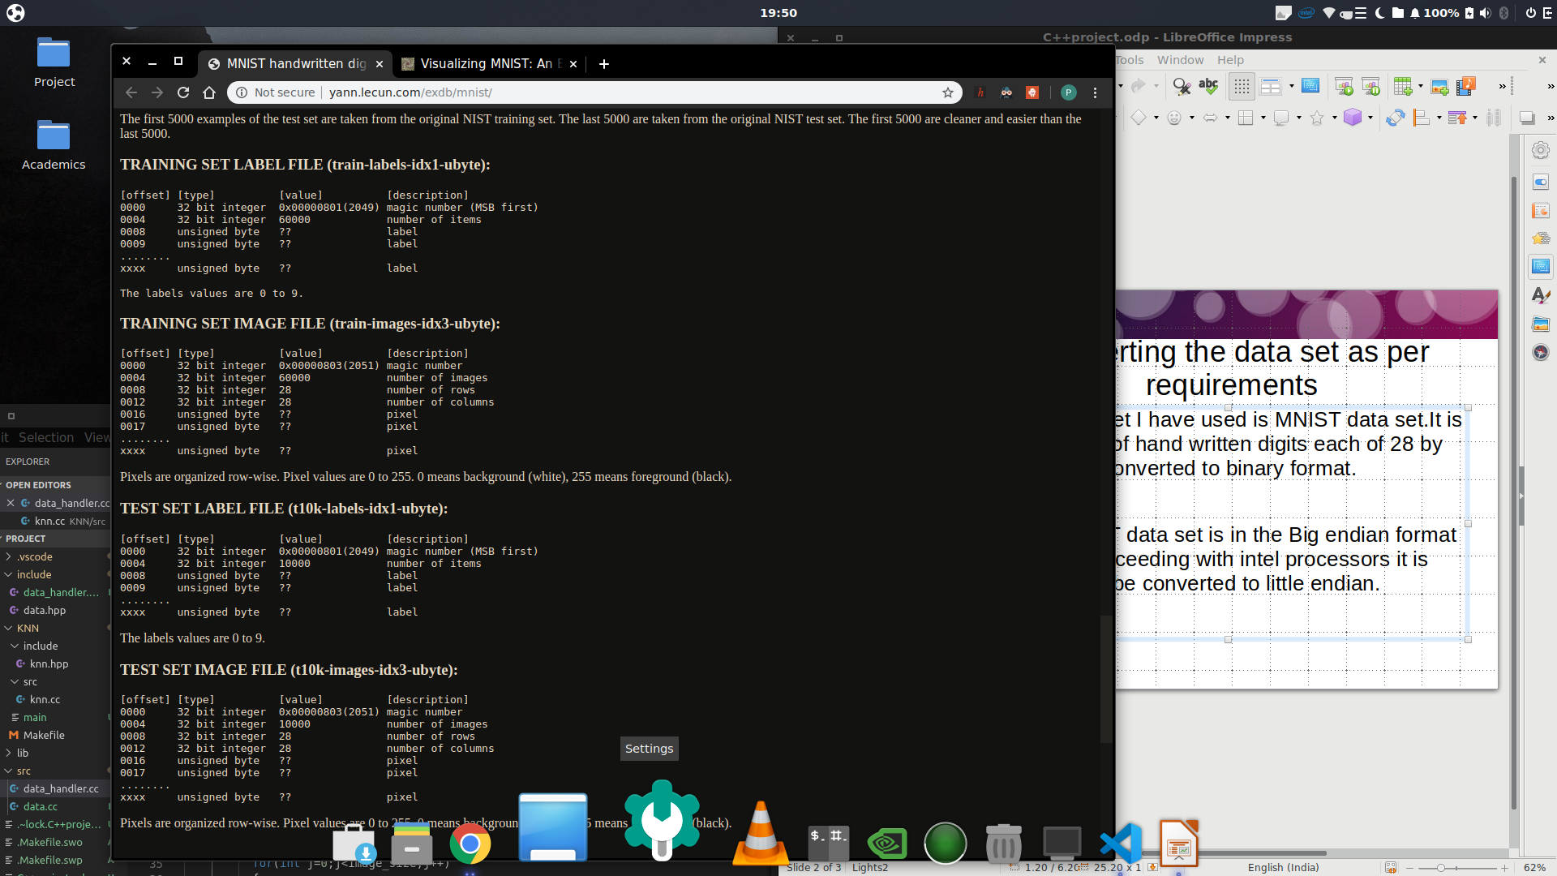

Slide 4
Show Code and Explain:the conversion of data to required form and appendng the feature vector

Slide 5
KNN
#ifdef EUCLID
for(unsigned i=0;i<query_point->get_feature_vector_size();i++)
{
distance+= pow(query_point->get_feature_vector()->at(i)-input->get_feature_vector()->at(i),2);
}
return(sqrt(distance));

Slide 6
Working of KNN Algo:
In KNN find the nearest neighbors using Eucladian distance method.
Map the nearby class neighbors into the vector,so the vector contains all the nearby classes.
In this vector that is created find the maximum occurances of a particular class and label it as 1 and the 2nd max occurances as 2 and so on...
The value at 1 is k=1 and the obtained class is most likely to be the predicted value.

Slide 7
Demonstrarion:
Run the code.....

