Slide 1

Chameli Devi Group of Institutions, Indore Department of Computer Science & Engineering
Major Project Synopsis Presentation
on
<< SwiftOps >>
Presented By: 1. Prasanna Samadhiya (0832CS211141)
2. Rachit Vijaywargiya (0832CS211149)
3. Divyansh Dawar (0832CS223D04)
Project Guide:
Mr. Dayanand Yadav Professor

Slide 2
Presentation Outline
Introduction
Problem Statement
Objectives & Scope
Project Overview
Proposed Solution
Software Functional Requirements
Software Non-Functional Requirements
Flow Chart/Block Diagram
Detailed Description of all Modules
Data Flow Diagram
ER Diagram and Schema
Conclusion
Future Scope
References

Slide 3
Introduction
Our Project is designed to revolutionize the software development process by automating critical tasks like Continuous Integration and Continuous Deployment (CI/CD), server management, and real-time monitoring. By integrating with platforms like GitHub, it automates code testing, building, and deployment, enabling faster, error-free software releases. It also manages server resources automatically, addressing issues like traffic spikes and downtime without manual intervention. With customizable workflows and real-time performance tracking, the tool adapts to each team’s unique needs, helping them focus on development while ensuring smooth, efficient, and reliable software delivery.

Slide 4
Problem Statement
In today’s competitive software landscape, development teams face increasing pressure to deliver features and updates rapidly while maintaining high quality and reliability. Traditional software development and deployment processes are often manual, time-consuming, and prone to human error. This results in slower release cycles, operational inefficiencies, and increased risk of bugs or downtime in production environments. Additionally, managing servers and monitoring application performance can be complex, requiring constant attention to ensure stability and scalability, particularly during high-traffic periods. Without effective automation, teams struggle to balance speed and reliability, leading to delayed releases, system failures, and inefficient resource allocation. This creates a critical need for a comprehensive solution that automates code deployment, server management, and performance monitoring, enabling faster, more reliable software delivery and freeing development teams to focus on innovation.

Slide 5
Objectives & Scope
1. Automation of CI/CD Pipelines:
To streamline the software development lifecycle by automating Continuous Integration and Continuous Deployment (CI/CD) processes, ensuring faster, error-free code delivery.
2. Enhanced Server Monitoring:
To automate server monitoring and resource management, ensuring high availability, automatic scaling, and recovery from failures without manual intervention.
3. Real-Time Monitoring and Alerts:
To provide real-time performance tracking and monitoring of applications, offering alerts and dashboards that highlight critical metrics such as memory usage, traffic, and server health.
4. Customizable Workflows:
To offer flexible, customizable workflows that allow development teams to tailor the tool according to their specific project needs, such as incorporating security checks or backups.

Slide 6
Project Overview
Our DevOps Automation Project streamlines the entire software development lifecycle by automating key tasks such as Continuous Integration and Continuous Deployment (CI/CD), server management, and real-time monitoring. By integrating directly with GitHub, the tool automates the testing, building, and deployment of code, enabling teams to deliver features more quickly and with fewer errors. Additionally, the tool manages server resources, automatically addressing issues like downtime or traffic spikes, while offering customizable workflows tailored to the unique needs of each project. With built-in monitoring and alert systems, teams can track the performance and health of their applications in real-time. Our solution empowers development teams to focus on innovation, reducing manual tasks and minimizing the risk of errors, ultimately ensuring faster, more reliable software delivery.

Slide 7
Proposed Solution
Automated CI/CD Pipeline
By automating the CI/CD pipeline, teams can release new features or updates more frequently and quickly, reducing development cycles. The tool minimizes manual intervention, allowing developers to focus on coding while the tool handles testing, deployment, and server management.
2. Automated Server Monitoring
Automated server scaling and recovery mechanisms prevent downtime and ensure optimal resource allocation, especially during traffic spikes. The tool’s auto-scaling feature adjusts server resources dynamically based on demand, eliminating the need for manual server adjustments.
3. Real-Time Performance Monitoring and Alerts
Real-time monitoring and alerts notify teams immediately when performance issues arise, allowing for faster response times. With automated error detection and scaling, the tool can resolve certain problems (e.g., server restarts) without manual input.
4. Customizable Workflows
Teams can tailor workflows to their specific project requirements, allowing them to integrate additional tasks like security checks, code reviews, or database backups.Supports multiple deployment models, including Agile and continuous delivery methodologies, adapting to the team's processes.

Slide 8
Software Functional Requirements
Automated Code Integration and Deployment (CI/CD): Implemented automated testing, building, and deployment workflows to streamline code integration and deployment processes. Tracking and managing deployment statuses, with automatic rollback on failures.
Server Monitoring and Management: Continuously monitoring server health, performance metrics, and resource usage. Automatically scaling server resources based on traffic and restarting servers upon failure.
Custom Workflow Configuration: Allow users to set up custom testing, security, and compliance checks within the deployment pipeline. Enable users to adjust the CI/CD workflow to fit team-specific needs.
Real-Time Alerts and Notifications: Sending real-time alerts for server issues, deployment failures, and security risks.
Dashboard and Analytics: Providing a dashboard for viewing performance metrics, resource usage, and deployment history.

Slide 9
Software Non-Functional Requirements
Scalability: Supporting high-traffic environments by scaling resources dynamically without performance degradation.
Reliability: Ensuring high uptime and minimizing failure risks through automated monitoring and self-healing mechanisms.
Security: Enforcing strict access controls, data encryption, and conducting security scans on each deployment.
Usability: Offering an intuitive interface for configuring workflows, with accessible documentation and help resources.
Performance: Maintaining quick response time for real-time monitoring and data visualization, even with large-scale deployments.
Maintainability: Ensuring modular code for easier updates, bug fixes, and the addition of new features.

Slide 10
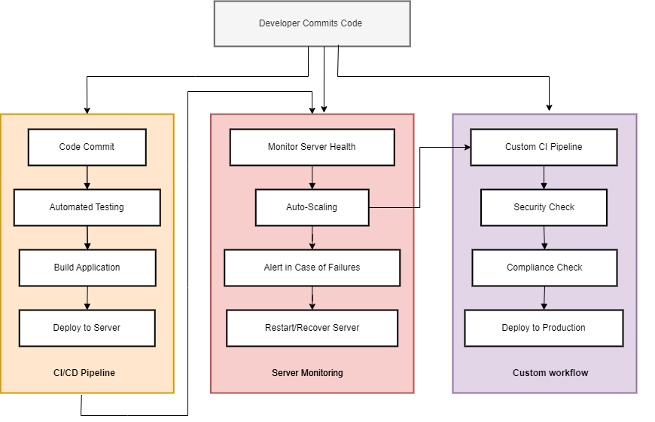
Flow Chart

Slide 11
Detailed Description of Modules
1. CI/CD Pipeline Module:
Automates code integration, testing, and deployment processes, ensuring continuous and seamless delivery.
Monitors code changes from repositories like GitHub.
Run unit, integration, and system tests on each code commit.
Compiles code and generates builds for deployment.
Deploys builds to servers automatically, supporting rollback if issues arise.
2. Server Management Module:
Manages server health, scaling, and recovery.
Tracks server load, CPU usage, memory, and storage.
Dynamically adjusts server resources based on traffic.
Detects and restarts failed servers automatically.

Slide 12
3. Monitoring and Alerting Module:
Provides real-time visibility into system performance and alerts for anomalies.
Tracks key metrics (e.g., response time, error rate).
Sends alerts for critical issues, such as server failures or high memory usage.
Visualizes performance data, allowing users to analyze trends.
4. Custom Workflow Module:
Allows teams to design workflows tailored to project-specific needs.
Enables customization of steps like testing, security scans, and compliance checks.
5. User Management Module:
Manages access and permissions for multiple users or teams.
Controls access based on user roles.
Allows for configuration of team-specific settings or workflows.
6. Data and Log Management Module:
Maintains logs and data records for analysis, auditing, and compliance.
Centralizes logs from all modules for easy access and analysis.
Retains performance data for future reference.

Slide 13
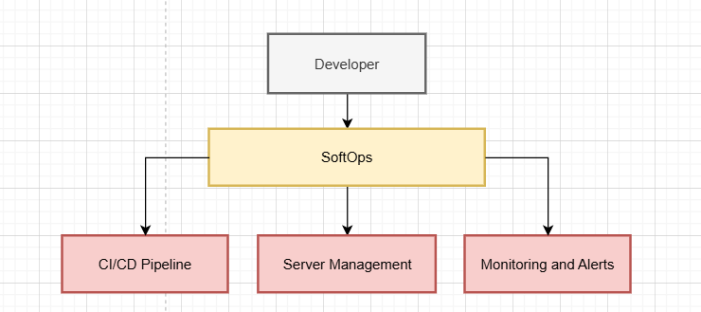
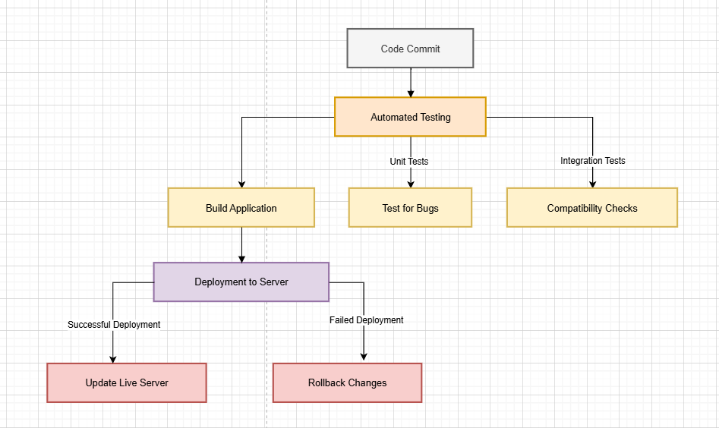
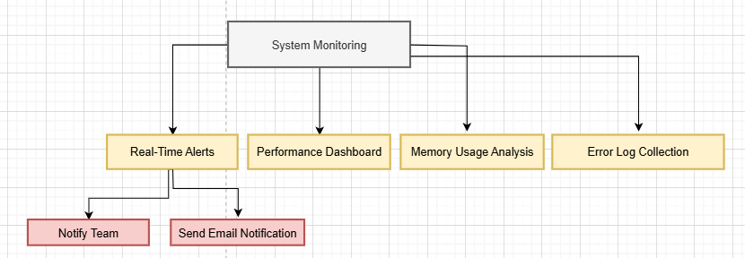
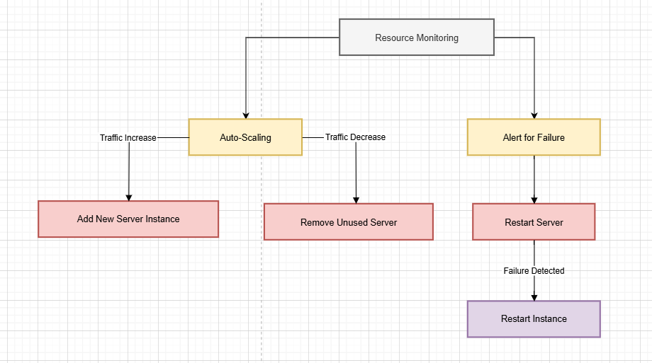
Data Flow Diagram

Slide 14
ER Diagram and Schema

Slide 15
Future Scope
The project can evolve significantly with ongoing advancements in cloud computing, AI, and machine learning. Future iterations could include predictive analytics for proactive server management, AI-driven test automation to detect anomalies faster, and enhanced scalability for enterprise-level deployments. Additionally, integration with new development and containerization technologies will allow teams to adopt cutting-edge architectures. Expanding custom workflows with more modular options and improving compliance automation for regulatory standards would ensure the tool remains adaptable and robust for diverse industry requirements.

Slide 16
Conclusion
The project streamlines software deployment, server management, and monitoring, enhancing efficiency and reliability for development teams. By automating critical processes and providing customizable workflows, the tool minimizes errors, accelerates deployment, and ensures system health. This project delivers a scalable, secure, and versatile solution for modern software development needs, supporting faster releases and reducing manual workload. It not only boosts team productivity but also strengthens infrastructure stability, paving the way for rapid innovation and continuous improvement.

Slide 17
References
S. Kumar and T. Li, "CI/CD Pipelines Evolution and Restructuring: A Qualitative and Quantitative Study," IEEE Transactions on Software Engineering, vol. 50, no. 1, pp. 120-130, 2024.
Sandeep Rangineni and Arvind Kumar Bhardwaj: " Analysis of DevOps Infrastructure Methodology and Functionality of Build Pipelines ", EAI.EU, 30 January 2024.
A survey paper on the design and implementation of CI/CD pipeline for automation using Jenkins by the International Research Journal of Modernization in Engineering Technology and Science, 2 February 2024.
M. A. Rahman, S. Shamsuzzaman, and A. K. Sarker, "Automating DevOps with GitLab CI/CD Pipelines: A Study on Efficiency and Deployment ", International Conference on Software Engineering, IEEE, 2023.
P. K. Roy, "Effect of Using Continuous Integration (CI) and Continuous Delivery (CD) in DevOps for Reducing Development Gaps," IEEE International Conference on DevOps Practices, IEEE, 2023.

