Slide 1

FAKE NEWS DETECTION USING MACHINE LEARNING AND
NATURAL LANGUAGE PROCESSING
Guide:
Name:Mr.Veera Reddy
Designation:Assistant Professor
Department:AIML
Submitted By :
S.Laxmi prasanna(21UP1A6655)

Slide 2
Contents
Abstract
Introduction
Problem Statement
Literature Survey
Existing System
Limitations of Existing System
Proposed System
Module Split-up
System Requirement Specifications
Model Architecture
Model Design
Algorithms Used
Result
Conclusion
References

Slide 3
Abstract:
This project focuses on detecting fake news using machine learning and natural language processing (NLP) techniques. The aim is to develop a system that can automatically identify and classify news articles or information sources as genuine or fabricated. By analyzing the language and patterns in these articles, the system can effectively distinguish between real and fake news, helping to reduce the spread of misinformation in the digital age. This approach combines data-driven techniques with linguistic analysis to ensure accurate and reliable detection of fake news.

Slide 4
Introduction:
Detecting fake news using machine learning and natural language processing is an innovative approach that ensures the integrity of information shared online. By leveraging these advanced technologies, algorithms can analyze the content of news articles and identify patterns that differentiate genuine news from fabricated stories. This method employs a combination of data-driven techniques and linguistic analysis to effectively mitigate the harmful impact of fake news, making it a crucial tool in today’s digital age.
Notes:
Image source: https://gospelpolaris.tistory.com/24

Slide 5
Problem Statement:
Develop a robust and accurate fake news detection system leveraging machine learning and natural language processing. The system will distinguish genuine news from deceptive content, adapting to evolving fake news tactics, and providing a reliable verification tool for users.

Slide 6
Literature Survey:
S.no | Title | Details | Achievements/ Methodologies | Limitations/ Drawbacks
1. | Fake news detection using machine learning | Vishnu A. https://ijcrt.org/papers/IJCRT2411403.pdf?form=MG0AV3 | Developed a machine learning-based system for fake news detection | Limited real world applications
2. | A survey on fake news detection using Machine Learning | P.Anjeni Venkata Devi https://www.researchpublish.com/upload/book/paperpdf-1608975417.pdf?form=MG0AV3 | Reviewed state-of-the-art fake news detection techniques | Limited implementation details
3. | A Literature Survey On Different Methods For Fake News Detection | Manav S.Lohabade https://sist.sathyabama.ac.in/sist_naac/documents/1.3.4/b.e-cse-batchno-214.pdf?form=MG0AV3 | Multi-model fake news detection using NLP and image analysis | Data source limitations and evolving fake news challenges

Slide 7
Existing System:
Snopes: Founded in 1994, Snopes is one of the oldest and most well-known fact-checking websites. It focuses on debunking urban legends, rumors, and misinformation circulating online. Snopes uses a combination of research, expert sources, and evidence to assess the validity of claims. The site covers a wide range of topics, from politics to pop culture
PolitiFact: Established in 2007 by the Poynter Institute, PolitiFact specializes in fact-checking political statements and claims. Its team of journalists analyzes statements from politicians, public figures, and government sources, rating them for accuracy on a "Truth-O-Meter" scale, ranging from "True" to "Pants on Fire" for falsehoods
FactCheck.org: Launched in 2003 by the Annenberg Public Policy Center, FactCheck.org aims to monitor the factual accuracy of statements made by politicians, political ads, and other public figures. The website works to debunk false or misleading claims, providing thorough explanations and context to clarify misinformation.

Slide 8
Limitations of Existing System:
Data Quality and Quantity
Imbalanced Datasets
Lack of Context
User Privacy Concerns
Scalability and Real-Time Processing

Slide 9
Proposed System
The proposed system enhances fake news detection by developing advanced machine learning and NLP models, using diverse training data to reduce bias and improve accuracy. It incorporates adversarial defense mechanisms to protect against manipulation by malicious actors, while ensuring continuous monitoring and updates to adapt to new misinformation tactics. Collaboration across various disciplines will further deepen understanding of the socio-cultural factors behind fake news, improving overall detection and resilience.

Slide 10
Module Split-up:
Data Collection and preprocessing
Feature Extraction
Model Selection
Model Training
Evaluation
Deployment

Slide 11
System Requirement Specifications
Software requirements :-
Programming Language: Python is the most widely used programming language for machine learning and NLP. Ensure you have Python installed.
Integrated Development Environment (IDE): Choose an IDE for development. Some popular options include JupyterNotebook, VS Code etc.
Machine Learning Libraries: Install machine learning libraries such as Scikit-learn, TensorFlow or PyTorch.
NLP Libraries: You'll need NLP libraries for text processing, tokenization, and feature extraction, such as NLTK, spaCy.
Flask Framework:Flask is a Python web framework that's lightweight and flexible. It's used to create web applications, APIs, and microservices
.
Notes:
Image source: http://www.projectsof8051.com/android-mobile-controlled-door-security-locking-system/

Slide 12
Hardware Requirements :-
CPU (Central Processing Unit)
GPU (Graphics Processing Unit) (Optional but Highly Recommended)
RAM (Random Access Memory):A minimum of 4 GB of RAM is recommended for working with moderately sized datasets and training machine learning models.
Storage: A fast SSD (Solid State Drive) with sufficient storage capacity (at least 256 GB) is crucial for storing datasets, model checkpoints, and project files.

Slide 13
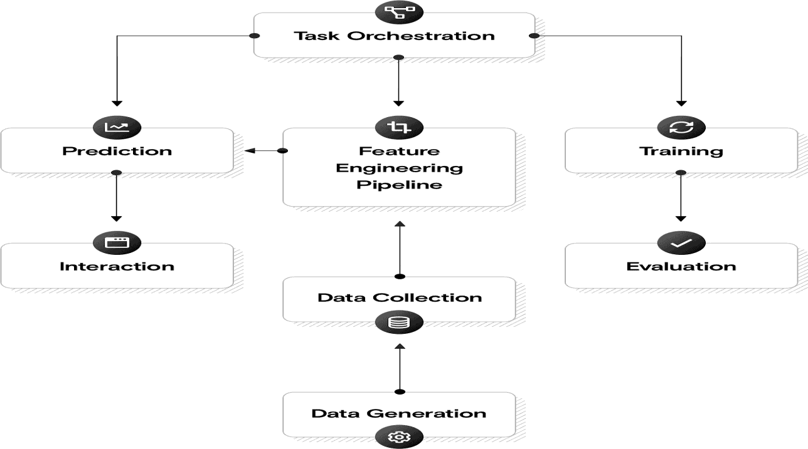
Model Architecture

Slide 14
Algorithms Used:
1.Naive Bayes - A probabilistic classifier based on Bayes' theorem, often used
for text classification tasks like spam detection and sentiment analysis.2.
2. Logistic Regression - A statistical method for binary classification problems,
particularly useful for predicting probabilities.
3.Text Preprocessing - Removing noise such as HTML tags and special
characters . Tokenization to break text into words.
4. Linguistic Analysis - Identifying patterns and cues associated with deceptive
content . Analyzing syntactic and semantic structures of text.

Slide 15
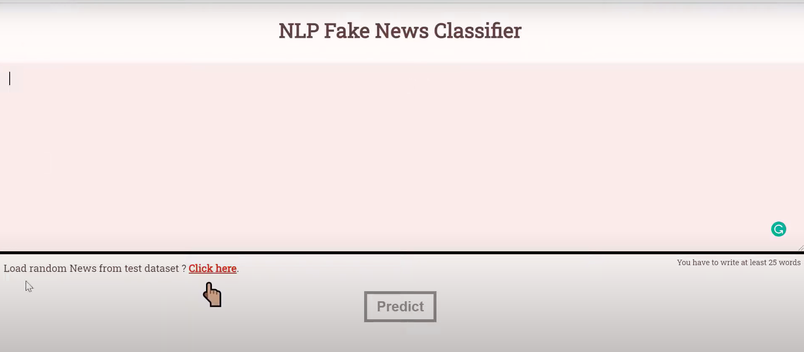
Result:

Slide 16
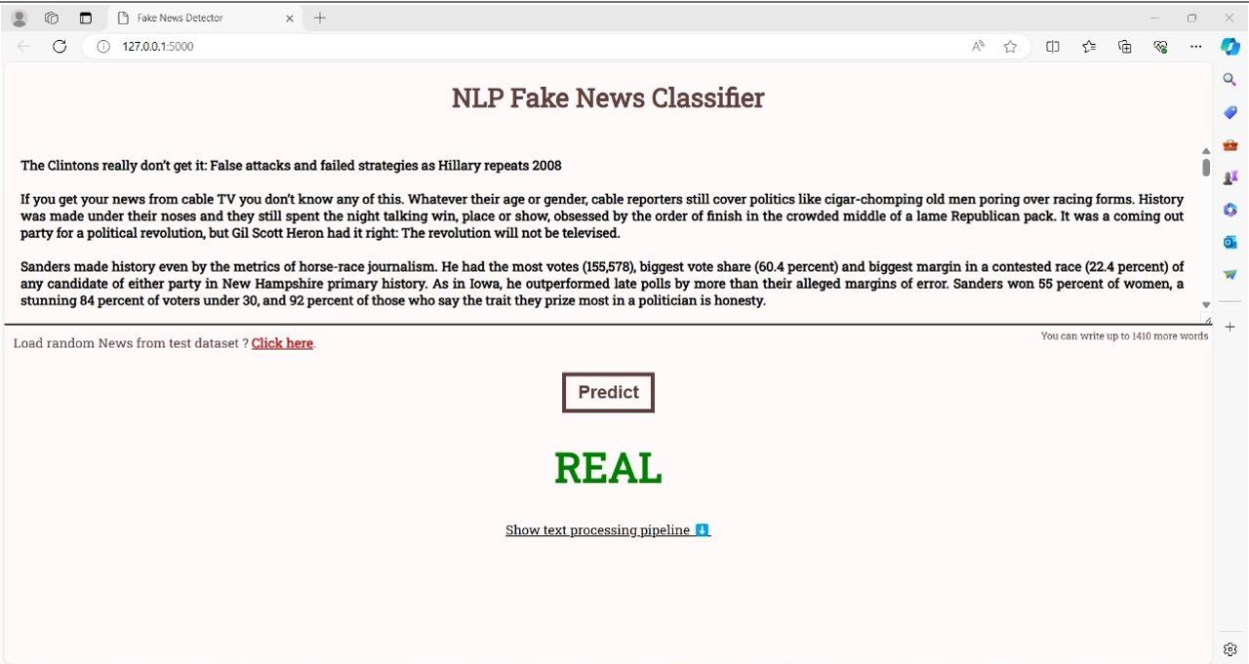

Slide 17
Conclusion:
In conclusion, the development of a fake news detection system using Machine Learning (ML) and Natural Language Processing (NLP) represents a significant step towards addressing the pervasive issue of misinformation in the digital age.
The proposed system integrates state-of-the-art technologies and methodologies to effectively identify deceptive content within news articles, contributing to a more informed and resilient information landscape.
Through the utilization of ML algorithms, including Naïve bayes , Logistic Regression the system can autonomously learn and distinguish patterns indicative of fake news.

Slide 18
References:
1.Fake news detection using machine learning.
https://ijcrt.org/papers/IJCRT2411403.pdf?form=MG0AV3
2. A survey on fake news detection using Machine Learning.
https://www.researchpublish.com/upload/book/paperpdf-1608975417.pdf?form=MG0AV3
3. A Literature Survey On Different Methods For Fake News Detection
https://sist.sathyabama.ac.in/sist_naac/documents/1.3.4/b.e-cse-batchno-214.pdf?form=MG0AV3

Slide 19
THANK YOU

