Slide 1
KEYLOGGERS
Presented by,
P.PrasannaKumari,
Priyadharshini Engineering College,
Computer Science.

Slide 2
OUTLINE
Problem Statement
Proposed System/Solution
System Development Approach
Algorithm & Deployment
Result
Conclusion
Future Scope
References

Slide 3
Problem Statement
In today's digital age, where cybersecurity threats loom large, one of the significant concerns is the proliferation of keyloggers, stealthy software tools designed to monitor and record keystrokes on a user's computer without their knowledge. Keyloggers pose a severe threat to individuals and organizations as they can capture sensitive information such as passwords, credit card details, and other personal data, leading to identity theft, financial loss, and privacy breaches

Slide 4
Proposed System/Solution
1. System Overview: The keylogger system is designed to capture and log keystrokes from a target computer system. It operates in a stealthy manner to avoid detection by the user and captures keyboard input for analysis or monitoring purposes.
2. Components: The keylogger system consists of the following components: Keylogger Module: This module is responsible for intercepting and capturing keystrokes from the system's keyboard input
Logging Module- Captured keystrokes are logged into a file or database for storage and later analysis.
Stealth Module: Implements techniques to run the keylogger discreetly without drawing attention, such as hiding its presence from the user and system processes

Slide 5
-. 3. System Architecture: User Interface (UI): The keylogger may have a minimalistic user interface for configuration and monitoring purposes. This UI allows users to start or stop the keylogging process and configure logging settings. -Keylogging Engine: The core component responsible for intercepting keystrokes. It hooks into the system's keyboard events to capture keystrokes before they reach the target application. -Logging System: Manages the storage and organization of captured keystrokes. Keystrokes can be logged to a local file or transmitted to a remote server for analysis. - Stealth Techniques: Implements methods to conceal the keylogger's presence on the system, such as hiding files, obfuscating process names, or running as a background service.

Slide 6
4. Functional Requirements: Key Capture: Intercept and capture keystrokes from the system's keyboard input. Logging: Log captured keystrokes to a file or database for later retrieval and analysis. Stealth Mode: Operate silently and discreetly without alerting the user or raising suspicion. Configuration: Allow users to configure settings such as log file location, logging frequency, and startup behavior. 5. Non-Functional Requirements: Security: Ensure that captured keystrokes are stored securely and transmitted (if applicable) using encryption to protect sensitive data. Performance: Minimize system resource usage (CPU, memory) to avoid impacting the target system's performance. Compatibility: Support multiple operating systems (e.g., Windows, macOS, Linux) or specific versions to maximize usability.

Slide 7
6. Implementation Technologies: Programming Language: Python (or language of choice) for cross-platform compatibility and ease of development. Libraries: Use libraries like `pynput` for keyboard input monitoring and `sqlite3` for local database storage. Deployment: Package the keylogger into an executable or installer for easy deployment on target systems.

Slide 8
System Development Approach
Software key-loggers :
Software key-loggers are the computer programs which are developed to steal password from the victims computer. However key loggers are used in IT organizations to troubleshoot technical problems with computers and business networks. Also Microsoft windows 10 also has key-logger installed in it.
JavaScript based key logger
Form Based Key logger

Slide 9
Hardware Key-loggers : These are not dependent on any software as these are hardware key-loggers. keyboard hardware is a circuit which is attached in a keyboard itself that whenever the key of that keyboard pressed it gets recorded.
USB keylogger – There are USB connector key-loggers which has to be connected to a computer and steals the data. Also some circuits are built into a keyboard so no external wire i used or shows on the keyboard.
Smartphone sensors – Some cool android tricks are also used as key loggers such as android accelerometer sensor which when placed near to the keyboard can sense the vibrations and the graph then used to convert it to sentences, this technique accuracy is about 80%

Slide 10
Algorithm & Deployment
- **Programming Language**: Python, C/C++, Java, or another language suitable for system-level programming.
- **Libraries and APIs**:
- Use system-specific libraries or APIs for keyboard input monitoring (e.g., `pyHook` or `pynput` for Python).
**Data Storage**:
- Decide on local storage (file-based or database) or remote storage (sending logs over network).
Security and Ethical Considerations:
Address security and ethical concerns associated with keyloggers:
- **Legal Compliance**:
- Ensure compliance with local laws and regulations regarding monitoring and data privacy.

Slide 11
- **User Consent**:
- Obtain explicit consent before deploying a keylogger, especially in organizational or shared computer environments.
- **Data Encryption**:
- Encrypt captured data during storage and transmission to protect sensitive information.

Slide 12
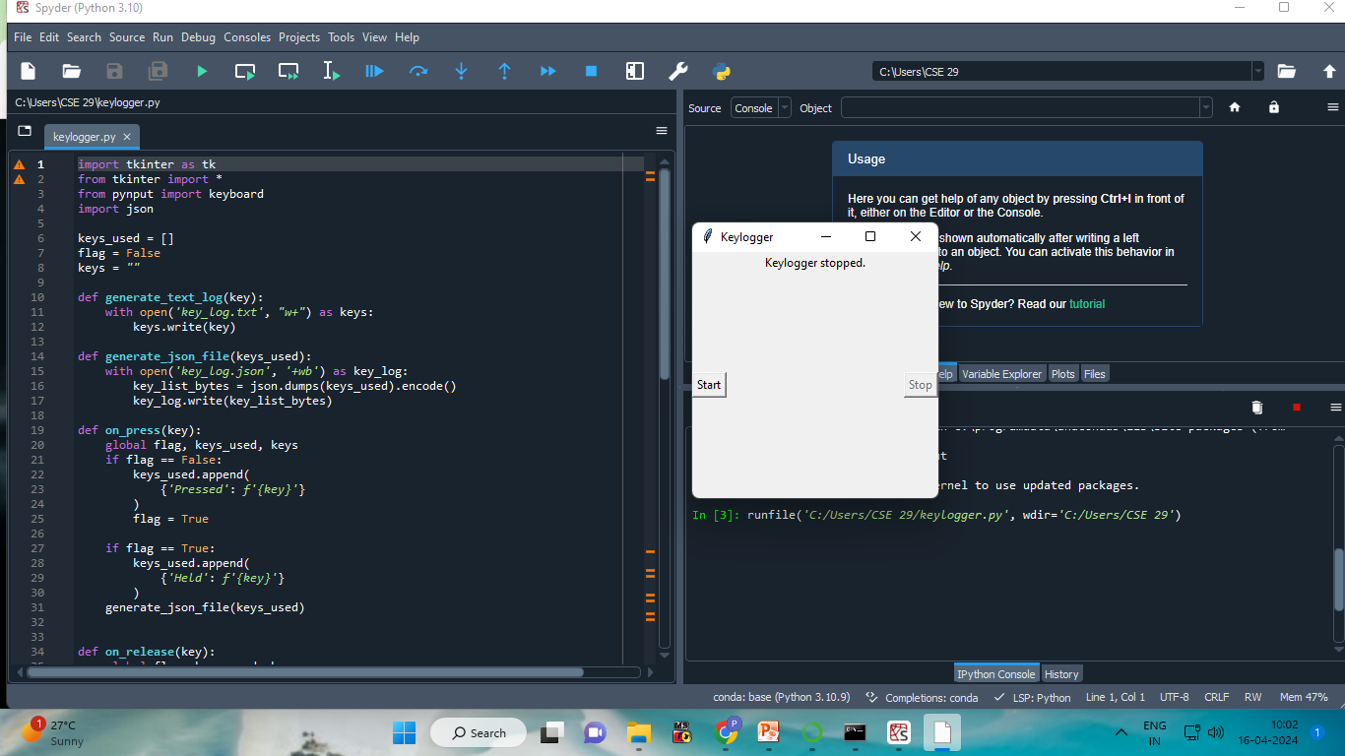
Result
Demonstrate the functionality of the developed keylogger through test cases.
Present insights into countermeasures and best practices to protect against keylogger attacks.

Slide 13
Conclusion
In conclusion, this project sheds light on the technical aspects, ethical considerations, and security implications of keyloggers. It emphasizes the importance of responsible use of monitoring technologies and highlights the need for robust cybersecurity practices to safeguard user privacy and data integrity.

Slide 14
Future Scope
Future extensions of this project could include: - Developing advanced features for the keylogger (e.g., remote data exfiltration, stealth mode). - Conducting a broader study on the legal landscape and regulatory frameworks surrounding keylogging. - Exploring machine learning techniques for anomaly detection to identify keylogger behavior.

Slide 15
References
1.[online] Available: http://www.cryptomuseum.com/covert/bugs/selectric/index.htm.
Show in Context
2.N. Grebennikov, "Keyloggers: How they work and how to detect them", [online] Available: http://www.viruslist.com/en/analysis?pubid=204791931.
Show in Context Google Scholar
.
3 "Kinkois spyware case highlights the risk of public internet terminals", [online] Available: http://www.siliconvalley.com/mld/siliconvalley/news/6359407.htm.
Show in Context Google Scholar
.
4. N. Strahija, "Student charged after college computers hacked", [online] Available: http://www.xatrix.org/article2641.html.
Show in Context Google Scholar
.
5 L. Zhuang, F. Zhou and J. D. Tygar, "Keyboard acoustic emanations revisited", ACM Trans. on Information and System Security, vol. 13, no. 1, pp. 1-26, 2009.
Show in Context CrossRef Google Scholar

Slide 16
Thank You

