Slide 1
CGB1201 – JAVA PROGRAMMING
Department of Artificial Intelligence and Data Science
Academic Year: 2024 – 2025 (Odd Semester)
Register Number : 2303811724321082
Name : Prasanna N
Year : II Year
Semester : III
Section :B
Date : 3-12-2024

Slide 2
Blood Management System

Slide 3
Problem Identification
Inefficient Inventory Tracking:
Lack of real-time updates on blood stock leads to overstocking, wastage, or shortages during emergencies.
Manual Donation and Allocation:
Reliance on paper-based processes results in errors, delays, and inefficiencies in donor registration and blood allocation.
Poor Communication and Awareness:
Limited communication with donors and hospitals causes missed donation opportunities and delays in meeting blood supply needs.

Slide 4
Objective
Automate Blood Donation and Allocation:To streamline the blood donation process, including donor registration, inventory tracking, and allocation, ensuring timely and efficient blood management.
Enhance Real-time Inventory Management:To provide real-time updates on blood stock levels, categorized by type and expiry, reducing wastage and ensuring blood availability when needed.
Improve Communication and Coordination:To facilitate better communication between blood banks, hospitals, and donors through notifications and alerts, ensuring prompt responses to critical blood requirements.

Slide 5
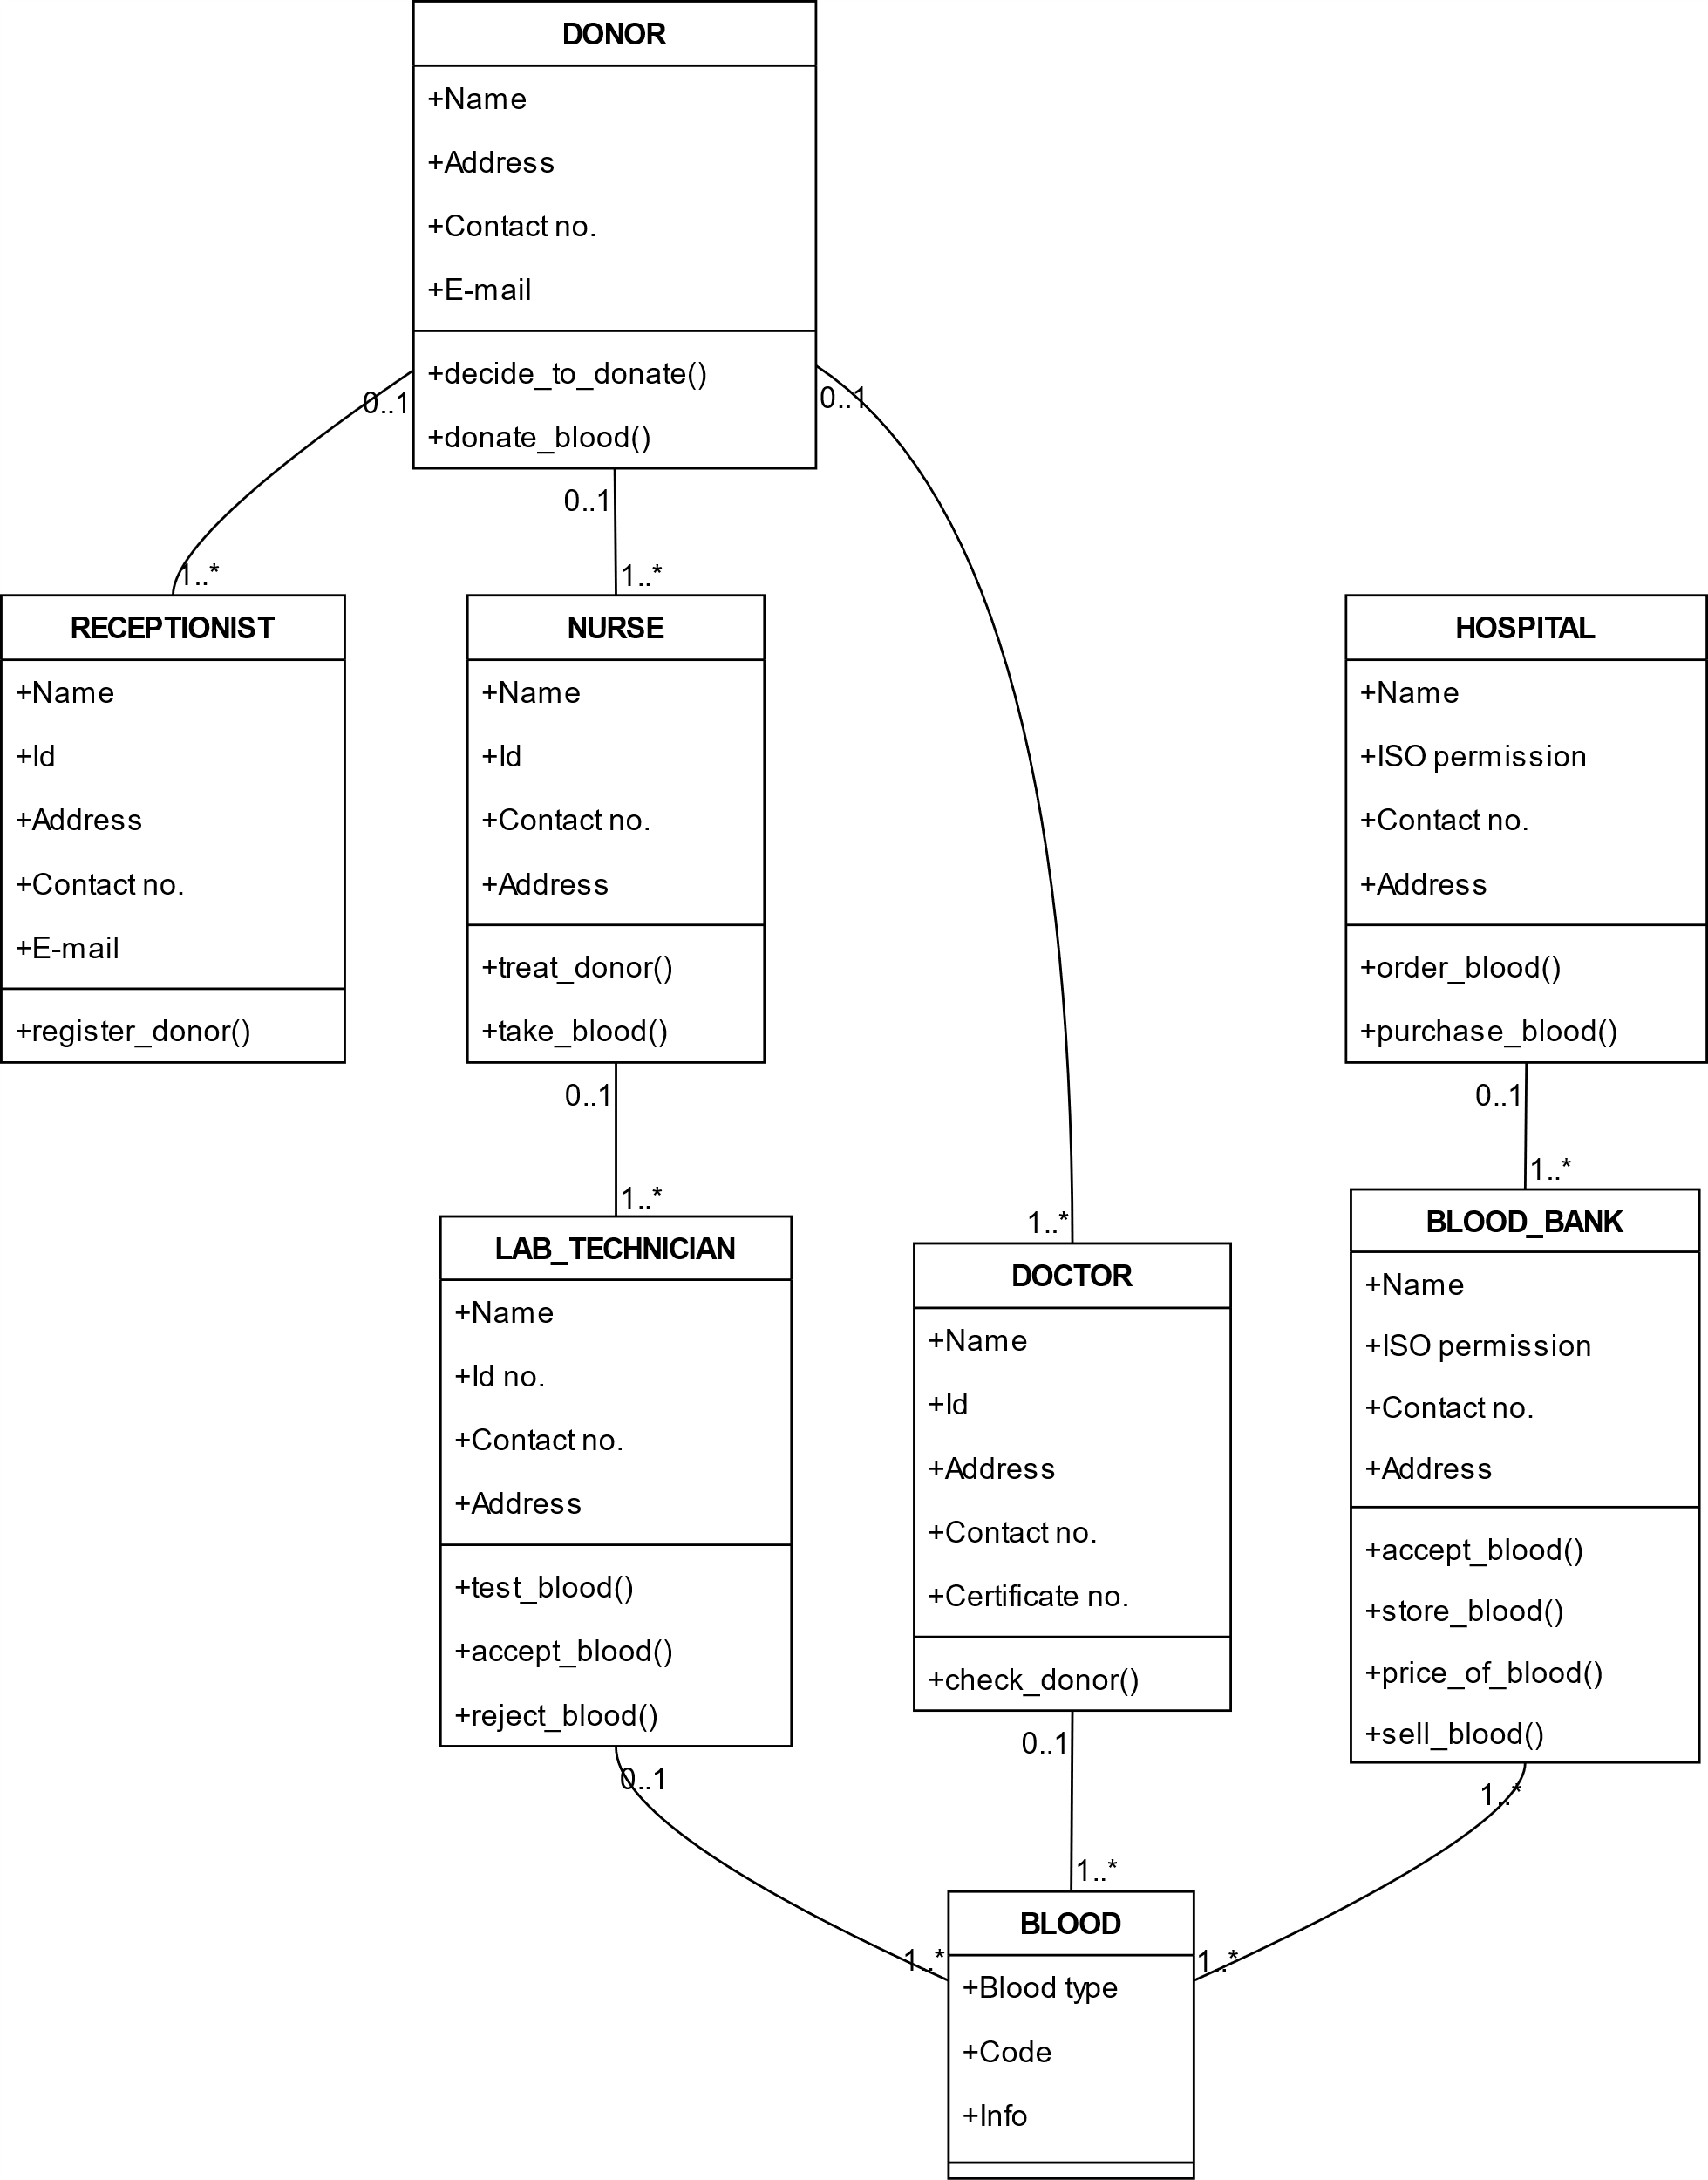
Proposed Architecture

Slide 6
Java Programming - Concepts Used
OOP: Classes and inheritance model donors, recipients, and blood bank entities.
Encapsulation: Secures data using private fields with public getters and setters.
Polymorphism: Enables methods like addRecord() to behave differently for donors and recipients.
Collections Framework: Manages data using structures like ArrayList and HashMap.

Slide 7
List of Modules
Donor Registration Module
Blood Inventory Management Module
Request Processing Module
Notification Module
Reporting and Analytics Module

Slide 8
Module Description
Donor Registration Module: This module facilitates the registration and management of donor information. It allows users to create profiles, input personal details, and provide donation history. The module also validates eligibility criteria for donors based on factors like age, health conditions, and donation frequency. It ensures that the system can track and update donor records efficiently.
Blood Inventory Management Module: This module manages and tracks the blood inventory across various blood types and their respective expiry dates. It ensures real-time updates whenever a donation is made or blood is allocated. This helps minimize wastage and avoid shortages. The module automatically notifies the system when blood units are near expiry or when stock levels are critically low.

Slide 9
Module Description (Cont..)
Request Processing Module:This module allows hospitals and clinics to submit requests for blood units. It processes these requests based on available inventory, ensuring that blood is allocated to the most urgent or nearby locations. The system evaluates the blood types needed, checks stock levels, and allocates the required units efficiently, aiming for timely delivery.
Notification Module:The Notification Module sends automated alerts and reminders to different users. Donors receive notifications about upcoming blood donation camps and other donation-related events. Hospitals and blood banks receive real-time notifications when blood stocks fall below a certain threshold, helping them take timely action. It enhances communication between stakeholders.
Reporting and Analytics Module:This module generates comprehensive reports on various aspects of the blood management system, such as the number of donations, inventory levels, blood type distribution, and request fulfillment statistics.

Slide 10
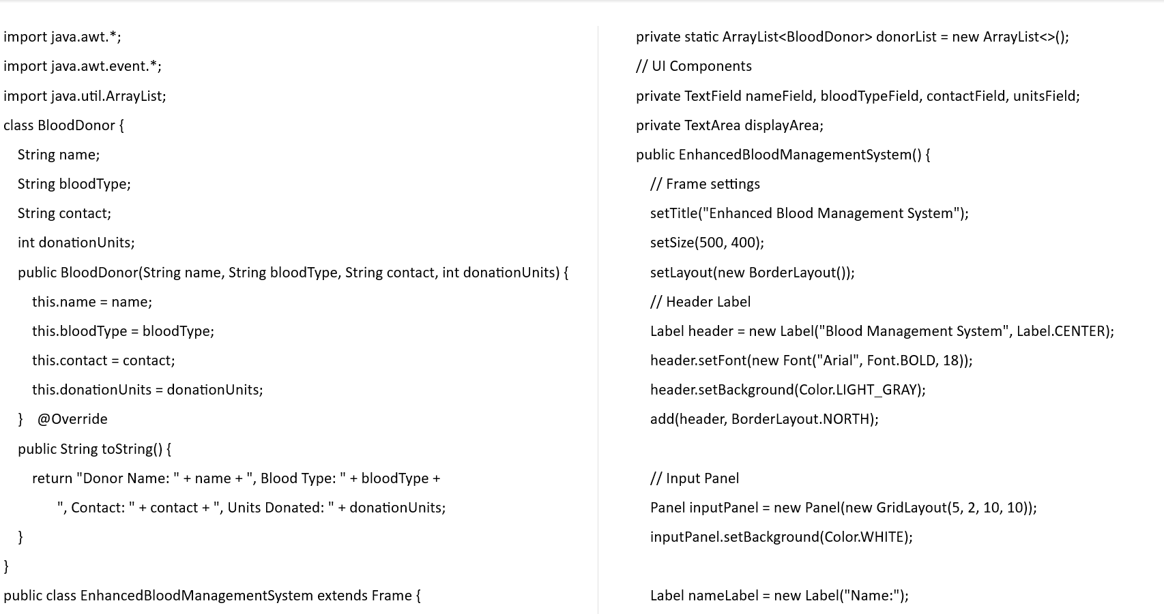
Source Code

Slide 11
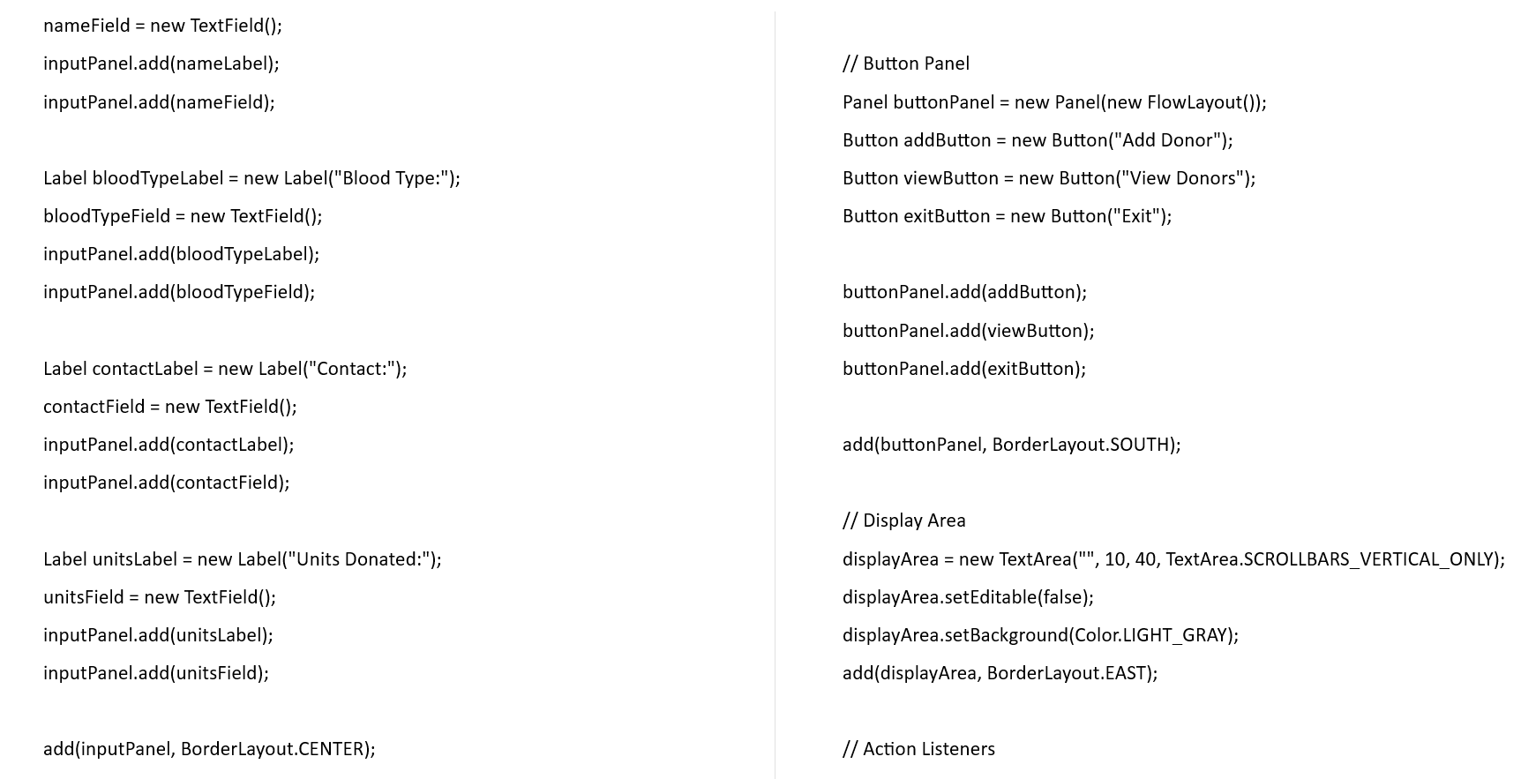
Source Code

Slide 12
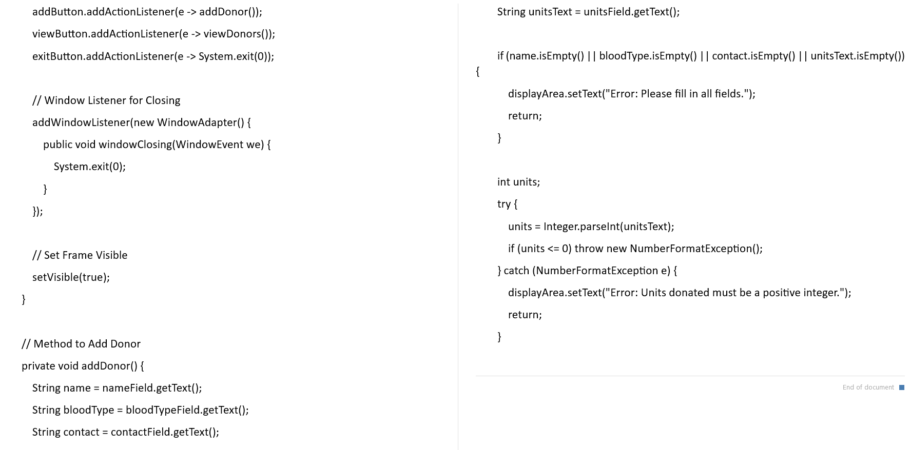
Source Code

Slide 13
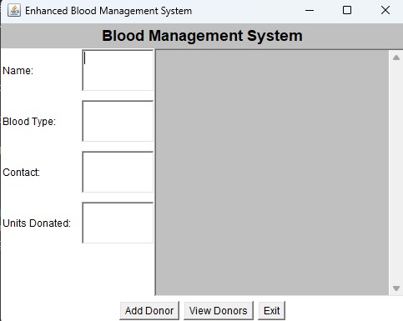
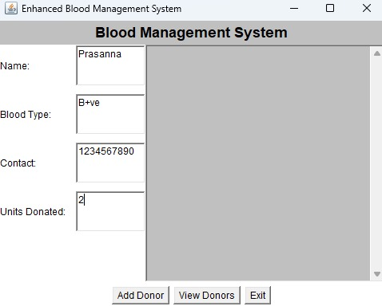
Results

Slide 14
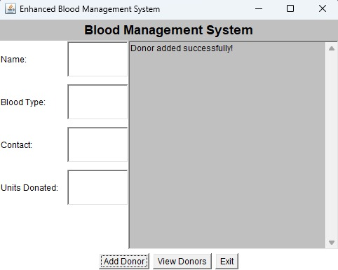
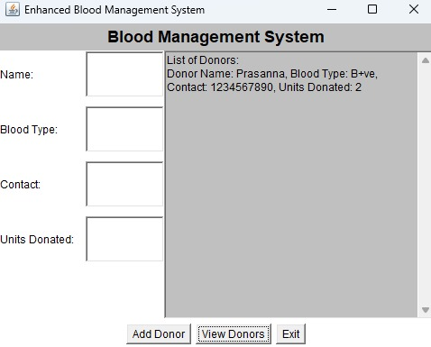
Results

Slide 15
Conclusion
A Blood Management System is a comprehensive platform designed to efficiently manage the collection, storage, distribution, and utilization of blood and its components. It ensures real-time tracking of blood inventory, donor information, and patient requirements to minimize shortages and wastage. By streamlining processes like donor recruitment, screening, and transfusion tracking, the system enhances transparency and safety in blood supply chains. Such systems play a critical role in saving lives by ensuring timely and equitable distribution of blood resources.

Slide 16
Thank You
ANY QUERIES???

