Slide 1


HEALER
healer
An Virtual AI Psycho Therapist
By OpenThunder

Slide 2


HEALER
An virtual AI Psychotherapist which Helps and consoles people who were depressed and became mentally unstable.Speaks with them revive them from their Suicidal Thoughts and gives tasks to keep them engaged and Joyful

Slide 3


WHY WE DID THIS?
Back to Agenda
YEAR2016
YEAR2018
YEAR2022
7,500
Nearly 800,000 people die every year due to metal unstability by suicide.
Since there's a lack of kindness and a person to console them and also to show the correct path to them
5,000
2,500
0
0
200,000
400,000
600,000
800,000

Slide 4
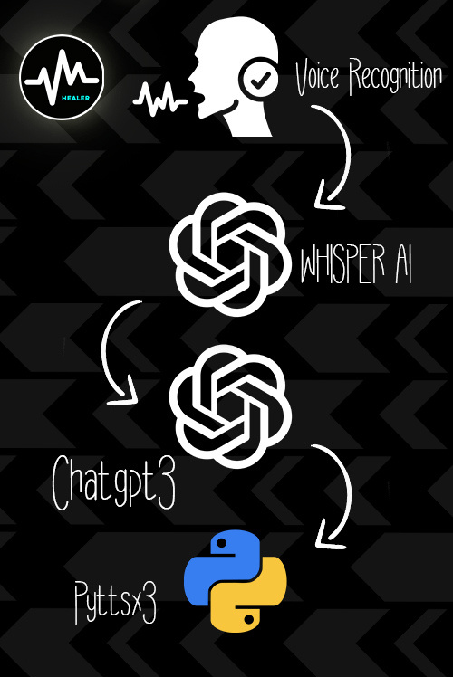

WORKING
Back to Agenda
Healer,an virtual AI psychotherapist based of the integration of whisper and chatgpt which sets as an next gen medical communication to patients,to resolve their mental unstablity.

Slide 5
PROCEDURAL WORKING OF HEALER WITH OPENAI TOOLS
WORKING
CHATGPT3
Replies to it
get text input from whisperAI
sends it to pyttsx
HEALER
WHISPERAI
Text to speech
Gets text input from chatGPT3
PYTTSX
Audio Integration and Noise Compression
Tip: Collaboration makes teamwork easier! Click "Share" and invite your teammates to fill this up. Use this whiteboard page for bulletins, brainstorms, and other fun team ideas!

Slide 6
ESSENTIALS AND FEATURES
Back to Agenda
Voice Chat 24/7
Fined Tuned for Medical Purposes
Easy Go Task Assignment 4)Simple and Responsive 5)Friendly

Slide 7



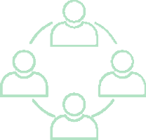
Back to Agenda
FEATURES
Easy to use and User& beginner-friendly UI design
Web Integration makes it even more accessible for the people.
Bends with the Ever growing Burgeoning Economy and Technology
Citizen centricity
Effective service- delivery improvements towards the product
Great Business Model

Slide 8

Problem We Solved
PROBLEMS
01
Reduces the Rate of Suicides
02
Psychotherapy for anyone at any time
03
Reduced Cost of Hospitality
Created an AI to console and revive them for a healthier life to lead.
The accessible session are free of cost for all public and subscription for hospitals at low cost which replace the traditional psychotherapists .
Literally, anyone can take up the Therapy session to revive their mind state from depression.

Slide 9
Business Model
MEDICAL DATA industry
REVENUE (BILLIONS)
50
40
It can Replace psychotherapists at hospitals.So a subscription- based model for hospitals can give us a lot scope of market
In the 40 Billion Dollar Healthcare industry, Data are very crucial and needed for research, so we can too provide analysis for them on patients' mental conditions with anonymous and secure data for improving the quality of Healthcare
30
20
10
0
2019
2020
2021
2022
Item 5

Slide 10

FUTURE OUTLOOK
A 3d Human model,CGI generated can be integrated with Healer ,to perform these tasks even at Online Meetings too.
Back to Agenda
Can Be implemented At AR/VR
Better Fine-Tuning of Model using new DataSets and better Web Interfacing for the model.

Slide 11
About OpenThunder
Team Leader,Web
integration & fine-tuning of AI
AI lead,AI-ML engineering & fine- tuning of model
AI lead,AI-ML engineering & fine- tuning of model
Website Deployment
Front-end Development & presentation speaker
Presentation
Prasanna
Muhammad Arslan
Muhammad Talha
Rabiu Adnan
Craig thatcher Sofia Azhniuk
Our Projects are predominantly Based on Healthcare to improve the Quality of Health Service to all,using Burgeoning Technologies

Slide 12

Get In Touch
contact us
Email
openThunder@gmail.com
Social Media
@openThunder
Connect with us
https://push.fm/fl/openthunder

Slide 13

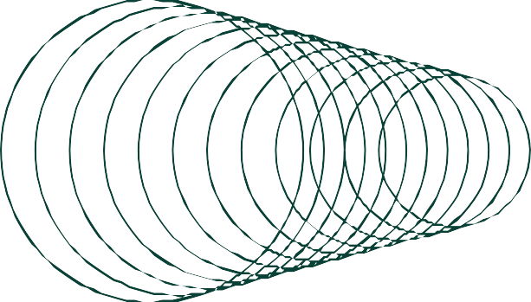



THANK YOU
I'm happy to share that the Team OpenThunder is the best collabortion in my Life. I have worked with the people with extraordinary skillset and talented which made me to learn more.Thanks Lablab.ai and openAI for this opportunity and initiation.

