Slide 1
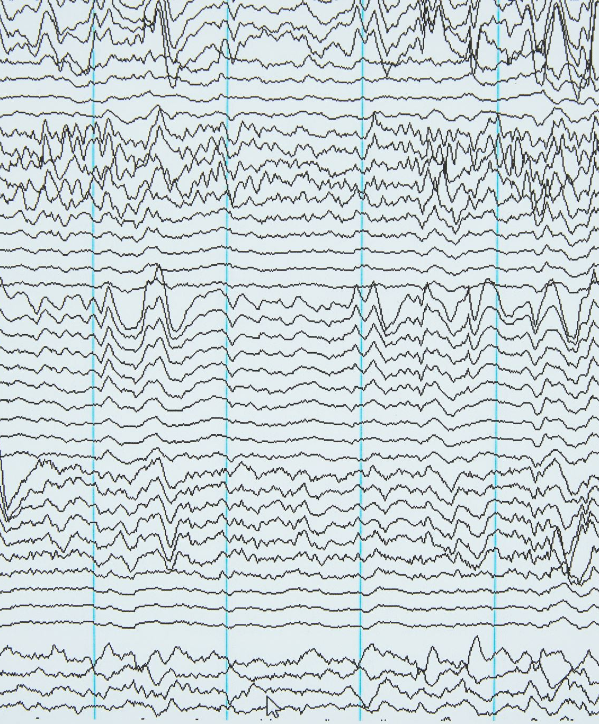
Earthquake risk mapping
Prasanna Gunawardana

Slide 2
Motivation & Context
Why earthquake risk mapping matters
Protects Lives/ Guides Infrastructure Development/Supports Urban Planning & Policy etc
Relevance to geoscience and hazard modelling
Understanding Earthquake Behavior/Regional Risk Assessment/Data-Driven Hazard Modelling
Goal: Use open-source data and tools for risk insights

Slide 3
Slide 3: Project Overview
Repository: earthquake-risk-mapping on GitHub
Sections: Exploratory Data Analysis → Modelling → Visualization → Risk Scoring → Map outputs

Slide 4
Dataset Overview
Data source: USGS Earthquake Catalog CSV
Key attributes: time, latitude, longitude, depth, magnitude (mag), plus metadata (place, net, etc.)
Summary stats: ~11,200 events globally (For 30 days till 28 July 2025)

Slide 5
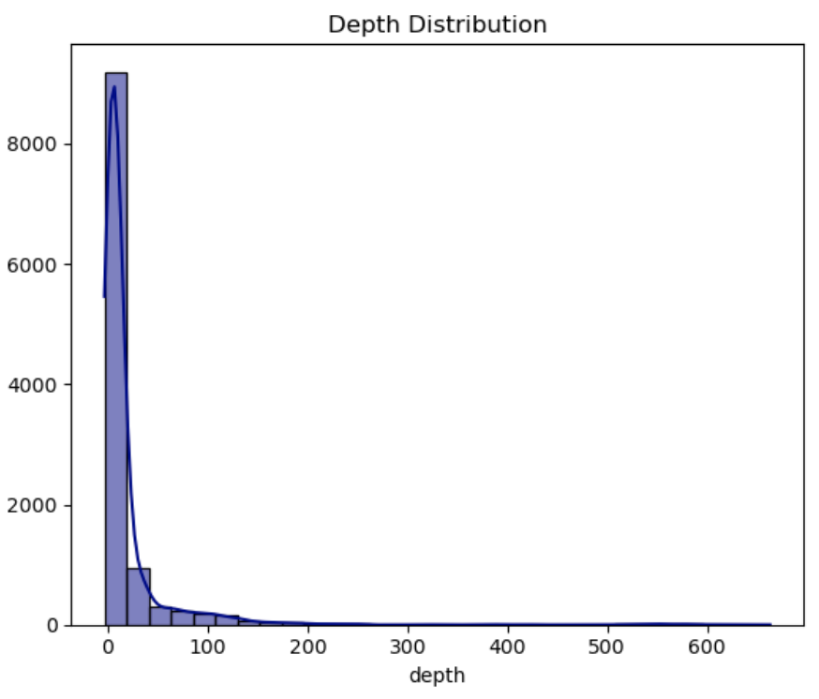
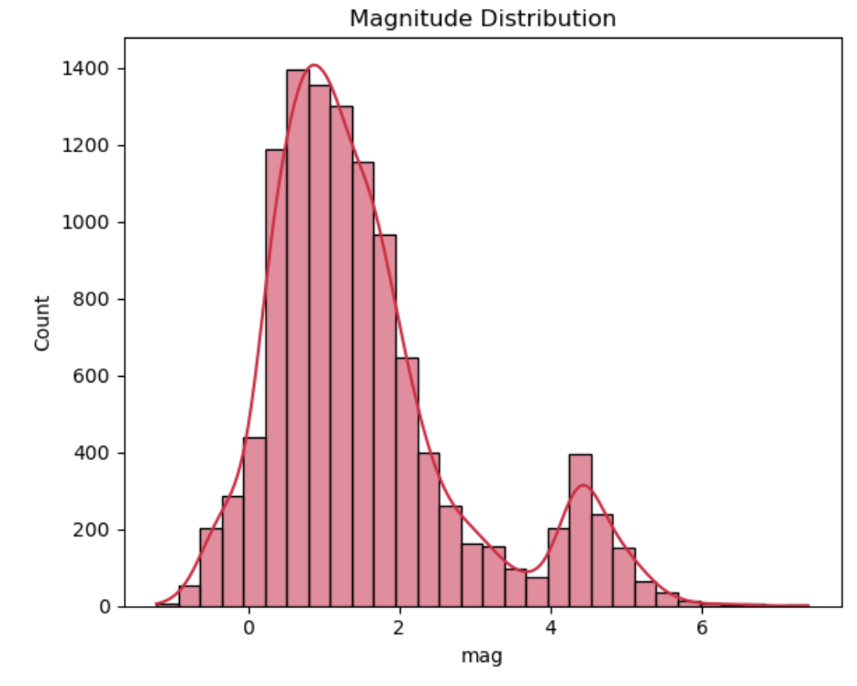
Data Exploration (EDA)
Two key plots:
Magnitude distribution (histogram + KDE): shows skew toward small quakes
Depth distribution: highlights prevalence of shallow events
Percentiles (25%, 50%, 75%) give insight into central tendency and spread

Slide 6
Feature Engineering & Modeling
Built binary classifier: high-risk zones (magnitude threshold)
Steps:
Train-test split
StandardScaler to normalize features (latitude, longitude, depth, mag)
Model: Random Forest Classifier (or Logistic Regression)
Evaluation: Precision, Recall, F1-balanced and robust despite class imbalance, Confusion matrix

Slide 7
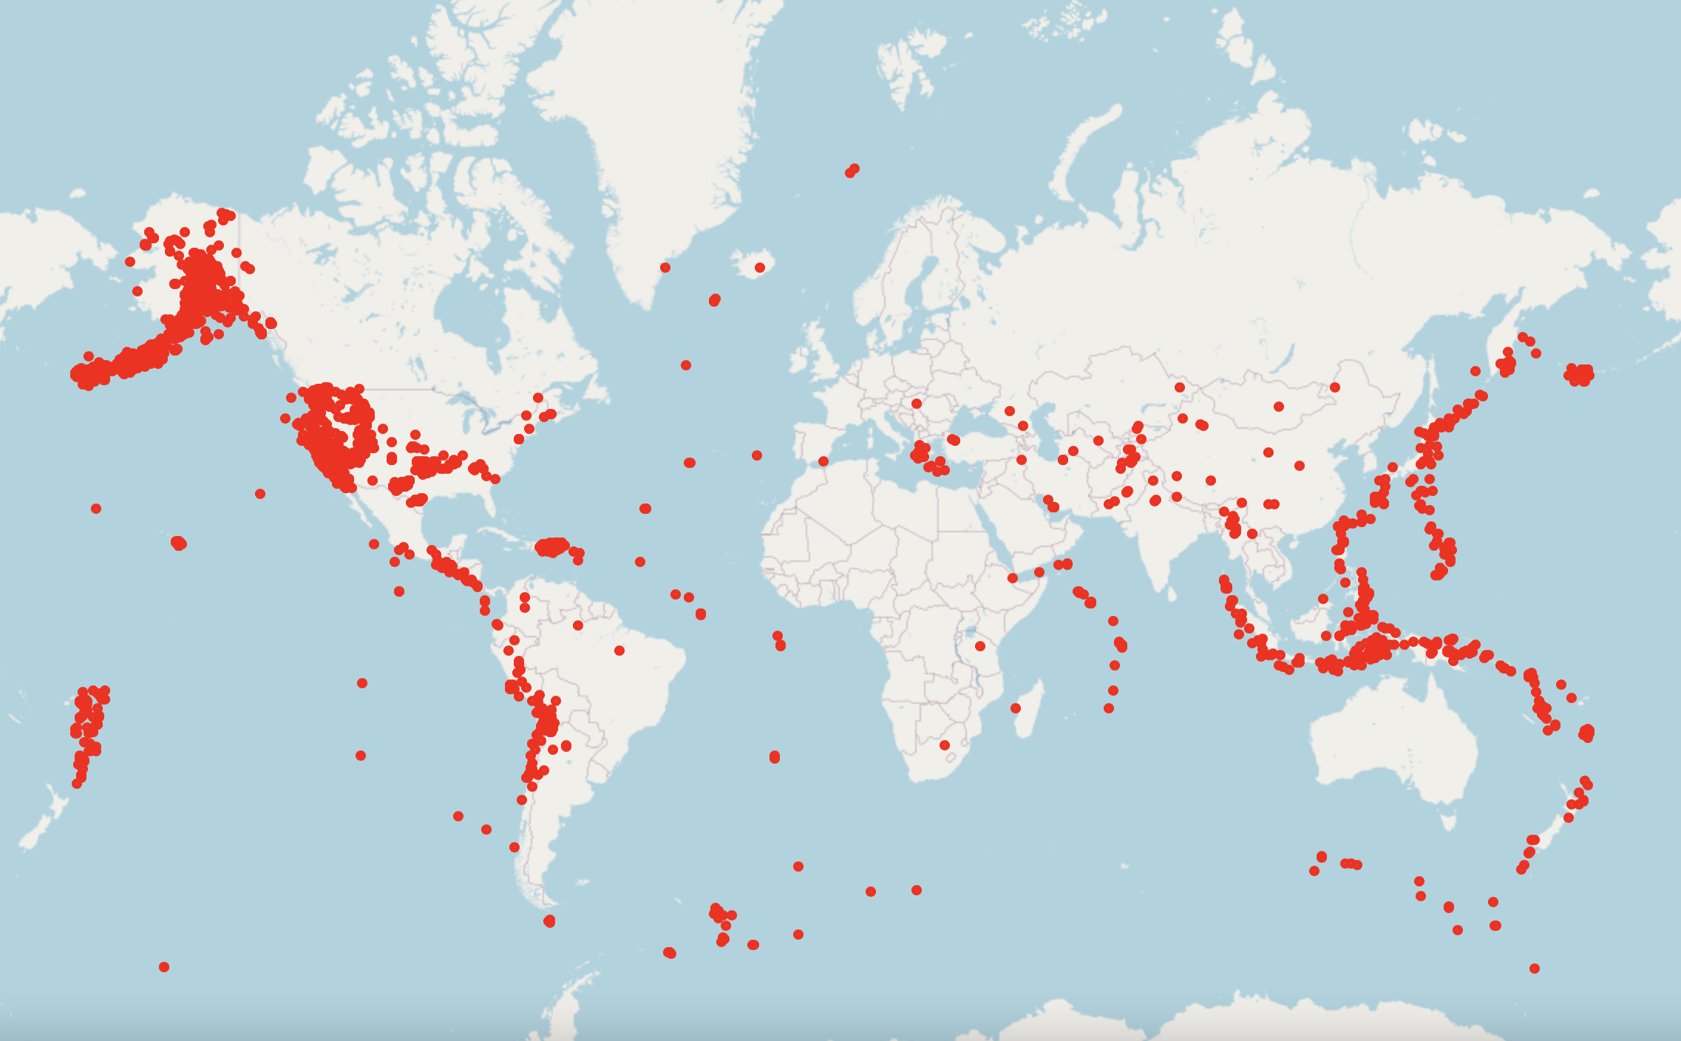
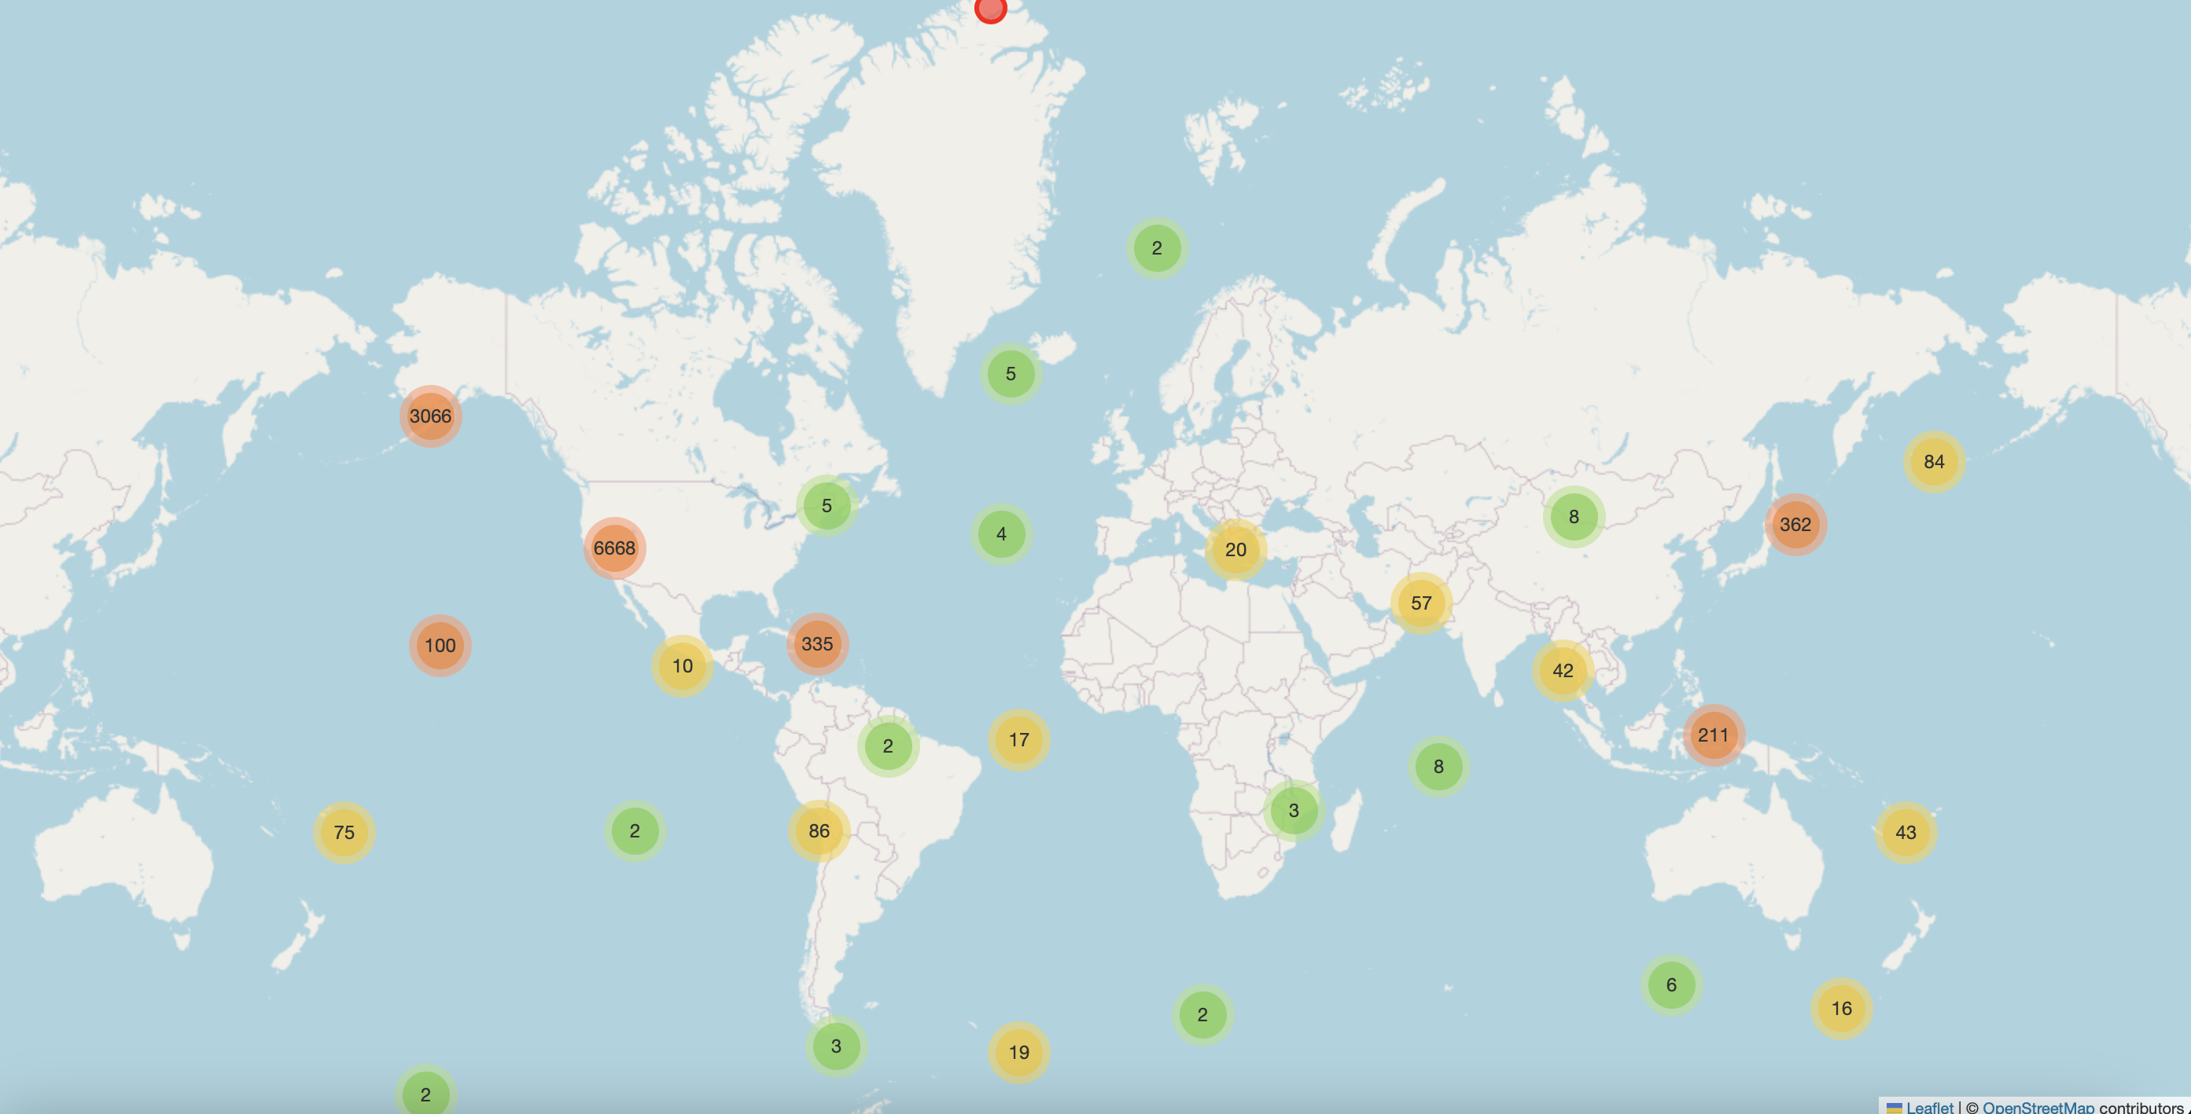
Geospatial Mapping – Earthquake Points
Interactive Folium map showing individual point markers
Marker size scaled by magnitude
Clustered view enhances readability

Slide 8
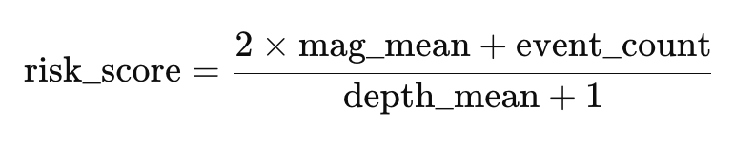
Regional Risk Scoring
Divided Earth into 5°×5° grid cells (lat_bin / lon_bin)
Aggregated per grid:
mag_mean, event_count, depth_mean
Risk score formula:
Weights magnitude heavily, considers event frequency, penalizes deep events

Slide 9
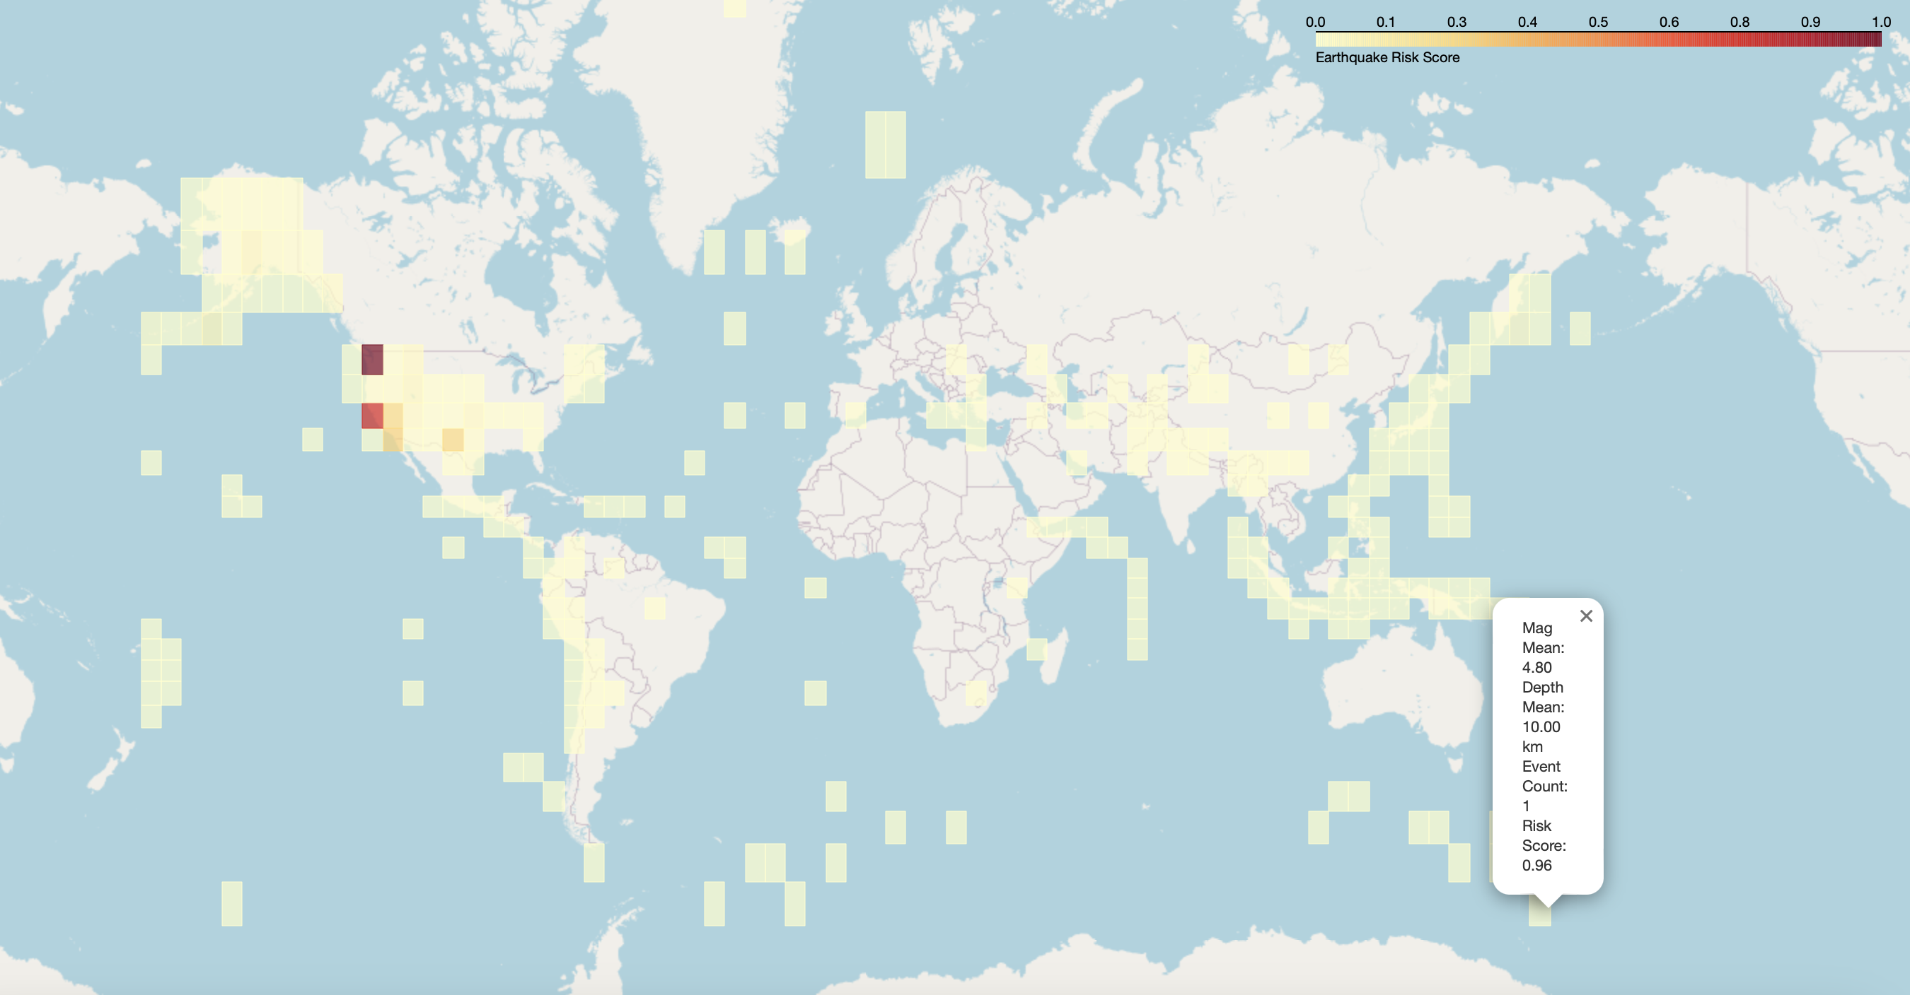
Risk Map Visualization
Folium rectangles representing grid cells colored by risk
red zones = highest risk,
yellow = moderate,
light for lower risk
Popups display region-specific statistics

Slide 10
Interactive and Static Outputs
Added interactive map saved as HTML (linked in repo)
Screen capture PNG linked in notebook/README for GitHub viewers

Slide 11
Key Findings & Insights
Highlighted global hotspots (e.g., Pacific Ring of Fire, parts of Indonesia, Japan)
Risk influenced by clustering of high-magnitude, shallow earthquakes
Most regions had low-to-moderate risk due to small magnitudes or deep focus

Slide 12
Limitations & Future Opportunities
Limitations:
Risk score is heuristic - no population exposure or infrastructure data
Grid resolution fixed at coarse 5° bins
No temporal dynamics integrated
Future Work:
Real-time USGS API data ingestion
Finer-resolution risk modelling
Integrate population density, fault lines, hazard layers
Deploy web dashboard (Streamlit, Dash)

