Slide 1

Enhancing Candidate Selection Efficiency through AMCAT Test Data Analysis
Project By:- A . Prasanna Kumar

Slide 2
Problem Statement:
Analyse AMCAT test data to identify candidate performance trends, pinpoint strengths and weaknesses, and explore correlations with job success. Optimize the use of AMCAT scores in the hiring process for more effective candidate selection.
Objective:-
The objective is to analyze AMCAT test data to understand how candidates perform across different sections, identify areas of strength and weakness, and determine how these scores relate to job success. By exploring trends in candidate performance, we aim to uncover which test sections candidates excel in and which ones they struggle with

Slide 3
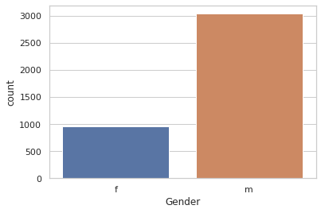
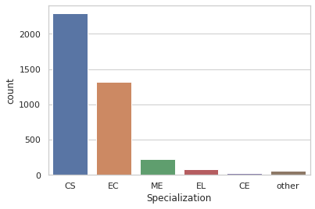
Univariate Analysis :
Gender Distribution: The count plot visually represents the distribution of gender within our dataset. You can observe the relative frequencies of different genders, which may provide insights into the gender balance or imbalance in your dataset.
Analyzing the count plot of gender distribution with respect to specialization provides insights into how different genders are distributed across various fields of expertise or study. This visualization allows for a nuanced understanding of gender representation within specific domains or industries.

Slide 4
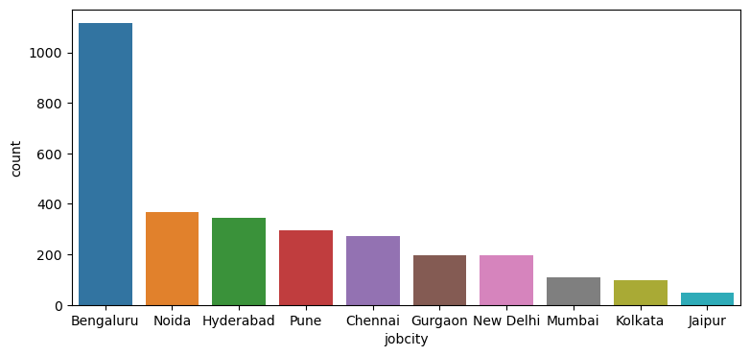
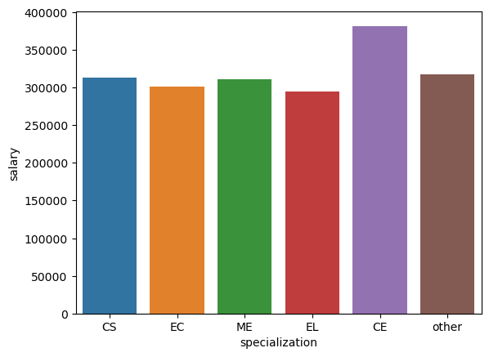
Bivariate Analysis :
Count Plot Shows the City’s with most and least job Opportunities:-
A count plot visualizes the frequency of occurrences of categorical data, in this case, cities and their job opportunities. By analyzing this plot, one can identify which cities offer the most and least job opportunities.
Salary Disparities: You can observe any significant differences in salaries across various specializations. For instance, some specializations might command higher salaries than others.
Highest Paying Specializations: Identify which specializations tend to have the highest average salaries. This insight can be useful for individuals considering career paths or educational choices.

Slide 5
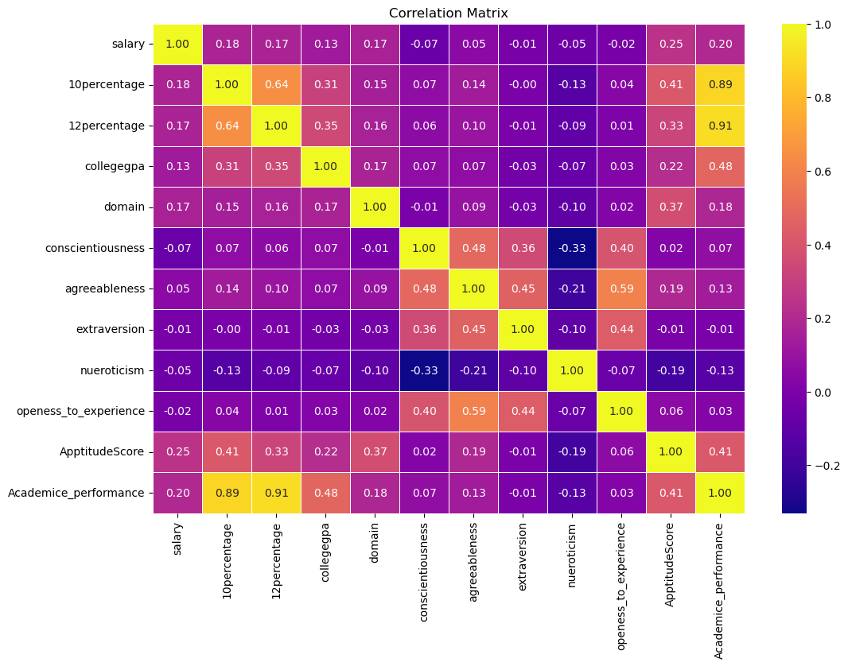
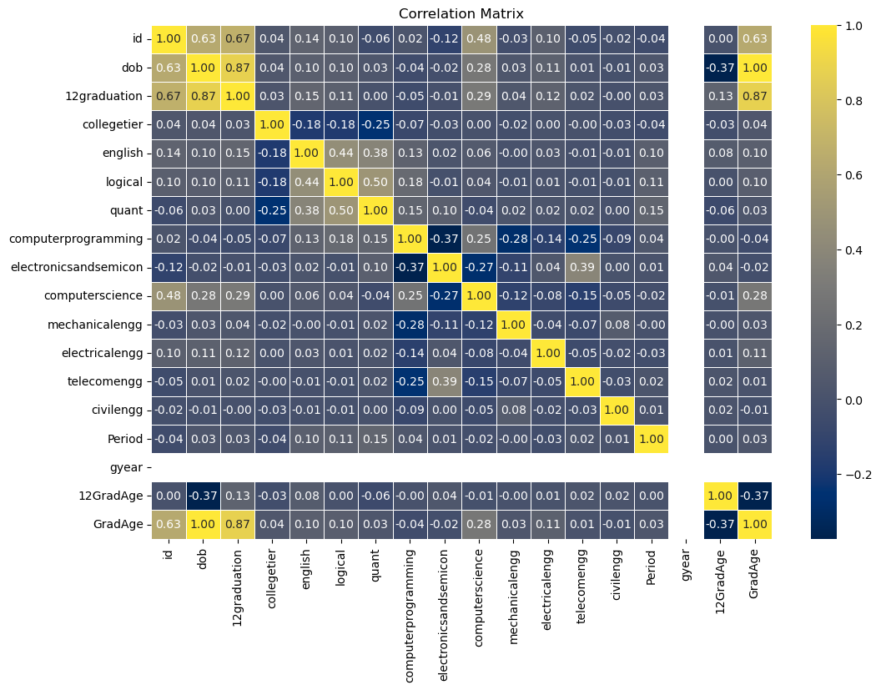
Correlation Matrix for Float & Integer values

Slide 6
Conclusion:
Most of Amcat Aspirants are male working in IT domain with an experience of around 5years with degree in Btech and specialization in Computer Science/Information Technology from tier-2 college in Uttar Pradesh with an average salary around 300k.
High paying jobs taken up by amcat aspirants are mostly from 'IT' Domain.
Software Engineer and Software Developer are the most aimed profession for amcat aspirants.

Slide 7

THANK YOU

