Slide 1
Introduction to Embedded Systems
A Practical Overview with Android & Embedded Boards

Slide 2
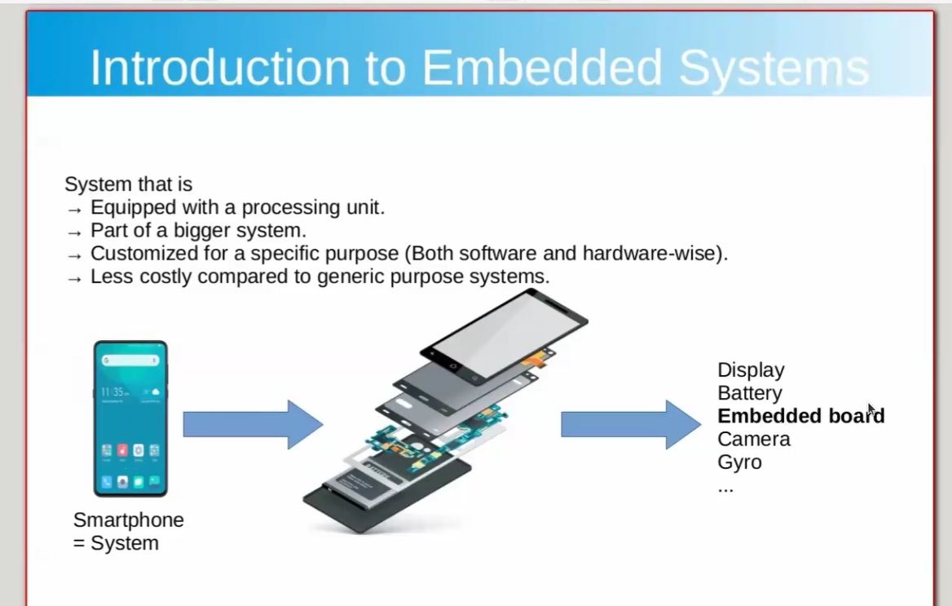
What is an Embedded System?
- Equipped with a processing unit
- Part of a bigger system
- Customized for a specific purpose (software & hardware)
- Less costly than general-purpose systems
Example: Smartphone components - Display, Battery, Embedded Board, Camera, Gyroscope

Slide 3
Why Use Embedded Systems?
Advantages:
✓ Cost-efficient
✓ Tailored to specific tasks
✓ Energy-efficient
✓ Smaller form factor
Challenges:
✗ Complex development
✗ Requires integration of hardware/software

Slide 4
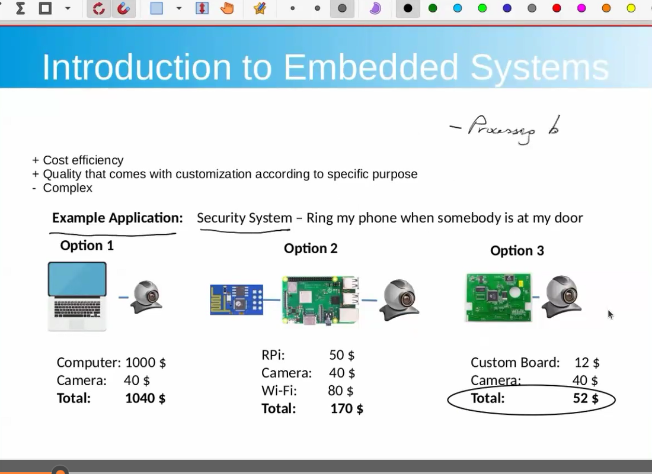
Example: Security System
Goal: Ring phone when someone is at the door
Option 1: PC + Camera = $1040
Option 2: RPi + Camera + WiFi = $170
Option 3: Custom Board + Camera = $52 (Most efficient)

Slide 5
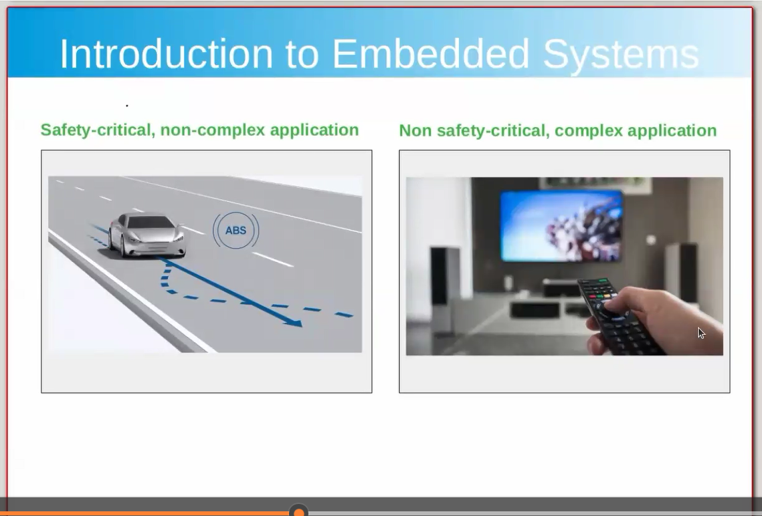
Embedded Systems by Criticality
1. Safety-Critical, Non-Complex (e.g., ABS braking)
→ Requires RTOS, deterministic scheduling
2. Non-Safety-Critical, Complex (e.g., TV remote)
→ Runs Linux/Android, handles complex UI/media

Slide 6
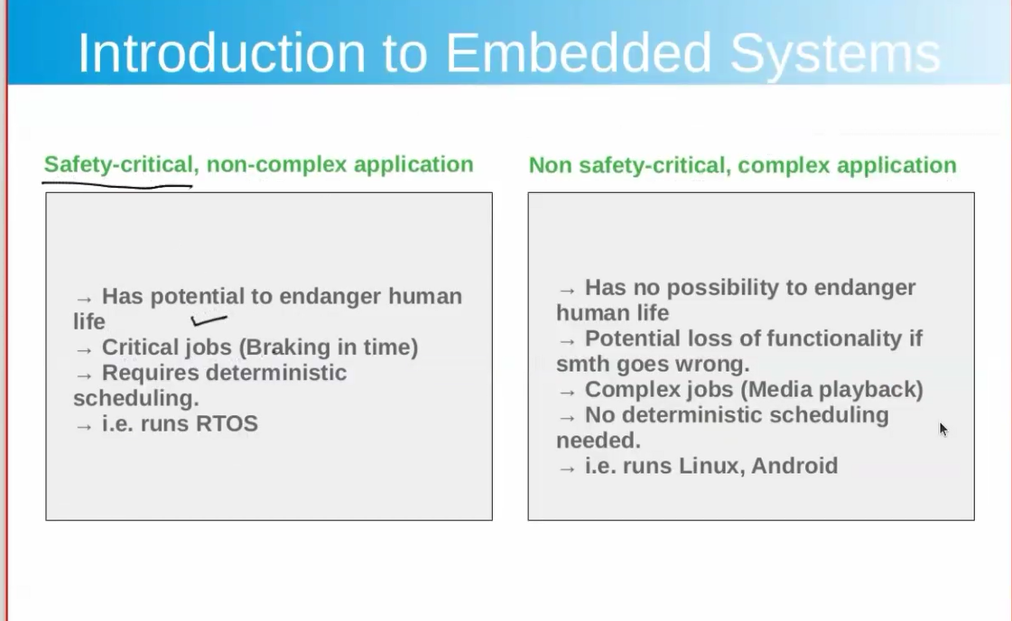
Safety-Critical vs Non-Safety-Critical
Safety-Critical:
- Endangers life if fails
- Requires deterministic scheduling
- Runs RTOS
Non-Safety-Critical:
- No threat to life
- May lose functionality
- Runs Linux/Android

Slide 7
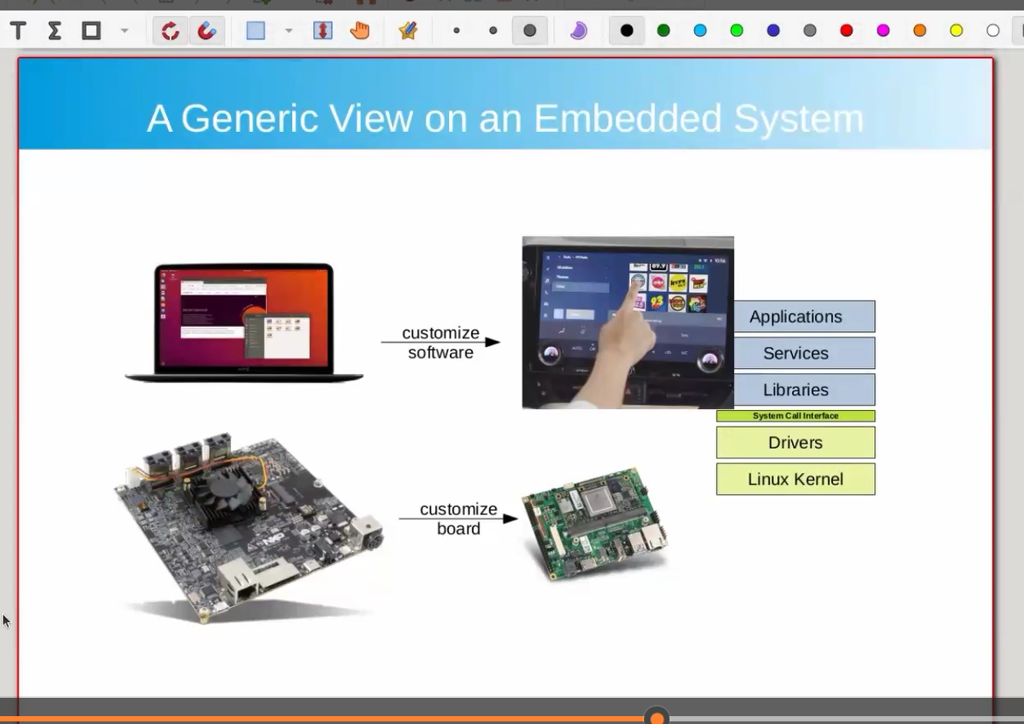
Generic View on Embedded System
Embedded System = Customized Software + Hardware
Includes: Linux Kernel, Drivers, Libraries, Applications

Slide 8
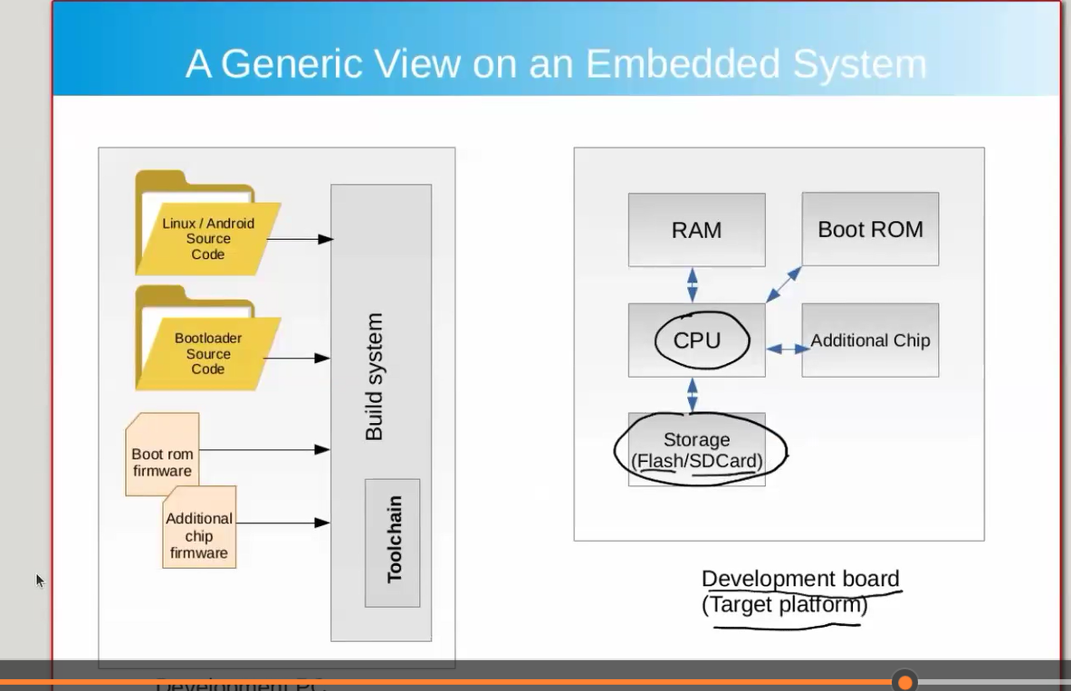
Build System for Embedded Linux/Android
Build System compiles:
- Kernel Image
- Bootloader Image
- Rootfs Image
Target Platform includes: CPU, RAM, Storage, Boot ROM, Additional Chips

Slide 9
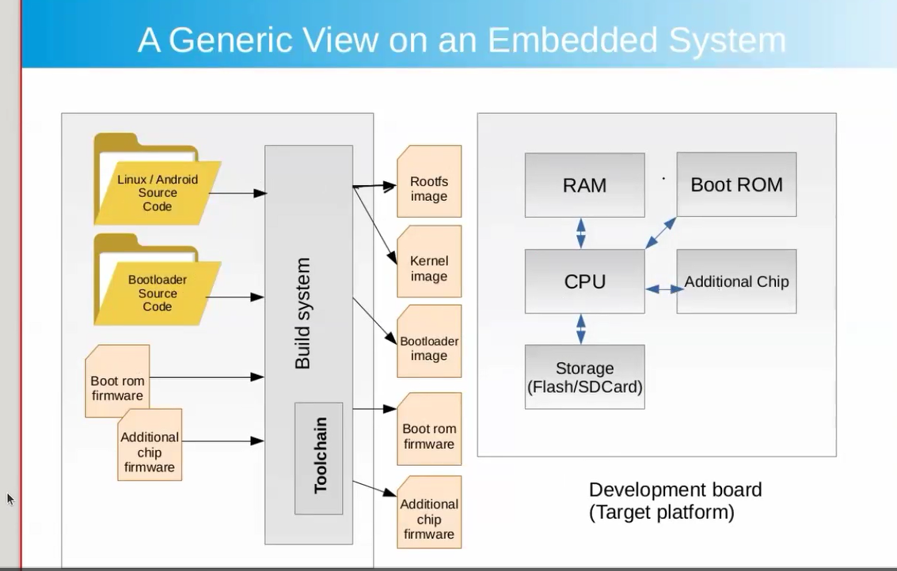
Complete Embedded System Build Overview
Combines:
- Source Code
- Firmware
- Toolchain
- Outputs for deployment to dev board

Slide 10
Summary
Embedded systems are:
✓ Purpose-built
✓ Cost-efficient
✓ Categorized by safety-criticality
Used in: Smartphones, Automotive, IoT, Media Devices

Slide 11
Q&A
Any Questions?
Let's Discuss!

