Slide 1
ISM 6128 ADBMS Final Project Chat Application
Dinesh Datta Pendyala ( U96239813 )
Goutham Reddy Mandadi ( U13039494 )
Venkata Sai Prasanna Kumar Tummala ( U92076820 )
Ashwin Kumar Reddy Guduru ( U74844599 )
Sri Sai Teja Balusu ( U25008106 )
Yaswanth Chandolu ( U03348669 )

Slide 2
Contents:
Purpose
ER Diagram
Chatting Database Tables
Database Normalization
Partitioning
Query writing
Stored Procedures
Indexing
DBA Scripts
Data Visualization
Conclusions

Slide 3
Purpose:
Chatting application Database Design Concept is for chat applications, by using this, you will be able to create group chat or a 1-1 chat application without any hassle. Below are the facilities supported by chat application:
Text messaging
Voice calling
File transfer (video, images)
Video calling
Smiley

Slide 4
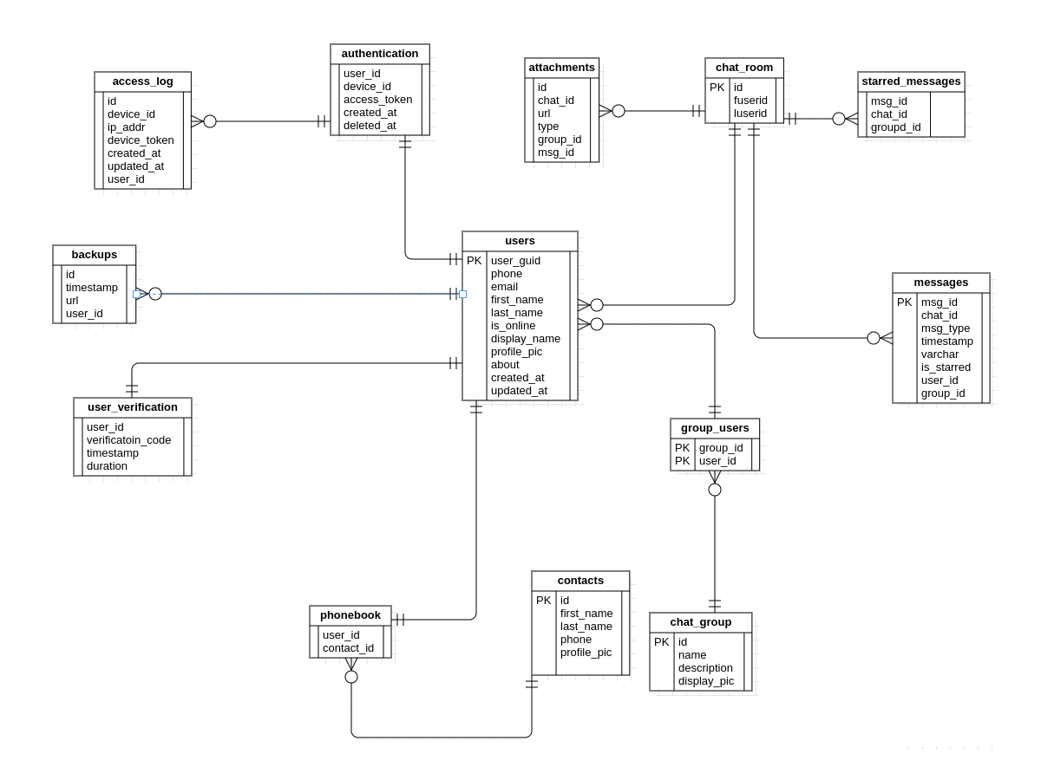
ER Diagram
The ER Diagram for Database :

Slide 5
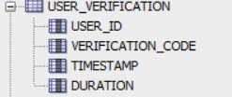
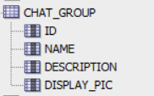
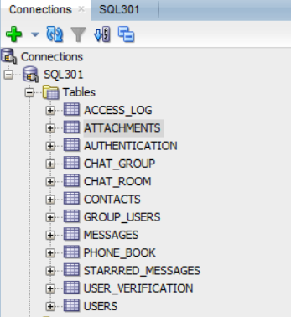
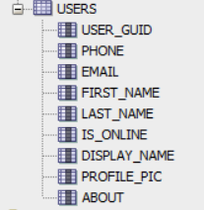
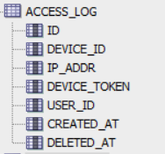

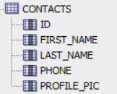

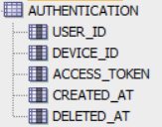
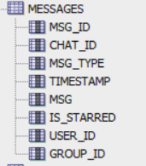
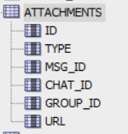


Chatting Database tables:

Slide 6
Database Normalization:
Normalization is a technique which reduces data redundancy and eliminates undesirable characteristics like Insertion, Update and Deletion Anomalies.
In chatting application, to avoid data redundancy we breakdown contact table into Phone book and contacts.
In Phonebook, each user_id will have multiple contact_id. In contacts, contact_id, first_name, last_name, phone and profile_pic. This will avoid redundancy.
ID | First Name | Last Name | Phone | Profile Pic | User ID
ID | User ID
ID | First Name | Last Name | Phone | Profile Pic

Slide 7
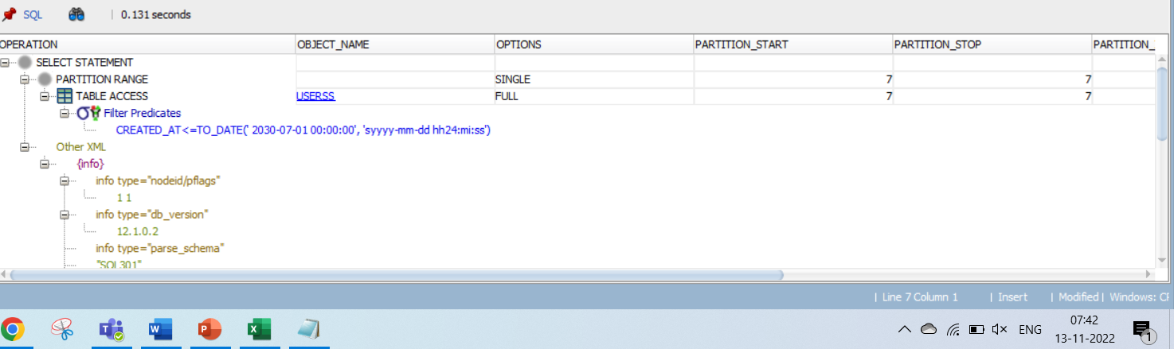
Partitioning:
Partitioning is a effective method, which can improve query performance by dividing table into pieces that can be accessed separately.
A table can be partitioned by one or more attributes which are widely used in queries.
In chatting application, we have applied partitioning for year column in user table which is used very frequently to check active users.
From the below snapshot, we have created Partition on user table. The range in query is using seventh Partition.

Slide 8
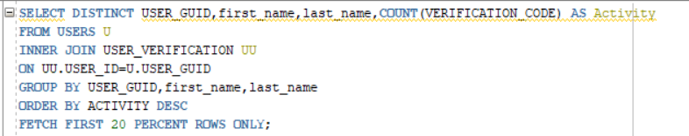
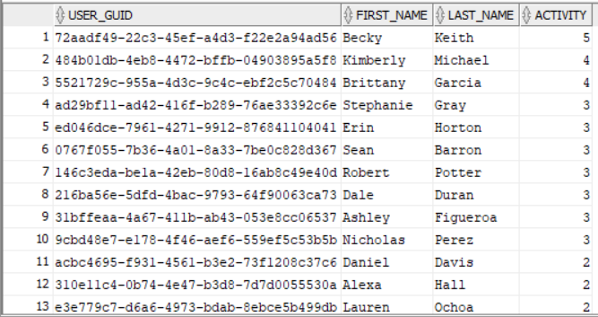
Query writing:
Top 20% users who got verification codes more than 3 times:
Output of the query writing:

Slide 9
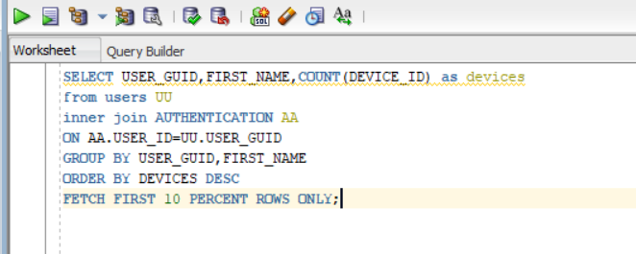
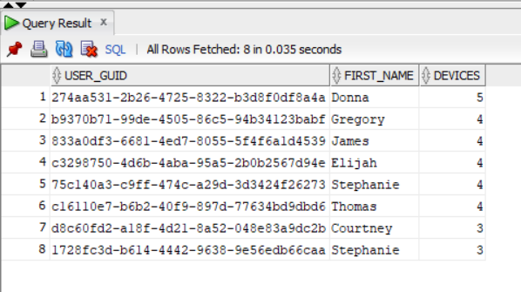
Query writing (cont):
Top 10% users who logged in more than 3 devices. This is gives users, who logged in more no of devices.
Output of the query writing:

Slide 10
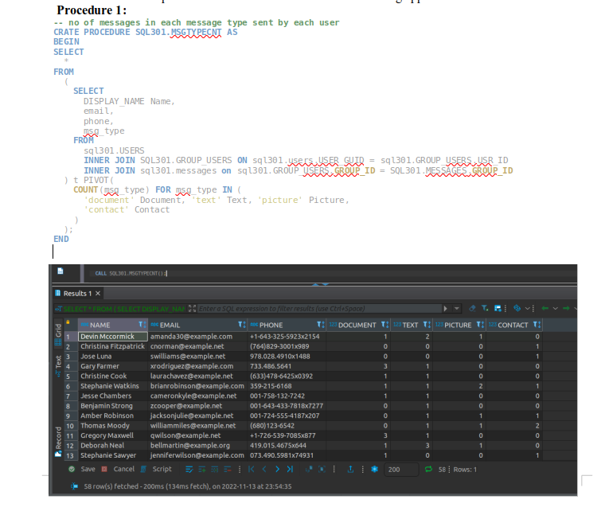
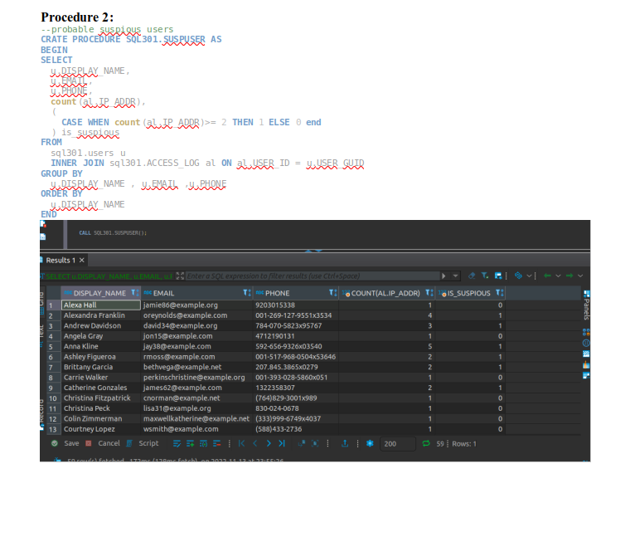
Stored Procedures:
Stored procedure is a re-usable SQL code that we can save, so the code can be reused over and over again.
If we have, SQL code that need to be re-used again and again. We can save that code and use it whenever it is required.
In Chatting application, we have created a stored procedure

Slide 11
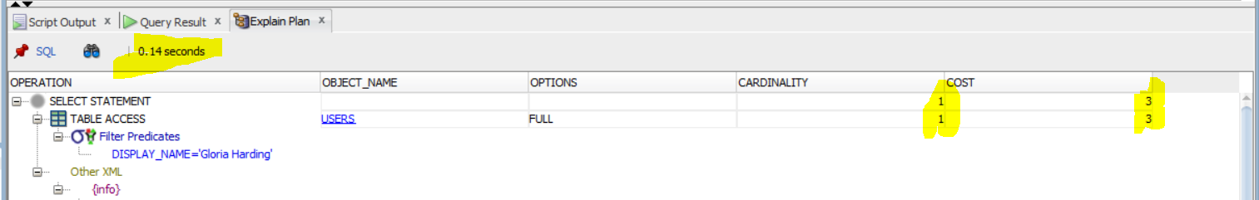
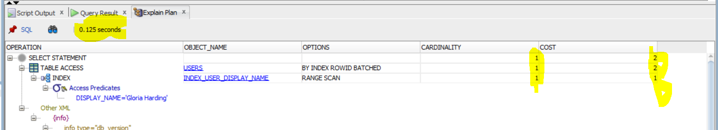
Indexing:
Indexes are used to quickly locate data without having to search every row in a database table every time a database table is accessed.
Created Index on FIRST_NAME, which helps us in locating data easily.
Before Indexing- Took 0.14 seconds to run and cost is 6.
After Indexing: Took 0.125 seconds to run and cost has been reduced to 5.

Slide 12
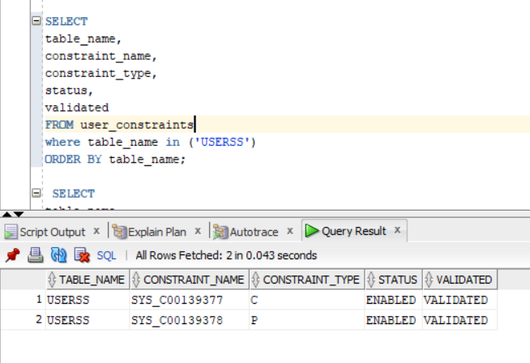
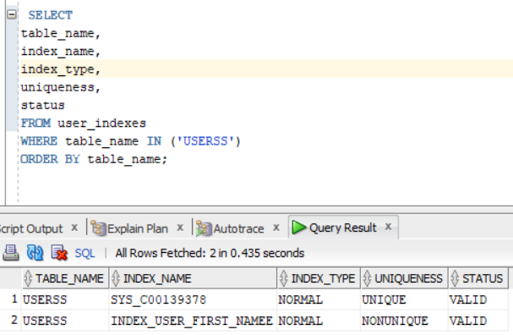
DBA Scripts:
The simple SQL script shows the table and column metadata are examples of Database administration scripts.
The database system catalog includes metadata tables and views that describe the implementations of individual schemas.
Below are two different views of DBA scripts used for USERSS table:
a) List Integrity constraints
b) List Index structure
a) List Name and Size of Table b) List Integrity constraints

Slide 13
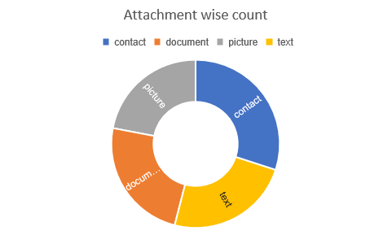
Data Visualization:
Below are the graphical representation of various important metrics of Chatting Application:
Pie chart shows active user count.
Bar chart represents Decade wise users.
Sunburst chart for Attachments sent in chats.

Slide 14
Conclusion:
To conclude the chatting application Dataset:
We have created Normalized the contacts table to Phonebook and sub-contacts which avoids redundancy.
We written sample queries to check whether we are getting right data.
Have completed performance tuning, created index on main variables reduced cost and time to run.
Also, created partition on CREATED_AT column in USERS table which improved query performance.
Visualized key metrics of chatting application database.

Slide 15
Thank you !

