Slide 1
Employee Data Analysis using Excel
STUDENT NAME: PRASANNA KUMARI R
REGISTER NO:312216386(asunm1621312216386)
DEPARTMENT:B.COM COMPUTER APPLICATIONS
COLLEGE:SHRI SHANKARLAL SUNDARBAI SHASUN JAIN COLLEGE FOR WOMEN

Slide 2
PROJECT TITLE
Employee Performance Analysis using Excel

Slide 3


AGENDA
Problem Statement
Project Overview
End Users
Our Solution and Proposition
Dataset Description
Modelling Approach
Results and Discussion
Conclusion
3/21/2024 Annual Review

Slide 4

PROBLEM STATEMENT
In the organization, the current methods for evaluating employee performance are inconsistent and lack a standardized approach. This has led to discrepancies in performance reviews, employee dissatisfaction, and difficulty in identifying top performers and areas needing improvement.
To address these issues, we aim to develop a comprehensive employee performance analysis system using Excel.
This system will standardize performance metrics, automate data collection and analysis, and provide clear, actionable insights to improve overall employee performance and satisfaction.

Slide 5

PROJECT OVERVIEW
.
Project Scope: Analyzing employee performance analysis using excel for the given employee data.
Objectives: identifying number of male and female employees performance individually and according to the business units.
Data Collection: the data I used are 9 features which is employee business units , gendercode,performance level and for value employee name.
Analysis Methods: used pivot table for evaluation of male and female employee performance and chart to show representation, used trend line and etc.,

Slide 6

WHO ARE THE END USERS?
EMPLOYEES
HR PROFESIONALS
MANAGERS
EXECUTIVES
ORGANISATION

Slide 7

OUR SOLUTION AND ITS VALUE PROPOSITION
Data Organization: the given data is well-organized with clear headers for each column, such as Employee ID, Name, buisness unit, Performance Score, etc.
Pivot Tables: Used pivot tables to summarize and analyze data. I group data by buisness unit ,gendercode,performance level, job role, or performance metrics to identify trends and patterns.
Charts and Graphs: Visualize the data with charts and graphs to make it easier to interpret. I used line graphs, and pie charts be more effective.
Formulas and Functions:
I used conditional formatting for removing missing values and filtering out.
used filter for sort out data and finding number of male and female count
used IFS formula for performance level using performance points or metrics.

Slide 8
Dataset Description
Employee Management Data: The data extracted from portal and conducted analysis. It helps in analyzing employee performance and management.
Employee Features: This dataset includes 26 columns like Employee ID, Full Name, buisness unit , Designation, Hire Date, and gendercode.
Features used: But used only employee id,first name and last name,Buisness unit,employee type and status,gendercode and performance level and rating.
Variabes used like Empid as number and anme as text.
There are male and female to sort Out according to the need.
Using employee rating filtered and formula (IFS) for the performance level (VERY HIGH,HIGH,MEDIUM,LOW)

Slide 9

THE "WOW" IN OUR SOLUTION
Used this formula for filtering the rating for Performance Level feature -IFS(Z8>=5,”VERY HIGH”,Z8>=4,”HIGH”,Z8>=3,”MED”,TRUE,”LOW” and applied for all the data rows.
Conditional formatting for the missed values and removed by filter option to evalation of performance analysis.
Used Slicer option for the choosing gender code accoring to the needs.
3/21/2024 Annual Review
9

Slide 10
MODELLING
Data Collection: The data extracted from portal and conducted analysis. I used employee data.csv sheet for analysis. It helps in analyzing employee performance and management.
Employee Features: This dataset includes 26 columns like Employee ID, Full Name, buisness unit , Designation, Hire Date, and gendercode.
Features Collection: But used only employee id,first name and last name,Buisness unit,employee type and status,gendercode and performance level and rating.
Data cleaning:used filter and conditional formatting for the removing of blank fields and empty and filter it out with the cells are not empty.thus it will filter only the values which are not empty for the analysing performance of employees.
Performance Level: by using conditional formatting , the employee rating are evaluated as performance level i.e, IFS(Z8>=5,”VERY HIGH”,Z8>=4,”HIGH”,Z8>=3,”MED”,TRUE,”LOW”) are applied to the rows .
Then, performance level considered As a feature to the pivot table.
10

Slide 11
Summary: Thus employee data analyzed using excel and filter the number of make and female employees performance to check whether the employees improving status and analysis.
The employee performance analysis created using pivot table and charts for interpret the data .
Visualisation: Created pivot tables to compare performance across different metrics and employees.
Used charts and graphs to visualize data and identify patterns and trendlines.
Used line chart and pie chart for better results .

Slide 12
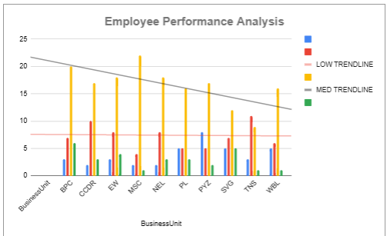
RESULTS
12

Slide 13
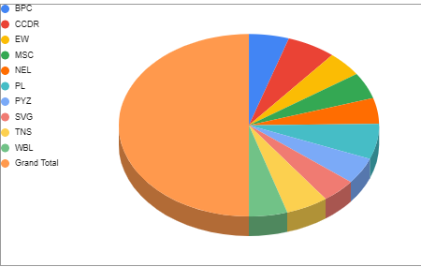
RESULTS

Slide 14
conclusion
In this Project the following objectives are achieved:
Improved consistency and fairness in performance evaluations.
Enhanced ability to identify and reward top performers.
Better identification of areas needing improvement and targeted training.
Increased employee satisfaction and engagement.

