Slide 1
In-Network Processing in WSN
Group No.4
Atish Majumdar - 1410110081
Prasanna Natarajan – 1410110298
Vedant Chakravarthy - 1410110489

Slide 2
Abstract
In this paper, we cover various aspects of in-network data aggregation and processing in wireless sensor networks. We survey existing literature about energy efficiency, compression, query processing and , security methods, looking at multiple existing research papers across these domains, identifying and highlighting key research objectives, methodologies and discuss how they build upon or improve previously existing solutions. Finally, we discuss future research goals in each of the areas.

Slide 3
Introduction
Advances in technology has led to the production of sensor devices which can sense the physical environment and provide valuable data. These sensors can communicate with each other, but also perform other tasks like signal processing, data aggregation and compression in the network rather than out of the network. There are three common features to all sensor network applications. The first one is the need for simple algorithms as sensor nodes have highly constrained resources. The second one is the need for minimizing communication among sensor nodes, since communication is the primary source of energy usage in these networks. The third is that data throughout a sensor network is bound to have spatial and temporal redundancy.

Slide 4
In-network Aggregation Techniques for Wireless Sensor Networks: A Survey[1]
In-network aggregation is the global process of gathering and routing information through a multi-hop network, processing data at intermediate nodes with the objective of reducing resource consumption (in particular energy), thereby increasing network lifetime.
The paper discusses about these 3 aspects of in-network processing:
Data Aggregation and compression
Energy
Security

Slide 5
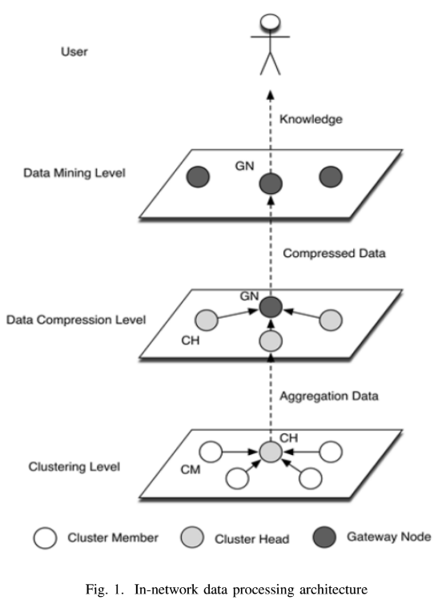
In-network Data Processing Architecture for Energy Efficient Wireless Sensor Networks[2]
At network level, the paper proposes implementing Neighbor-Aware Clustering Aggregation (NMCA). For compression, it suggests using Optimal Clustering Compression (OCC) to reduce aggregated packet size. The CH sends the aggregated data by NMCA to the sink node.
A data pre-processor (DP) is deployed for the outlier detection in the model for improving the data accuracy. The real-time data mining engine (RDME) operates the data mining model and event detector to match the format annotation of the sensed value.

Slide 6
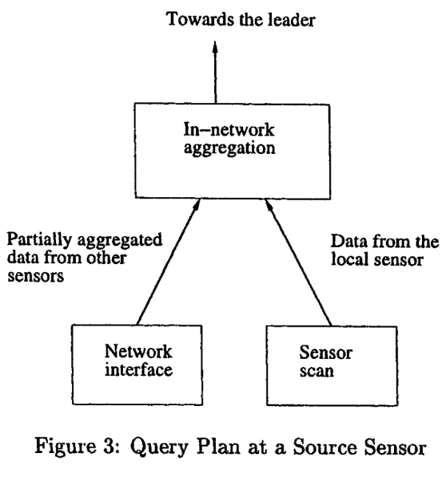
The Cougar Approach to In-Network Query Processing in Sensor Networks[3]
This paper proposes an architecture for a data management system for sensor networks.
It proposes the introduction of a query processing layer between the network layer and the application layer.
Using declarative queries can help separate the user from the details of the individual nodes in the sensor network and make the network more flexible.
Pre-processing these queries can allow for energy saving.

Slide 7
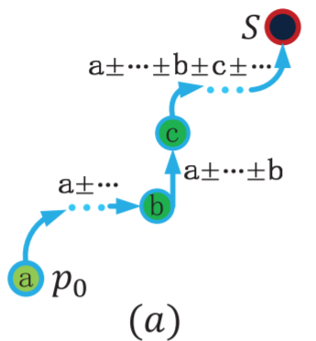
CDC: Compressive data collection for wireless sensor networks [4]
Proposes improved routing and compression protocol called Compressive Data Collection(CDC).
Uses opportunistic routing for packet forwarding.
As the packet travels towards the sink, the compression scheme adds or subtracts the sensory reading of a newly encountered node, as in the figure.
For estimation error within 20%, CDC prolongs the network lifetime by 1.5× ∼ 2×. This is because that CDC requires fewer measurements, even fewer number of sensory readings in each measurement, thus greatly reduces the energy consumption.

Slide 8
PINCO: a Pipelined In-Network Compression Scheme for Data Collection in Wireless Sensor Networks[5]
Buffers sensor data in the network, combines it through a pipeline compression scheme into groups of data, while satisfying end to end latency bounds. Trades higher latency for reduced energy consumption.
Reduces data redundancy in data collected from sensors.
Prioritizes hop minimization over latency minimization
Current implementation only supports single valued data, future implementations aimed towards complex sensor data (audio and video)

Slide 9
Energy Efficient In-Network Data Processing in Sensor Networks[6]
Extends current in-network aggregation methods by utilizing temporal coherency tolerance to minimize the size and number of transmitted messages.
Three particular design decisions involved in this paper:
A query model
Energy cost model
In-network Data Processing
Broadcasting Query Message
Processing Data Locally
Packet Merging
Packet aggregation in in-network data processing method consumes less energy compared to other methods, it reduces redundancy in sensor readings.

Slide 10
In-network Data Processing for Wireless Sensor Networks[7]
Placement of the “proxy” node, to minimize energy. Scheme called ENERGY( Energy Efficient Rate Governed Yardstick)
It is also observed that as the node density increases, the power consumption decreases, more sensor nodes, each node has more neighbors, which helps to shorten the path from the proxy to the other nodes, thus improving energy consumption.

Slide 11
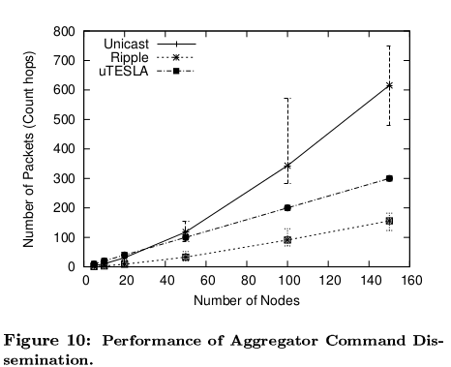
Security Support for In-Network Processing in Wireless Sensor Networks[8]
The focus of this paper is on the challenges of securing in-network processing in WSN. Security mechanisms are proposed for both upstream and downstream data flow. It proposes protocols for:
determining secure membership. (how to authenticate?)
Letting the aggregators securely disseminate commands in a scalable fashion. (Ripple)

Slide 12
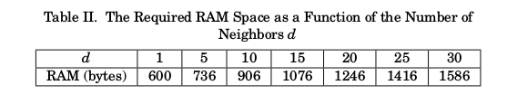
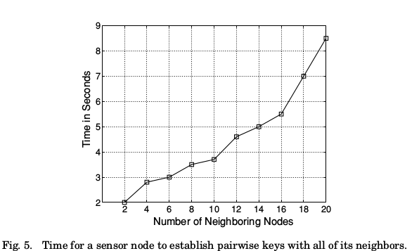
LEAP+: Efficient Security Mechanisms for Large-Scale Distributed Sensor Networks[9]
This paper introduces a protocol called LEAP+ (Localized Encryption and Authentication Protocol).
It focuses on two main aspects of efficiency: Memory usage and Time taken to establish the network.
A sensor node needs to store 4 keys initially.
Demonstrated on TinyOS.

Slide 13
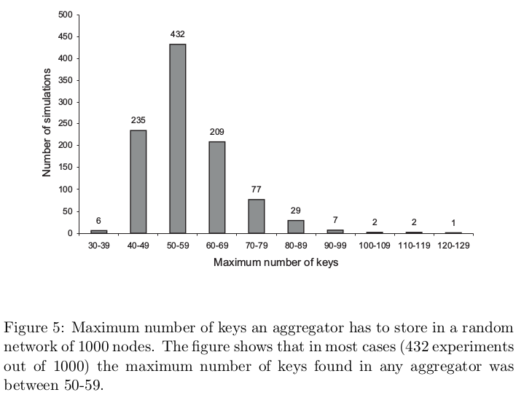
Secure In-Network Processing in Sensor Networks[10]
This paper introduces a protocol to effectively secure data in a sensor network without affecting the in-network capabilities of the network.
It reduces the network traffic between the aggregators and the base station.
The initial number of keys stored in a sensor node is 2.

Slide 14
Conclusion
In this paper we have presented a review of in-network processing in wireless sensor networks on 3 different aspects, namely, Data Aggregation and Compression, Energy and Security.
One of the main design aspects for sensor network architectures is energy efficiency, to keep the network operational as long as possible. Therefore, aggregation techniques are an essential building block, as they aim at reducing the number of transmissions required for data collection which, in turn, reduces energy consumption.

Slide 15
Conclusion
Energy efficiency is critical in wireless sensor networks. The two different schemes discussed in this paper are aimed towards maximizing energy efficiency of a wireless sensor network, given the constraints which exist in the real world. Compression also plays a key part in saving energy, as the amount of data that a node has to communicate reduces, its power consumption also decreases.
Security is a major concern in wireless sensor networks, especially without affecting the in-network processing capabilities of the network. Three different protocols using a very similar approach has been discussed in the paper. Each one is an improvement from the other in terms of memory required for storing keys and network traffic, that is communication with the base station.

Slide 16
References
[1] Fasolo E, Rossi M, Widmer J, Zorzi M. “In-network aggregation techniques for wireless sensor networks: a survey”. IEEE Wireless Communications. 2007 Apr;14(2).
[2] He W, Yang SH, Yang L, Li P. “In-network data processing architecture for energy efficient wireless sensor networks”. InInternet of Things (WF-IoT), 2015 IEEE 2nd World Forum on 2015 Dec 14 (pp. 299-304). IEEE.
[3] Yao Y, Gehrke J. “The cougar approach to in-network query processing in sensor networks". ACM Sigmod record. 2002 Sep 1;31(3):9-18.
[4] Liu XY, Zhu Y, Kong L, Liu C, Gu Y, Vasilakos AV, Wu MY. "CDC: Compressive data collection for wireless sensor networks". IEEE Transactions on Parallel and Distributed Systems. 2015 Aug 1;26(8):2188-97.
[5] Arici T, Gedik B, Altunbasak Y, Liu L. “PINCO: A pipelined in-network compression scheme for data collection in wireless sensor networks”. InComputer Communications and Networks, 2003. ICCCN 2003. Proceedings. The 12th International Conference on 2003 Oct 20 (pp. 539-544). IEEE.
[6] Prakash GL, Thejaswini M, Manjula SH, Venugopal KR, Patnaik LM. “Energy efficient in-network data processing in sensor networks”. World Academy of Science, Engineering and Technology. 2008 Dec 25;48.
[7] Chen Y, Leong H, Xu M, Cao J. “An energy-efficient framework for multi-rate query in wireless sensor networks”. InComputer and Information Technology, 2006. CIT'06. The Sixth IEEE International Conference on 2006 Sep (pp. 89-89). IEEE.
[8] Deng J, Han R, Mishra S. “Security support for in-network processing in wireless sensor networks”. InProceedings of the 1st ACM workshop on Security of ad hoc and sensor networks 2003 Oct 31 (pp. 83-93). ACM.
[9] Zhu S, Setia S, Jajodia S. “LEAP+: Efficient security mechanisms for large-scale distributed sensor networks”. ACM Transactions on Sensor Networks, (TOSN). 2006, Nov 1;2(4):500-28.
[10] Dimitriou T, Krontiris I. “Secure in-network processing in sensor networks”. Security in Sensor Networks. 2006:275-90.

