Slide 1


OBJECTIVES
What technology have we used?
What is Linkway?
What problem does it solve?
What are the different user roles in Linkway?
What has been my contribution in Linkway?
Home Page
Team Page
Outing Page
What is the future scope for Linkway?
Presented By:
| Prasanna Pandit |

Slide 2
What technologies have we used?
OBJECTIVES
What technology have we used?
What is Linkway?
What problem does it solve?
What are the different user roles in Linkway?
What has been my contribution in Linkway?
Home Page
Team Page
Outing Page
What is the future scope for Linkway?
Frontend:
HTML and CSS
JavaScript
React.js
Material UI Library
2. Backend:
a. Node.js
b. Express.js
Presented By:
| Prasanna Pandit |
3. Database:
a. MongoDB
b. Mongoose Library
4. Version Control:
a. Git
b. Azure DevOps

Slide 3
What is ?
OBJECTIVES
What technologies have we used?
What technology have we used?
What is Linkway?
What problem does it solve?
What are the different user roles in Linkway?
What has been my contribution in Linkway?
Home Page
Team Page
Outing Page
What is the future scope for Linkway?
Frontend:
HTML and CSS
JavaScript
React.js
Material UI Library
2. Backend:
a. Node.js
b. Express.js
Linkway is a web-based employee profiling system, designed to streamline employee management with our organisation.
It serves as a employee directory, similar to LinkedIn, and it allows HR, RMG, Manager, Candidates, and Admin users to efficiently manage and access employee information, and also includes the ability to export resumes.
It also facilitate integration with our organisation’s internal programs (namely GIFT, RnR and Shabash).
3. Database:
a. MongoDB
b. Mongoose Library
4. Version Control:
a. Git
b. Azure DevOps

Slide 4
What problem does it solve?
What technologies have we used?
What is ?
Frontend:
HTML and CSS
JavaScript
React.js
Material UI Library
2. Backend:
a. Node.js
b. Express.js
Linkway is a web-based employee profiling system, designed to streamline employee management with our organisation.
It serves as a employee directory, similar to LinkedIn, and it allows HR, RMG, Manager, Candidates, and Admin users to efficiently manage and access employee information, and also includes the ability to export resumes.
It also facilitate integration with our organisation’s internal programs (namely GIFT, RnR and Shabash).
Linkway fills one of the biggest void in our organization, it creates a centralized employee directory for users to get information for anyone working within the organization.
The organization also lacks a centralized system for management of our Internal Programs(i.e. GIFT, RnR and Shabash), Linkway solves this problem as well.
Linkway also features a outing request management system for managers, which saves managers the hassle of following multiple steps to apply for an outing.
3. Database:
a. MongoDB
b. Mongoose Library
4. Version Control:
a. Git
b. Azure DevOps

Slide 5
What are the different user roles in ?
What is ?
What problem does it solve?
Linkway consits of role based access for the following roles:
Employee: This role consists of each and every employee working within our organization.
Manager: This role consits of the employees with the following designation:
HR (Human Resources) manager.
RMGs (Resource Management Group).
All other manangers and executive officers.
Admin: This role is designated to the application managers and can be assigned to anyone within the organization.
Linkway is a web-based employee profiling system, designed to streamline employee management with our organisation.
It serves as a employee directory, similar to LinkedIn, and it allows HR, RMG, Manager, Candidates, and Admin users to efficiently manage and access employee information, and also includes the ability to export resumes.
It also facilitate integration with our organisation’s internal programs (namely GIFT, RnR and Shabash).
Linkway fills one of the biggest void in our organization, it creates a centralized employee directory for users to get information for anyone working within the organization.
The organization also lacks a centralized system for management of our Internal Programs(i.e. GIFT, RnR and Shabash), Linkway solves this problem as well.
Linkway also features a outing request management system for managers, which saves managers the hassle of following multiple steps to apply for an outing.

Slide 6
What has been my contribution in ?
What are the different user roles in ?
What problem does it solve?
Linkway consits of role based access for the following roles:
Employee: This role consists of each and every employee working within our organization.
Manager: This role consits of the employees with the following designation:
HR (Human Resources) manager.
RMGs (Resource Management Group).
All other manangers and executive officers.
Admin: This role is designated to the application managers and can be assigned to anyone within the organization.
I have worked as a full stack developer in Linkway.
In backend I have created the following modules:
Login Module
Comments and feedback module
Resume Export
In frontend I have created the following modules:
Home page
Team page
Outing page
Linkway fills one of the biggest void in our organization, it creates a centralized employee directory for users to get information for anyone working within the organization.
The organization also lacks a centralized system for management of our Internal Programs(i.e. GIFT, RnR and Shabash), Linkway solves this problem as well.
Linkway also features a outing request management system for managers, which saves managers the hassle of following multiple steps to apply for an outing.

Slide 7
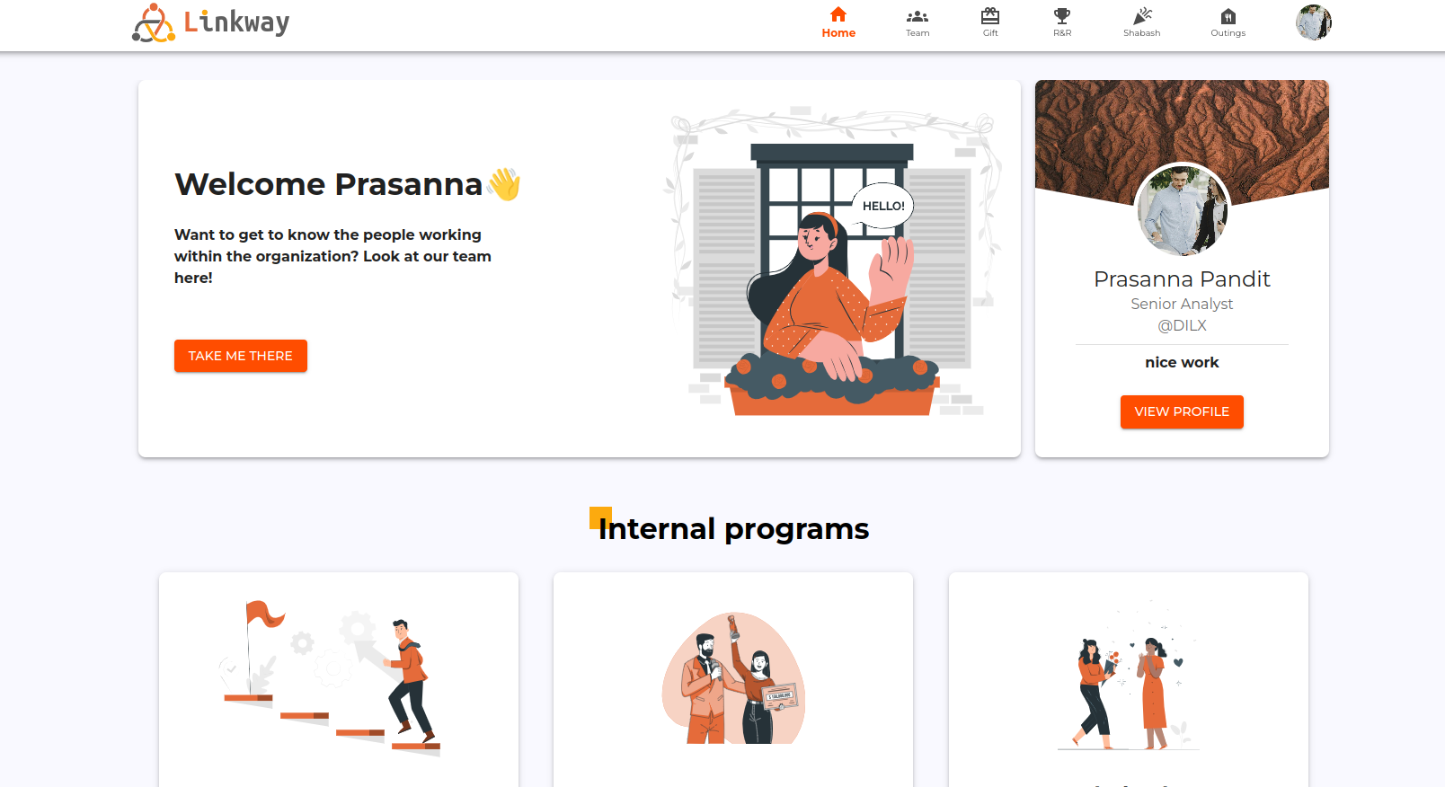
Home Page
What has been my contribution in ?
What are the different user roles in ?
I have worked as a full stack developer in Linkway.
In backend I have created the following modules:
Login Module
Comments and feedback module
Resume Export
In frontend I have created the following modules:
Home page
Team page
Outing page
Linkway fills one of the biggest void in our organization, it creates a centralized employee directory for users to get information for anyone working within the organization.
The organization also lacks a centralized system for management of our Internal Programs(i.e. GIFT, RnR and Shabash), Linkway solves this problem as well.
Linkway also features a outing request management system for managers, which saves managers the hassle of following multiple steps to apply for an outing.

Slide 8
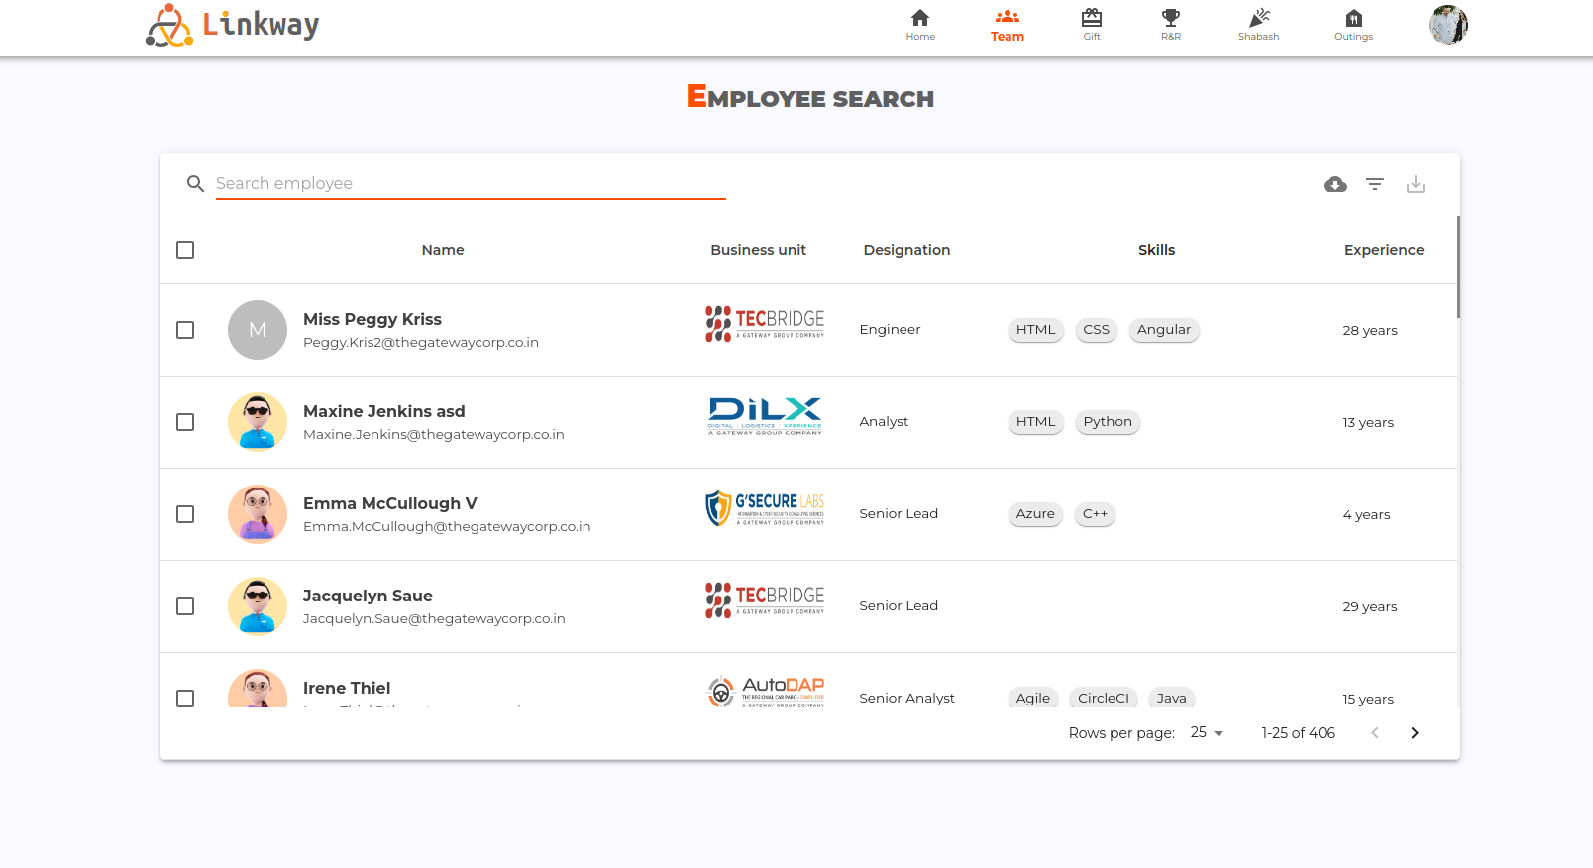
Team Page
Home Page
What has been my contribution in ?
Linkway fills one of the biggest void in our organization, it creates a centralized employee directory for users to get information for anyone working within the organization.
The organization also lacks a centralized system for management of our Internal Programs(i.e. GIFT, RnR and Shabash), Linkway solves this problem as well.
Linkway also features a outing request management system for managers, which saves managers the hassle of following multiple steps to apply for an outing.

Slide 9
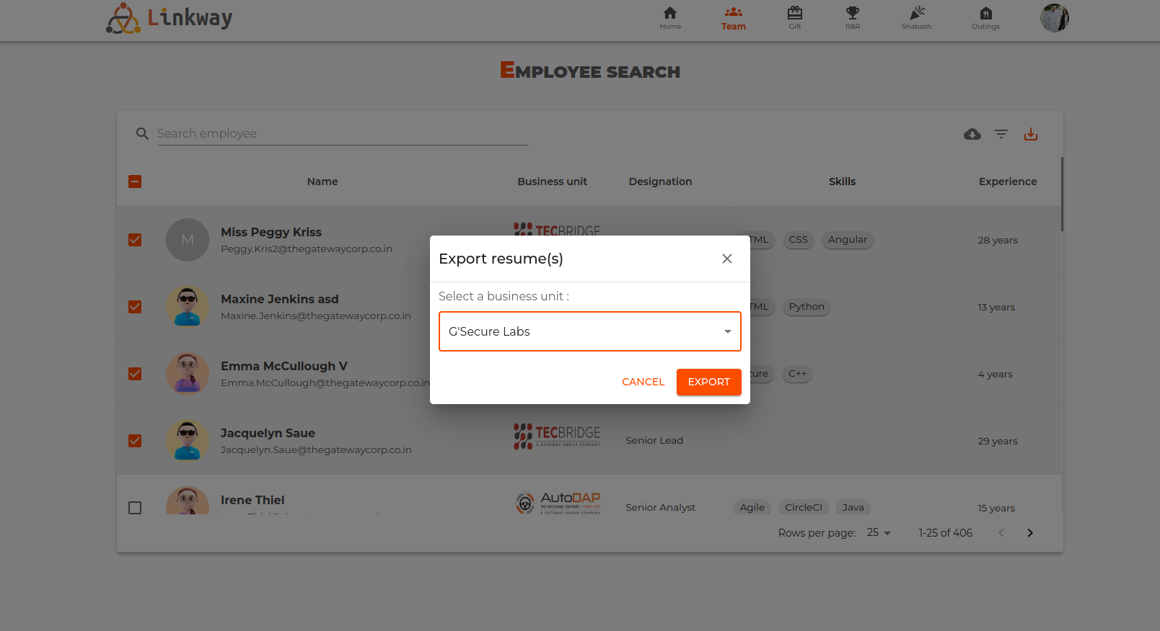
Team Page
Home Page

Slide 10
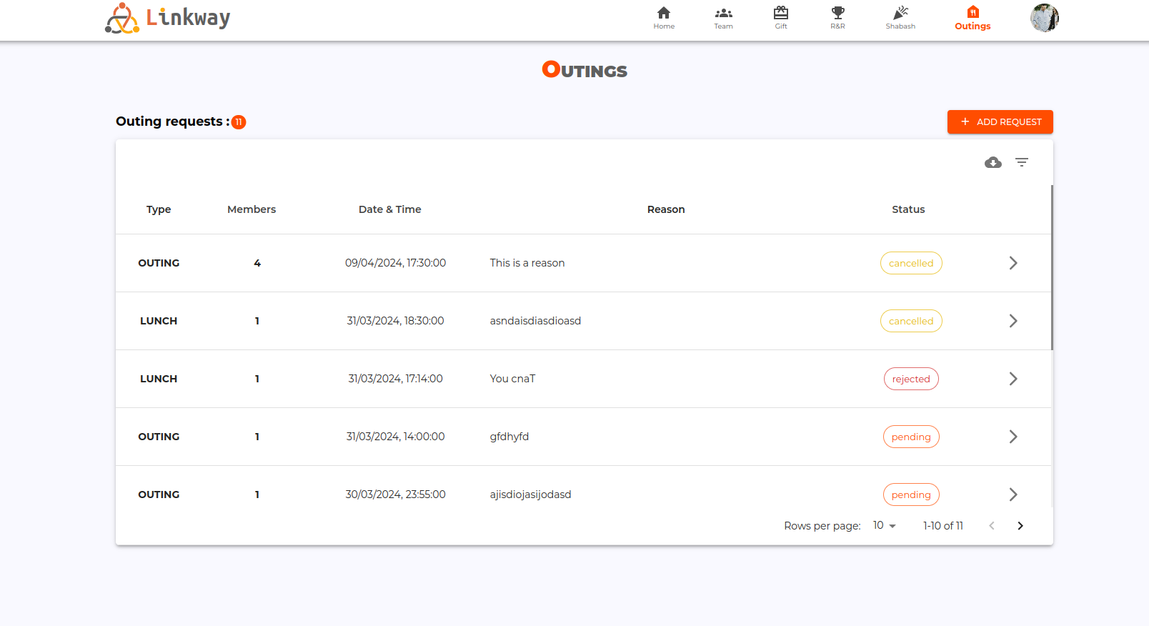
Outing Page
Team Page

Slide 11
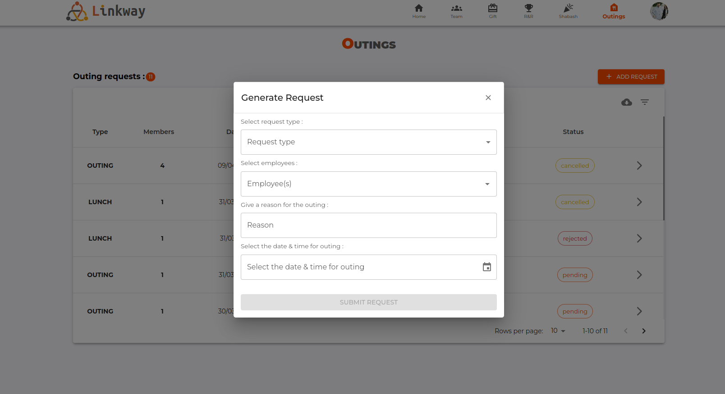
Team Page
Outing Page

Slide 12
Outing Page

Slide 13
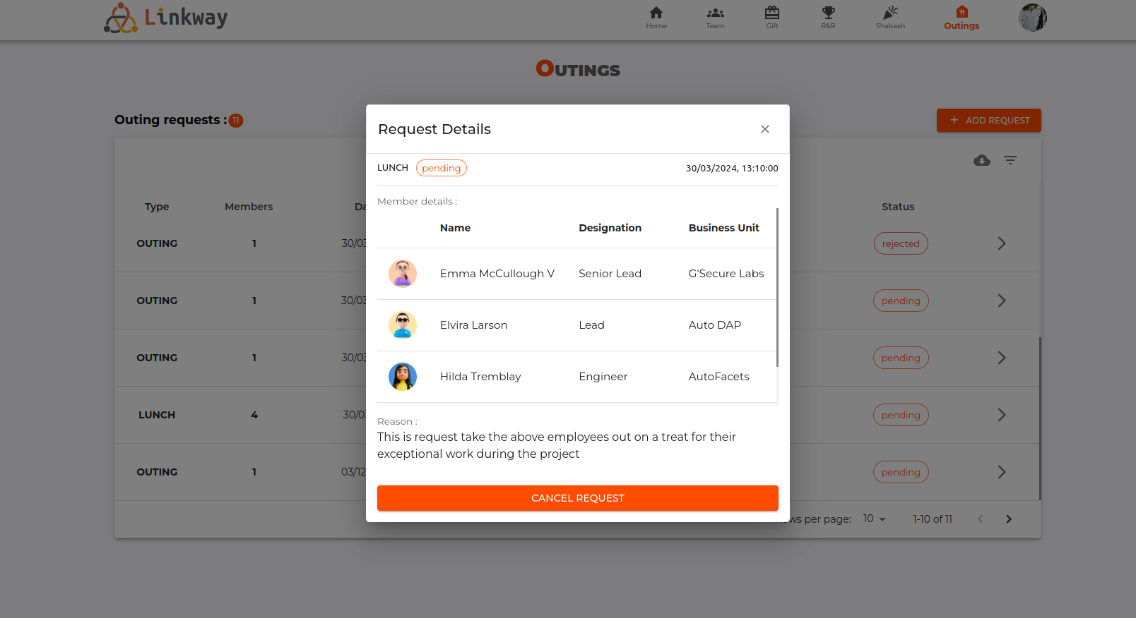
Outing Page

Slide 14
What is the future scope for Linkway?
Outing Page
Linkway has a huge potential to be the primary social networking application (like LinkedIn) for the organization.
It can have post features, where we can integrate the GNN(Gateway News Network) into Linkway to view all the news inside Linkway.
It can also be intergrated into G-NXT, to make features of Linkway available on mobile platforms as well.
An AI chat bot can also be integrated into Linkway to make any information regarding the application avalaible by just entering a prompt similar to ChatGPT.

Slide 15
What is the future scope for Linkway?
Linkway has a huge potential to be the primary social networking application (like LinkedIn) for the organization.
It can have post features, where we can integrate the GNN(Gateway News Network) into Linkway to view all the news inside Linkway.
It can also be intergrated into G-NXT, to make features of Linkway available on mobile platforms as well.
An AI chat bot can also be integrated into Linkway to make any information regarding the application avalaible by just entering a prompt similar to ChatGPT.

Slide 16
What is the future scope for Linkway?
Linkway has a huge potential to be the primary social networking application (like LinkedIn) for the organization.
It can have post features, where we can integrate the GNN(Gateway News Network) into Linkway to view all the news inside Linkway.
It can also be intergrated into G-NXT, to make features of Linkway available on mobile platforms as well.
An AI chat bot can also be integrated into Linkway to make any information regarding the application avalaible by just entering a prompt similar to ChatGPT.
Thankyou
Any questions?

