Slide 1
Adaptive Rank Decomposition

Slide 2
Adaptive Rank Decomposition
 | Rank or RP | Size in MB | FID | After Finetuning
Fixed Rank | 128 | 1.88 | 35.87
 | 256 | 2.74 | 18.25
 | 512 | 4.48 | 10.09
 | 680 | 5.61 | 9.08
Fixed Rank with NC_9_13 | 128 | 5.02 | 13.76
 | 256 | 5.75 | 8.26
 | 512 | 7.22 | 6.44
 | 680 | 8.18 | 6.24
Adaptive Rank | 1 | 2.55 | 13.22 | 7.25
 | 1/5 | 3.21 | 9.52 | 6.86
 | 1/10 | 5.25 | 7.67 | 6.34
 | 1/15 | 6.62 | 6.63 | 5.90
 | 1/20 | 8.32 | 5.85 | 5.69

Slide 3
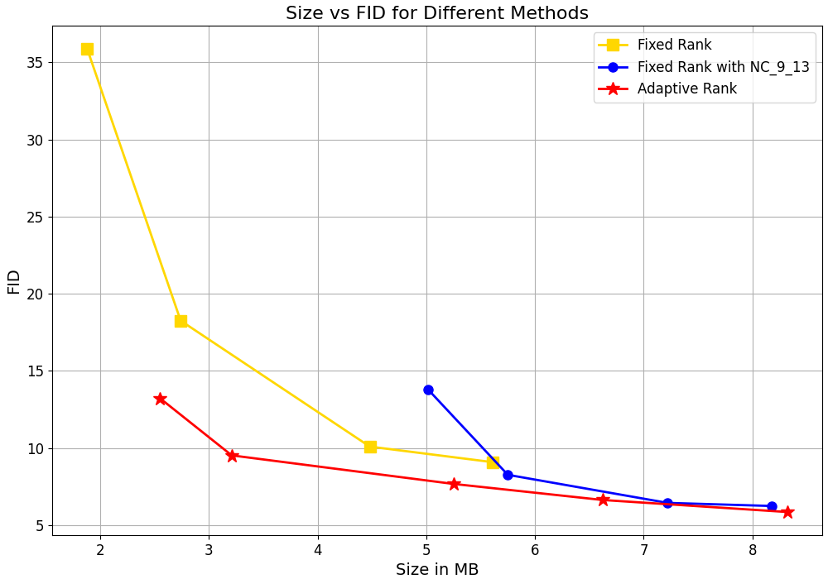
Plot

Slide 4
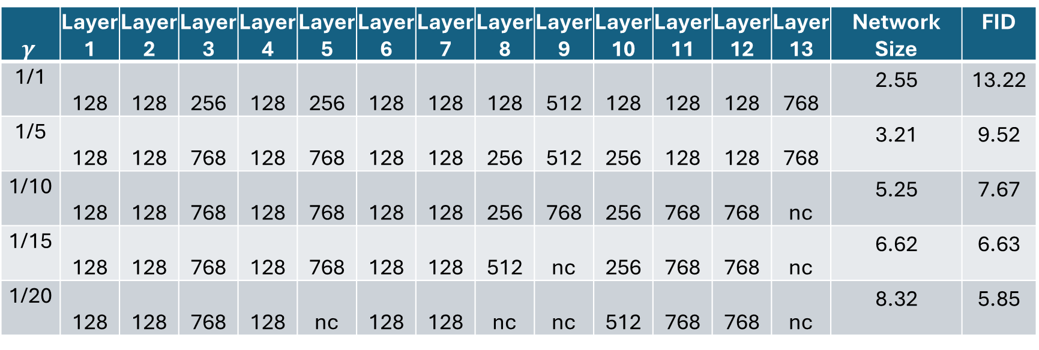
Adaptive Rank Selection
$$γ$$ | Layer 1 | Layer 2 | Layer 3 | Layer 4 | Layer 5 | Layer 6 | Layer 7 | Layer 8 | Layer 9 | Layer 10 | Layer 11 | Layer 12 | Layer 13 | Network Size | FID
1/1 | 128 | 128 | 256 | 128 | 256 | 128 | 128 | 128 | 512 | 128 | 128 | 128 | 768 | 2.55 | 13.22
1/5 | 128 | 128 | 768 | 128 | 768 | 128 | 128 | 256 | 512 | 256 | 128 | 128 | 768 | 3.21 | 9.52
1/10 | 128 | 128 | 768 | 128 | 768 | 128 | 128 | 256 | 768 | 256 | 768 | 768 | nc | 5.25 | 7.67
1/15 | 128 | 128 | 768 | 128 | 768 | 128 | 128 | 512 | nc | 256 | 768 | 768 | nc | 6.62 | 6.63
1/20 | 128 | 128 | 768 | 128 | nc | 128 | 128 | nc | nc | 512 | 768 | 768 | nc | 8.32 | 5.85

