Slide 1

Instagram Performance Analytics for Sugar Cosmetics
Subtitle:
Social Media Performance Analysis using Tableau

Slide 2
Overview
This project analyzes Sugar Cosmetics’ Instagram performance using historical social media data to evaluate engagement, reach, content effectiveness, and campaign performance.
Domain
Digital Marketing
Social Media Analytics
Business Intelligence
Tools Used
Tableau
Microsoft Excel

Slide 3
Project Objective
Main Objective
Analyze Instagram performance
Measure KPIs
Identify top-performing content
Understand audience engagement
Improve social media ROI
Business Goal
Provide actionable insights to optimize content strategy and engagement.

Slide 4
Dataset & Methodology
Dataset Includes
Post Date
Post Type
Likes
Comments
Reach
Impressions
Shares
Saves
Hashtags
Campaign Type
Methodology
Data Cleaning
KPI Calculation
Tableau Dashboard
Business Insight Generation

Slide 5
KPI Overview
KPI | Value
Posts | 50K
Likes | 147.7M
Comments | 18.46M
Reach | 987.4M
Engagement | 18.54%
Insight
Strong visibility and engagement.
Risk
High reach may not convert into deeper interactions.
Recommended Action
Improve comment/share CTAs.

Slide 6
Task 2: Monthly Posting Trend
Results
Consistent posting across months
Peak: Dec 2024 (4296 posts)
Lowest: Apr 2025
Insight
Festive campaigns increased activity.
Risk
Low posting months reduce reach.
Recommended Action
Maintain monthly content calendar.

Slide 7
Task 3: Top 10 Posts by Likes
Insight
Influencer-driven content boosts visibility.
Risk
Overdependence on influencers.
Recommended Action
Balance promotional + organic content.
Best Performing Content
Influencer Collaborations
Giveaways
Reels
Highest likes: 11,392

Slide 8
Task 4: Top 10 Posts by Engagement Rate
Highest Engagement Post
Date: 05-Apr-2025
Type: Image
Campaign: Influencer Collab
Engagement Rate: 34.10%
Insight
Small reach + high interaction = loyal audience
Risk
Niche audience may limit scaling.
Recommended Action
Replicate high-engagement niche content.

Slide 9
Task 5: Post Type Performance
Insight
Stories drive better engagement.
Risk
Overusing one format reduces freshness.
Recommended Action
Use content mix strategy:
40% Stories
30% Reels
20% Images
10% Videos
Results
Best format:
🏆 Stories
Performance order:
Story
Reel
Image
Video

Slide 10
Task 6: Day of Week Analysis
Best Days
Wednesday
Friday
Saturday
Weakest:
Sunday
Insight
Timing impacts engagement.
Risk
Posting on weak days lowers visibility.
Recommended Action
Schedule premium posts on best days.

Slide 11
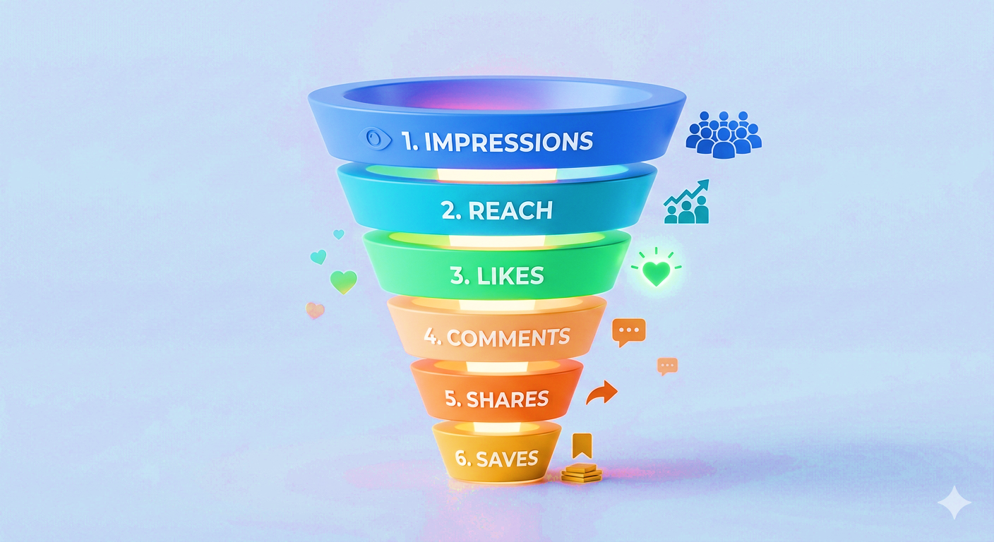
Task 7: Engagement Funnel
Funnel
Insight
Strong awareness but weaker deeper engagement.
Risk
Passive audience limits growth.
Recommended Action
Increase interactive CTAs:
Comment
Share
Save

Slide 12
Task 8: Hashtag Analysis
Insight
Ethical beauty messaging performs strongly.
Risk
Repeated hashtags reduce discoverability.
Recommended Action
Use mix:
40% branded
40% niche
20% trending
Best Hashtags
#BoldLooks
#CrueltyFree
#VeganBeauty

Slide 13
Strategic Recommendations
Recommended Strategies
Increase creator collaborations
Improve story engagement
Launch interactive campaigns
Optimize posting schedule
Growth Drivers
Influencer marketing
Story content
Ethical beauty branding

