Slide 1
MARKETPLACE REVENUE LEAKAGE & PROFITABILITY GAP ANALYSIS
A structured SQL-driven investigation into hidden margin erosion, discount dependency, and return-driven revenue loss across marketplace operations.
PREPARED BY
TOOLS USED
Prasanna Kumar R
MySQL · SQL · Excel

Slide 2
Project Overview
15 Tasks. One Mission: Find the Profit Gap.
This analysis identifies where and why marketplace profitability breaks down — from loss-making SKUs and over-discounting to return-driven leakage and payment fee drag.
01
02
Revenue vs Profit Reality
Category-wise Profitability
Does high sales volume translate to actual profit?
Which categories drive margin vs. just volume?
03
04
Loss-Making Products
Discount & Return Impact
Which SKUs are actively eroding the bottom line?
Are promotions and returns undermining profit growth?

Slide 3
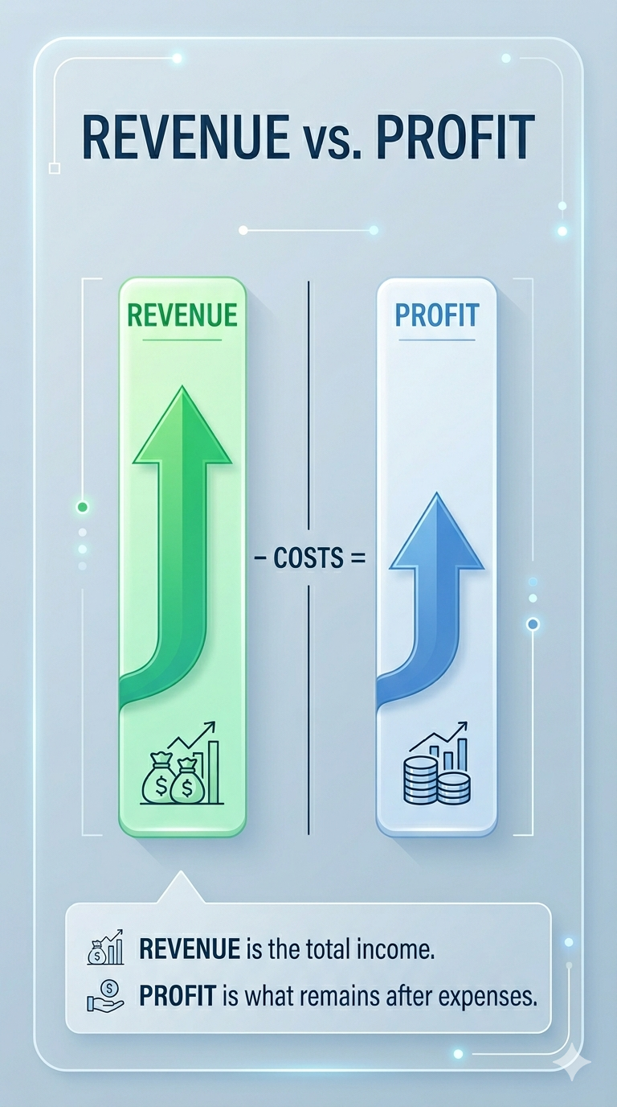
Task 1: Revenue vs. Profit Reality
Business Objective: Evaluate whether the marketplace is truly profitable or simply generating high sales volume.
Recommended Actions
Improve pricing strategy
Monitor cost-to-revenue ratio
Improve profitability tracking
High revenue does not always mean high profit
Hidden operational costs reduce profitability
GAP Identified
Business Risks
Low margins
Inefficient pricing
Poor Cost Control

Slide 4
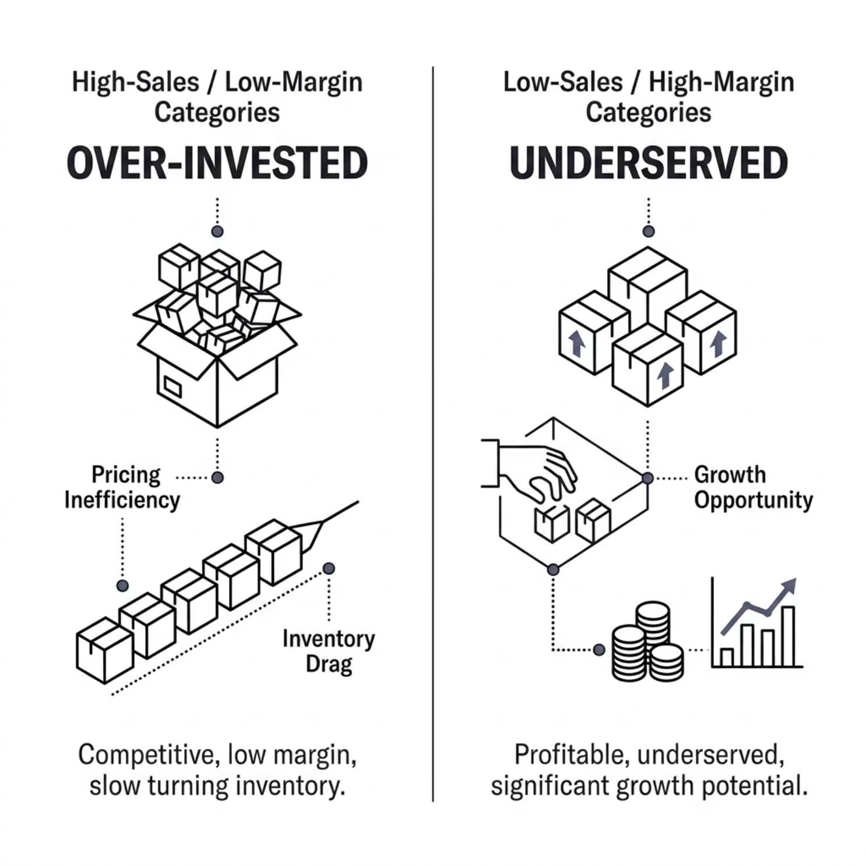
Task 2: Category-wise Sales & Profit
Business Objective: Identify which categories genuinely drive profitability — not just top-line sales volume.
Promote profitable categories
Optimize category pricing
Improve inventory planning
Recommended Actions
GAP Identified
Some categories generate high sales but low profit
Some categories have strong margins despite lower sales
Business Risks
Over-investment in low-margin categories

Slide 5
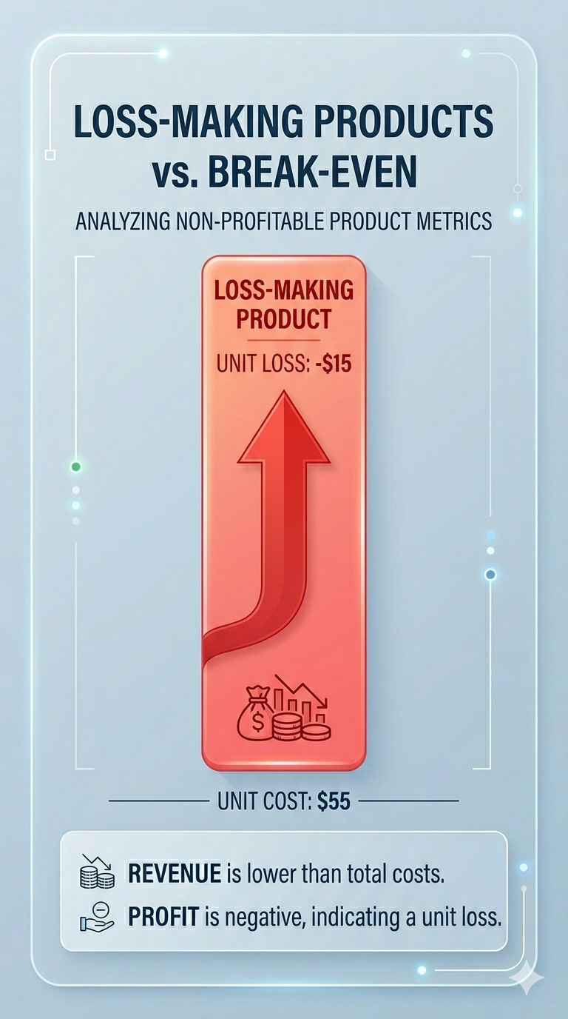









Task 3: Loss-Making Products
Business Objective: Identify specific SKUs generating negative profit and quantify their drag on overall business performance.
Incorrect Pricing
Products priced below cost or without margin buffers built in
High Procurement Cost
Supplier pricing not renegotiated relative to market benchmarks
Frequent Returns
Returned units absorb reverse logistics and restocking costs
Excessive Discounts
Promotions applied without margin safeguards in place
Action Required: Reprice underperforming SKUs, remove structurally weak-margin products, and initiate supplier renegotiation cycles.

Slide 6
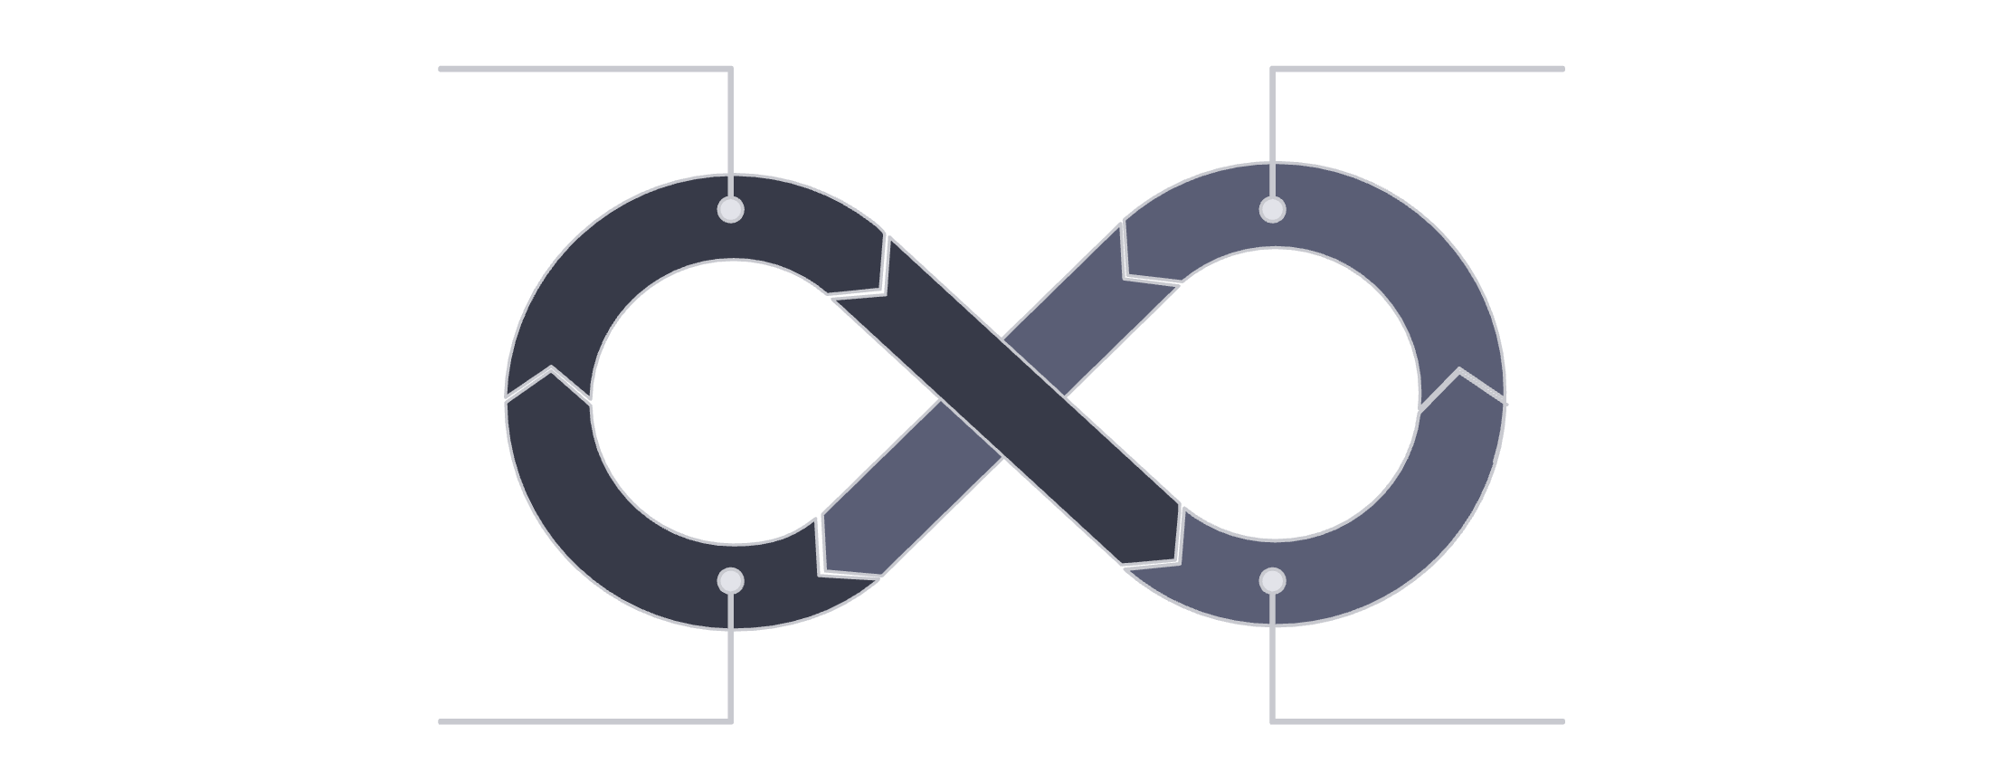
Task 4: Discount Usage & Margin Erosion
Business Objective: Evaluate the marketplace's dependency on promotional discounts and measure their true cost to profitability.
Business Risks
Margin erosion
Unsustainable growth
Customer dependency on offer
Heavy Promotions
Volume Growth
Optimize coupon strategy
Reduce unnecessary discounts
Monitor discount ROI
Customer Discount Dependency
Recommended Actions
Margin Erosion
Discounts that drive short-term volume growth often create long-term structural margin problems if not actively governed.

Slide 7
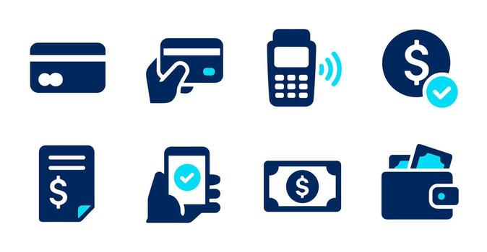
Task 5: Payment Method Popularity & Cost Leakage
Business Objective: Understand customer payment behavior and identify which methods create hidden transaction cost burdens.
GAP Identified
Popular payment methods may create high transaction cost
Payment fee leakage
Operational complexity
Business Risks
Promote low-cost payment methods
Negotiate payment gateway fees
Improve payment cost analysis
Recommended Actions

Slide 8

Task 6: Discount vs. Profit Gap
Business Objective: Determine whether discounts are generating genuine profit improvement — or just inflating gross revenue metrics without bottom-line benefit.
Core Risk: Revenue growth and profit growth are decoupling — high order volumes are masking flat or declining per-order margins.
Recommended Actions
GAP Identified
Business Risks
Evaluate promotion effectiveness
Improve targeting strategy
Protect margin stability
Discounts increase volume but reduce profit margins
Revenue growth without profit growth

Slide 9
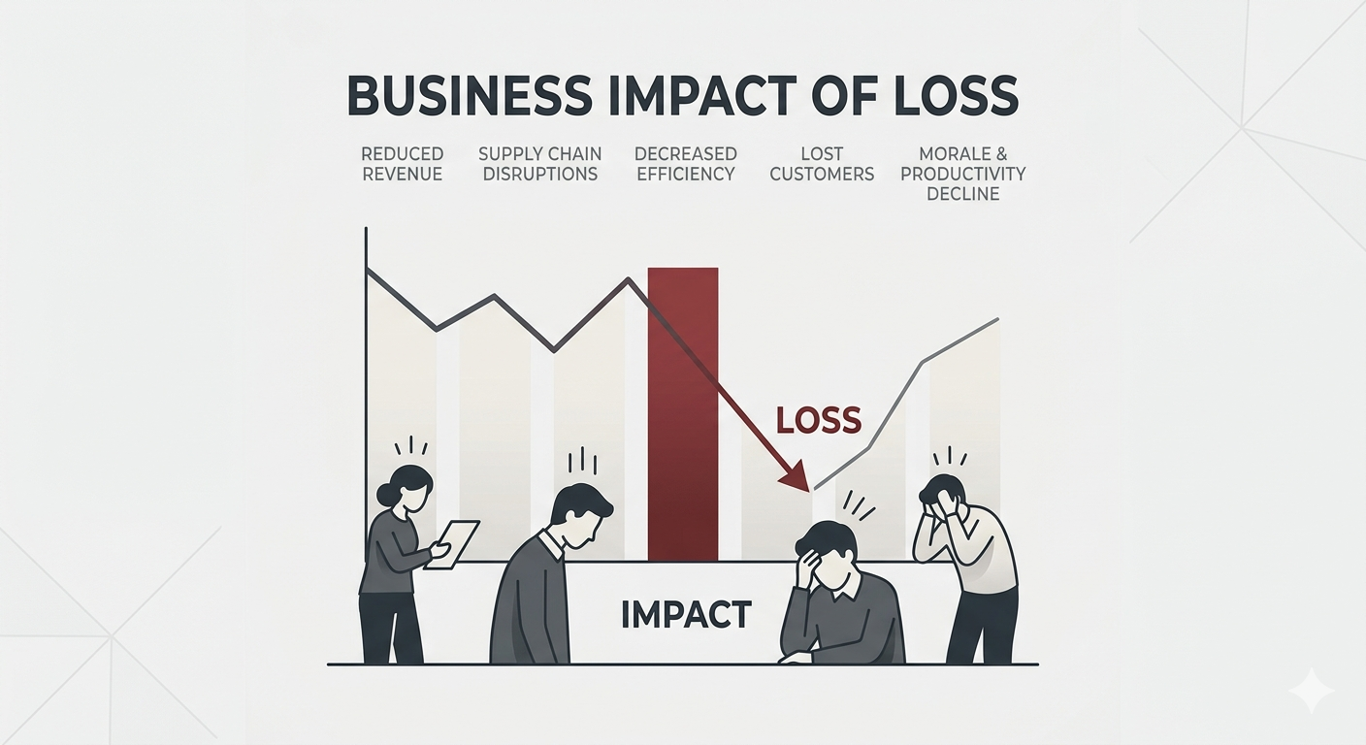
Task 7: Return Impact on Revenue
Business Objective: Quantify the financial losses caused by product returns and identify systemic drivers of return-driven revenue leakage.
GAP Identified
Recommended Actions
Improve product quality
Improve fulfillment accuracy
Reduce return rate
Returns reverse revenue and reduce profitability
Revenue leakage
Reverse logistics burden
Business Risks

Slide 10

Task 8: Return Reason Analysis
Customer dissatisfaction
Increased refund costs
Business Risks
Major issues:
Damaged products
Wrong item delivery
Poor quality
Delivery issues
GAP Identified
Improve packaging
Improve supplier quality checks
Optimize logistics operations
Business Risks

Slide 11
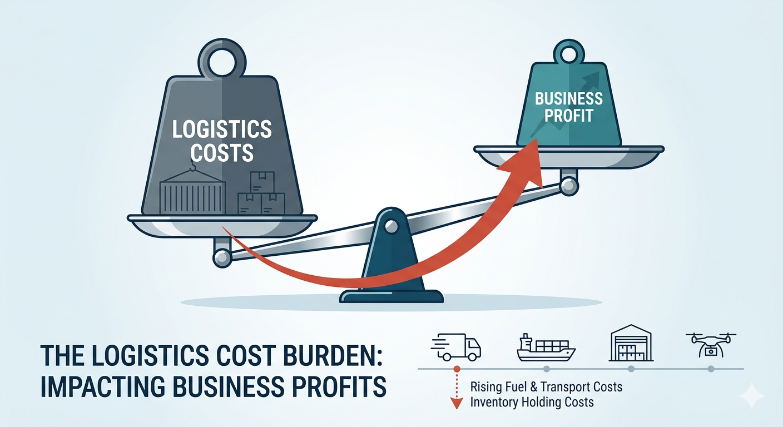
Task 9: Logistics Cost Burden
GAP Identified
Low-value orders create disproportionately high delivery cost.
Reduced profit margins
High reverse logistics cost
Business Risks
Introduce minimum order value
Optimize delivery planning
Reduce reverse shipping costs
Recommended Actions

Slide 12
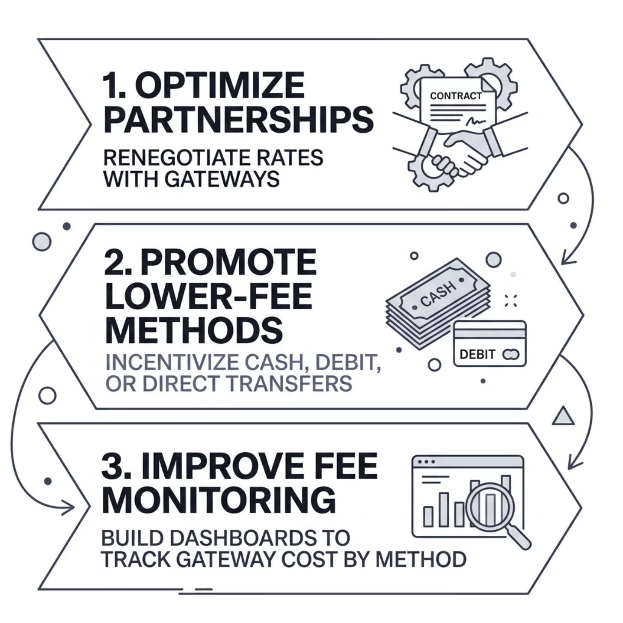
Task 10: Payment Fee Leakage
Certain payment methods quietly reduce final profitability through accumulated gateway fees — a hidden
cost that compounds at volume.
GAP Identified
Some payment methods reduce final profitability.
Business Risks
Silent profit reduction
Transaction fee burden
Recommended Actions
Optimize payment partnerships
Promote lower-fee methods
Improve fee monitoring

Slide 13
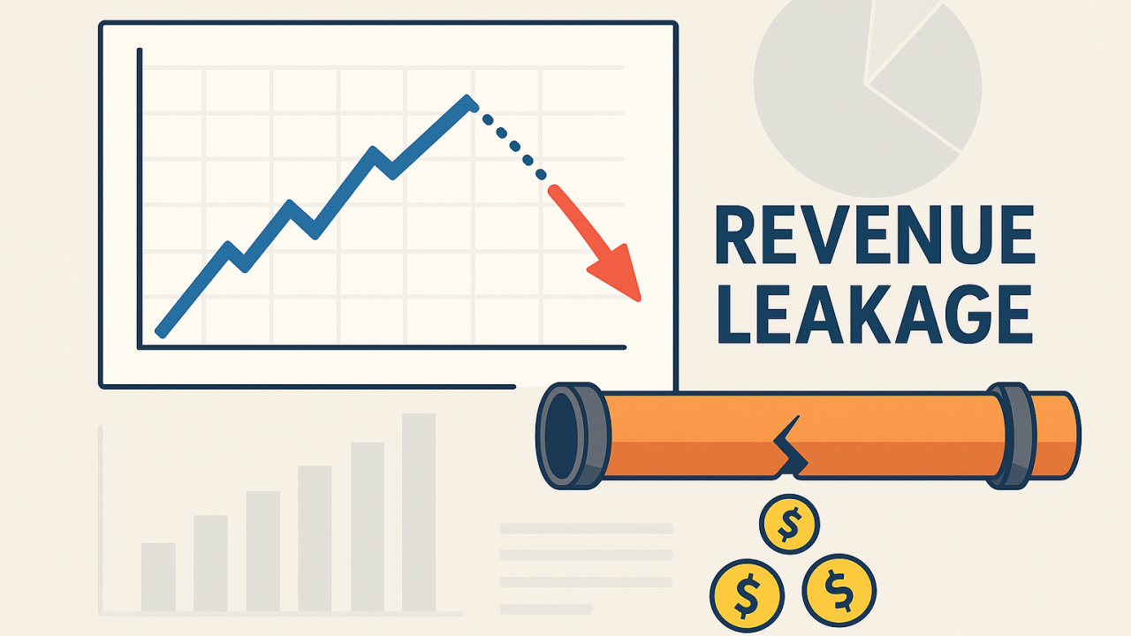
Task 11: Revenue Leakage Breakdown
Business Objective
Measure hidden costs caused by payment gateway fees.
GAP Identified
Some payment methods reduce final profitability.
Business Risks
Silent profit reduction
Transaction fee burden
Recommended Actions
Optimize payment partnerships
Promote lower-fee methods
Improve fee monitoring

Slide 14
Task 12 & 13: Product Profit Ranking & Category Margin Stability
Product Profit Ranking
Category Margin Stability
A small number of products drive the majority of profits. Low-performing SKUs tie up capital without delivering returns.
Certain categories show volatile margins driven by pricing inconsistency and supplier cost fluctuations.
Improve pricing governance frameworks
Stabilize supplier cost agreements
Build margin monitoring by category
Focus investment on high-margin products
Reduce or eliminate weak-margin inventory
Optimize overall product assortment

Slide 15
Task 14: High-Risk Customers
A small segment of customers generates excessive returns, elevated logistics costs, and disproportionate profit leakage — including potential return abuse and fraudulent behavior.
Risk Scoring
Return Policy
Fraud Detection
Implement customer-level risk scores based on return frequency and order behavior patterns.
Strengthen return eligibility rules to reduce abuse while maintaining legitimate customer trust.
Deploy detection logic to flag suspicious transaction and return patterns before losses compound.

Slide 16
Task 15: Executive Profitability Summary
Business Objective
Provide executive-level profitability diagnosis.
Business Risks
Strong revenue but weak profitability
Discounts
Major Leakage Drivers
Discounts
Returns
Logistics costs
Payment gateway fees
Recommended Actions
Improve profit monitoring
Reduce operational leakage
Optimize overall cost structure
Logistics
Gateway Fees
Closing the gap between revenue and net profit requires targeted action across all four leakage vectors simultaneously.

Slide 17

Overall GAP Findings & Strategic Recommendations
Major Problems Identified
Strategic Recommendations
1
Revenue–Profit Gap
Profitability Optimization
Improve margin tracking; focus on profitable products.
2
Discount Dependency
Discount & Return Control
3
Return-Driven Leakage
Reduce unnecessary promotions; improve product quality to lower return rates.
4
Logistics Cost Burden
Logistics & Payment Cost
Reduce reverse shipping costs; promote low-fee payment methods.
5
Product Profit Imbalance
6
Customer Risk Concentration
Customer Risk Management
Track and score high-risk customers; strengthen fraud detection.

Slide 18
Conclusion & Thank You
High revenue alone does not guarantee profitability. Hidden operational leakages — across discounts, returns, logistics, and payment fees — consistently reduce business performance below its true potential.
SQL Analytics Identified
Strategic Impact
Revenue leakage, cost inefficiencies, and high-risk operational areas surfaced through structured analysis.
Targeted improvements can increase profit margins, operational efficiency, and sustainable long-term growth.
Thank you for your time and attention.

