Slide 1

Big Data TTT – Project Presentation
Oliver Prasanna
29/11/2016
Best Solution Guaranteed
Notes:
This template can be used as a starter file to give updates for project milestones.
Sections
Right-click on a slide to add sections. Sections can help to organize your slides or facilitate collaboration between multiple authors.
Notes
Use the Notes section for delivery notes or to provide additional details for the audience. View these notes in Presentation View during your presentation.
Keep in mind the font size (important for accessibility, visibility, videotaping, and online production)
Coordinated colors
Pay particular attention to the graphs, charts, and text boxes.
Consider that attendees will print in black and white or grayscale. Run a test print to make sure your colors work when printed in pure black and white and grayscale.
Graphics, tables, and graphs
Keep it simple: If possible, use consistent, non-distracting styles and colors.
Label all graphs and tables.

Slide 2

Overview
Pre-requisite
Study Links
Terminologies
GitHub
Project – Real time Application
Notes:
What is the project about?
Define the goal of this project
Is it similar to projects in the past or is it a new effort?
Define the scope of this project
Is it an independent project or is it related to other projects?
* Note that this slide is not necessary for weekly status meetings

Slide 3
Pre-requisites
Java Essentials
Create Code in Java
JSP /Servets
To Understand and Implement web Application
MySQL
Basic SQL Queries
NoSQL
To Implement Logic in all Basic Functionalities of Java
Notes:
* If any of these issues caused a schedule delay or need to be discussed further, include details in next slide.

Slide 4
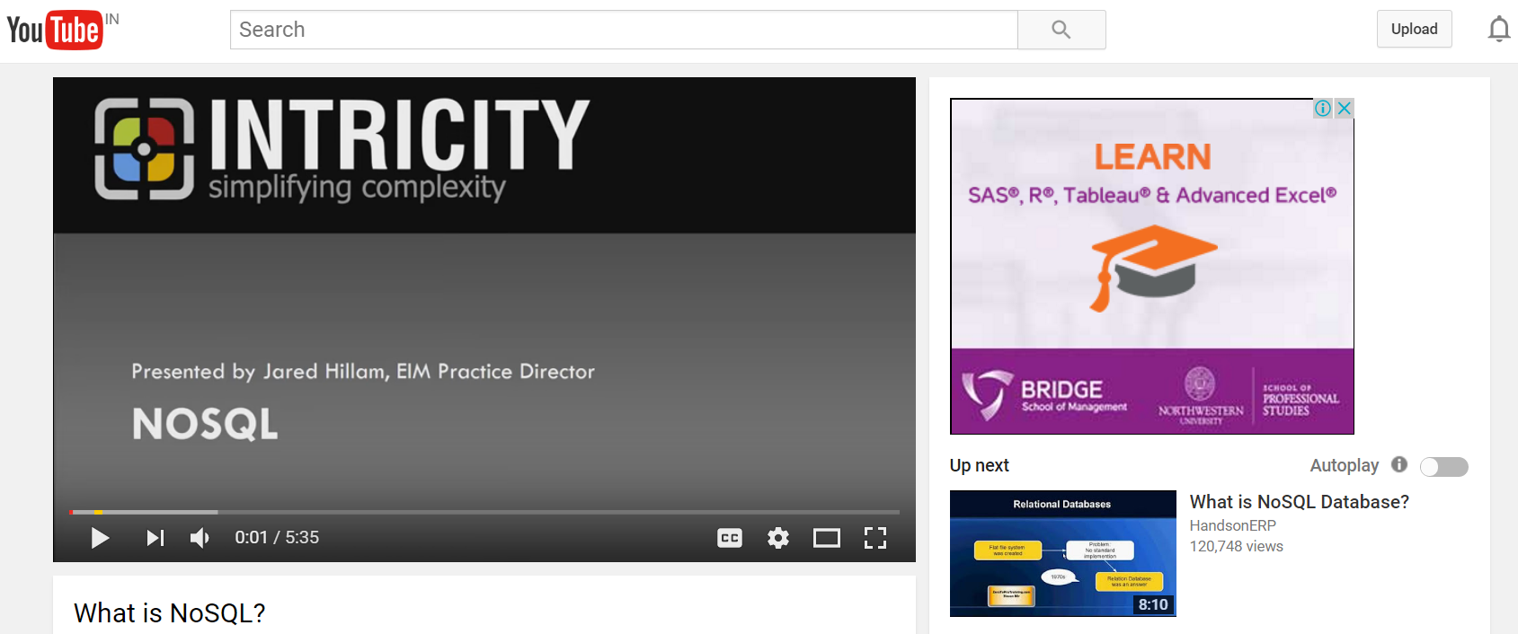
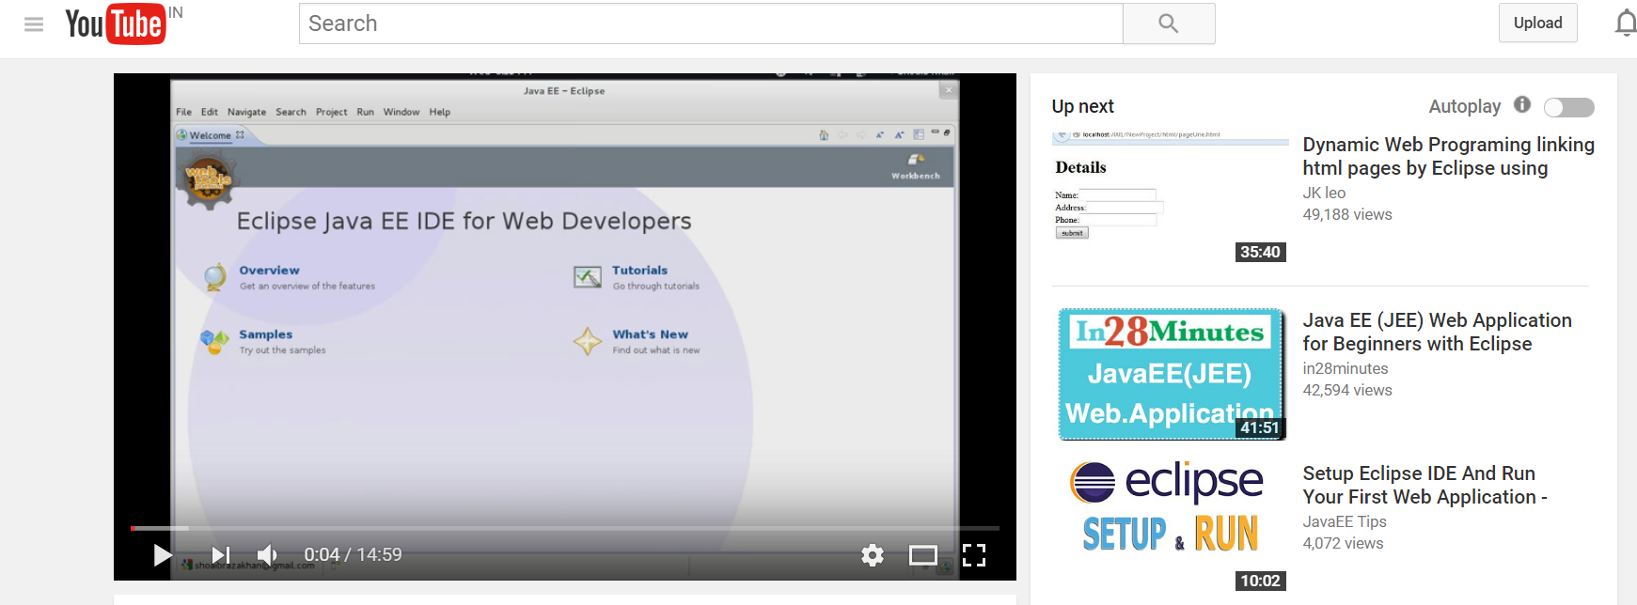
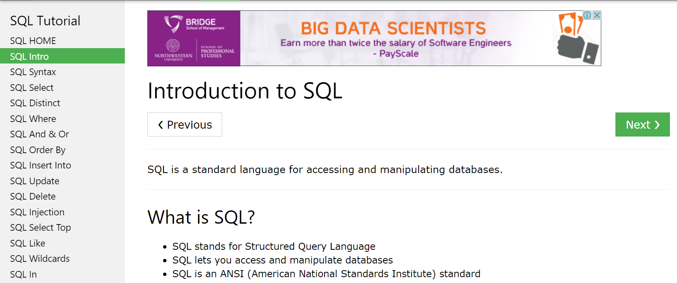
Study Links
Notes:
Duplicate this slide as necessary if there is more than one issue.
This and related slides can be moved to the appendix or hidden if necessary.

Slide 5
Topic Flow
Bigdata & Hadoop
Architecture
HDFS
Map Reduce
MR1
MR2 / YARN
PIG
High Level Prog Language
PIG Commands
HIVE
Hive QL
SQL based querying Language
Notes:
The following slides show several examples of timelines using SmartArt graphics.
Include a timeline for the project, clearly marking milestones, important dates, and highlight where the project is now.

Slide 6
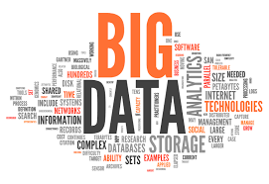
Terminologies BIG DATA
Big data is a term for data sets that are so large or complex that traditional data processing applications are inadequate to deal with them.
Volume
Velocity
Variety
Veracity

Slide 7
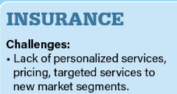
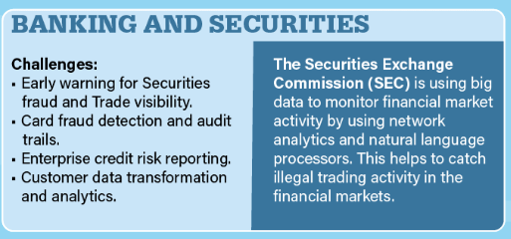
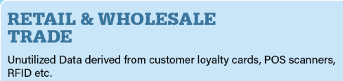
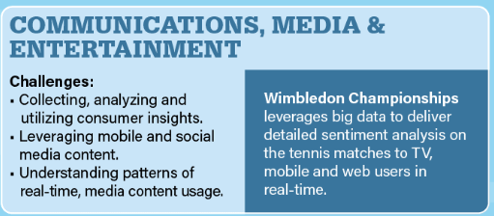
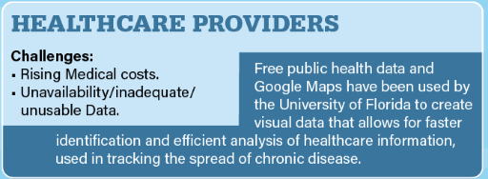

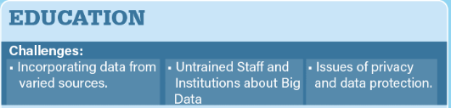




Slide 8



Terminologies HADOOP
Apache Hadoop is an open-source software framework used for distributed storage and processing of very large data sets
It consists of computer clusters built from commodity hardware
All the modules in Hadoop are designed with a fundamental assumption that hardware failures are a common occurrence and should be automatically handled by the framework
Hadoop Components
HDFS(Storage)
Map Reduce
Process/Compute

Slide 9
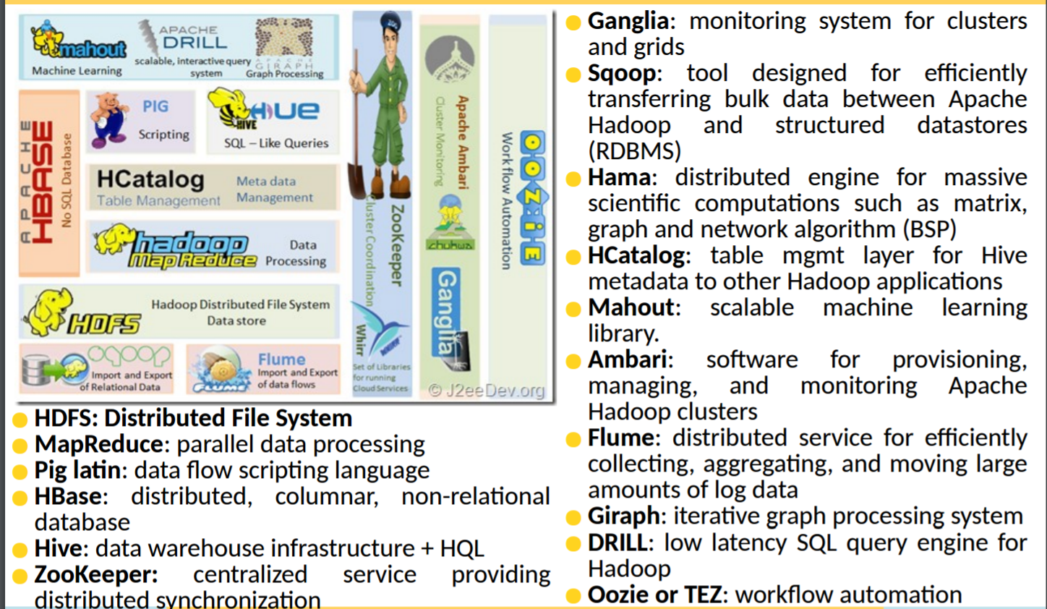
Terminologies Map Reduce, PIG, HIVE, SQOOP,FLUME,HBASE,OOZIE,ZOOKEEPER

Slide 10
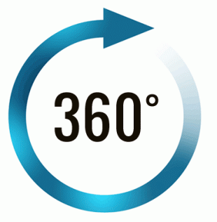
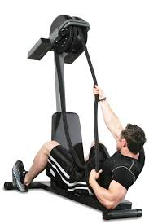
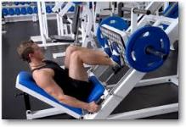
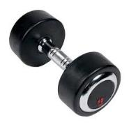
Project 1 – My Shopping Trend – A View
Abstract
To Create an Easy & Customized Report for an Organization which becomes an easy tool for every employees to visualize the Organizational Performance as well as their Individual Contribution.
Highlights :
Technology Used :
Advanced MR Techniques.
Data Validations
PIG Latin Language
Hive QL

Slide 11
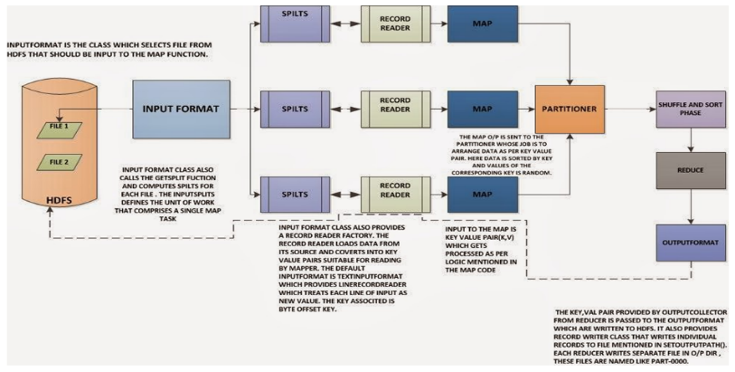
Apache Hadoop – Map Reduce Work Flow

Slide 12
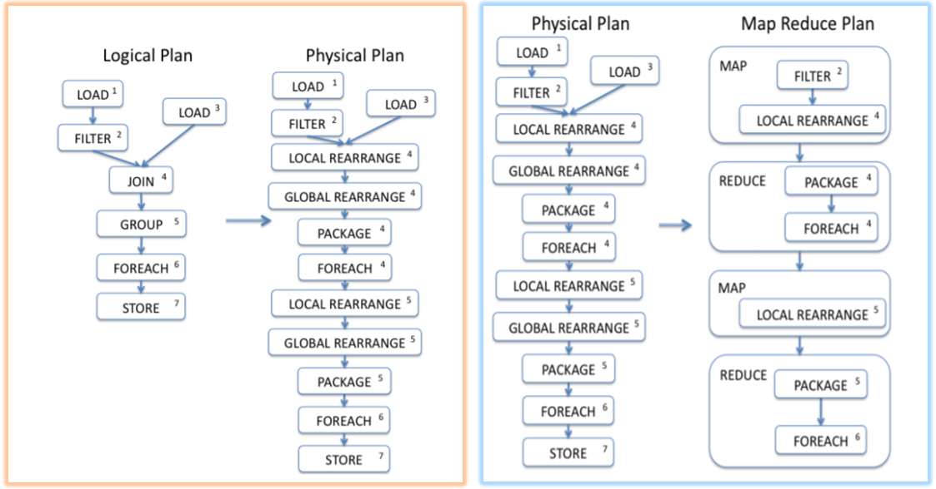
Apache Pig – Data Flow

Slide 13
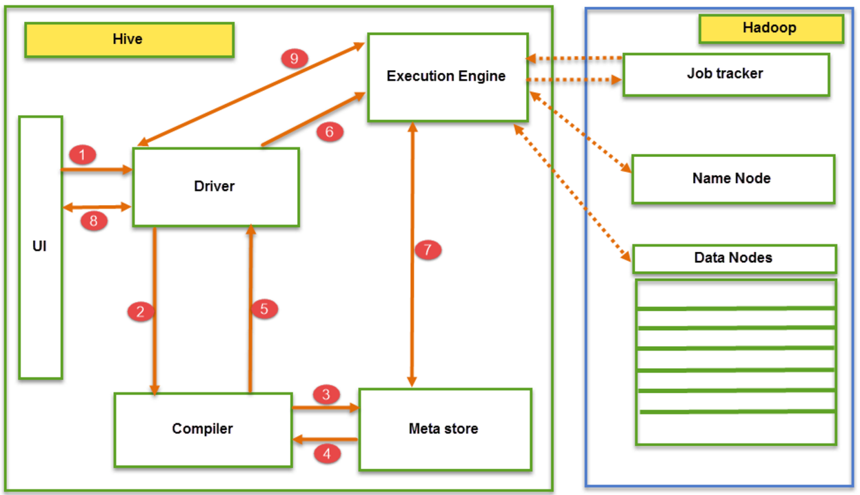
Apache Hive – Data Flow

Slide 14



E2
Abstract
To Identify Mechanism to analyse the Population data and to bring out innovative results , thereby Government creates new benefits towards the welfare of the Country
Highlights :
Technology Used :
Advanced MR Techniques.
Data Validations
PIG Latin Language
Hive QL

Slide 15
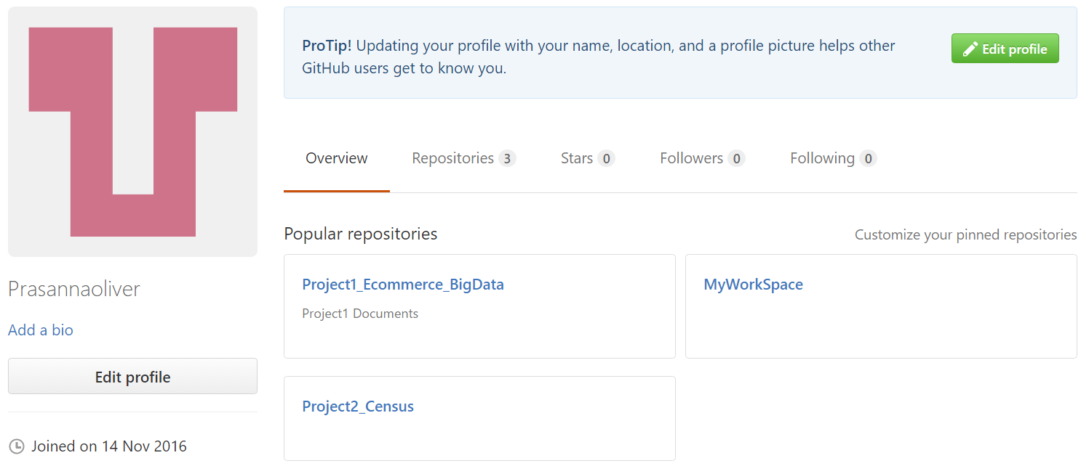
GitHub

Slide 16
Future Scope
Project
BigData
Hadoop
Map Reduce
PIG
Future Enhancement
OOZIE
Project 1- User Personalization
Project 2 – Education Business
Notes:
What are the dependencies that affect the timeline, cost, and output of this project?

Slide 17

“Thanks to Big Data . Machines Can be Now Programmed to do the next thing Right .. But only Developers can do the next Right Thing “

Slide 18





