Slide 1
By Prasant Rao Jillella S S
Latitude and Longitude coordinate specify and Network population Indicator

Slide 2
Motivation
As there can be many unauthorised users in a network that may access data without permission this software enables and acts as a guard that detects the number of users in the network and the corresponding MAC addresses related to them.
This list that is maintained is used to compare with the list of authorised users provided and see if there are any unauthorised users present in the network.
The latitude and longitude coordinate specify helps to divide the provided block of area in a room to equal sized 1x1 squares with their central coordinates.

Slide 3
About Latitude and Longitude coordinate specify
This part of the project is mainly aimed at determining the geographical coordinates (Latitude and Longitude) of all the central points of the 1X1 square grids that can possibly fit in the square building or room whose central geometric coordinates and side is provided.
To understand algorithm that is implemented in this project we need to first have an understanding of the following information:
-About Latitude and Longitude of earth.
-Conversions involved in Latitude and Longitude computation.
-About Google earth software.

Slide 4
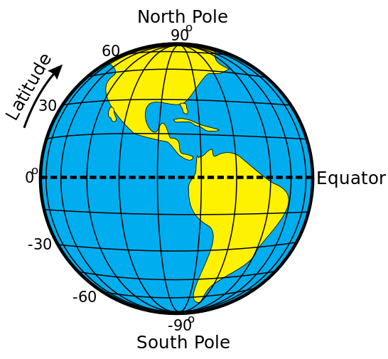
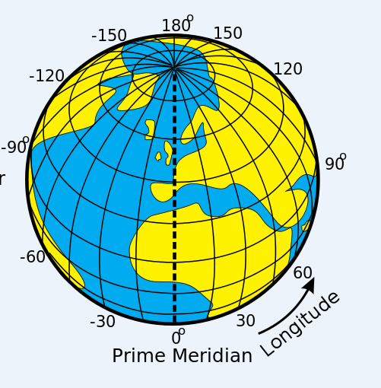
Latitude and Longitude of earth
The "latitude" (abbreviation: Lat., φ, or phi) of a point on the Earth's surface is the angle between the equatorial plane and the straight line that passes through that point and through (or close to) the centre of the Earth.
The "longitude" (abbreviation: Long., λ, or lambda) of a point on the Earth's surface is the angle east or west from a reference meridian to another meridian that passes through that point

Slide 5
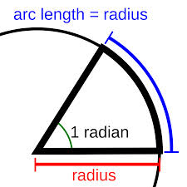

Conversions involved in latitude and longitude computation
The radian is the standard unit of angular measure, used in many areas of mathematics. An angle's measurement in radians is numerically equal to the length of a corresponding arc of a unit circle one radian is just under 57.3 degrees.
Bearing can be defined as direction or an angle, between the north-south line of earth or meridian and the line connecting the target and the reference point.
A degree (in full, a degree of arc, arc degree, or arc degree), usually denoted by ° , is a measurement of plane angle, representing ¹⁄₃₆₀ of a full rotation.
Lattitude2 = ((d/R)* cos(bearing)) + Latitude;
Longitude2 = (d/(R*sin(Latitude2))*sin(bearing))+ Longitude;

Slide 6

Google Earth
This is one of the most widely used software in the world that is used to search through the earth for any specific location in a 3 dimensional view. This software is used in this project in order to verify the correctness of the output that has been obtained by following the algorithm that has been used.

Slide 7
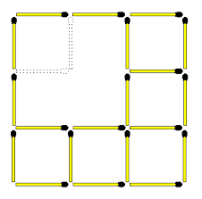
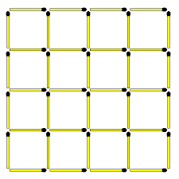
Algorithm 1
First take a square building from the Google earth and take it’s central geographic coordinates along with the dimensions of the square grid.
Based on the dimensions of the grid (even or odd) the algorithm is divided into 2 parts:
So the algorithm gets divided into two parts. One for a even dimensioned square and the other for a odd dimensioned one

Slide 8

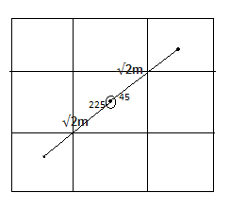
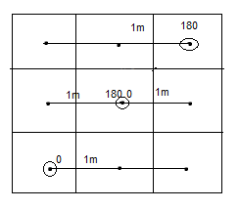
Odd dimensioned square
The central geographic coordinate of the 3X3 square grid is now the centre of a 1X1 square grid. We know that in a square if length of a side is ‘a’ then it’s diagonal length is given by √2.a.
Using this diagonal length we can now calculate the central coordinates of the remaining 1X1 square grids.

Slide 9
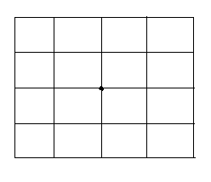
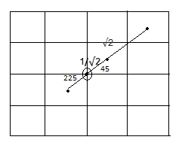
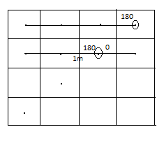
Even dimensioned square
First consider the Even dimensioned square (say 4X4) divide it into 1X1 dimensioned small squares. You can see that the 3X3 square is sub-divided into 16 1X1 square grids
The central geographic coordinate of the 4X4 square grid is now the common point of 4 1X1 square grids at the center. We know that in a square if length of a side is ‘a’ then it’s diagonal length is given by ‘√2a’.

Slide 10
Algorithm 2
So the algorithm gets divided into two parts again:
--One for an even dimensioned square and the other for an odd dimensioned one.
The Algorithm 1 as we know follows the computation initially along the diagonal but this Algorithm uses the initial computation initially in a horizontal manner.
Based on the dimensions of the grid (even or odd) the algorithm is divided into 2 parts.
So the algorithm gets divided into two parts again.One for an even dimensioned square and the other for an odd dimensioned one.

Slide 11
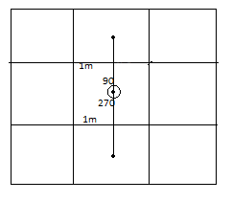
Odd dimensioned square
The central geographic coordinate of the 3X3 square grid is now the centre of a 1X1 square grid.
Here as we mention in this algorithm we use a horizontal calculation approach initially so the distance taken is 1m.
If the coordinates are being computed in the upward direction the bearing is taken to be 90° and if the diagonal being measured is in downward direction the angle is taken to be 270°.

Slide 12
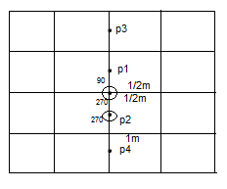
Even dimensioned square
The central geographic coordinate of the 4X4 square grid is now the common point of 4 1X1 square grids at the centre.
When we are computing the coordinates to the left of the current coordinate the bearing is taken to be 180° and while we are computing that in the right of the current coordinates then it is taken to be 0°.

Slide 13
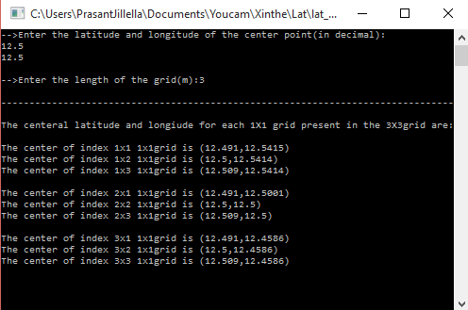
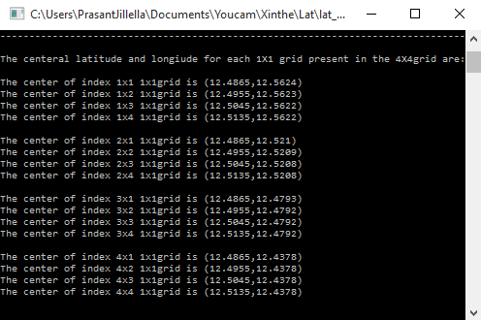
The output for the Latitude and Longitude coordinate Specify is as follows
Output for 3X3 square building is:
And
This is output for a 4X4 square grid

Slide 14
Network population Indicator
The network population indicator is the second project done in this industrial training process.
The Network population indicator is mainly designed with the reference to the DHCP lists present in the routers and is used to find out the various number users that are present in hotspot network that is being shared by us.

Slide 15
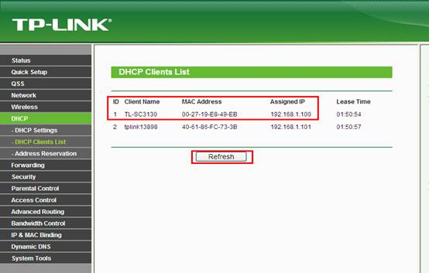
Description of DHCP lists used in router
Dynamic Host Configuration Protocol is commonly referred as DHCP which is a protocol followed in a router to assign dynamic IP addresses to devices.
The DHCP manages a pool of IP addresses and information about client configuration parameters such as default gateway, domain name.

Slide 16
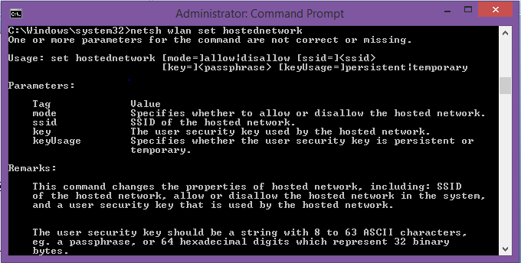
Establishing hotspot using command prompt
Type the following command to get to know about the structure of the network before changing it:
"netsh wlan set hostednetwork“

Slide 17
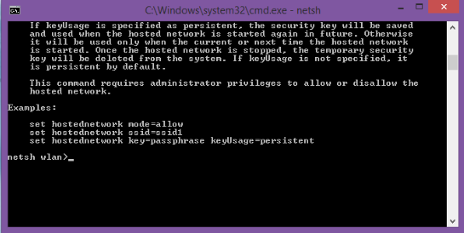
"netsh wlan set hostednetwork mode=allow ssid=prwifi key=******"

Slide 18
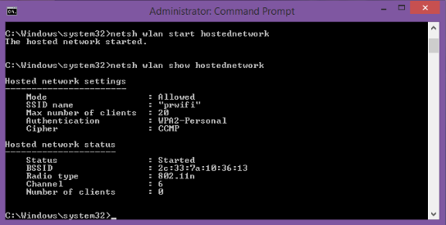
"netsh wlan show hostednetwork"

Slide 19
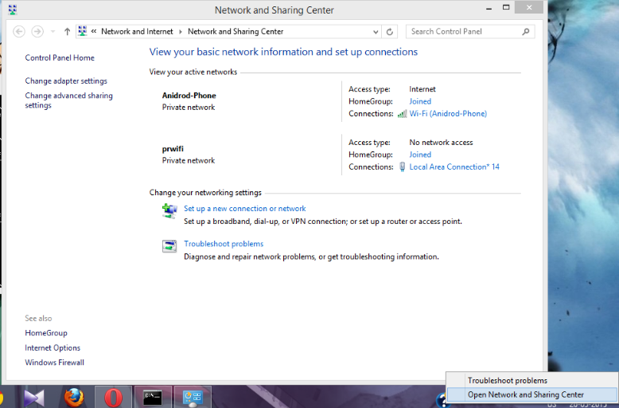
"open network and share center".

Slide 20
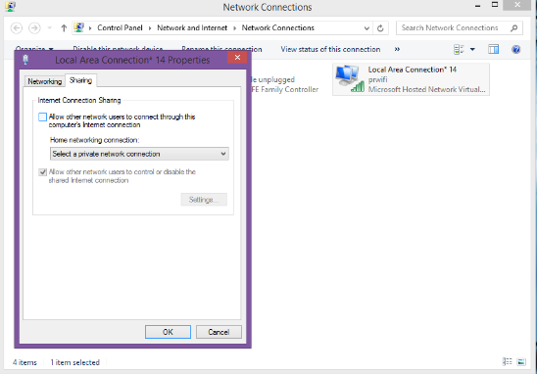
select "change adapter settings“
Then right click on "local area connection"
goto "shearing" in the local area network

Slide 21
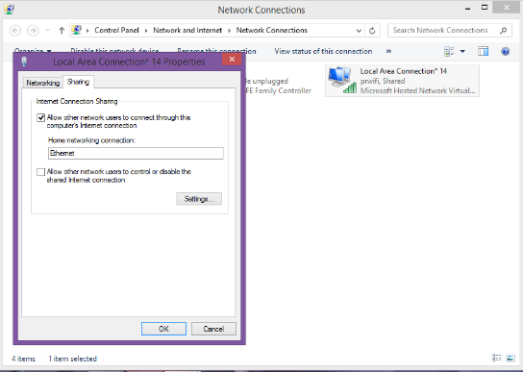
Now check the "Allow other network users to connect through the computer's internet connction“
then in home network connection-select "Ethernet"

Slide 22
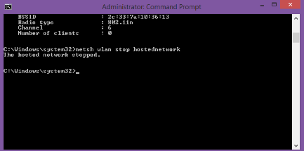
Now the your system acts as a router with the (ssid)username as prwifi and can be connected to other devices.
step 9- After finishing the use with it you can deactivate the wifi from your system by typing the command "netsh wlan stop hostednetwork" on the command prompt.

Slide 23
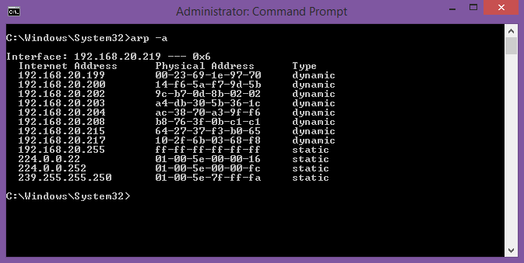
Command used instead of DHCP list in a hotspot for creating NPI
The “arp” commands are a special type of commands that do the magic instead of the DHCP commands if there is no DHCP server in your system.
First open your command prompt type the arp command "arp -a"to view the number of people connected to your hotspot.

Slide 24
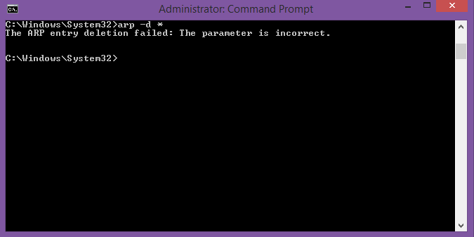
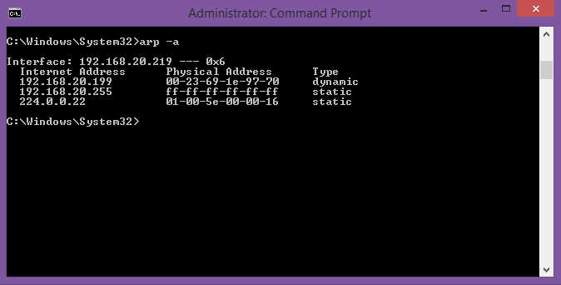
The list contains number of id’s these involve those from previous activation reports as well, so use command "arp -d *" and then view the list again to get the devices that are currently connected.

Slide 25
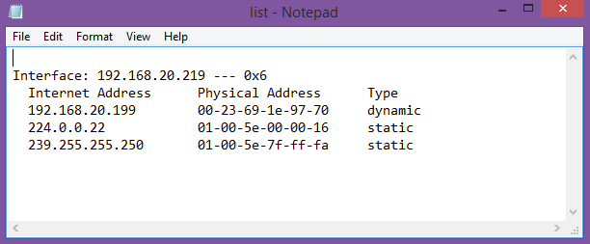
Now copy the information to a text document using the command
"arp -a >F:/list.txt

Slide 26
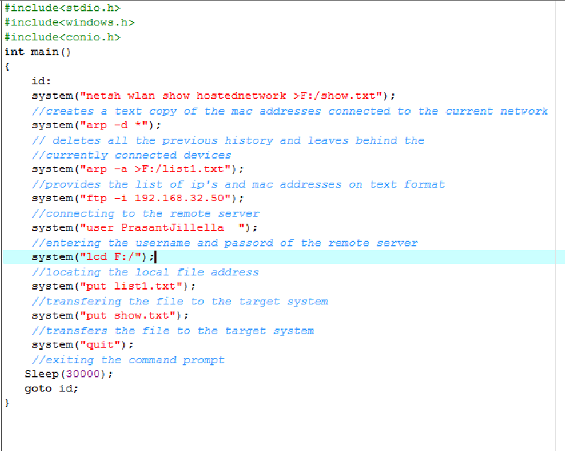
This text file that is so created is transfered to the desired system in the network through the commands either by typing them in command prompt manually or by using the following program that is set to run for every 30 seconds and update the data regularly.

Slide 27
Tools and utilities used
The latitude and longitude specify program runs to provide locations where devises required are to be placed.
Router system ---- This system identifies the users and their identifications and reports to the server.
The file transfer program generates the list of the identities and sends them to the server at a regular interval of 30 seconds.
Server system ---- This system checks by comparing if the users are authentic.

Slide 28

Conclusion
The following project that is developed runs as two individual part that are used to detect whether an authentic access of the internet is being taking place and to establish a secured network.
The text file containing the data regarding the user id’s (mac and ip addresses) is checked with the list of users that are authorised to access the services provided in the network.
If there is an un authorised user in the network then it can be dealt with immediately.
The latitude and longitude coordinate specify indicates where the
routers are to be placed in order to identify the users in the
network easily.

Slide 29
Thank You

