Slide 1
Use Case
Problem Statement -
There is a large customer with different Departments use various Azure services. The IT department manages the Azure Tenant and Subscriptions. Each department is given multiple subscriptions. The departments are not given enough privilege to get the cost details of the services consumed.
Each department is billed separately (subscription wise) by the IT team. Each department is struggling to find the service usage and the cost of the usage on daily basis. It happens they are either under utilizing or over utilizing the service and they come to know about it at the end of the month.
Proposed Solution -
The cost management data can be exported to the storage and the data can be reported in power bi report. The management team in departments, can analyse the data on daily basis, the services and their cost.
The mail (service usage and cost) can be triggered based on the business rules to various teams within a department

Slide 2





Architecture
Analytical Report
Service Usage flat files
Process the flat files
Central storage of the usage cost data
Send mail to the appropriate team
Mail with usage alert

Slide 3
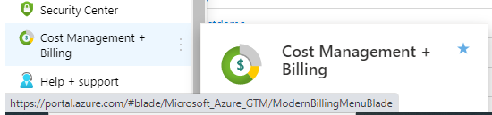
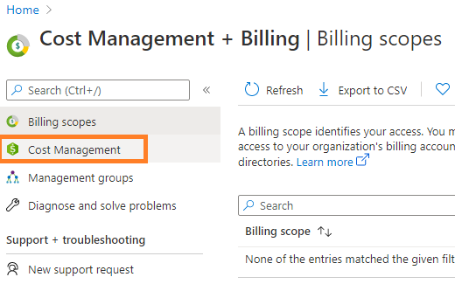

Service Usage Export option
Choose the Cost Management and Billing option from the menu
Choose the Cost Management option
Choose the Export option to export the cost data in csv file format to the storage

Slide 4

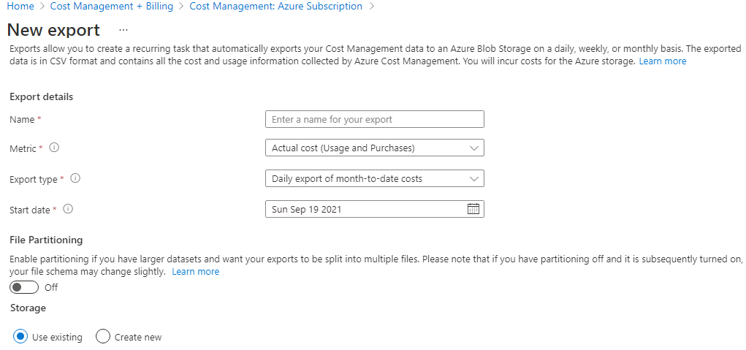
Cost Management data option
Add the cost management data details to be exported
Multiple cost management data details can be exported per subscription wise
Choose existing storage (GEN 2) or create a new one to store the cost management data

Slide 5
App Configuration
Azure App Configurations are used to keep all the application configuration values. Multiple applications refer the data available with the configuration service.
Configuration Name | Description
StorageName | Azure Storage Name where the service usage flat files are exported
StorageKey | Azure Storage Key where the service usage flat files are exported
FileSystemName | Name of the container of the storage service which contains the file
ParentDirectoryName | Directory name where the files are exported (it is suggested to keep a single directory to hold each subscription data)
ChildrenDirectoryNames | Comma separated directory names where the files are exported (Subscription (D), Subscription (U), Subscription (P))
SqlServerName | Target Azure SQL DB server Name
SqlDBName | Target Azure SQL DB Name
SqlUserName | Azure SQL user Name for Authentication
SqlUserPassword | Azure SQL user Password for Authentication
SqlTableName | The table name to store the service usage data (use <schemaname>.<tablename> if schema name other than dbo)
IsPrevMonthDataLoad | Flag to indicate whether to load previous month data (by default current month data is loaded)
IsFullLoad | Flag to indicate whether to load all data available in the file (each file contains month to date data)
Ex of the files are stored in the storage AzureServiceUsage \ Subscription (D), AzureServiceUsage \ Subscription (U), AzureServiceUsage \ Subscription (P)

Slide 6
Steps to do
Create the azure services like storage gen2, sql server, function (timer trigger), app configuration
Follow the steps mentioned in slides 3 and 4 to export the cost data
Run the export and verify the cost data (in csv format) available in the defined storage location
Create the table (db schema attached in the repo) to store the cost details
Add the configuration name and values in the app configuration
Open the source doe and update the app configuration details
Build and deploy the solution to the azure function
Open the power bi report to connect the appropriate azure sql server (database and table name)

