Slide 1
NASSAU CANDY DISTRIBUTOR
Product-Line Profitability &
Margin Risk Analytics
End-to-End EDA, Pareto Concentration, Cost Diagnostics, Margin Volatility, Research Paper and Streamlit Decision-Support Dashboard.
Data Analyst Project Portfolio
Prasanta Das
B.Tech Information Technology
10,194
$141.8K
65.91%
5 products
Streamlit
Cleaned records
Total sales
Gross margin
Drive 95% profit
Live dashboard
01

Slide 2
NASSAU CANDY DISTRIBUTOR
Why the project matters
Sales volume alone can hide weak unit economics, cost pressure, and portfolio dependency.
Revenue ≠ Profitability
Research questions
Which products and divisions truly drive profit?
Where is revenue/profit concentrated?
Which products are cost-heavy or margin-poor?
Which items need repricing, renegotiation or review?
How can results be operationalized in a dashboard?
Decision lens
Profitability = Scale × Margin × Stability
The project integrates financial KPIs, EDA, Pareto analysis, quantile-based cost diagnostics, margin volatility and dashboard visualization.
02

Slide 3
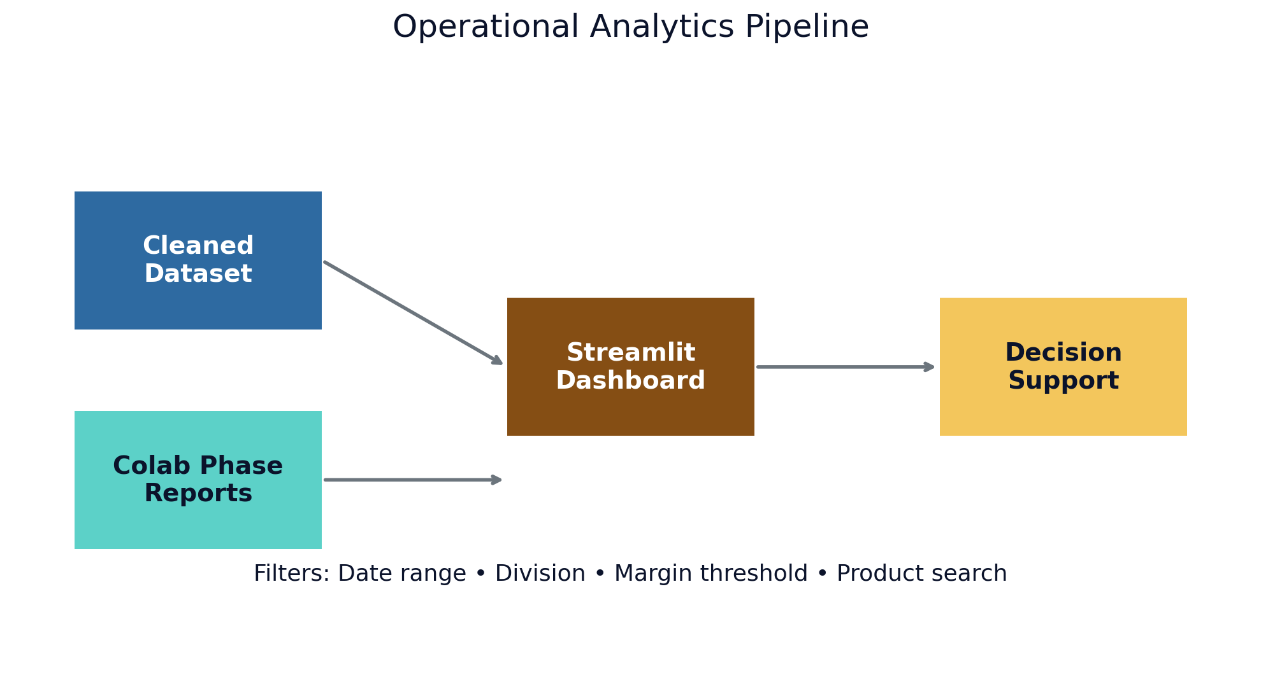
NASSAU CANDY DISTRIBUTOR
Data foundation and analytical workflow
Dataset profile
10,194
8,549
Rows
Orders
5,044
15
Customers
Products
3
59
Divisions
States/Provinces
Known data-quality disclosure: shipping dates/durations are excluded from profitability conclusions.
03

Slide 4
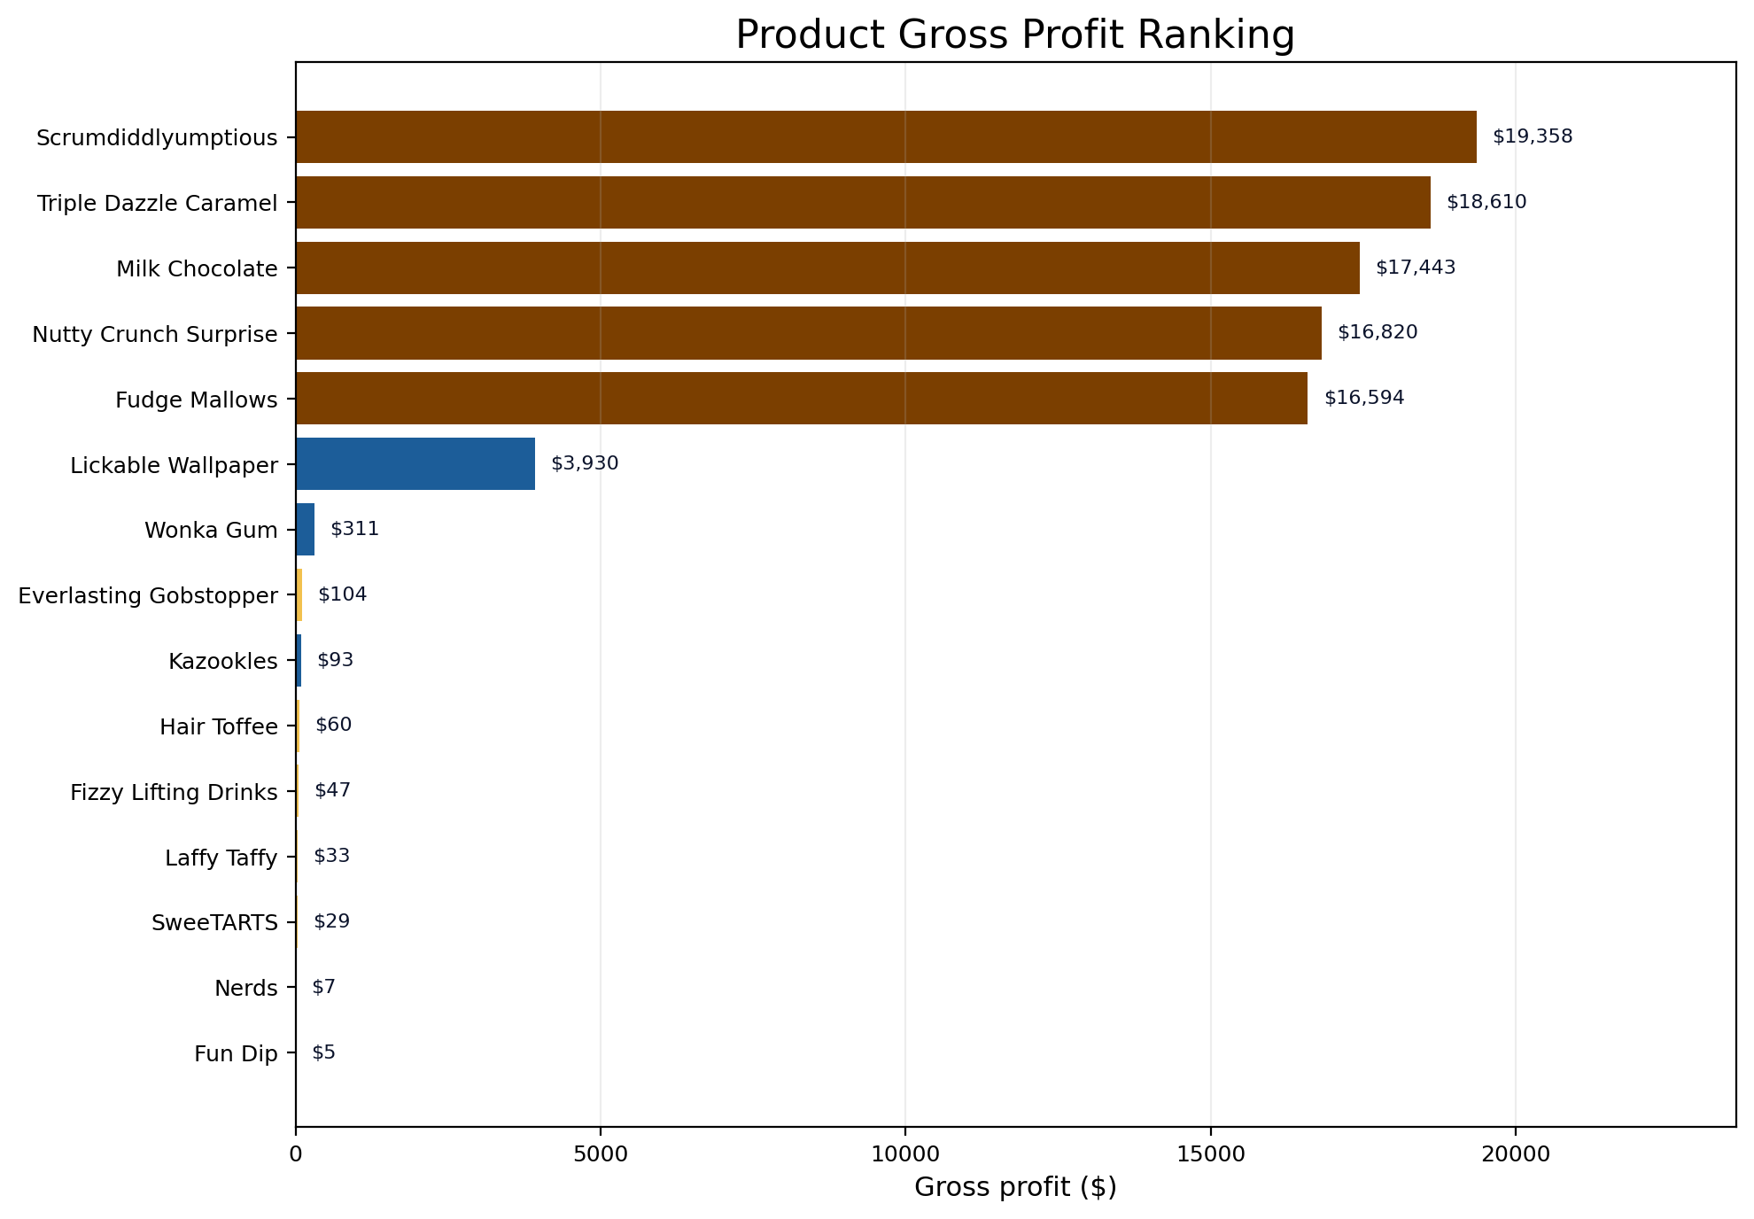
NASSAU CANDY DISTRIBUTOR
Financial snapshot: strong margins, concentrated economics
$141,783.63
$93,442.80
65.91%
$48,340.83
Total Sales
Gross Profit
Overall Gross Margin
Total Cost
Key reading
Five Chocolate products dominate absolute gross profit.
Aggregate margins are healthy, but portfolio risk is hidden inside the product mix.
Scale and margin must be interpreted together.
04

Slide 5
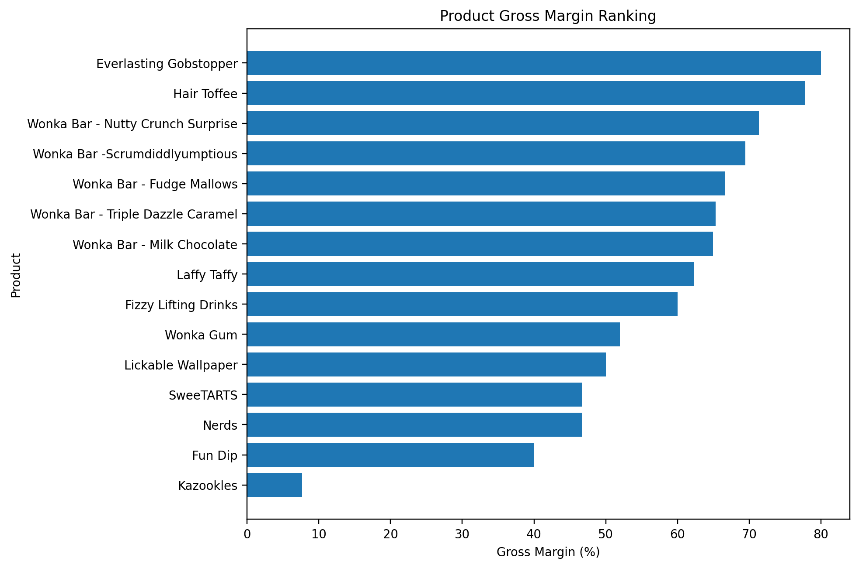
NASSAU CANDY DISTRIBUTOR
Product-level profitability: winners and warning signs
Percentage margin is not the same as business impact.
Everlasting Gobstopper shows 80% margin but only $104 gross profit.
Kazookles: 7.69% margin
$0.25 profit per unit
Core Chocolate: 64.9–71.4% margins
High scale + high contribution
Interpretation
Protect high-scale, high-margin products.
Avoid ranking products by percentage margin alone.
Review low-sales / low-profit products using action rules.
05

Slide 6
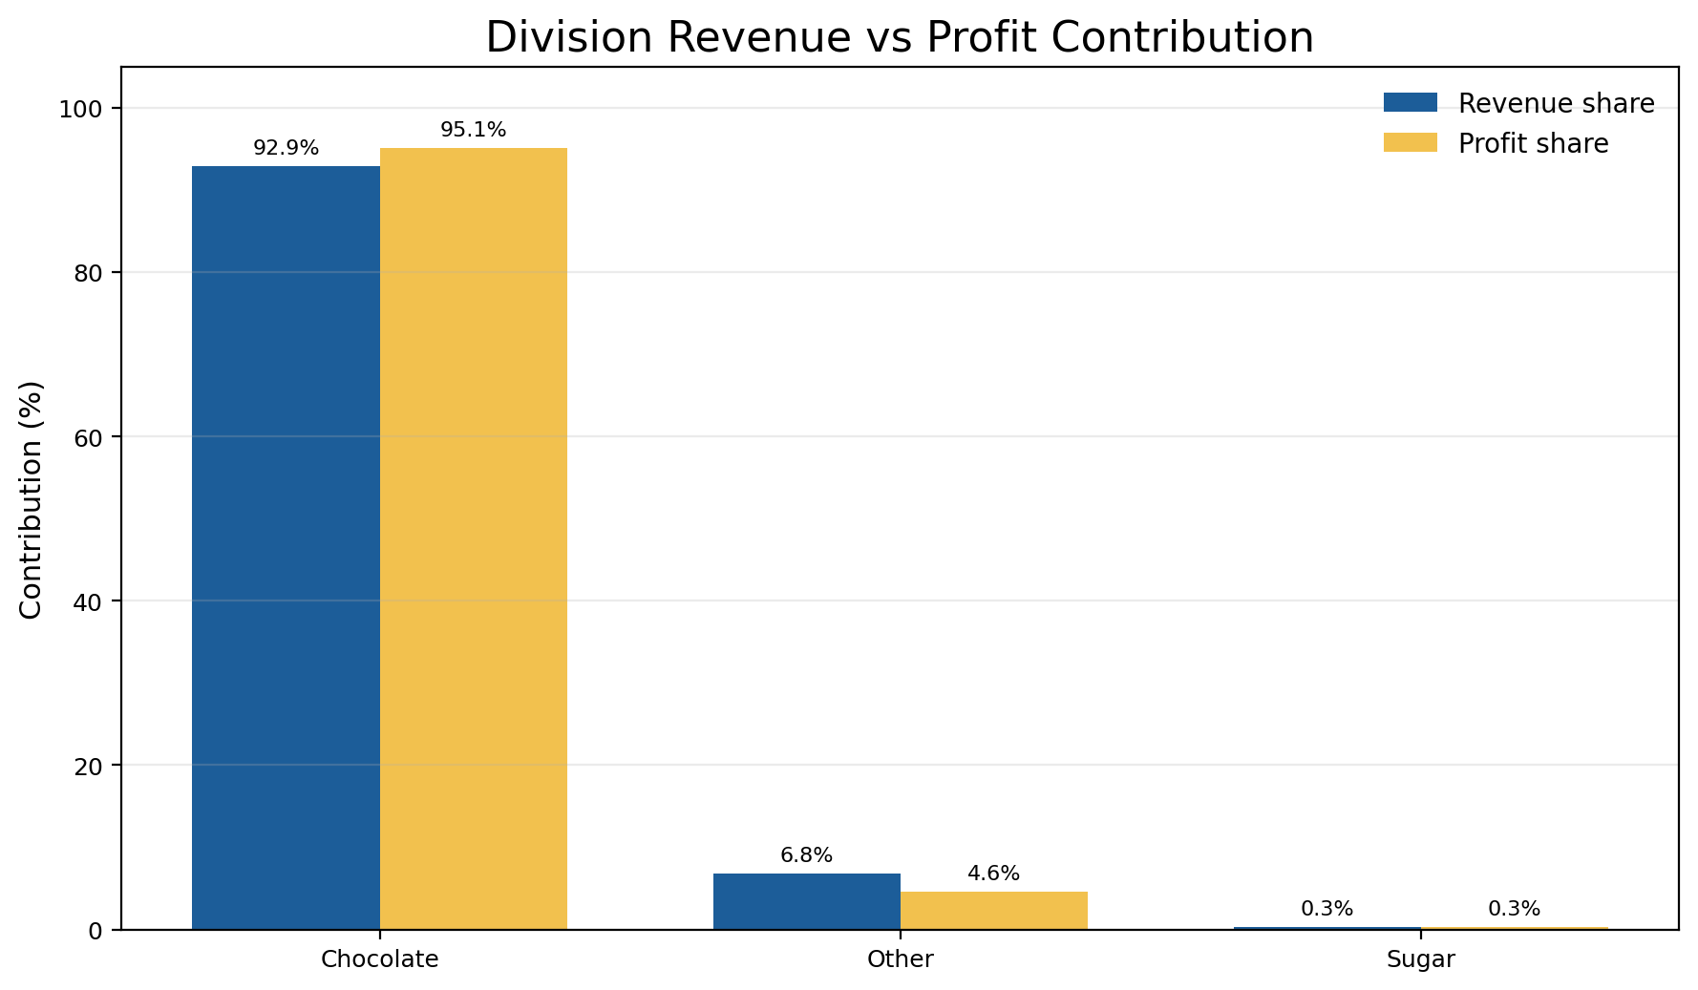
NASSAU CANDY DISTRIBUTOR
Division performance: profit engine vs structural margin issue
Division economics
95.06%
44.84%
Chocolate share of gross profit
Other division margin
0.30%
Insight
Sugar revenue contribution
Chocolate contributes more profit than revenue share. Other contributes less profit than revenue share, signaling structural margin pressure.
Business priority: protect Chocolate economics while improving non-Chocolate contribution.
06

Slide 7
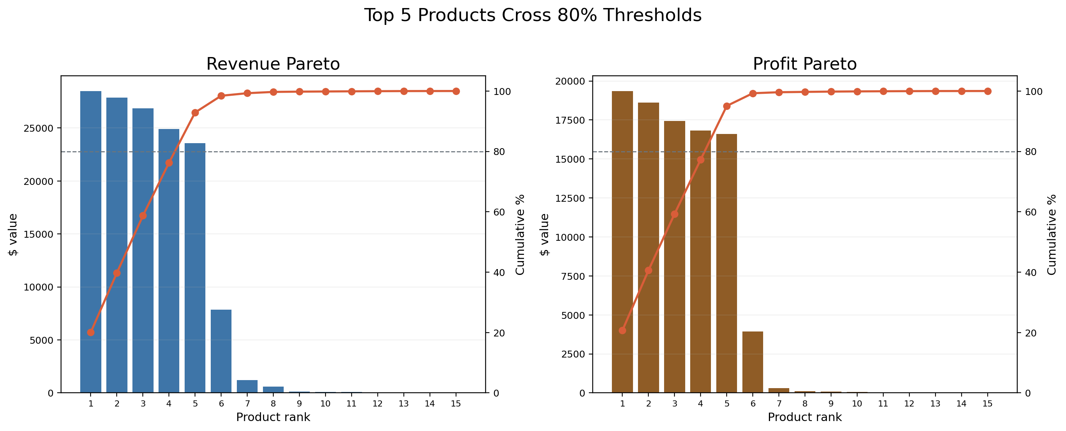
NASSAU CANDY DISTRIBUTOR
Profit concentration: five products define the portfolio
Pareto result
5 of 15 products
generate
92.88% revenue
95.06% gross profit
All five are Chocolate products, creating both a strength and an over-dependency risk.
07

Slide 8
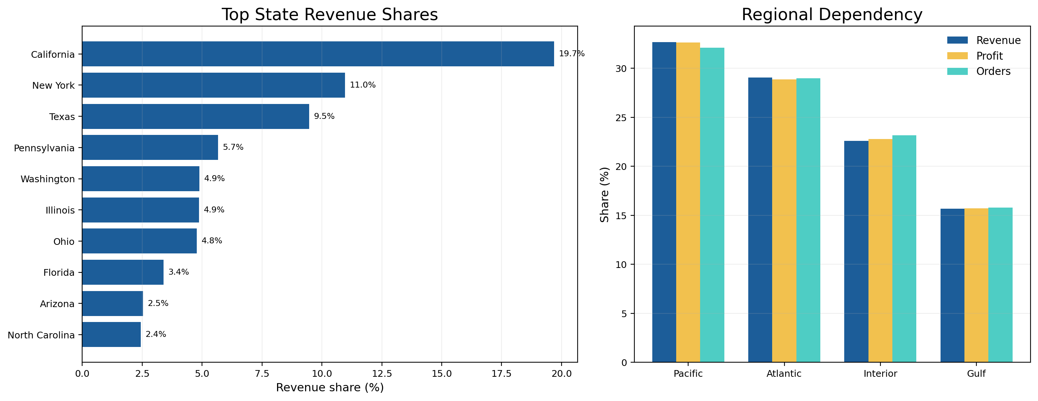
NASSAU CANDY DISTRIBUTOR
Geographic dependency: concentration extends to markets
Dependency signals
16 / 59
states/provinces reach 80% revenue
California
largest single market
Pacific
highest-load region
Caveat: high-load refers to demand/order concentration, not proven logistics congestion.
08

Slide 9
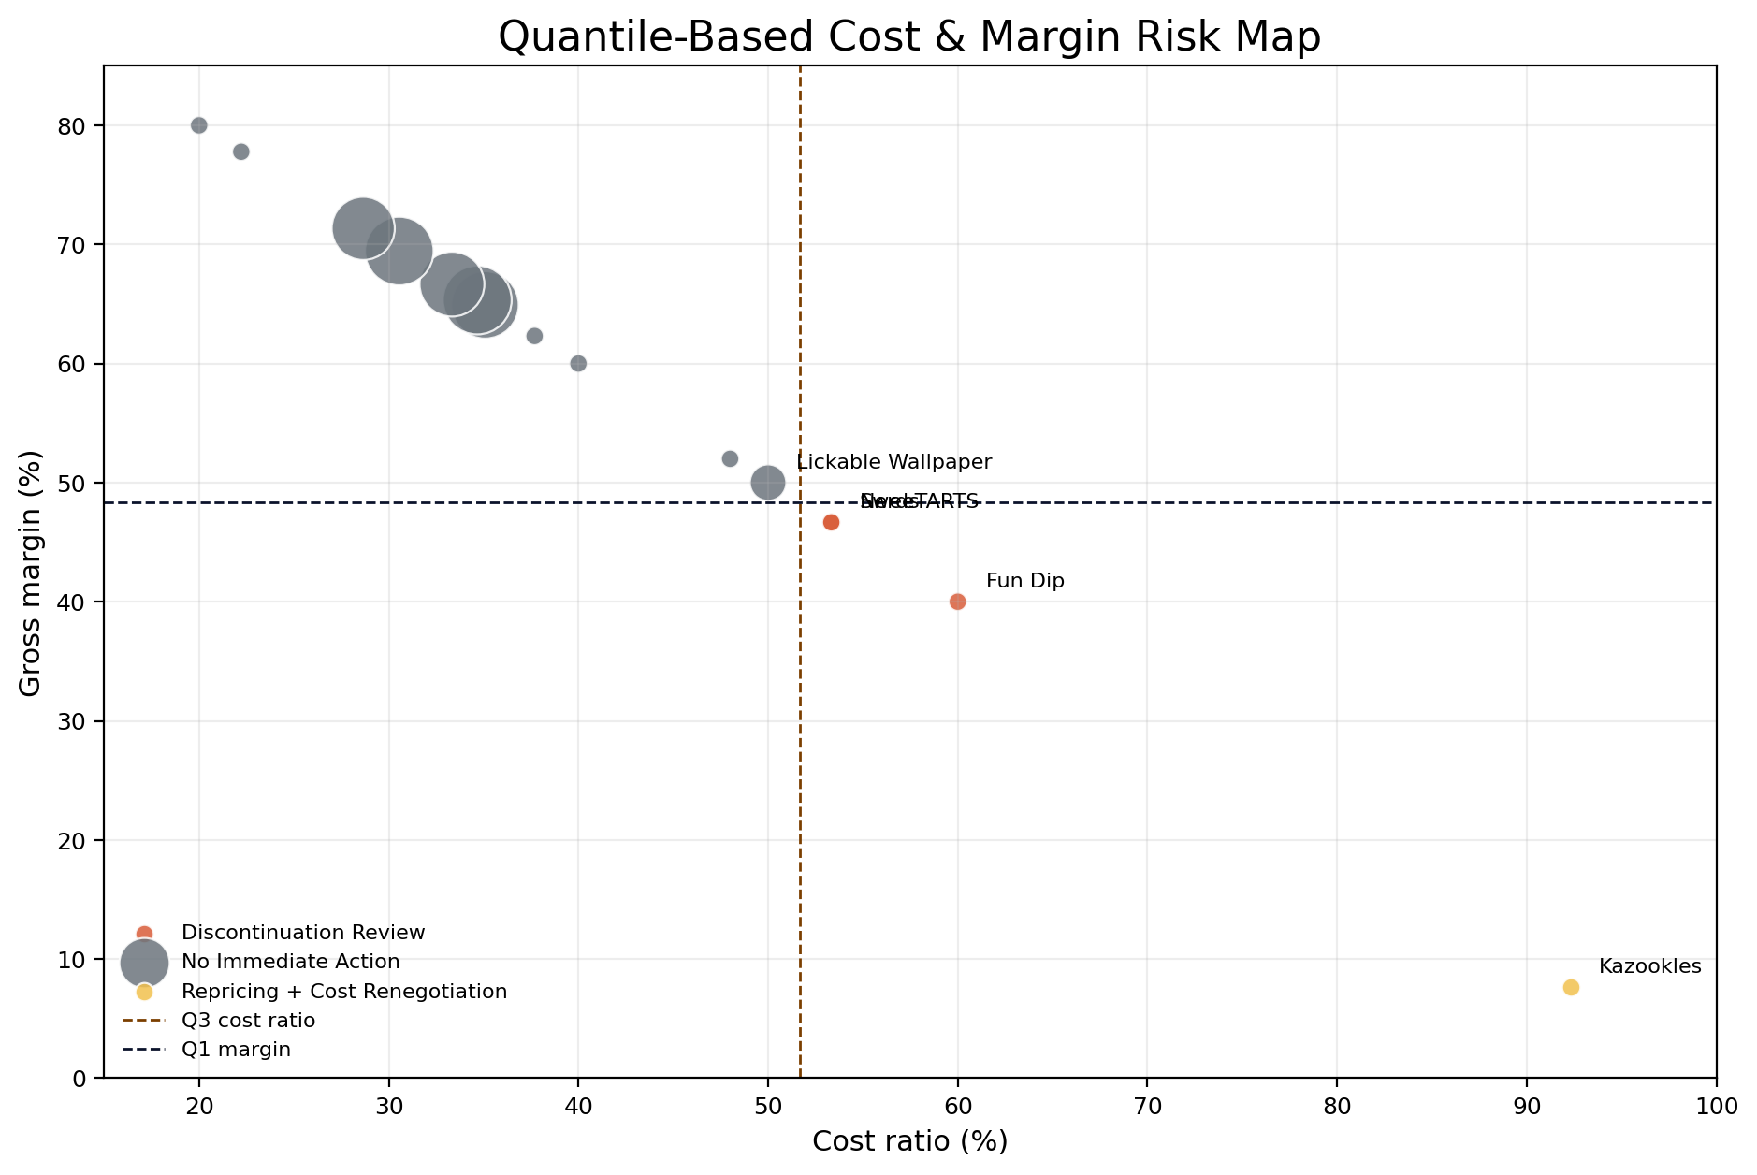
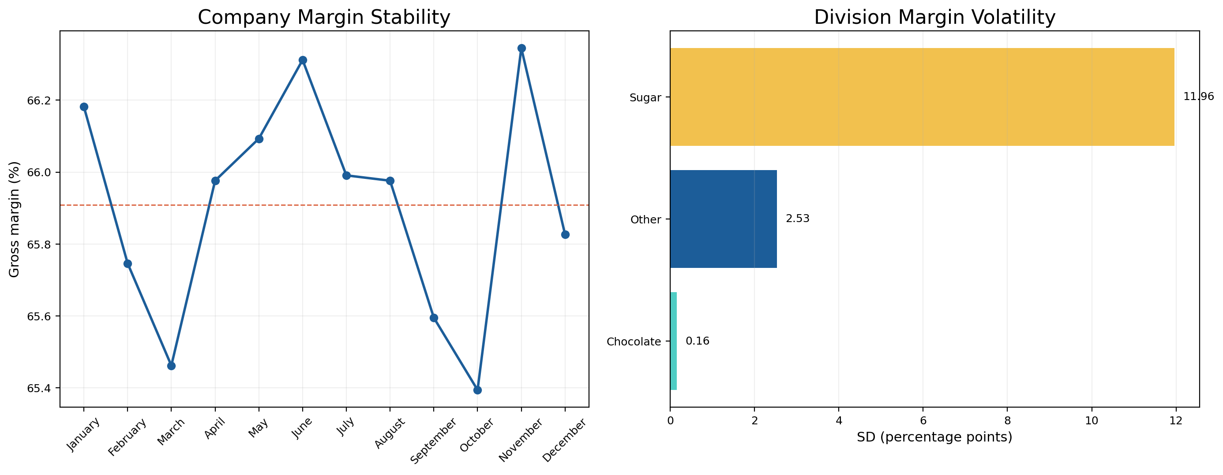
NASSAU CANDY DISTRIBUTOR
Cost diagnostics and margin volatility
Kazookles: 92.31% cost ratio, 7.69% margin → Repricing + Cost Renegotiation
Chocolate is stable; Sugar/Other drive division-level margin volatility.
09

Slide 10
From analysis to decision support
Final recommendations and project deliverables
Strategic recommendations
Protect the five core Chocolate products as the profit engine.
Prioritize Kazookles for pricing and supplier-cost intervention.
Review Fun Dip, SweeTARTS and Nerds for discontinuation or renegotiation.
Diversify profitable contribution beyond Chocolate and top regions.
Use the Streamlit dashboard for recurring portfolio governance.
Deliverables: cleaned analysis pipeline • phase reports • research paper • Streamlit live dashboard • project review video
10

